Slide 1

Asynchronous Ignition

Slide 2
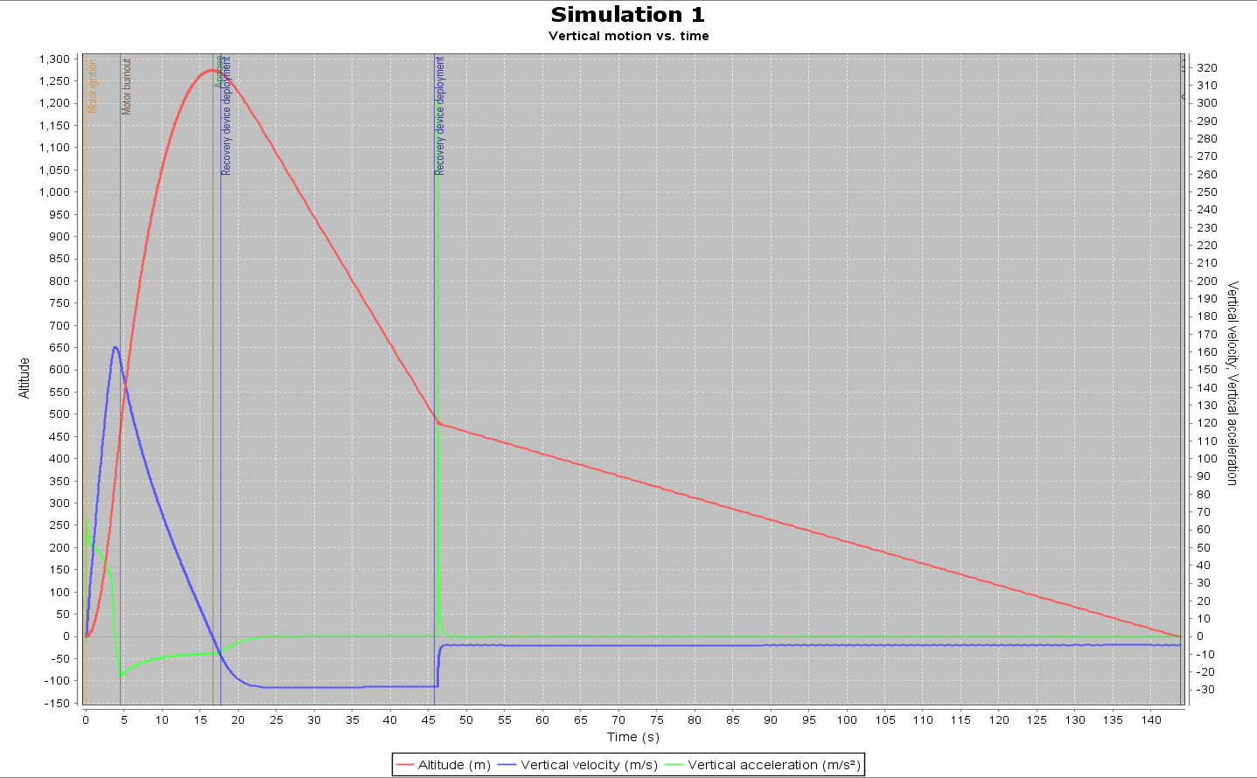
Main Engine Running Only

Slide 3
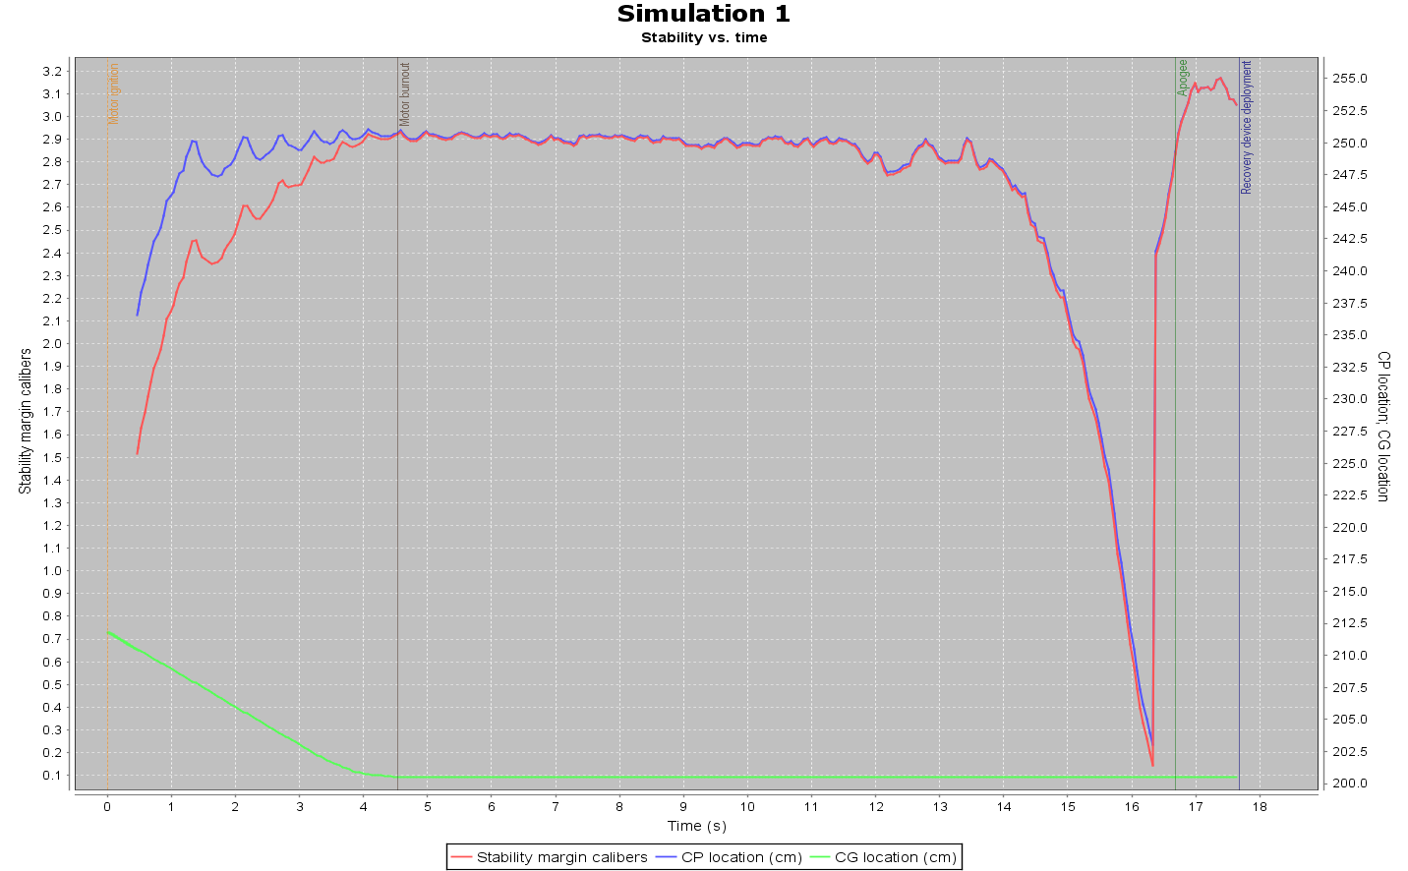
Main Engine Running Only

Slide 4
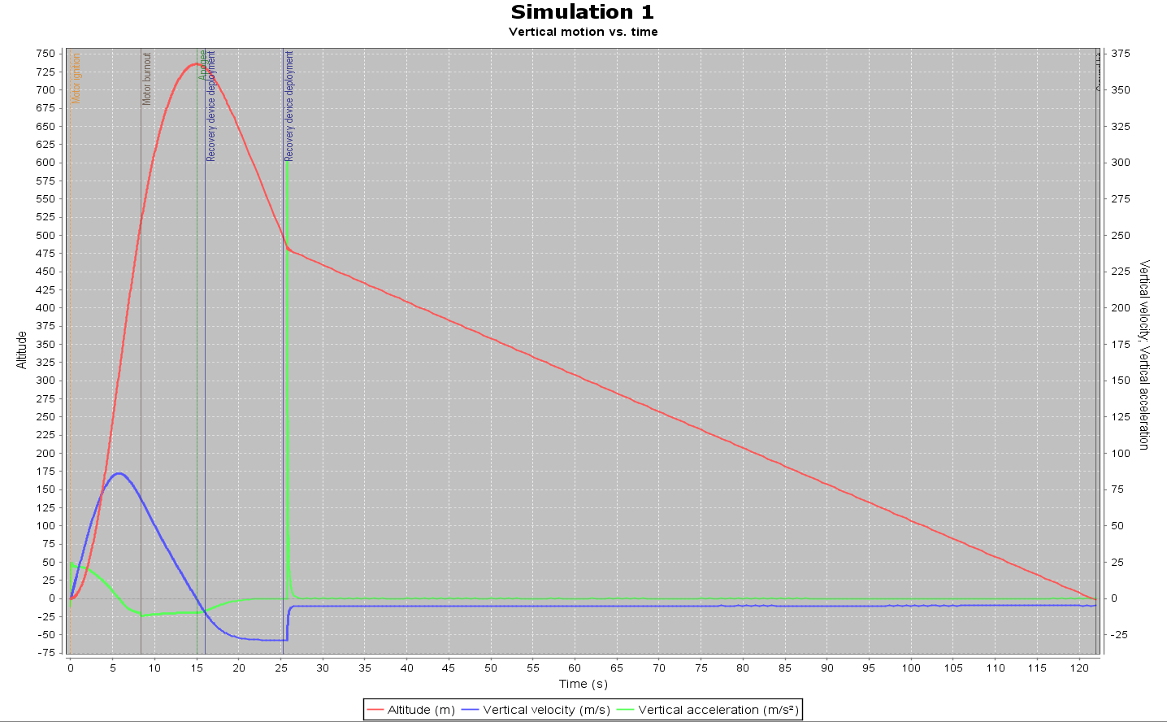
Both Boosters Running Only

Slide 5
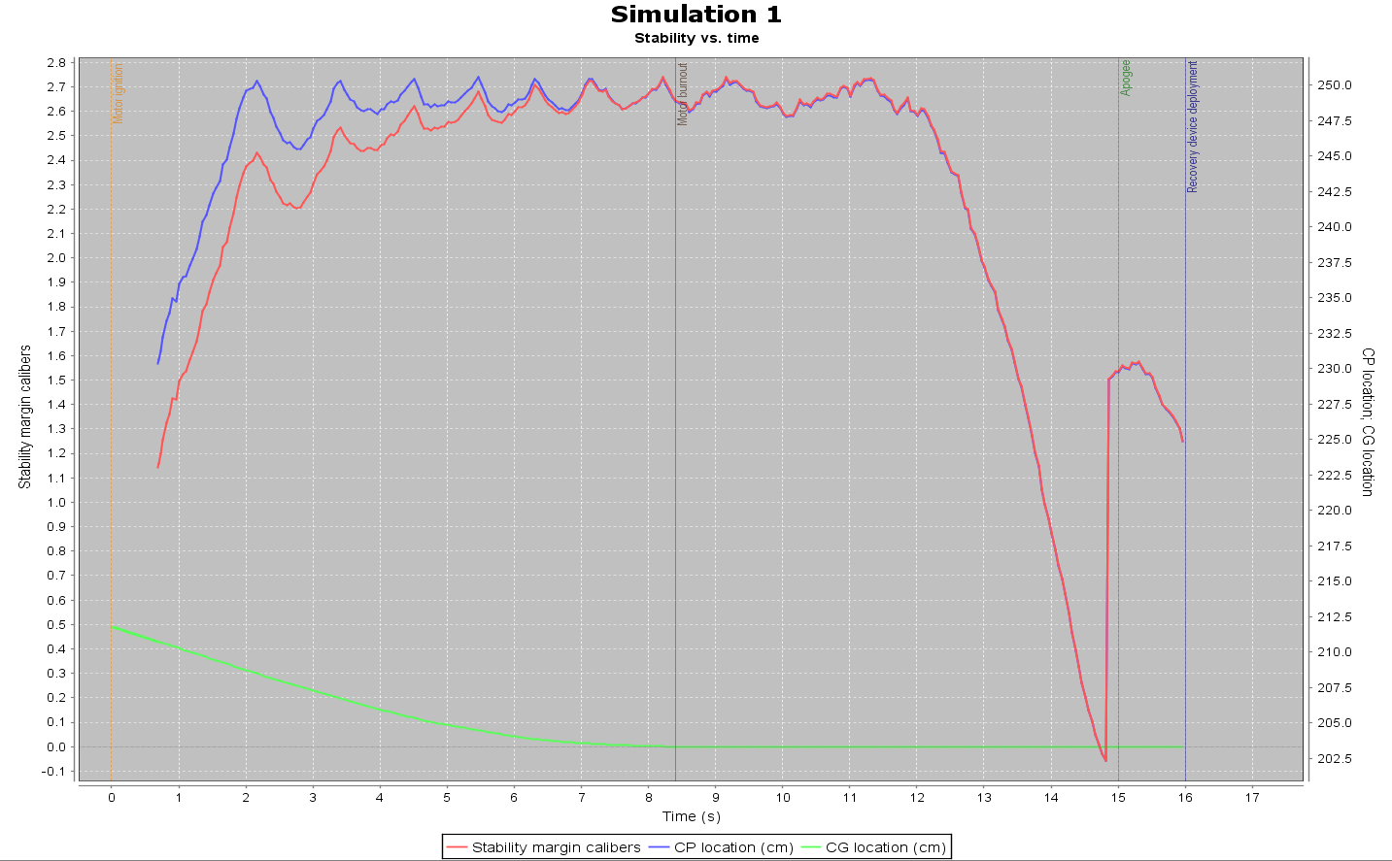
Both Boosters Running Only

Slide 6
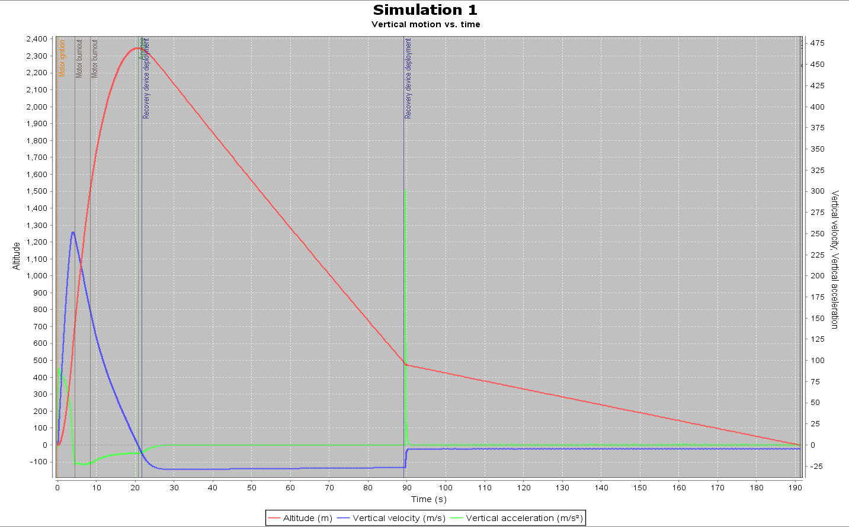
0.1 s delay on booster one 0.1 s delay on booster two
No delay on main engine

Slide 7
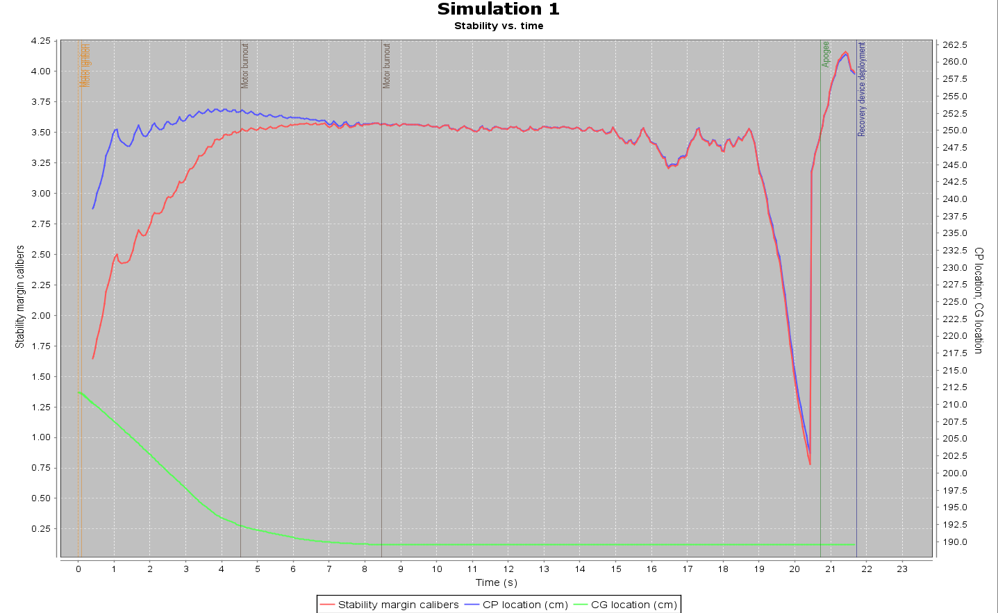
0.1 s delay on booster one 0.1 s delay on booster two
No delay on main engine

