Slide 1
ICN RG Proposed Charter
IETF–81
July 2011
Börje Ohlman & Dirk Kutscher

Slide 2
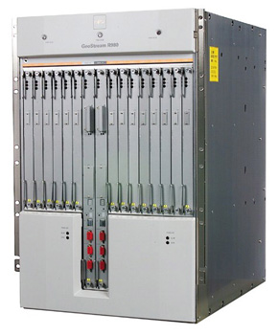
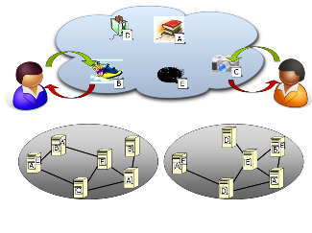
Information Centric Networking (ICN)
Background
Future
Information Centric Network
Focus on
information objects and
real world objects
Today’s Internet
Focus on
nodes
Evolution
Web
CDN
P2P
In today’s Internet,
accessing information is
the dominating use case!
Notes:
Evolution:
In traditional telephony networks the focus was on connecting wires. The major breakthrough was moving to automatic switching.
In Internet the focus has been on interconnecting nodes via a packet switched network. The original design did not take mobility and security into account.
In the Future Internet, which SAIL addresses, the vision is to focus on networking of information.
Networking of Information:
It is the information that is important to users, not the nodes
And the quality and properties of that information
Where it came from is less important
As long as it has the desired properties, including authenticity
As the architecture focuses on the information objects themselves the underlying network infrastructure needs to transparently support things like mobility, multihoming and security.

Slide 3
ICN Research challenges
Scalability of naming and name resolution for object naming
Receiver-oriented transport protocols that can take advantage of caches in the network
Security based on name data integrity
API and application interaction with ICN
Deployment issues, business models and legal issues related to introduction of ICN
Green ICN

Slide 4
ICNRG Objectives
(condensed version)
Main objective: Advance the state of ICN research
Forum for exchange and analysis of ICN research ideas and proposals
Provides guidelines for experimental activities to be able to compare alternative solutions consistently.
Investigate components of a common protocol framework for ICN, aiming to identify key architecture invariants across different specific approaches and protocols for future standardization.
Foster the development of ICN testbeds for performing experiments with running code.
Initiate discussions about ICN interfaces to the application layer, from network management systems, etc.
Resulting in a common protocol framework for standardization. These protocols may or may not re-use existing IETF protocols.

Slide 5
ICNRG Objectives
The main objective of the ICNRG is to advance the state of ICN research in at least the mentioned areas, focusing on solutions that are relevant for evolving the Internet at large.
The ICNRG will provide a forum for exchange and analysis of ICN research ideas and proposals, work that is based on implementation experiences will be given preference.
The ICNRG will produce a document that provides guidelines for experimental activities in the area of ICN so that different, alternative solutions can be compared consistently.
The ICNRG will investigate components of a common protocol framework for information-centric networking, aiming to identify key ICN architecture invariants across different specific approaches and protocols for future standardization.
The ICNRG will foster the development of ICN testbeds for performing experiments with running code.
The ICNRG will initiate discussions about desirable interfaces to an ICN, as relevant for an application layer, from network management systems, or others.
The intention is that one result from this work could be a common protocol framework that can be used to identify protocols for standardization. These protocols may or may not re-use existing IETF protocols.

Slide 6
ICNRG Milestones
The ICNRG will not work along a complete list of milestones, but will be set to meet the following starting point, intermediate and potential long-term goals:
  As a starting point the ICNRG will produce a document that describes the ICN problem statement, the main concepts and research challenges in depth.
  An an intermediate milestone, the ICNRG will produce a document that provides a survey of different approaches and techniques.
  Eventual long-term goals would be documents describing an ICN architecture and possible specific (protocol) elements, as well as documents providing recommendations to the IETF regarding transferring ICNRG results to standardization work.

Slide 7
ICNRG current status
Well attended bar-bar-BOF in Prague
Charter proposal on IRTF Wiki
Number of subscribers to the icn-interests mailing list: 130
Positive feedback from all research projects in the area (that we heard from)
Initial contacts with IRTF chairs Aaron Falk (previous) and Lars Eggert (current) – positive feedback
  Will present the ICNRG proposal at the IRTF Open Meeting on Wednesday morning
Planning group
  Bengt Ahlgren, Stephen Farrell, Volker Hilt, Dirk Kutscher,
  Börje Ohlman, Jörg Ott, Martin Vigoureux, Lixia Zhang

Slide 8
ICN RG short term objectives
Bring researchers together
Exchange research results
  especially from implementation and simulation work
Identify a few initial topics to focus the discussion around

Slide 9
Possible research topics
naming schemes for ICN
scalable name resolution for flat names
scalable routing schemes
a protocol framework
security and privacy
application/application-protocol design
API
business, legal and regulatory framework

Slide 10
Possible output
Mid-term
  a common ICN framework
  input to existing IETF WGs
Long-term
  IETF work on ICN
  influencing legal and regulatory framework

Slide 11
Misc
ICN mailing list
  icn-interest@listserv.netlab.nec.de
IRTF Wiki page
  https://trac.tools.ietf.org/group/irtf/trac/wiki/icnrg
ICN workshop at SIGCOMM 2011
  http://www.neclab.eu/icn-2011/

Slide 12
What now?
General comments?
Discuss ICN research topics
Discuss proposed charter
Your views on what the focus should be
Is IRTF ready for ICNRG?

