Slide 1
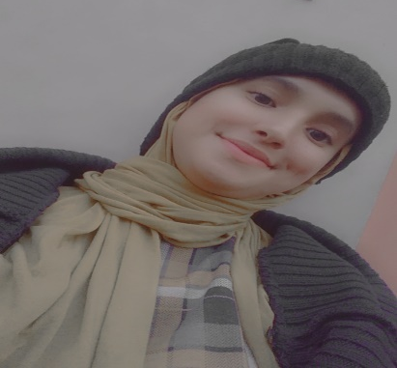









IKRAM BENKAROUM
Engineering student
About me
CONTACT
Enthusiastic engineering student with a passion for leveraging emerging technologies. Known for dedication and strong work
ethic, I thrive in challenging environments. Particularly interested
in the dynamic realm of cloud DevOps
Marrakech
+ 212 0629709168
EDUCATION
ibeen171@gmail.com
2023- 2024
https://github.com/icobeen
Ecole National des sciences appliquées (ENSA) l Marrakech
4éme année Cycle d'ingénieur /
filière :Réseau services et systèmes
programmables
Office Productivity and Document Processing
2020 - 2022
Ecole National des sciences appliquées (ENSA) l Marrakech
PowerPoint
Cycle préparatoire
Latex / Nyx
2019 - 2020
Excel
Lycée El Farahidi l Amizmiz
Word
Baccalauréat sciences physique :
option français
Soft skills
Cmmunication skills
PROJECTS
Collaboration skills
Intrusion detection system with machine learning
Adaptability
Creative thinking
Deploying applcations with docker and kubernetes
Team work
Time management
VPn desktop application(using Ec2 and Flask )
Stress management
Organizational
Languages
SKILLS
Hard skills
Arab
French
English
Unix/Linux
Ansible
Passions
AWS/Vmware/Cisco
Python/Java/php/Sql
Docker/K8s
Software developement
Jenkins /Git
Configuration management

