Slide 1

FUTURE ROOTS

Slide 2

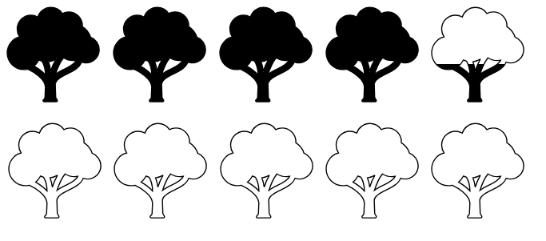

4236 trees planted
5 hours

Slide 3
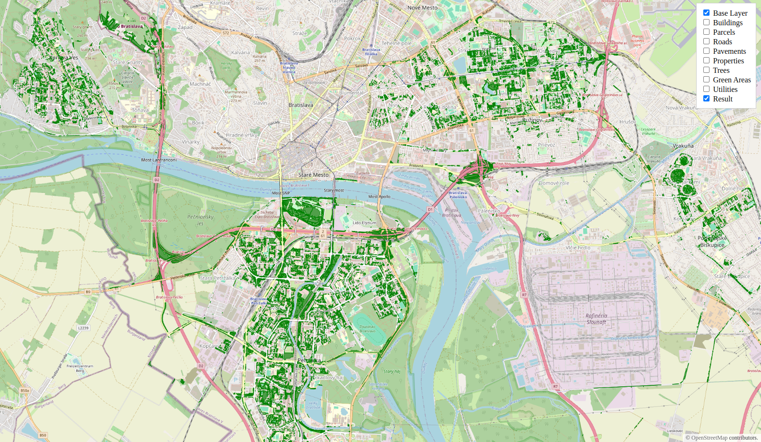
Areas to plant trees

Slide 4
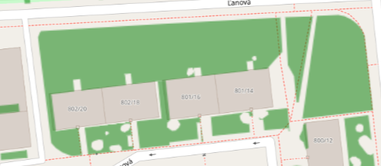
Green areas are restricted by infrastructure

Slide 5
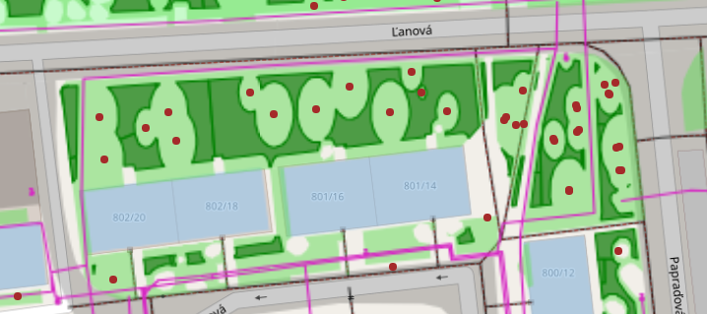
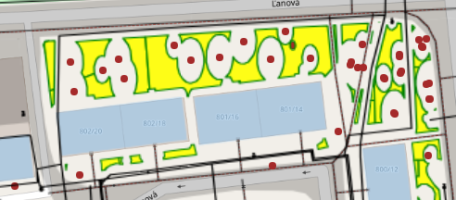




Green areas are restricted by infrastructure

Slide 6
User can order by area size

Slide 7

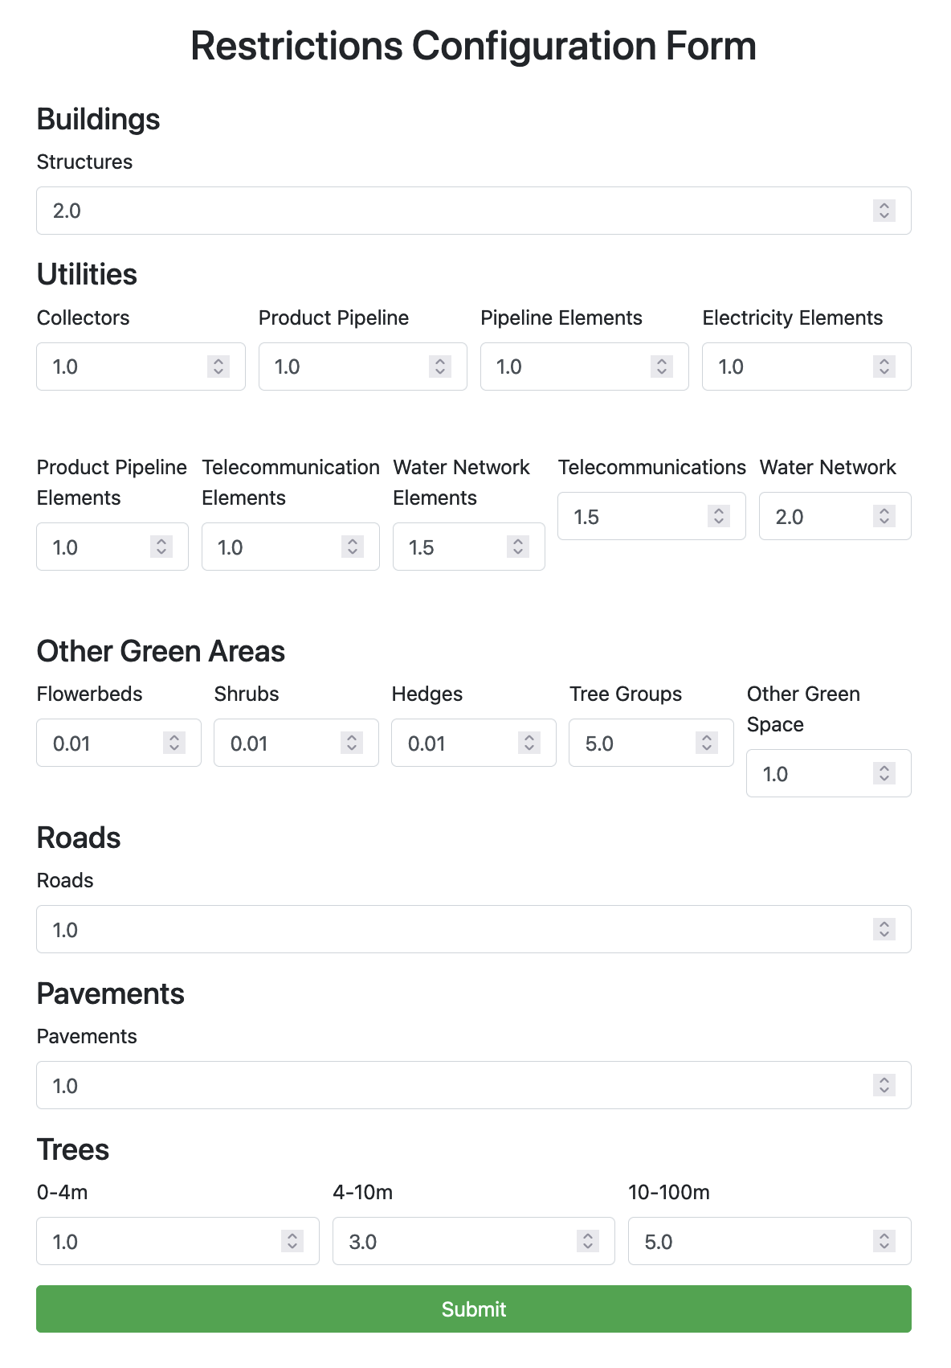

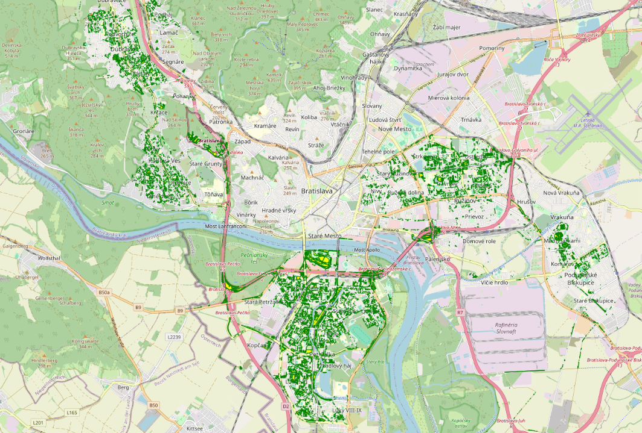
Custom web app

Slide 8
FUTURE ROOTS

Slide 9
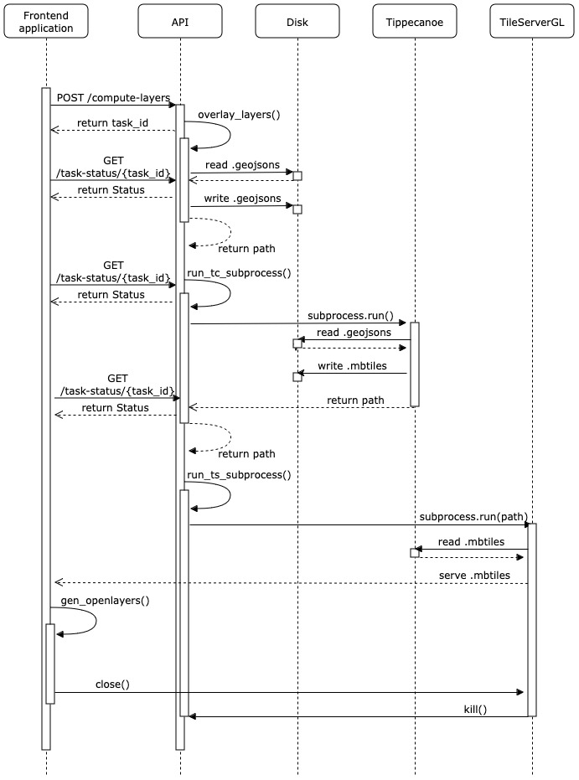
Appendix 1: Application sequence diagram

Slide 10
Appendix 2: Used data
Data used | Source
Buildings | European Inspire Project
Roads | European Inspire Project
Sidewalks | OpenSourceMap
City properties | City data provided
Trees | City data provided
Green areas | City data provided
Utilities (collectors, product pipelines, electricity, water pipelines, telecommunications) | City data provided

Slide 11
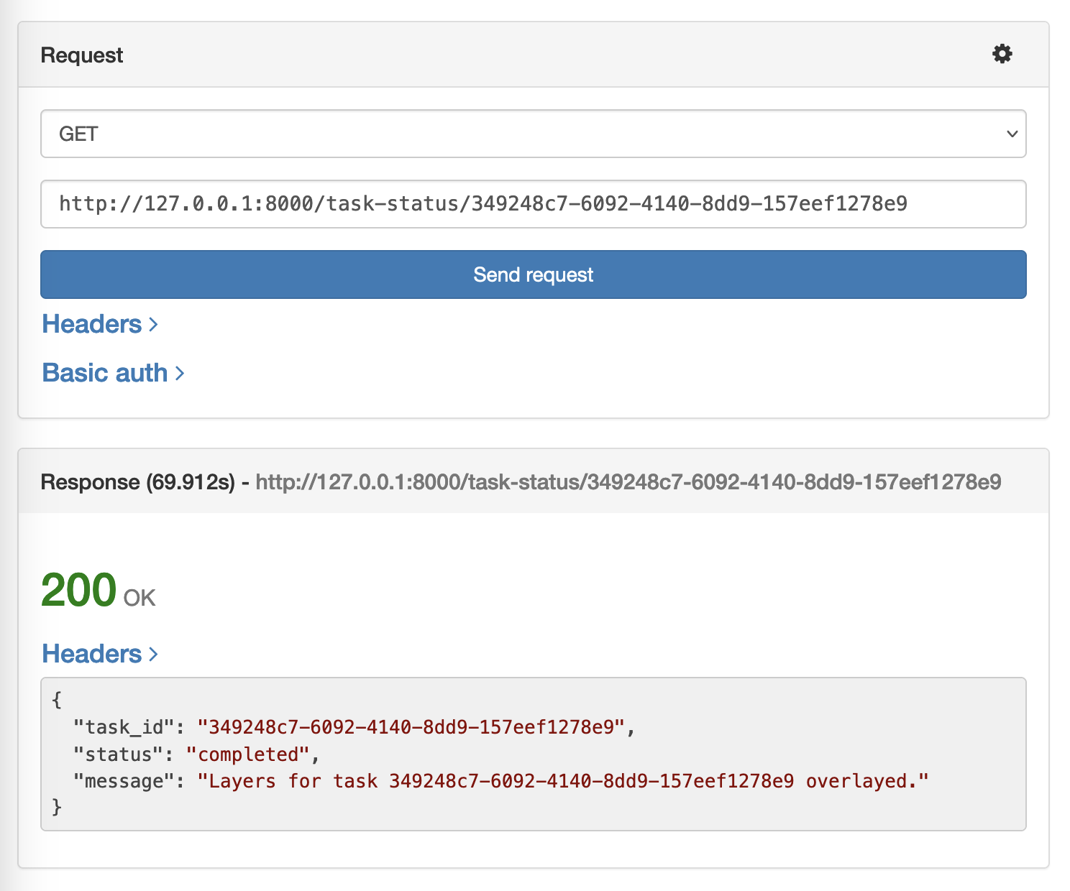
Appendix 3: Task status message

Slide 12
Appendix 4: Code repository link
https://github.com/icobx/future-roots

