Slide 1
SyriaTel Churn Analysis
icallyoupickup llc

Slide 2
Table of contents
01
02
03
Business Problem
Conclusion
Analysis

Slide 3
Business Problem
01
Finding the reasons customers are churning from SyriaTel

Slide 4
Data Overview
The data provided contained of over 3000 data points and we took a look at 16 different features

Slide 5
14%
Amount of churned customers in data set

Slide 6
Revenue
All together the customers in this data set brought in $200,000 revenue for the company
Churned customers represented $32,000

Slide 7
WHY?

Slide 8

02
Analysis

Slide 9

Final Predictive Model
Overview
Accuracy = .95
Recall score = .78
Precision score = .85

Slide 10
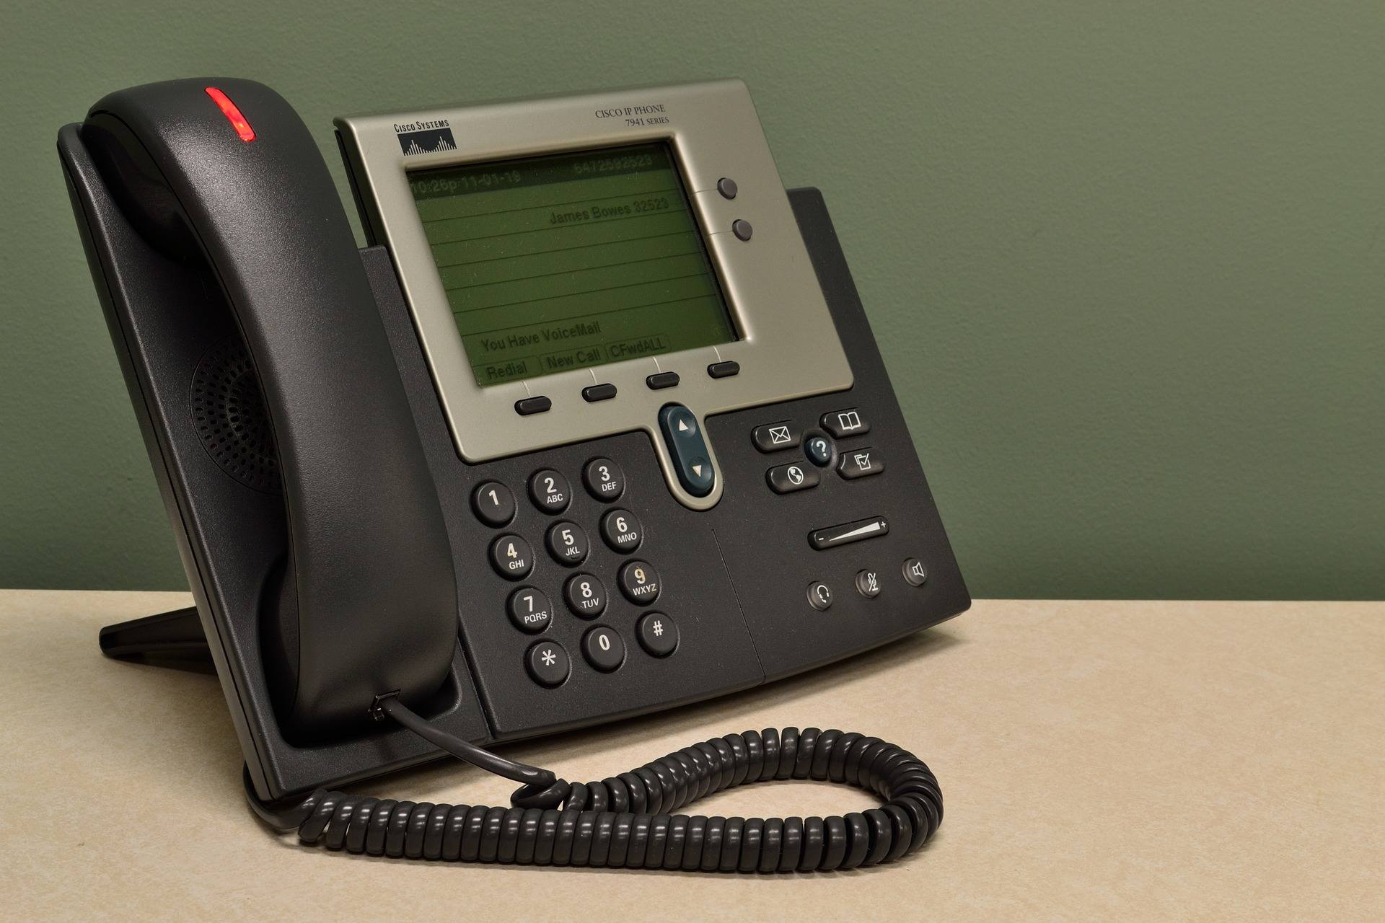
Top 3 Most important features in Model
Total Intl calls
Total Day Minutes
Voicemail Plan

Slide 11

03
Conclusion

Slide 12
Recommendations based on model
Int Call
Voicemail
Competitive International calls package
Provide voicemail services to customers debating on churning

Slide 13
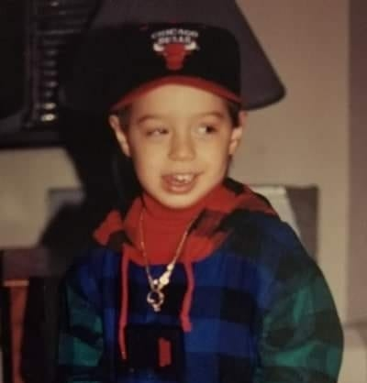
Our team
Thanks
Do you have any questions?
babykev@gmail.com
icallyoupickup.com
Baby Kev

