Slide 1
S
SalesIQ
ANALYTICS & FORECASTING
Intelligent Sales Analytics
& Forecasting Platform
An end-to-end AI/ML system: raw sales data → validation & cleaning → EDA →
feature engineering → forecasting (Baseline · SARIMA · XGBoost) → REST API → dashboard
Python 3.11+
FastAPI
Next.js 14
SQLite / PostgreSQL
Docker
XGBoost
SARIMA
AI/ML Internship Assignment · Project Showcase
github.com/icodervivek/SalesIQ

Slide 2
S
SalesIQ
ANALYTICS & FORECASTING
AGENDA
What this deck covers
01
Problem Statement & Objectives
02
Core Features
Why SalesIQ, and what it needs to demonstrate
Upload, validation, EDA, forecasting, dashboard
03
Tech Stack & Architecture
04
ML Approach
How the system is put together
Baseline, SARIMA, XGBoost, features, validation
05
Results
06
Live Product Walkthrough
Measured model comparison, not illustrative numbers
Screenshots of the running dashboard
07
Testing, Deliverables & Limitations
AI/ML Internship Assignment
What's verified, what's shipped, what's next
02 / 23

Slide 3
S
SalesIQ
ANALYTICS & FORECASTING
THE CHALLENGE
Problem Statement
Businesses sit on large volumes of historical sales data, but converting that data into reliable, forward-looking information is hard.
Who feels this pain
Sales Manager
Understand performance & expected future sales
Manual spreadsheets can show what already happened — they are far less effective at surfacing seasonality, trend shifts, or expected future demand.
Business Analyst
Explore trends, products, regions, scenarios
Operations Team
Use demand forecasts for planning
SalesIQ's goal: build an end-to-end forecasting & analytics system that turns raw transaction data into actionable forecasts and visual insight.
Technical Team
Run, evaluate, maintain the ML pipeline
AI/ML Internship Assignment
03 / 23

Slide 4
S
SalesIQ
ANALYTICS & FORECASTING
SCOPE
Project Objectives
✓
Ingestion & Cleaning
✓
Exploratory Analysis
A clean, reusable pipeline for sales-data validation and preprocessing
Surface trends, seasonality, outliers, and product/region performance
✓
Feature Engineering
✓
2+ Forecasting Models
Time-based and business features (lags, rolling stats, calendar, exogenous)
Implement and fairly compare multiple forecasting approaches
✓
Time-Aware Evaluation
✓
REST API
Chronological validation with forecasting-appropriate metrics
Expose data, analytics, training and forecasting through endpoints
✓
Interactive Dashboard
✓
Documentation & Packaging
A real UI for uploading, exploring, and forecasting
Assumptions, limitations, setup — runnable by another developer
AI/ML Internship Assignment
04 / 23

Slide 5
S
SalesIQ
ANALYTICS & FORECASTING
WHAT IT DOES
Core Features
Feature | Expected Behavior
Data Upload | Upload CSV sales data, validate required columns
Validation & Cleaning | Detect + handle missing/invalid dates, duplicates, negatives
EDA Dashboard | Trends, growth, product & regional performance, distributions
Feature Engineering | Date, lag, rolling, growth-rate, exogenous features
Forecasting | Selectable horizon: 7 / 30 / 90 / custom days
Model Comparison | Baseline · SARIMA · XGBoost, consistent metrics
Prediction Intervals | Shaded forecast range, not just a point estimate
Product/Region Forecasting | Scope training & forecasting to a segment
Anomaly Detection | Rolling z-score flags unusual sales periods
CSV Export | Download forecast results
AI/ML Internship Assignment
05 / 23

Slide 6
S
SalesIQ
ANALYTICS & FORECASTING
INPUT
Dataset Specification
Column | Type | Requirement
date | Date | Required
product_id / product_name | String | Required
units_sold / revenue | Numeric | Required
category / region | String | Recommended
unit_price | Numeric | Recommended
discount / marketing_spend | Numeric | Optional
6 bundled sample datasets
sample_sales.csv
29,330 rows · main dataset, 24 months
quick_test_sample.csv
734 rows · fast single-product test
fmcg_grocery_sample.csv
10,220 rows · different vertical
minimal_history_sample.csv
50 rows · training boundary case
sparse_gaps_sample.csv
342 rows · missing calendar days
edge_case_sample.csv
13 rows · every cleaning rule at once
AI/ML Internship Assignment
06 / 23

Slide 7
S
SalesIQ
ANALYTICS & FORECASTING
SYSTEM DESIGN
Architecture
Next.js Frontend
FastAPI Backend
ML Pipeline
Dashboard · Upload · Filters · Forecast viz
REST endpoints · validation · orchestration
preprocessing → features → models → eval
Database (SQLite / PostgreSQL)
Docker + Docker Compose
datasets · training runs · forecast results
reproducible dev & deployment runtime
Frontend talks to the backend only via REST. The backend is a thin API layer over a service layer that calls a framework-agnostic ML pipeline (pure pandas / scikit-learn / statsmodels / xgboost) — independently testable, reusable from a notebook or batch job.
AI/ML Internship Assignment
07 / 23

Slide 8
S
SalesIQ
ANALYTICS & FORECASTING
BUILT WITH
Tech Stack
LANGUAGE
DATA
ML
TIME SERIES
Python 3.11+
Pandas · NumPy
Scikit-learn · XGBoost
Statsmodels (SARIMA)
BACKEND
DATABASE
FRONTEND
CHARTS
FastAPI · SQLAlchemy
SQLite (local) · PostgreSQL (Docker)
Next.js 14 · React 18 · TypeScript
Recharts
STYLING
CONTAINERIZATION
TESTING
VERSION CONTROL
Tailwind CSS
Docker · Docker Compose
Pytest (22 tests)
Git + GitHub
AI/ML Internship Assignment
08 / 23

Slide 9
S
SalesIQ
ANALYTICS & FORECASTING
FORECASTING
ML Approach — Three Models
BASELINE
MODEL 1
MODEL 2
Seasonal-Naive
SARIMA(1,1,1)(1,1,1,7)
XGBoost + Exogenous Features
Forecasts day t as the value 7 days earlier. Zero training cost — the bar every other model must clear.
Classical statistical model with an explicit weekly seasonal term. Native confidence intervals.
Gradient-boosted trees over lag/rolling/calendar features plus discount, marketing spend, and a lagged category/region peer benchmark.
LSTM/GRU intentionally not used — higher overfitting risk on ~24 months of data and far less interpretable than XGBoost's feature importances.
AI/ML Internship Assignment
09 / 23

Slide 10
S
SalesIQ
ANALYTICS & FORECASTING
INPUTS
Feature Engineering
Calendar
day · day-of-week · week · month · quarter · year · is_weekend · is_month_start/end
Lag Features
lag-1, lag-7, lag-14, lag-30 (strictly past values only — no leakage)
Rolling Stats
7 / 14 / 30-day rolling mean & standard deviation, shifted by 1 day
Growth Rate
Recent 7-day growth computed from lagged values only
Exogenous
discount, marketing_spend (planned/known inputs) + a one-day-lagged product/category/region peer-average benchmark
⚠ Bug caught during development: an early version used the SAME-DAY peer average, which is a near-perfect proxy for the target itself. Lagging it by one day fixed the leakage.
AI/ML Internship Assignment
10 / 23

Slide 11
S
SalesIQ
ANALYTICS & FORECASTING
RIGOR
Validation & Evaluation
Chronological Holdout
Metrics Reported
→ Last N days (default 14) held out as test set
→ Models fit ONLY on data before that cutoff
→ No shuffling, ever — the #1 leakage source in forecasting
→ Test size auto-capped at 20% of series length
→ Minimum 45 days of history required to train
→ MAE — average absolute error, in units
→ RMSE — penalizes large misses more heavily
→ MAPE — percentage error, 1-unit floor prevents zero-actual blowups
→ R² — reported for context, not used to pick the winner
→ Selection rule — lowest holdout RMSE wins
AI/ML Internship Assignment
11 / 23

Slide 12
S
SalesIQ
ANALYTICS & FORECASTING
REAL MEASURED RESULTS
Model Comparison
Global daily series · sample_sales.csv · 731 days · 14-day holdout
Model | MAE | RMSE | MAPE | R²
Baseline (Seasonal Naive) | 32.93 | 41.21 | 4.99% | 0.834
SARIMA(1,1,1)(1,1,1,7) | 41.63 | 48.68 | 6.05% | 0.768
XGBoost (Lag+Calendar+Exogenous) | 33.72 | 36.97 | 5.05% | 0.866
🏆
XGBoost wins on RMSE (fewer large misses around demand spikes). Seasonal-Naive is unusually strong here (clean weekly seasonality in the data) — a healthy reminder that a fancier model isn't automatically much better than a good baseline. For a single product's series (smaller, noisier), SARIMA sometimes wins instead — model selection runs fresh on every training run rather than hard-coding a winner.
AI/ML Internship Assignment
12 / 23

Slide 13
S
SalesIQ
ANALYTICS & FORECASTING
INTERFACE
REST API
Method | Endpoint | Purpose
POST | /api/datasets/upload | Upload + validate + clean a CSV
GET | /api/analytics/summary | KPIs — revenue, units, AOV, growth
GET | /api/analytics/trends | Historical trend series
POST | /api/models/train | Train & evaluate all 3 models
POST | /api/forecast | Generate a forecast for a horizon
GET | /api/forecast/{id}/export | Download forecast as CSV
GET | /api/health | Service health check
AI/ML Internship Assignment
13 / 23

Slide 14
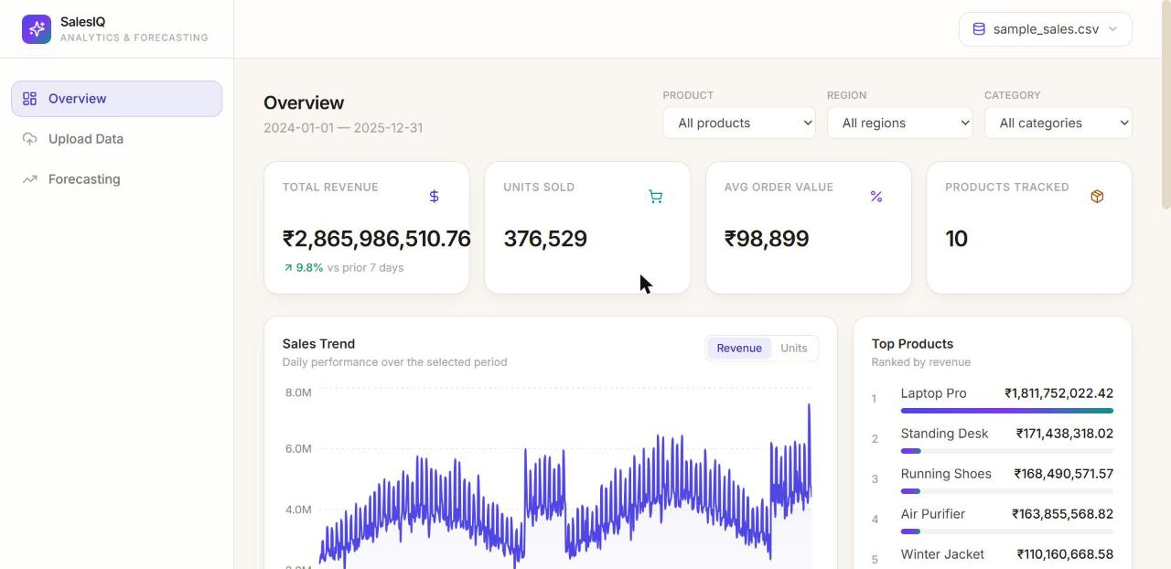
S
SalesIQ
ANALYTICS & FORECASTING
LIVE PRODUCT
Overview Dashboard
KPI cards, revenue trend, and top products — live data from the bundled sample dataset
AI/ML Internship Assignment
14 / 23

Slide 15
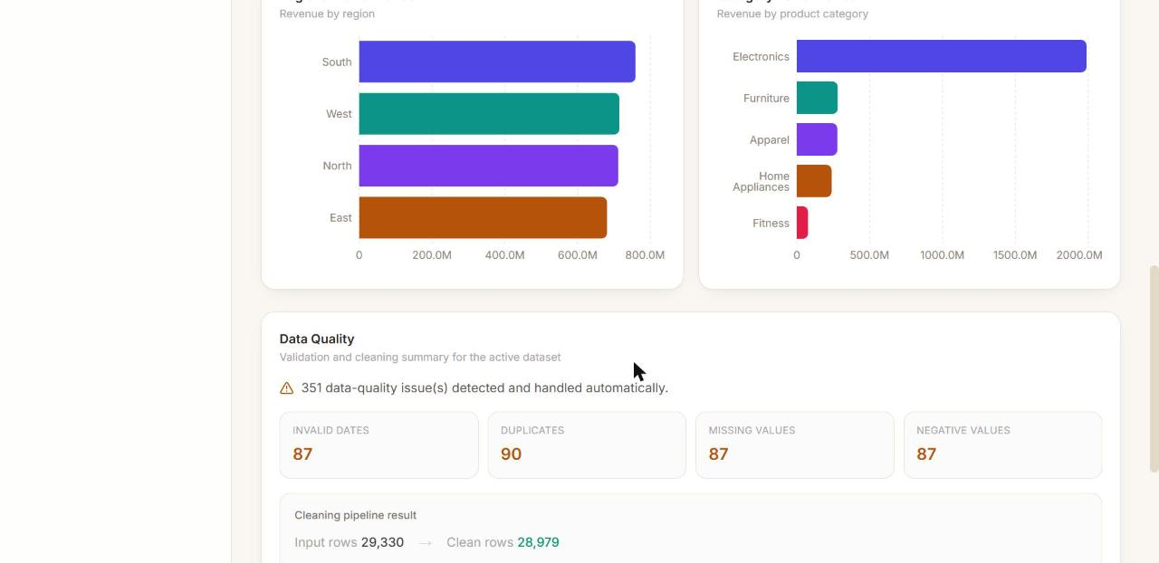
S
SalesIQ
ANALYTICS & FORECASTING
LIVE PRODUCT
Regional / Category Performance & Data Quality
Revenue breakdowns plus a transparent validation & cleaning report for every upload
AI/ML Internship Assignment
15 / 23

Slide 16
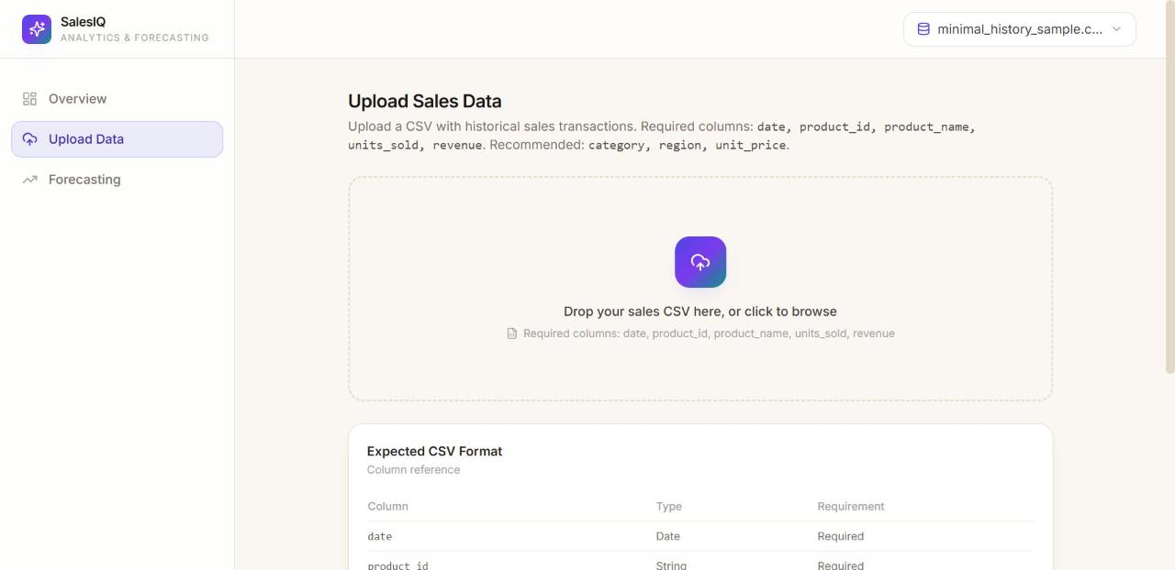
S
SalesIQ
ANALYTICS & FORECASTING
LIVE PRODUCT
Upload & Validation
Drag-and-drop CSV upload with the expected column reference
AI/ML Internship Assignment
16 / 23

Slide 17
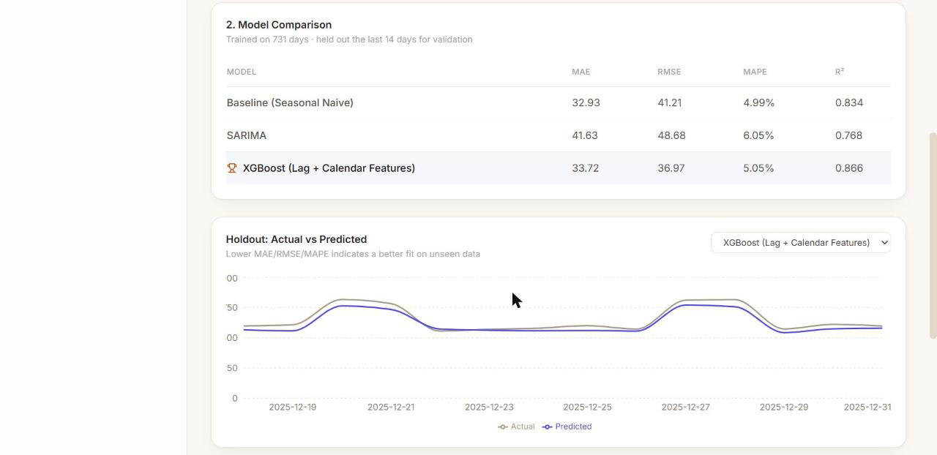
S
SalesIQ
ANALYTICS & FORECASTING
LIVE PRODUCT
Model Comparison
All 3 models evaluated on the same holdout — best model flagged automatically
AI/ML Internship Assignment
17 / 23

Slide 18
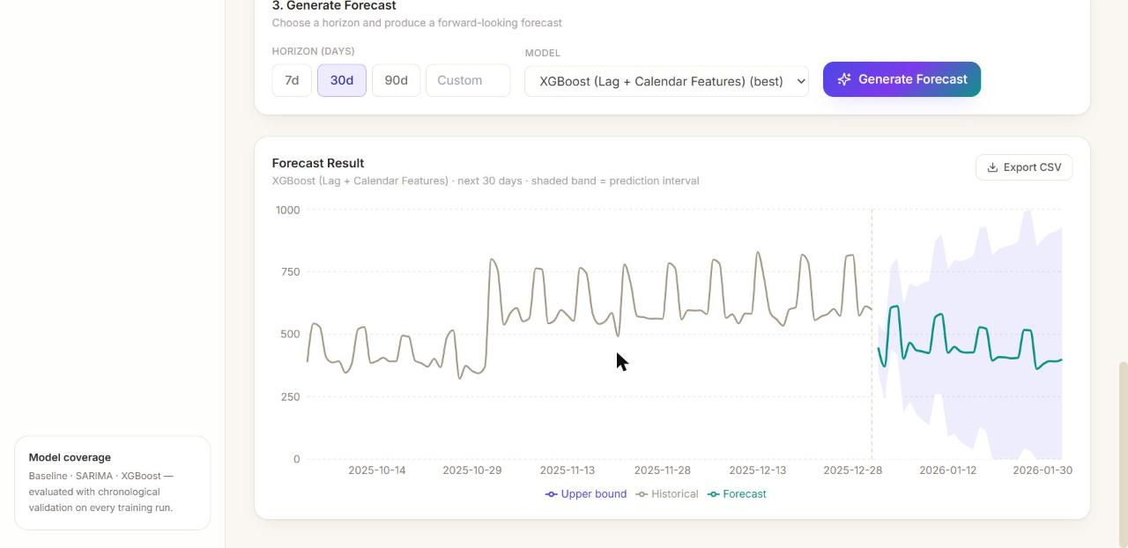
S
SalesIQ
ANALYTICS & FORECASTING
LIVE PRODUCT
Forecast Result
Historical vs. forecast clearly distinguished, shaded prediction interval, CSV export
AI/ML Internship Assignment
18 / 23

Slide 19
S
SalesIQ
ANALYTICS & FORECASTING
VERIFICATION
Testing, Edge Cases & Quality
BACKEND TESTS
SAMPLE DATASETS
EDGE CASES HANDLED
API ENDPOINTS
22 / 22 passing
6 datasets
10+
13
Covered by tests
Data edge cases handled
→ Validation & cleaning edge cases
→ Feature-engineering leakage checks (lag_1 uses only the past)
→ Zero-actual-safe MAPE and all evaluation metrics
→ Full upload → train → forecast → export API flow
→ Exogenous-feature persistence in recursive forecasting
→ Missing/invalid dates, duplicate rows
→ Missing required fields, negative values
→ Zero-sales days, extreme outliers (winsorized)
→ Gaps in the calendar (missing days)
→ Datasets right at the minimum-history boundary
AI/ML Internship Assignment
19 / 23

Slide 20
S
SalesIQ
ANALYTICS & FORECASTING
SHIPPED
Deliverables Checklist
✓
Complete source-code repository (GitHub, public)
✓
Working frontend dashboard (Next.js)
✓
Working FastAPI backend
✓
ML training & forecasting pipeline
✓
6 sample datasets (main + edge cases)
✓
requirements.txt + Dockerfile x2 + docker-compose.yml
✓
README — architecture, setup, API reference, assumptions
✓
Model evaluation report with real comparison results
✓
Screenshots from a live running instance
✓
22 automated tests
AI/ML Internship Assignment
20 / 23

Slide 21
S
SalesIQ
ANALYTICS & FORECASTING
BEYOND THE BASELINE
Bonus Features Implemented
✓ Implemented
○ Explicitly out of scope
→ Product & region-level forecasting
→ Automatic model selection (by holdout RMSE)
→ Prediction intervals / uncertainty visualization
→ Anomaly detection (rolling z-score)
→ CSV export of forecasts
→ Docker Compose (frontend + backend + Postgres)
→ What-if analysis (discount/marketing scenarios)
→ Scheduled retraining / background job queue
→ Authentication & role-based access
→ Cloud deployment
→ MLflow experiment tracking
AI/ML Internship Assignment
21 / 23

Slide 22
S
SalesIQ
ANALYTICS & FORECASTING
HONEST ASSESSMENT
Limitations & Production Roadmap
Known limitations
Production improvement path
→ Single-fold holdout, not full walk-forward backtesting
→ Missing calendar days treated as zero sales
→ XGBoost's interval is a residual-based approximation
→ No cold-start model for brand-new products
→ No holiday calendar or competitor pricing signals
→ Expanding-window backtesting as a background job
→ Holiday calendar + competitor pricing as features
→ Per-segment models with fallback to the global model
→ MLflow experiment tracking
→ Drift monitoring — alert when live MAPE regresses
AI/ML Internship Assignment
22 / 23

Slide 23
S
Thank You
SalesIQ — from raw sales data to a validated forecast, end to end.
github.com/icodervivek/SalesIQ
Full docs, model evaluation report, and setup instructions in the repo README

