Slide 1

AMD AI ACADEMY CHALLENGE · SEPT – DEC 2026
ROCm Migration
Copilot
The AI agent that frees GPU code from CUDA lock-in — it analyzes, ports, builds, tunes, and reports. Automatically.
01
→
02
→
03
→
04
→
05
Analyze
Port
Build & Test
Tune
Report
TEAM ROCM RANGERS
INDIVIDUAL BUILD · OPEN SOURCE
AMD DEVELOPER CLOUD · MI300X

Slide 2
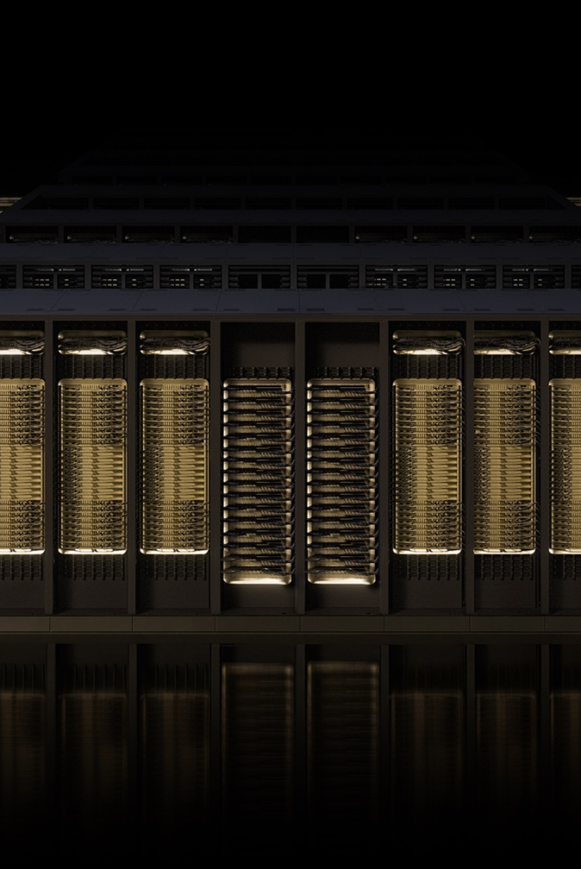
THE PROBLEM
GPU code is trapped behind CUDA
Millions of lines of production GPU code — from HPC simulations to AI inference servers — compile against one vendor's proprietary stack. Moving them to AMD's open ROCm ecosystem means weeks of manual rewriting by engineers who know both platforms. Almost nobody does.
2–6 weeks
1 vendor
0 verification
typical manual port of a mid-size repo
that every line of code answers to
in today's syntax-only conversion tools
hipify-perl rewrites syntax — it cannot reason about kernels, memory models, or build systems.
THE MIGRATION GAP — MANUAL, SLOW, ERROR-PRONE

Slide 3
THE SOLUTION
From a multi-week port to an afternoon
Today — manual porting
With ROCm Migration Copilot
×
Grep for CUDA API calls across the repo
→
One command ingests the whole repository
×
Hand-rewrite every kernel and memory path
→
Agent plans the port before touching a line
×
Debug compiler errors one by one, for days
→
HIP code generated with full repo context
×
Tune blind — no AMD hardware in the loop
→
Compiles, tests, and tunes on real AMD GPUs
One command in → a verified, tuned, documented HIP codebase out.

Slide 4
HOW IT WORKS
A five-stage agentic pipeline
01
02
03
04
05
Analyze
Port
Build & Test
Tune
Report
AST parsing builds a kernel inventory and dependency graph; flags the long tail that hipify-perl misses.
LLM agent translates CUDA APIs, kernels, and memory management to HIP with repo-wide context.
Automated compile and test loop on real AMD GPUs; every failure feeds back to the agent.
Performance advisor driven by Omniperf and Omnitrace profiles of the migrated code.
Every change logged with a confidence score and a human-review checklist.
→
→
→
→
↻
The build–test–fix loop runs autonomously until the port compiles and passes tests.

Slide 5
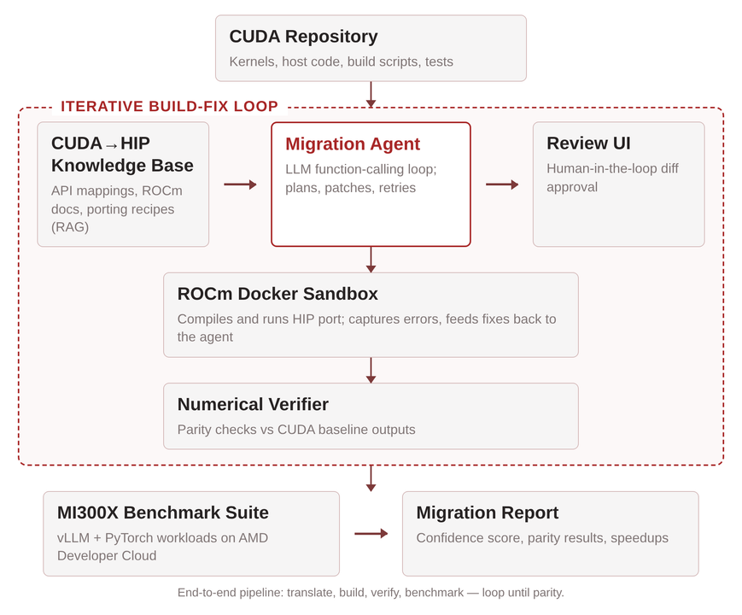
ARCHITECTURE
Under the hood
◯
Agent core
LLM with tool calling and RAG over official ROCm documentation.
☂
AST precision
LibClang and Tree-sitter parse CUDA for surgical, structure-aware edits.
✚
Self-healing loop
Compiler and test output drive the next fix — no human in the loop.
✦
Orchestration
Python + LangGraph, running on ROCm-enabled MI300X cloud instances.

Slide 6
TECHNOLOGY
AMD, end to end
STACK / 01
✦
STACK / 02
⇄
CLOUD / 03
☁
ROCm
HIP
AMD Developer Cloud
The open GPU software stack. Every layer inspectable, every commit public.
Portable runtime and kernel language — CUDA's structure, AMD's openness.
MI300X instances through the challenge's $100 developer credits. No hardware required.
PROFILING / 04
✦
WHY IT MATTERS / 05
⚑
Omniperf + Omnitrace
First-class profiling feeds the tuning stage with real kernel-level data.
Runtime, cloud, profilers, docs — every layer of this project is AMD technology. That is the point.

Slide 7
WHY WE WIN
Why this beats the alternatives
OUR EDGE
STATUS QUO
THE GUESSING APPROACH
ROCm Migration Copilot
hipify-perl
Generic AI coders
→
Repo-wide reasoning before a single edit
×
Syntax-level regex rewrites
×
No GPU in the loop — errors found late
→
Real MI300X hardware verifies every change
×
Breaks on custom kernels and templates
×
Hallucinate APIs without doc grounding
→
Confidence-scored, review-ready output
×
No build, no test, no verification
×
No repo-wide build context
NO VERIFICATION
NO GROUNDING
VERIFIED ON MI300X
The alternatives stop at translation — this copilot keeps building, testing, and tuning until the port is verified on real AMD hardware.

Slide 8
EXECUTION PLAN
September → December 2026
SEP
OCT
NOV
DEC
Core pipeline
Hardware-in-the-loop
Hardening
1.0 release
⚑
Analysis + HIP porting stages live; public repo open with weekly builds.
Build–test–tune loop running on MI300X; first end-to-end port demo.
Bigger real-world repos, benchmark suite, migration report 2.0.
Docs, public video demo, launch post, final challenge submission.
3 MONTHLY CHALLENGE THEMES · SHIPPED AS PROJECT MILESTONES

Slide 9
SCORING
Playing the scoreboard on purpose
The challenge awards XP per category — this project is shaped to hit the highest-weight ones head-on.
+250
+200
+200
Built on AMD technology
Complete working project
Open source from day one
~2,475
XP PLANNED THROUGH DECEMBER
3 × 100
+150
Monthly milestone drops
Public demo + documentation
Individual scoring — one builder, full accountability, zero coordination tax.

Slide 10


TEAM ROCM RANGERS
Give every CUDA codebase an escape hatch.
ROCm Migration Copilot — open source from day one, verified on MI300X.
LABLAB DISCORD — SAY HI
SEPT 1 → DEC 1 2026
BUILT ON AMD DEVELOPER CLOUD

