Slide 1
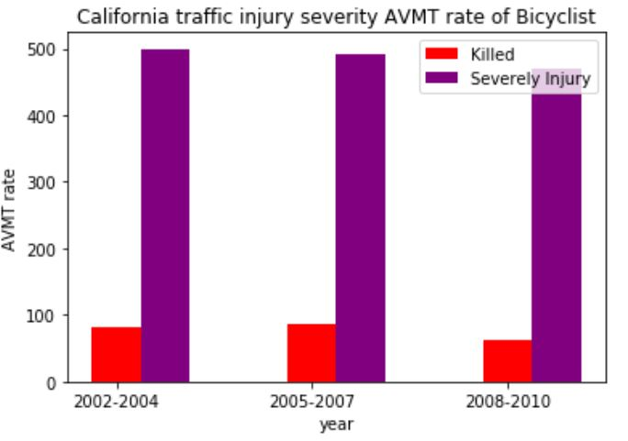
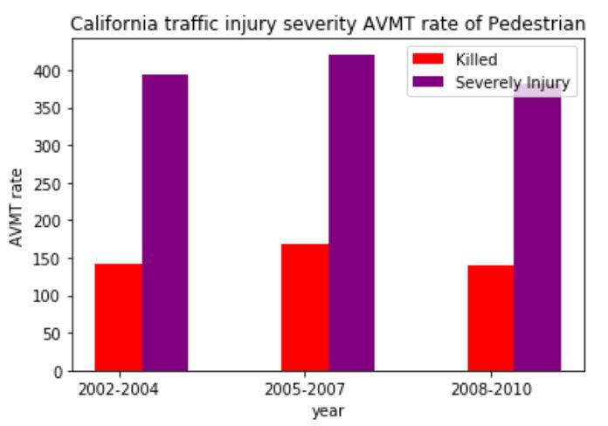
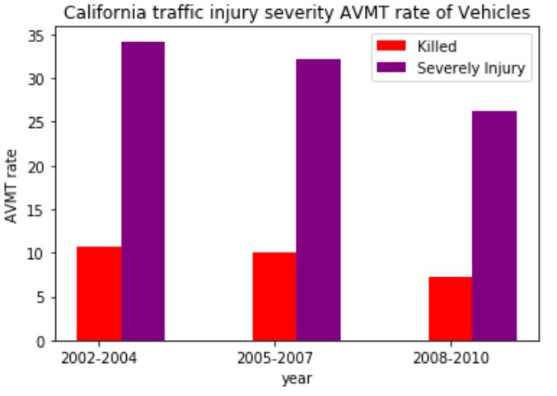
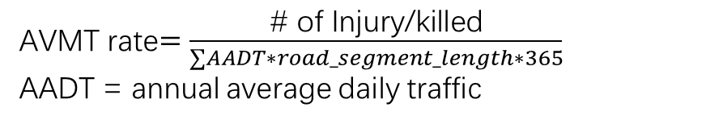
Severity: CA Annual Vehicle Miles of Travel rate
$\text{AVMT}$ rate$=\frac{\text{\# }\text{of} \text{Injury}\text{/}\text{killed}}{∑AADT∗road_segment_length∗365}$
AADT = annual average daily traffic

Slide 2
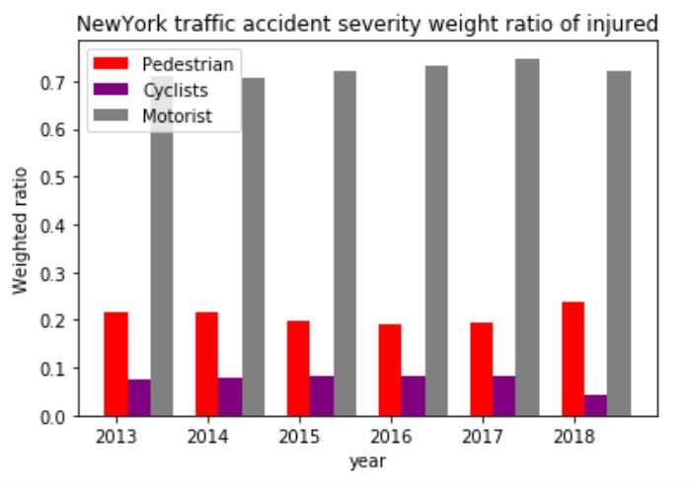
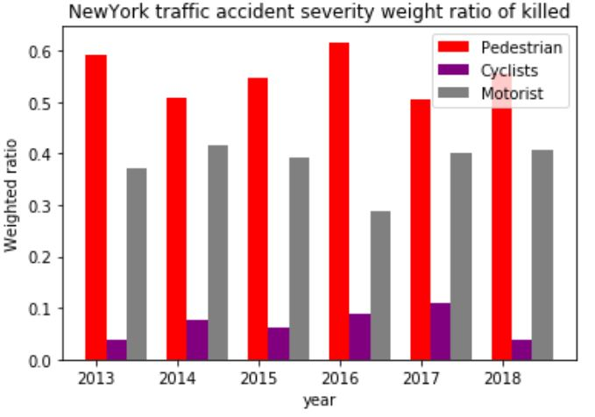
Severity: NY Traffic injury weight ratio

