Slide 1
Ensemble-Based Methods
Jindal K. Shah (jindal.shah@okstate.edu)
Masrur Ahmed (masrur.ahmed@okstate.edu)
Amey Thorat (amey.throat@okstate.edu)

Slide 2
Topics
Decision Tree
Bagging (bootstrap + aggregating)
Random forests
Hands-on Exercise

Slide 3
About Myself
Associate Professor in Chemical Engineering at Oklahoma State University
Trained in MD/MC
Started learning QM and machine learning a few years ago

Slide 4
Decision Tree
Supervised learning method
Regression/classification
Non-linear model(?)
If…then…else…
Non-parametric model
Piecewise continuous
t1
x2
s1
x1

Slide 5
Decision Tree
Node
Branch
Depth of the tree = maximum number of branches to reach a leaf
Leaf

Slide 6
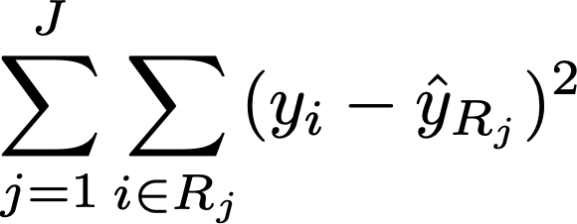
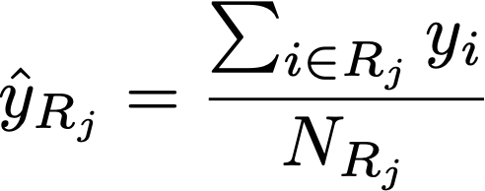
Objective function
The objective is to minimize the residual sum of squares
Here J represents the number of regions the feature space is partitioned into. The prediction in each of the regions is given by the average response.

Slide 7


Partitioning the Feature Space
Top-down greedy approach known as recursive binary splitting:
Begins at the top of the tree and successively splits the feature space
Greedy because the split at a particular step minimizes the RSS at that step rather than splitting in such a way to achieve a better tree in a future step
Consider a split over a feature j and the corresponding threshold value s, which divides the data such that

Slide 8
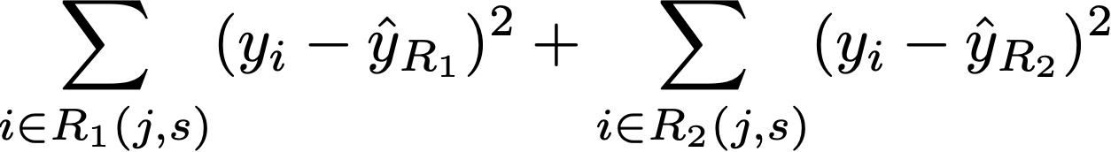
Selection of feature and its threshold
Minimize the RSS

Slide 9
(Dis)Advantages of Decision-Tree Models
Advantages
Ease of interpretation
Graphical representation and understanding by a non-expert
Scaling of features is not required
Disadvantages
Accuracy is usually lower than other regression-based approaches
Small changes in the data can greatly impact the tree structure
As outputs are only piecewise continuous, multiple inputs can yield identical results.

Slide 10
Overcoming disadvantages
Bagging (bootstrap + aggregating)
Using multiple decision-tree models
Random forests

Slide 11
Bootstrap sampling
Using the same data set, create multiple data sets by randomly drawing samples with replacement
Original Data
Bootstrapped Samples
Bootstrapped Samples

Slide 12
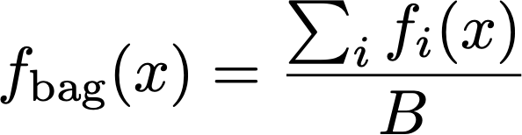
Aggregating
For each of the bootstrapped data set, develop a model and predict a response f_{i}(x)
Average each of the responses to obtain the response due to bagging.

Slide 13
Random Forests
Multiple decision-tree models
Bootstrapped data set
Randomly selected subset of features at every split
Achieves decorrelation of trees
Hyperparameters:
Number of trees
Number of features to select at every split
Minimum number of samples required at an internal node
Minimum number of samples required at a leaf node

Slide 14
Hands-on exercise

