Slide 1
Day 3, Session 1:
PCA, multidimensional scaling, and all that follows
Today’s lecture will follow closely the resources found at here and here.

Slide 2
Some notes on notation… (see notation guide)

Slide 3
Dimensionality reduction (DR) describes a set of of methods that convert highly-dimensional data into a more interpretably or information-rich format.

Slide 4
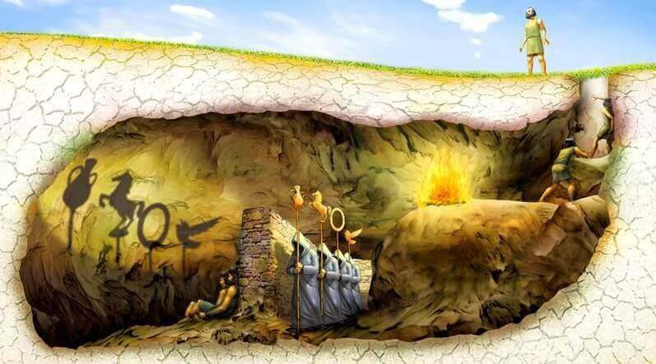

Slide 5
Generally, there are two major classes of DR: data compression and visualization/interpretation.
In data compression, we aim to construct a smaller feature space (e.g. set of columns) that contains as much information as our initial data space (Session 1)
In visualization/interpretation, we aim to identify trends in our data that help our visual or conceptual understanding (Session 2)
Some methods can be useful towards both of these goals, but these goals have different intentions → different mathematics!

Slide 6
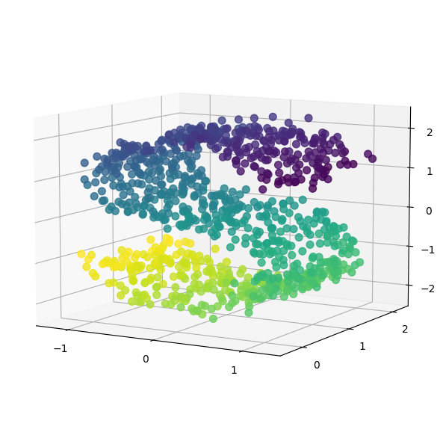
Let’s say we want to take a matrix X
… and determine a matrix T
… whose columns are a linear combination of those in X
… AND from which we can reconstruct X with minimal information loss.

Slide 7
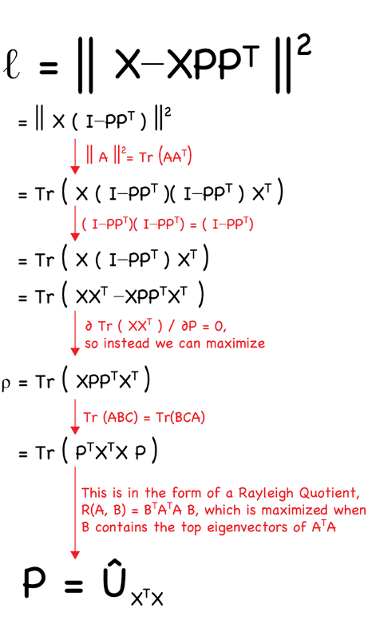
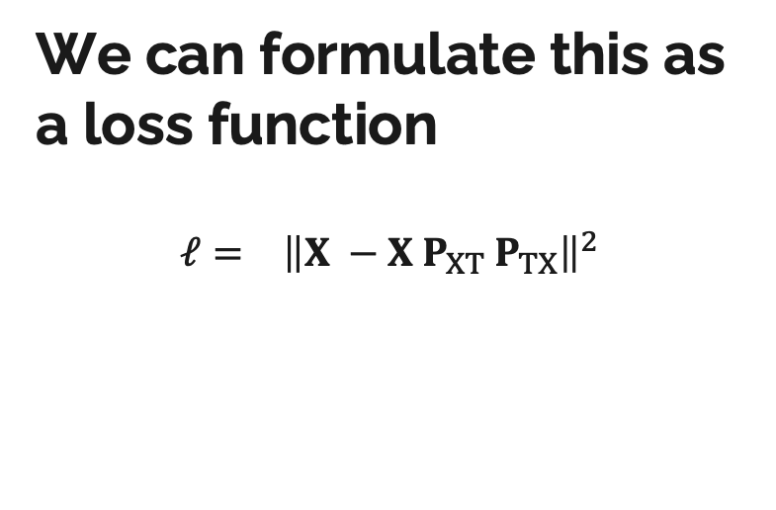
We can formulate this as a loss function $$ℓ= {\left\|X −X P_{XT} P_{TX}\right\|}^{2}$$
Notes:
I will write on these slides

Slide 8
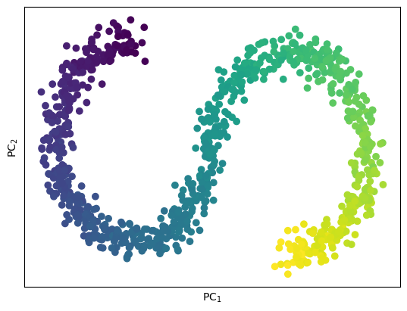
This fairly simple idea, determining a small matrix that best-approximates a larger one, leads to our archetypal DR technique: Principal Components Analysis.

Slide 9
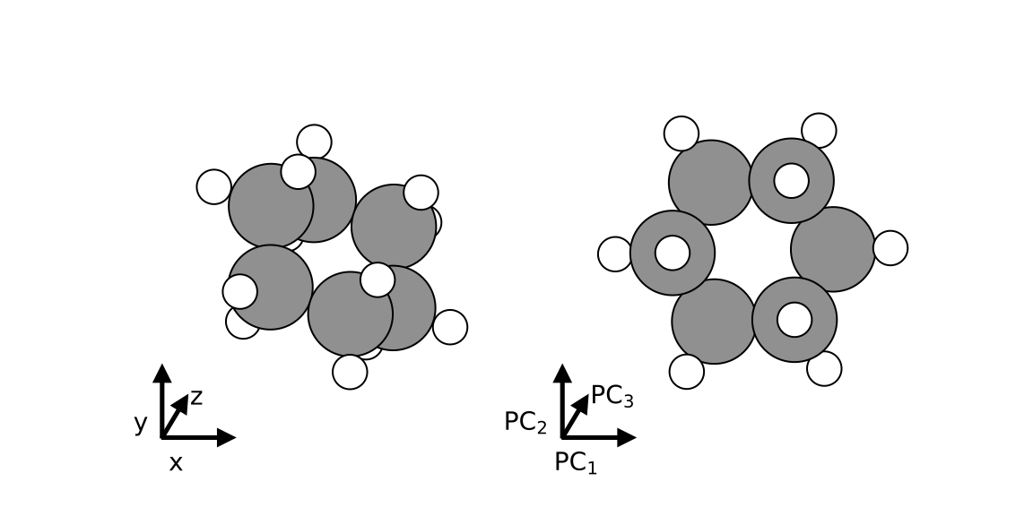
This fairly simple idea, determining a small matrix that best-approximates a larger one, leads to our archetypal DR technique: Principal Components Analysis.
I always like to note that PCA can also be useful for visualization – I often use it to help me orient the molecules for figures:

Slide 10
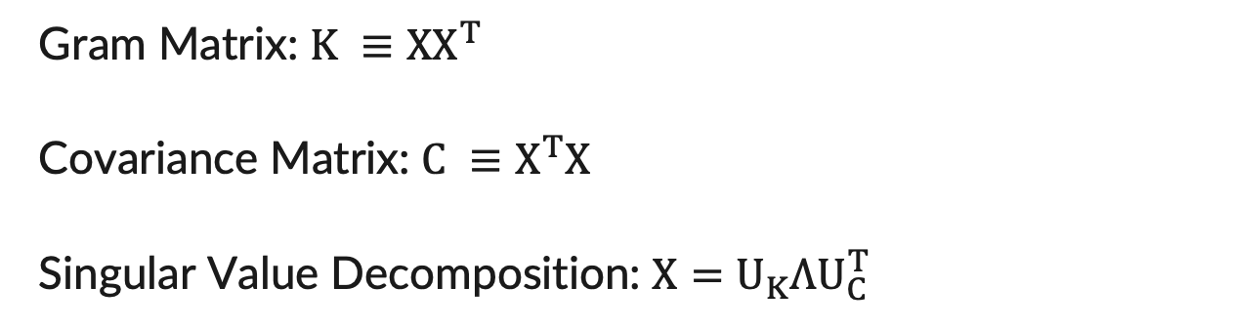
The projections determined via PCA are based on the eigendecomposition of the Gram matrix or covariance matrix, which is related to the singular value decomposition (SVD).
These “singular values” are the eigenvalues of our gram and covariance matrix (they share them)
We rank our eigenvectors by these values, as the singular values communicate the variance corresponding to each vector
Gram Matrix: $K ≡XX^{T}$
Covariance Matrix: $C ≡X^{T}X$
Singular Value Decomposition: $X=U_{K}ΛU_{C}^{T}$

Slide 11
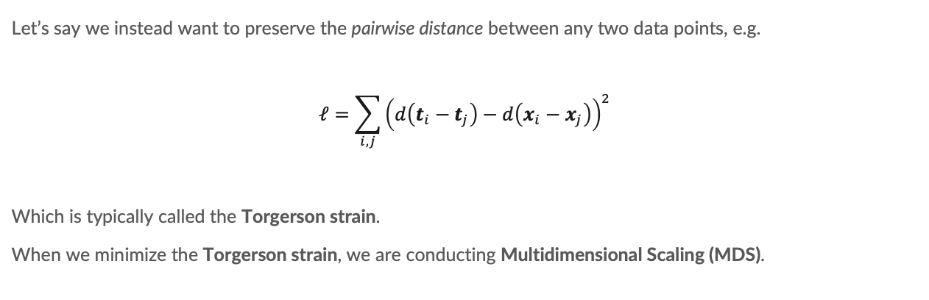
Sometimes, we care less about reconstructing the data itself, and more about reconstructing the relationship between data points.
Let’s say we instead want to preserve the pairwise distance between any two data points, e.g.
$$ℓ=\sum_{i,j}{{\left(d\left(t_{i}−t_{j}\right)−d\left(x_{i}−x_{j}\right)\right)}^{2}}$$
Which is typically called the Torgerson strain.
When we minimize the Torgerson strain, we are conducting Multidimensional Scaling (MDS).
Notes:
I will write on these slides

Slide 12
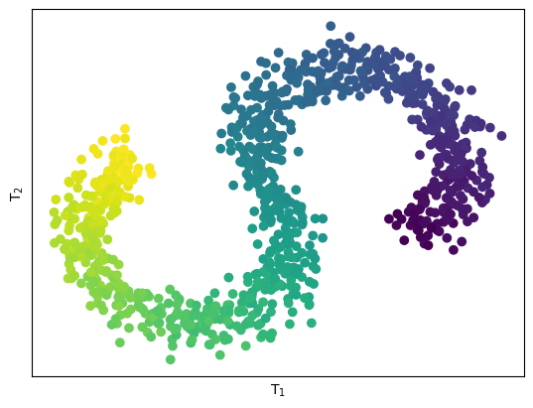
Formulating our Torgerson strain in terms of the Euclidean distance, i.e. doing Classical MDS, yields the similar projection to PCA.

Slide 13
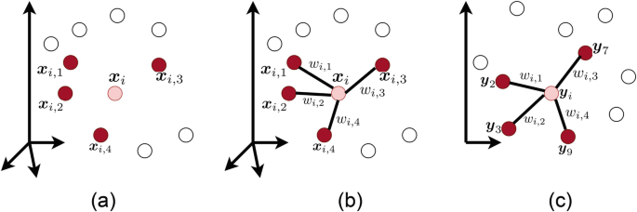
Locally-linear embeddings and isomap are two variations on MDS.
In LLE, we add weights to our distances based upon how “important” it is that we reconstruct them.
https://link.springer.com/chapter/10.1007/978-3-031-10602-6_8

Slide 14
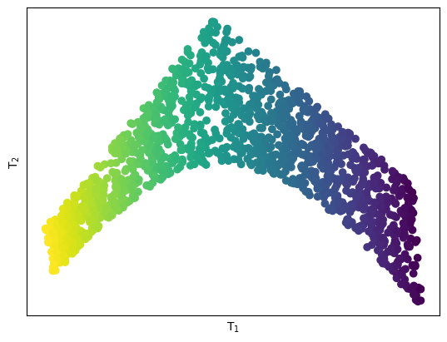
Locally-linear embeddings and isomap are two variations on MDS.
In LLE, we add weights to our distances based upon how “important” it is that we reconstruct them.

Slide 15
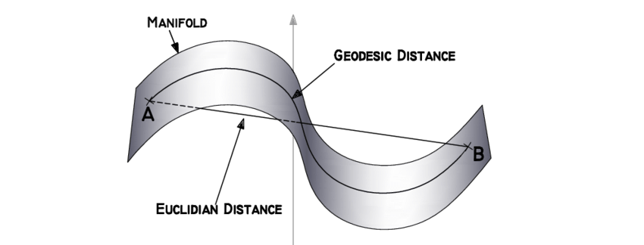
Locally-linear embeddings and isomap are two variations on MDS.
In isomap, we replace the Euclidean distance by a geodesic distance determined by a weighted graph of all samples.
https://www.researchgate.net/publication/323178329_Graph_embedding_for_speaker_recognition

Slide 16
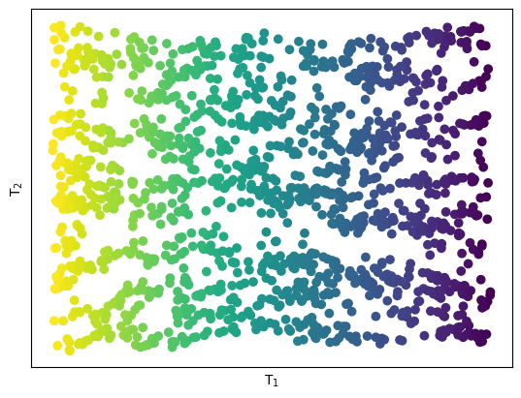
Locally-linear embeddings and isomap are two variations on MDS.
In isomap, we replace the Euclidean distance by a geodesic distance determined by a weighted graph of all samples.

Slide 17
“Neighbors” have some nuance for chemical systems.
Locally-determined DR techniques (e.g. LLE and isomap, but later t-SNE) require that we define a number of “neighbors” for each data point.
For non-chemical data, this can be some distance-based cutoff.
For atoms and molecules, this may change atom-to-atom and molecule-to-molecule.

Slide 18
What is a manifold?
A manifold is the topological space in which we’re living.
I find the easiest way to think about it is “some surface in a higher-dimensional space that, if only we could see in that many dimensions.”

Slide 19
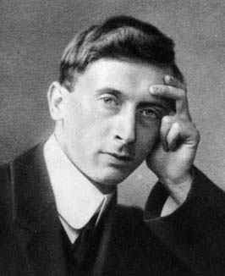
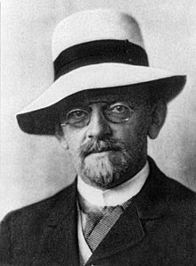
Whenever we stray from Euclidean distances and linear embeddings, we are in a class of non-linear dimensionality reduction techniques.
But! For certain distance measures (here conceptually synonymous with similarity measures), we can take advantage of the workings of James Mercer and David Hilbert.

Slide 20
Mercer and Hilbert’s work were able to show that many similarity functions yielded matrices that were mathematically analogous to the dot product of some potentially infinite and unknowable set of features.
Similarity function:
Euclidean distance
Similarity(x_i, x_j) = sqrt(x_i - x_j)
This is what we did in MDS, where we yielded that preserving these distances was tantamount to preserving the dot product of X
Euclidean similarity is analogous to the dot product of our original features.

Slide 21
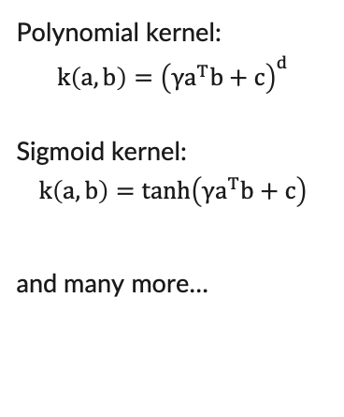

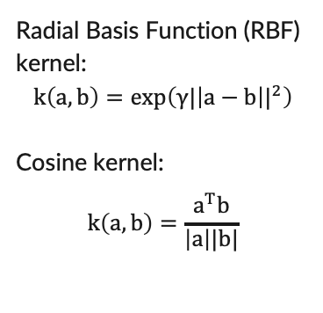
But, for which similarity functions is this true?
Any similarity function which yields a positive-definite kernel.
Radial Basis Function (RBF) kernel:
$$k\left(a,b\right)=\exp\left(γ{|\left|a−b\right||}^{2}\right)$$
Cosine kernel:
$$k\left(a,b\right)=\frac{a^{T}b}{\left|a\right||b|}$$
Polynomial kernel:
$$k\left(a,b\right)={\left({γa}^{T}b+c\right)}^{d}$$
Sigmoid kernel:
$$k\left(a,b\right)=tanh\left({γa}^{T}b+c\right)$$
and many more…
$$\sum_{i=1}^{n}{\sum_{j=1}^{n}{k\left(x_{i}, x_{j}\right)c_{i}c_{j}≥0}}$$
Additional resources:
Mercer’s Theorem
Reproducing Kernel Hilbert Spaces
https://www.youtube.com/watch?v=Q7vT0--5VII&pp=ygUQdGhlIGtlcm5lbCB0cmljaw%3D%3D

Slide 22
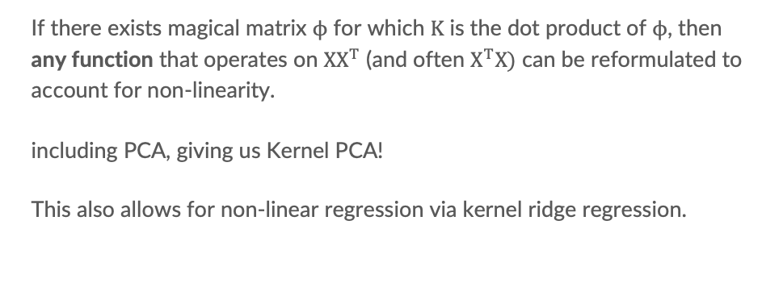
So, why does this matter?
I’m glad you asked.
If there exists magical matrix $ϕ$ for which $K$ is the dot product of $ϕ$, then any function that operates on $XX^{T}$ (and often $X^{T}X)$ can be reformulated to account for non-linearity.
including PCA, giving us Kernel PCA!
This also allows for non-linear regression via kernel ridge regression.

Slide 23
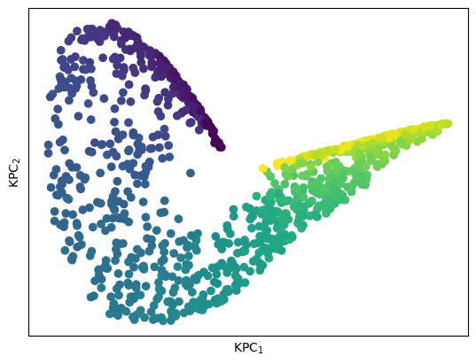
So, why does this matter?
I’m glad you asked.

Slide 24
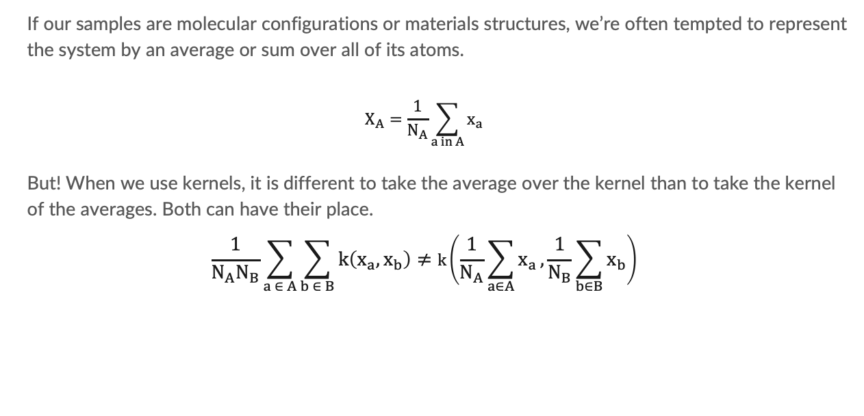
Kernels have some nuance for chemical systems.
If our samples are molecular configurations or materials structures, we’re often tempted to represent the system by an average or sum over all of its atoms.
$$X_{A}=\frac{1}{N_{A}}\sum_{a in A}{x_{a}}$$
But! When we use kernels, it is different to take the average over the kernel than to take the kernel of the averages. Both can have their place.
$$\frac{1}{N_{A}N_{B}}\sum_{a ∈ A}{\sum_{b ∈ B}{k\left(x_{a}, x_{b}\right)}}≠k\left(\frac{1}{N_{A}}\sum_{a∈A}{x_{a}},\frac{1}{N_{B}}\sum_{b∈B}{x_{b}}\right)$$

Slide 25

We can skip a lot of this ugliness when our samples have analogous or comparable atoms.
Comparing molecules and solids across structural and alchemical space

