Slide 1
Day 3, Session 2:
Dimensionality reduction with other intentions

Slide 2
Some notes on notation… (see notation guide)

Slide 3
Dimensionality reduction (DR) describes a set of of methods that convert highly-dimensional data into a more interpretably or information-rich format.

Slide 4
Generally, there are two major classes of DR: data compression and visualization/interpretation.
In data compression, we aim to construct a smaller feature space (e.g. set of columns) that contains as much information as our initial data space (Session 1)
In visualization/interpretation, we aim to identify trends in our data that help our visual or conceptual understanding (Session 2)

Slide 5
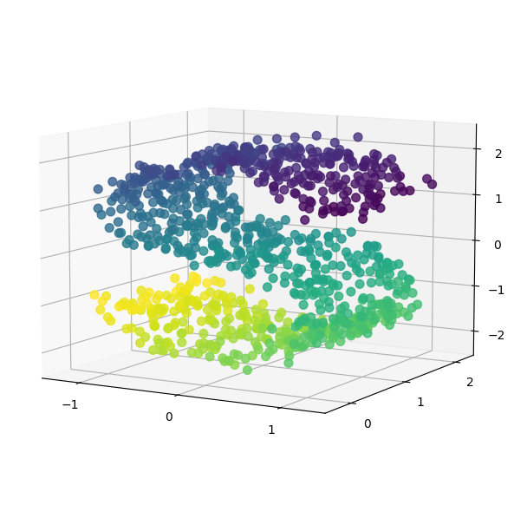
Let’s say we want to take a matrix X
… and determine local patterns in the data we can do this by identifying where points are most likely to be by using the probability density.

Slide 6
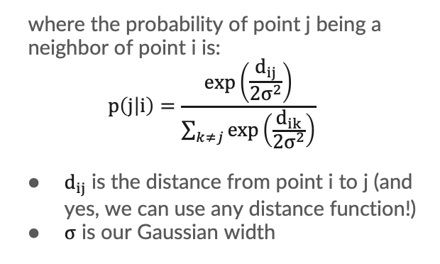
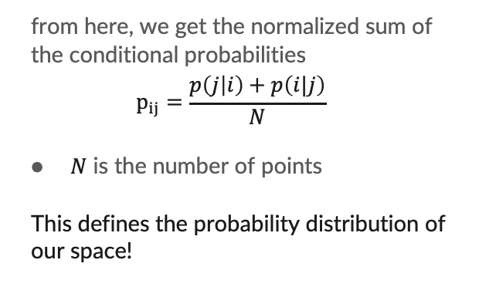
We first simplify things by assuming an underlying Gaussian distribution of our points.
where the probability of point j being a neighbor of point i is: $$p\left(j | i\right)=\frac{exp\left(\frac{d_{ij}}{2σ^{2}}\right)}{\sum_{k≠j}{exp\left(\frac{d_{ik}}{2σ^{2}}\right)}}$$
$d_{ij}$ is the distance from point i to j (and yes, we can use any distance function!)
$σ$ is our Gaussian width
from here, we get the normalized sum of the conditional probabilities $$p_{ij}=\frac{p\left(j | i\right)+p\left(i|j\right)}{N}$$
$N$ is the number of points
This defines the probability distribution of our space!
Notes:
I will write on these slides

Slide 7
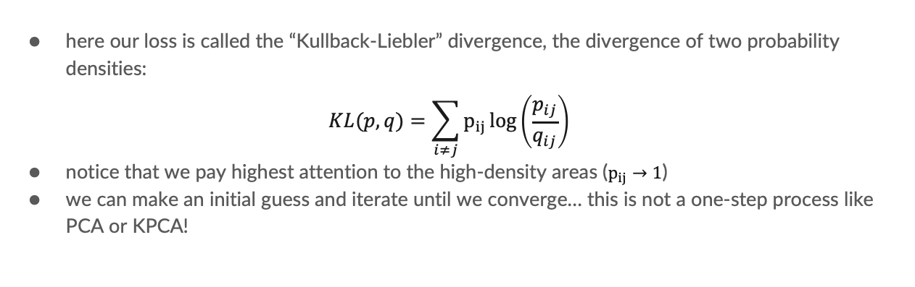
Now we have a “clear” task – determine a lower-dimensional space that has the same probability density as our original space.
here our loss is called the “Kullback-Liebler” divergence, the divergence of two probability densities:
$$KL(p, q)=\sum_{i≠j}{p_{ij}\log\left(\frac{p_{ij}}{q_{ij}}\right)}$$
notice that we pay highest attention to the high-density areas ($p_{ij}→1$)
we can make an initial guess and iterate until we converge… this is not a one-step process like PCA or KPCA!

Slide 8
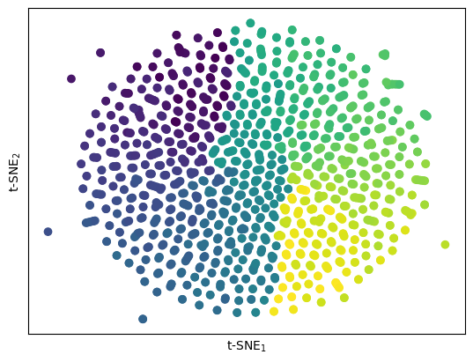
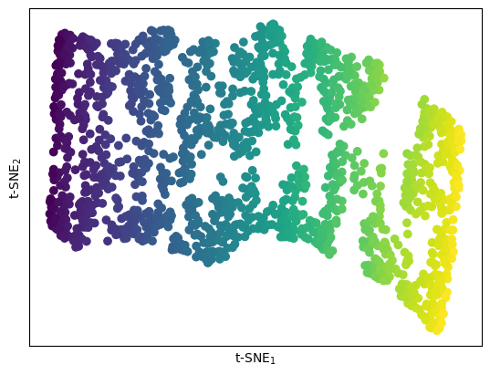
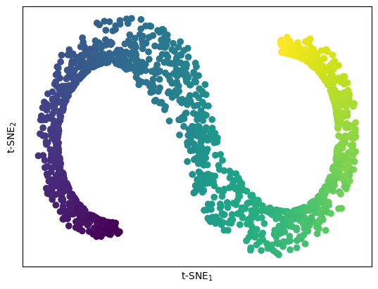
This is call t-stochastic neighbor embedding, or t-SNE!
perplexity=1
perplexity=50
perplexity=1000

Slide 9
The cautionary tales of t-SNE…
Like any ”open-form” method, t-SNE is computed using optimization methods, so it can get caught in local minima, preventing it reaching “global” minimization of the KL divergence
t-SNE can vary wildly based upon the initialization of our new probability distribution (q) or on the attention that we give local versus global similarity (you would control this using the oft-discussed “perplexity” value)
t-SNE is not recommended on low-dimensional datasets, where the probability distribution is less-likely to be normal
t-SNE is very good at finding islands in your data! But to get there, it must distort distances, so the size of these islands and their separation have limited physical meaning

Slide 10
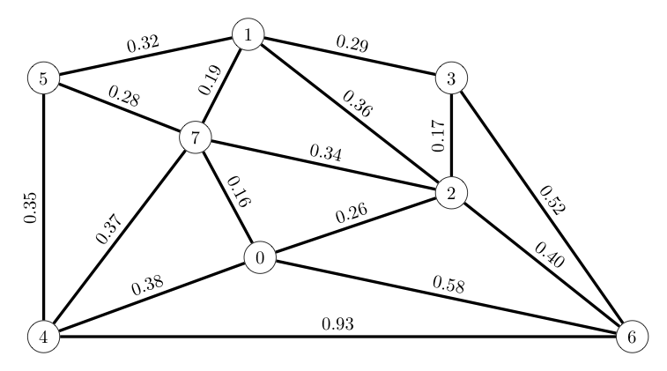
Uniform Manifold Approximation and Projection (UMAP) achieves similar goals, but leverages topological mathematics to do so more efficiently.
We extend a radius from every point
Any two points with overlapping radii are considered neighbors, and every point is enforced to have a minimum number of neighbors
We weight these neighbors by how far they are away – further neighbors count less as neighbors
Our lower dimensional embedding is that which preserves this graph structure best!

Slide 11
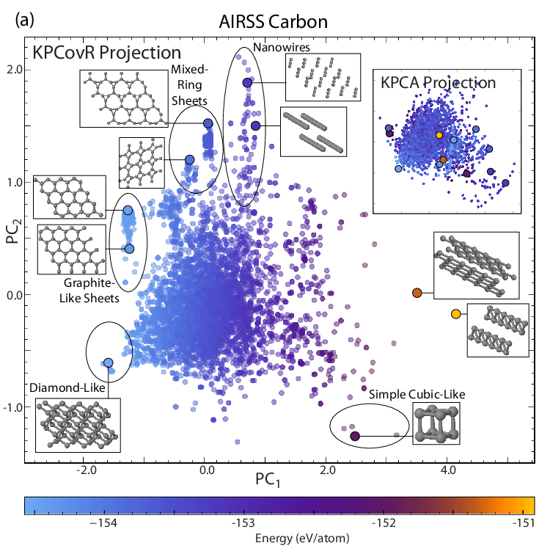


Other topics in dimensionality reduction
(Kernel) Principal Covariates Regression – determining a matrix that balances data reconstruction with property regression – can be used to make QSPR maps for undestanding structure-property relationships
MLST 1 045201
ORE 15789.1

Slide 12

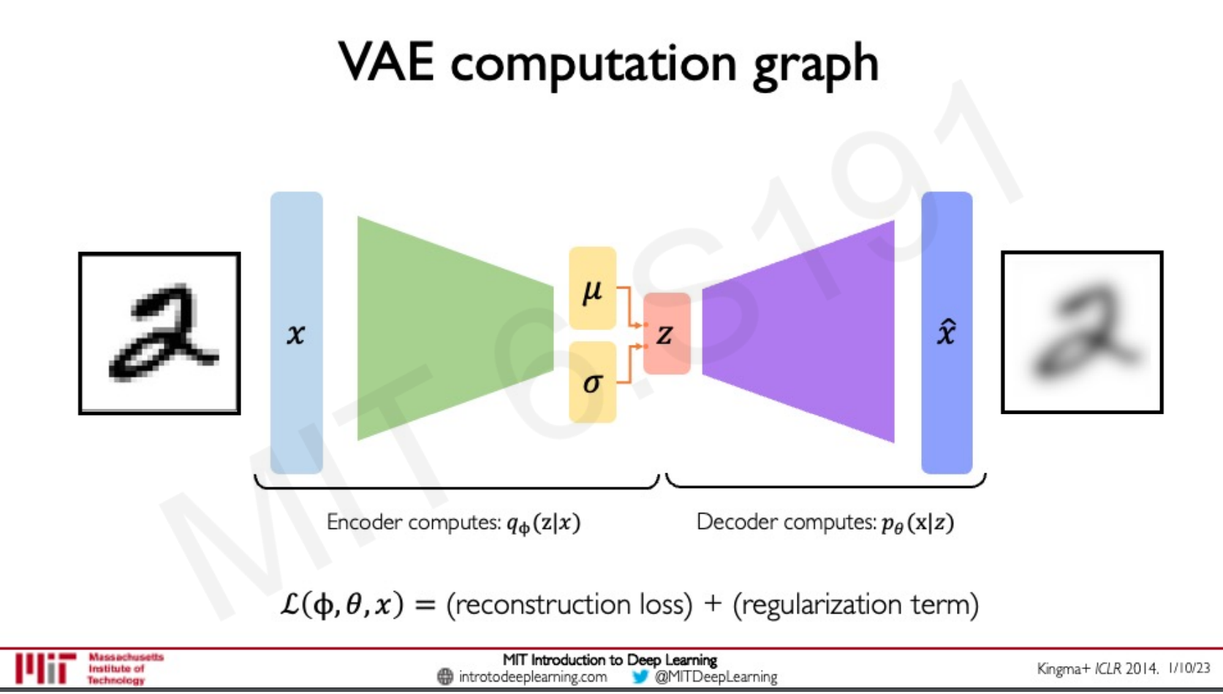
Other topics in dimensionality reduction
Auto-Encoding Variational Bayes
Variational Autoencoders – multi-layer models that “encode” our data into a latent space assuming “priors” about our distribution to sample it, then “decodes” data via backpropagation (more on this tomorrow)
http://introtodeeplearning.com/slides/6S191_MIT_DeepLearning_L4.pdf

