Slide 1
Dimensionality Reduction - PCA
Shuwen Yue
i-CoMSE ML for Molecular Sciences

Slide 2
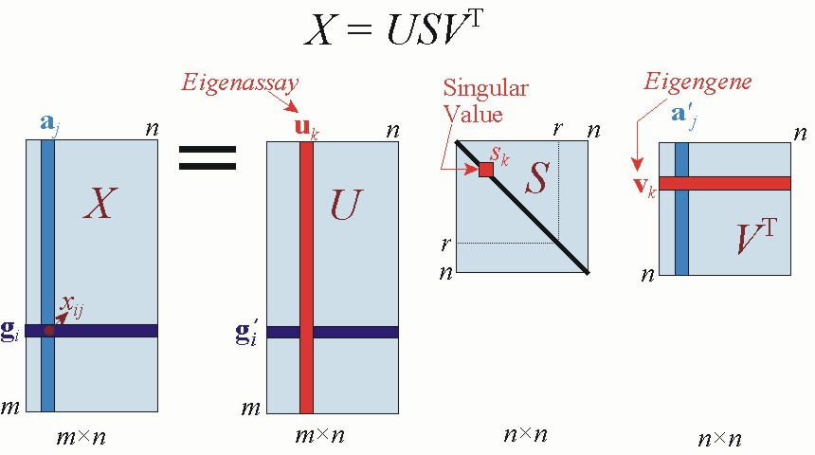
Principle Component Analysis (PCA)
PCA transforms data linearly into new properties that are not correlated with each other
Based on Single Value Decomposition (SVD)
https://jonathan-hui.medium.com/machine-learning-singular-value-decomposition-svd-principal-component-analysis-pca-1d45e885e491

Slide 3
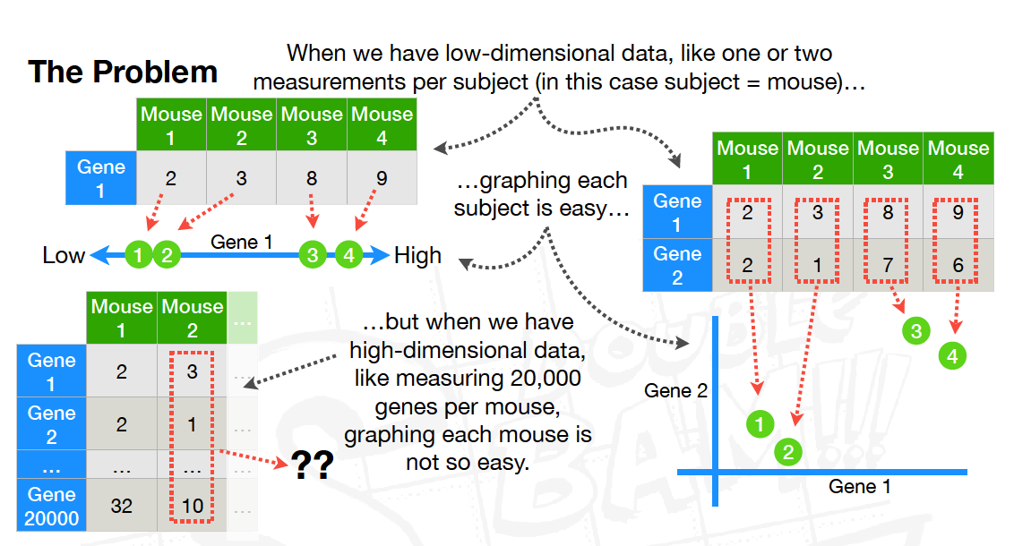
https://www.youtube.com/watch?v=FgakZw6K1QQ

Slide 4
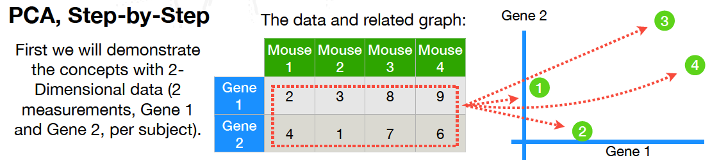
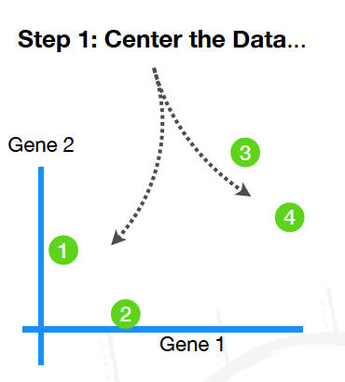
https://www.youtube.com/watch?v=FgakZw6K1QQ

Slide 5
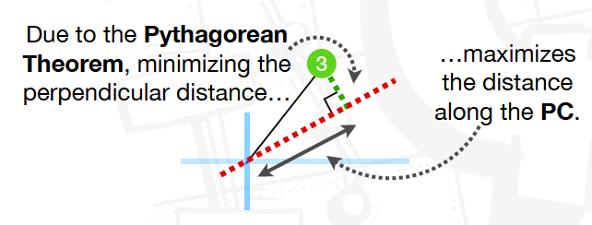
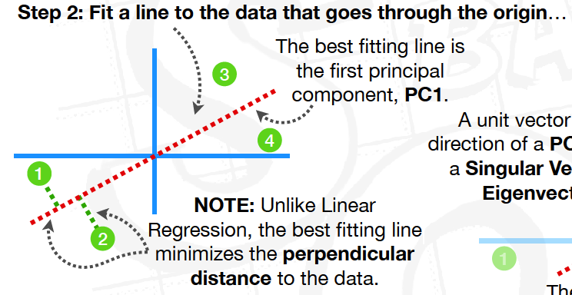
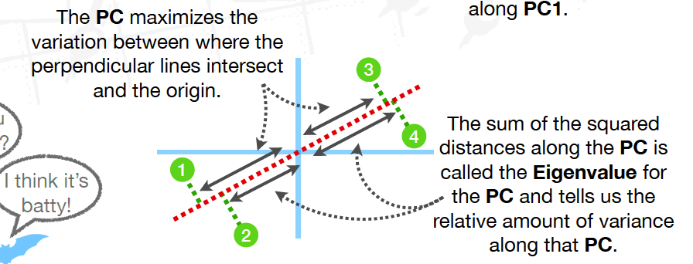
https://www.youtube.com/watch?v=FgakZw6K1QQ

Slide 6
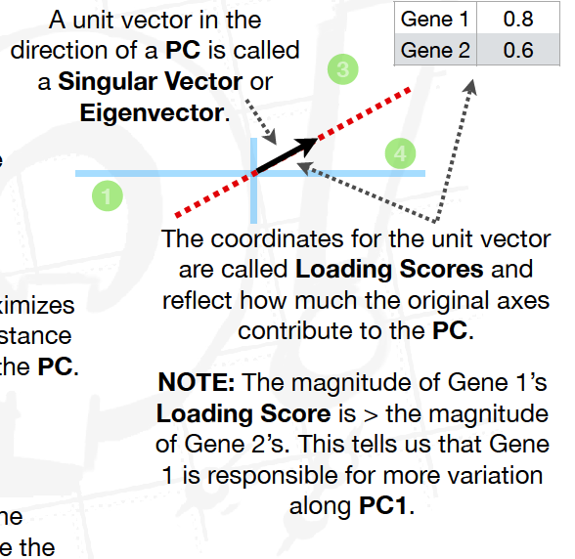
https://www.youtube.com/watch?v=FgakZw6K1QQ

Slide 7
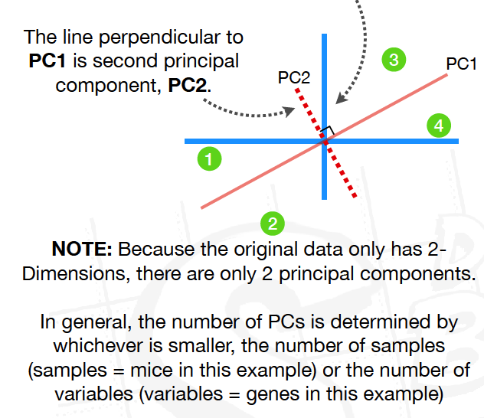
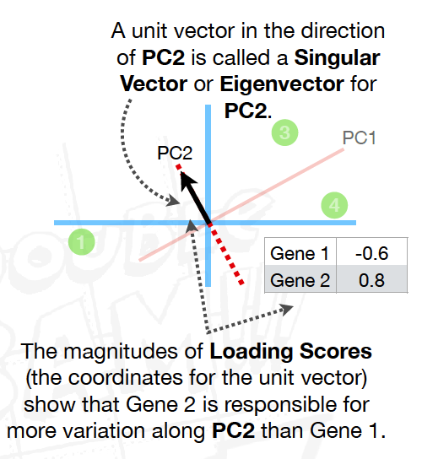
https://www.youtube.com/watch?v=FgakZw6K1QQ

Slide 8
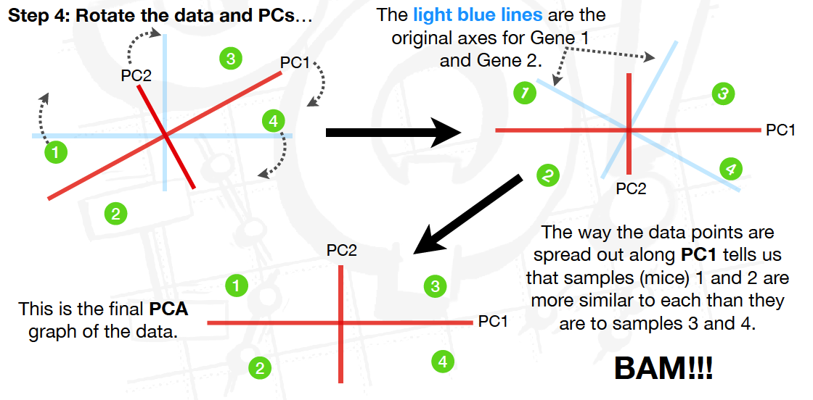
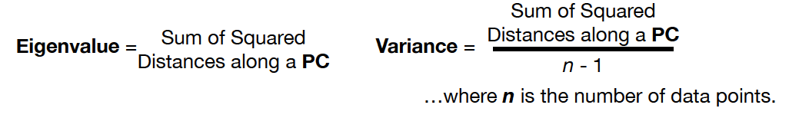
https://www.youtube.com/watch?v=FgakZw6K1QQ

Slide 9
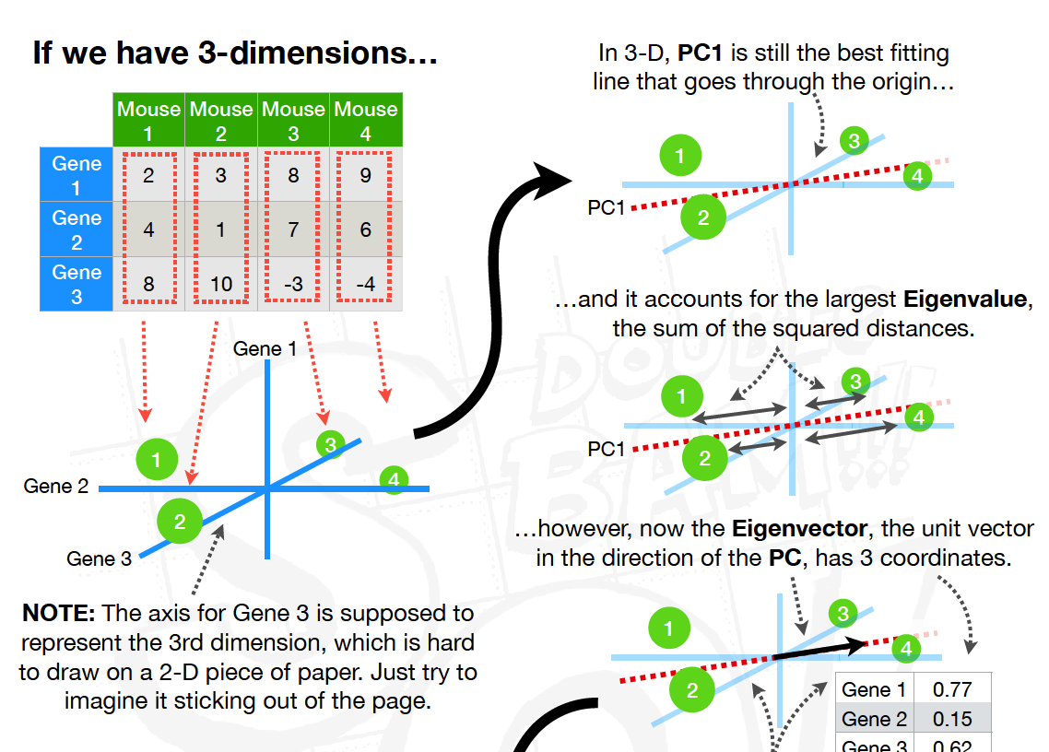
https://www.youtube.com/watch?v=FgakZw6K1QQ

Slide 10
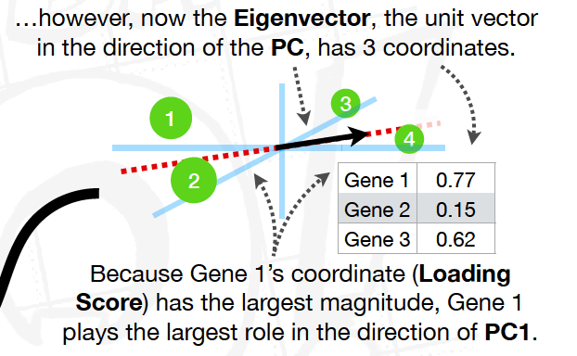
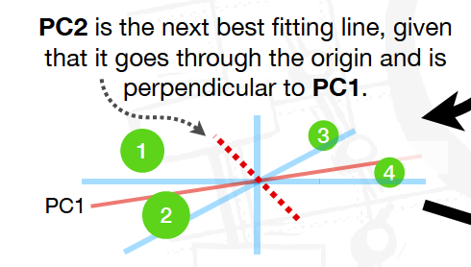
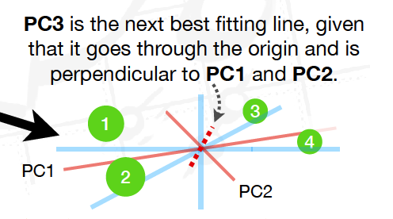
https://www.youtube.com/watch?v=FgakZw6K1QQ

Slide 11
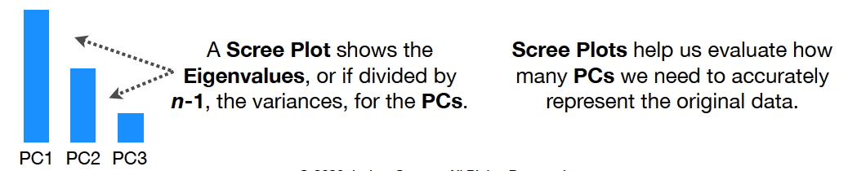
https://www.youtube.com/watch?v=FgakZw6K1QQ

Slide 12
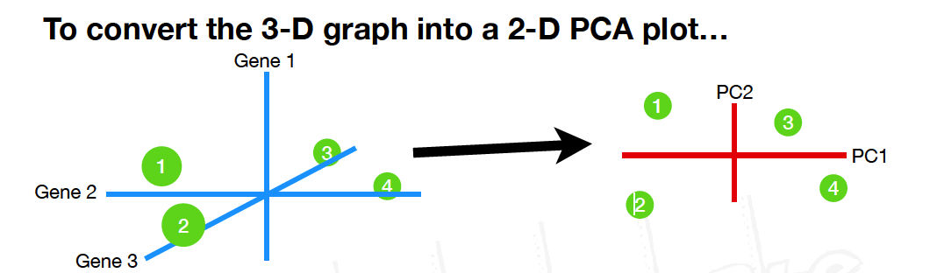
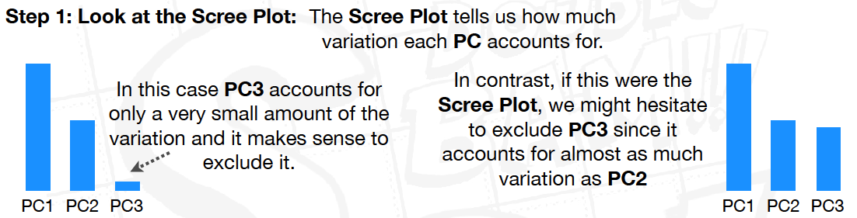
https://www.youtube.com/watch?v=FgakZw6K1QQ

Slide 13
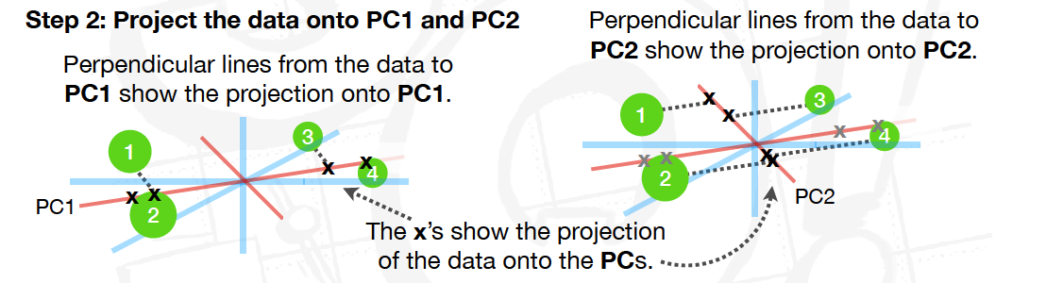
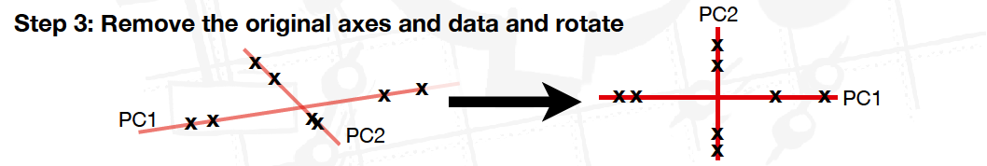
https://www.youtube.com/watch?v=FgakZw6K1QQ

Slide 14
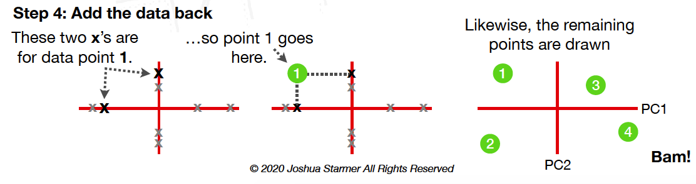
https://www.youtube.com/watch?v=FgakZw6K1QQ

Slide 15
Google Collab notebook on PCA

