Slide 1
Dimensionality Reduction - PCA
Shuwen Yue
i-CoMSE ML for Molecular Sciences

Slide 2
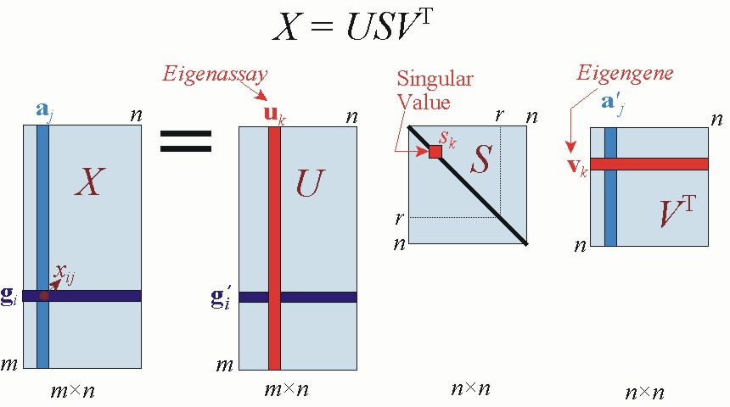
Principle Component Analysis (PCA)
PCA transforms data linearly into new properties that are not correlated with each other
Based on Single Value Decomposition (SVD)
https://jonathan-hui.medium.com/machine-learning-singular-value-decomposition-svd-principal-component-analysis-pca-1d45e885e491

Slide 3
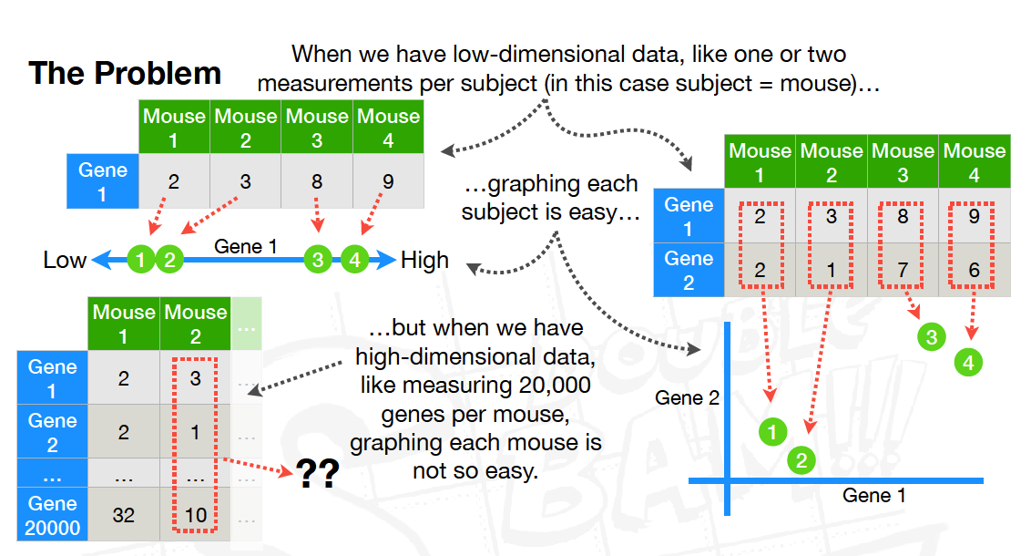

Slide 4

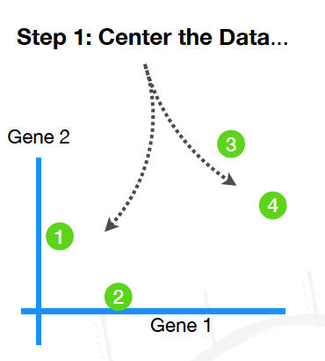

Slide 5
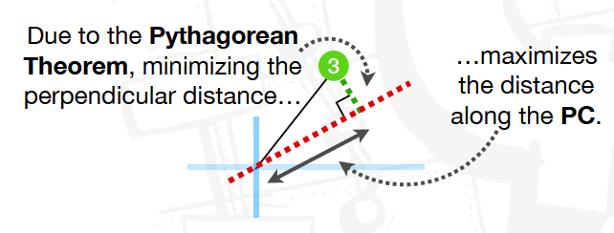
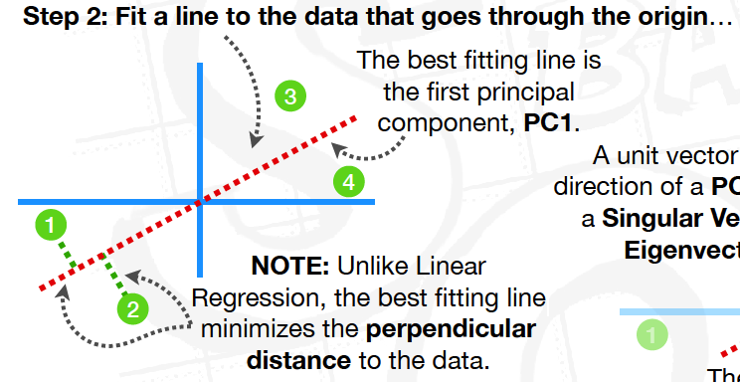
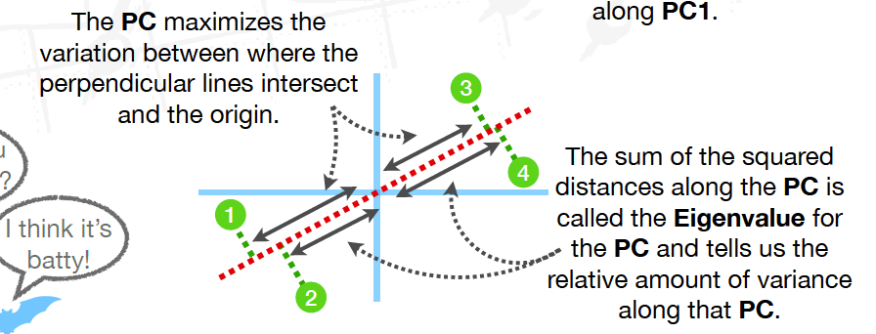

Slide 6
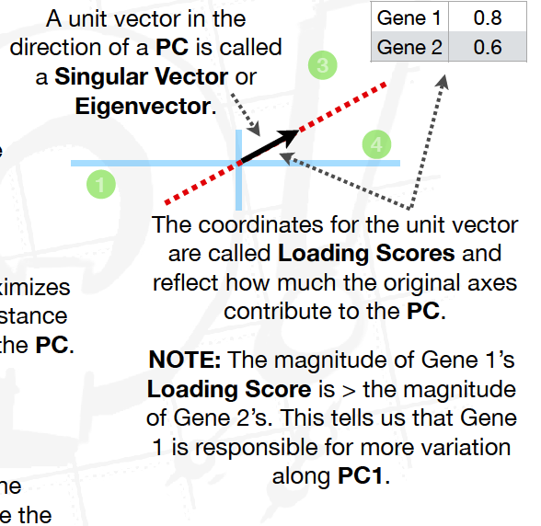

Slide 7
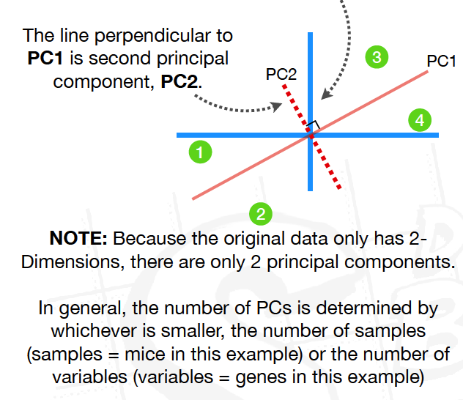
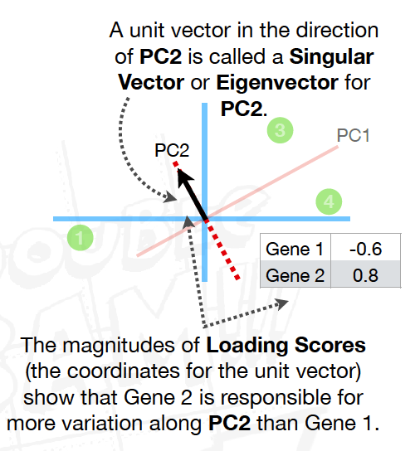

Slide 8
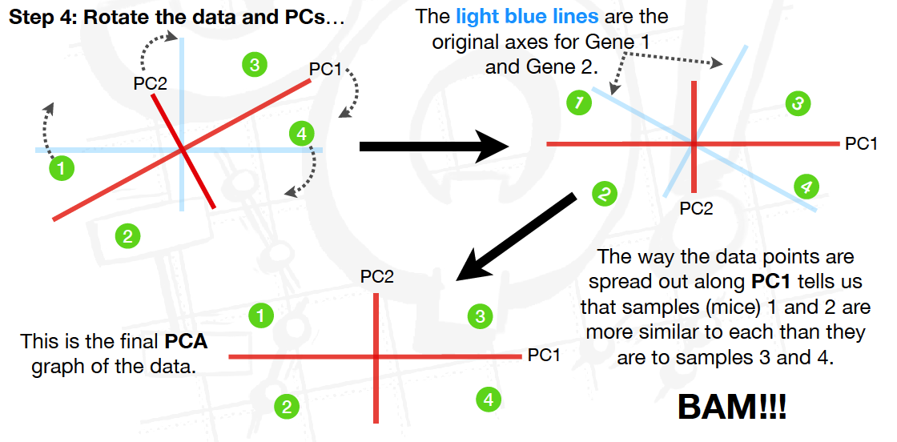


Slide 9
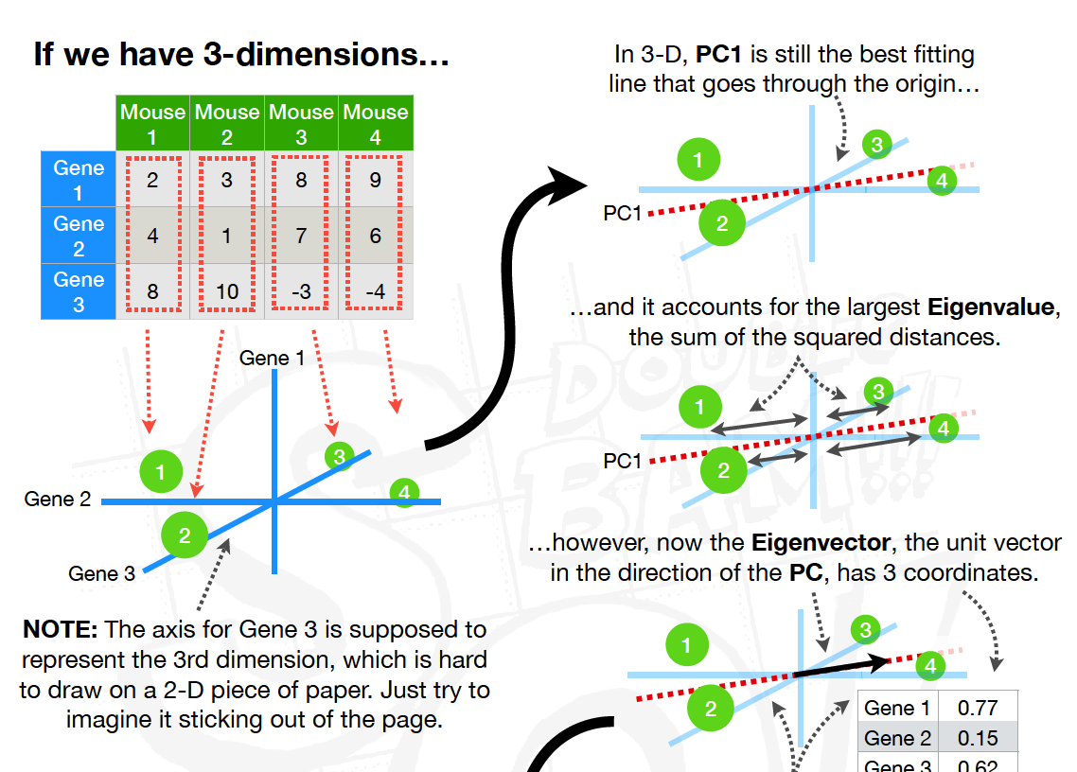

Slide 10
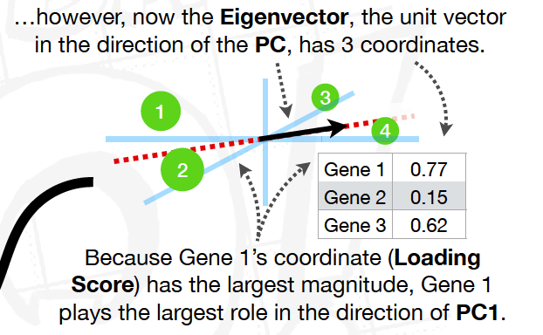
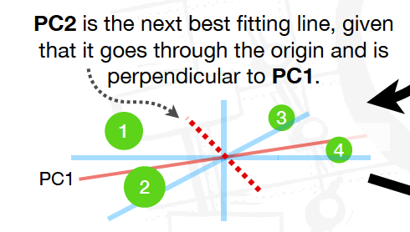
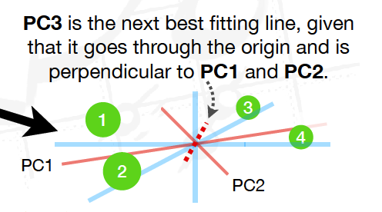

Slide 11


Slide 12

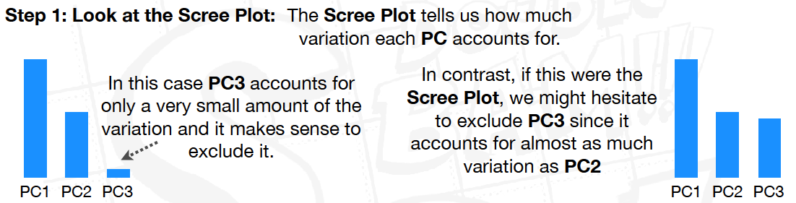

Slide 13



Slide 14


Slide 15
Google Collab notebook on PCA

