Slide 1
Fragment-Based Sampling Approach
Jindal K. Shah
Associate Professor
Oklahoma State University
i-CoMSE 2022 MD-MC Summer School
1

Slide 2
Sampling Intramolecular DOFs
In order to change the internal degrees of freedom of an articulated molecule, Cassandra carries out a fragment-based simulation approach. We will outline here the process. For more details, refer to the following paper
2

Slide 3
Definition of a Fragment
A single branch point – an atom bonded to two more more atoms
For cyclic moieties, all the atoms in the rings and those connected to the ring atoms are considered part of a fragment
3

Slide 4
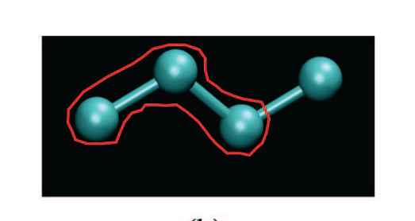
Example: UA Model of Butane
The molecule is composed of two fragments:
CH₃-CH₂-CH₂ and CH₂-CH₂-CH₃
Although there are two fragments, they are identical
Note that the two fragments share a common bond
CH₂-CH₂
4

Slide 5
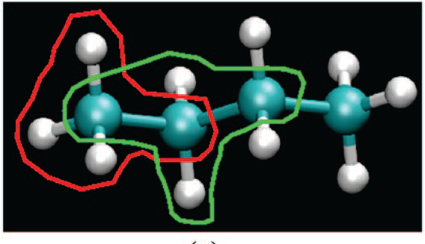
Example: AA Model of Butane
The molecule is composed of four fragments:
CH₃-C-; -C-CH₂-C; -C-CH₂-C; -C-CH₃
Although there are four fragments, there are only two unique fragments
5

Slide 6
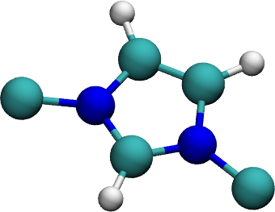
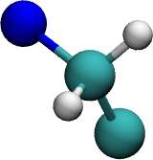
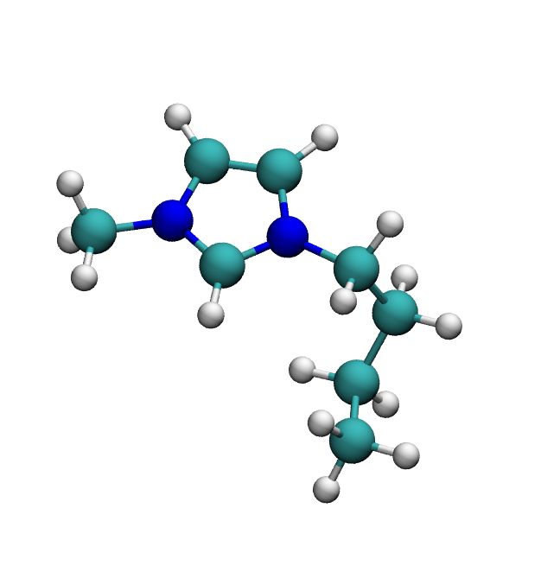
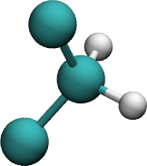
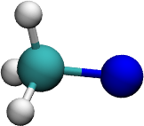
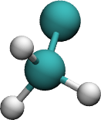
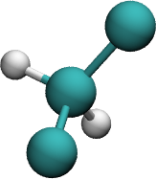
Example: An Ionic Liquid Cation
Shah and Maginn, J. Chem. Phys., 135, 134121 (2011),
Macedonia and Maginn, Mol. Phys., 96, 1375 (1999)
6

Slide 7
Example: An Ionic Liquid Cation
Shah and Maginn, J. Chem. Phys., 135, 134121 (2011),
Macedonia and Maginn, Mol. Phys., 96, 1375 (1999)
7

Slide 8
Basic Idea
Decompose a molecule into its fragments
Identify unique fragments
Sample intramolecular degrees of freedom for each of the fragments in the gas phase to generate library of conformations
Reassemble the molecules using conformations from these libraries
8

Slide 9
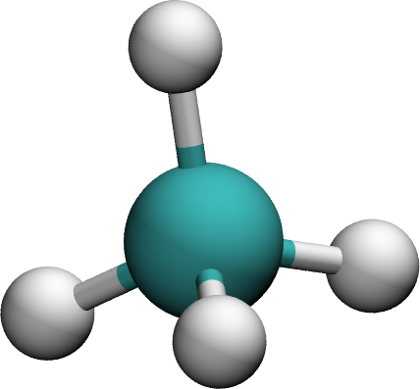
Spherical Sampling for non-cyclic Fragments
z
1
y
4
2
3
x
Change the angles ψ and Φ to generate a large number
of conformations for use in simulations
Shah and Maginn, J. Chem. Phys., 135, 134121 (2011)
9

Slide 10
Sampling of Cyclic Fragments
Crank-shaft move
Atom-displacement move
Shah and Maginn, J. Chem. Phys., 135, 134121 (2011)
10

Slide 11
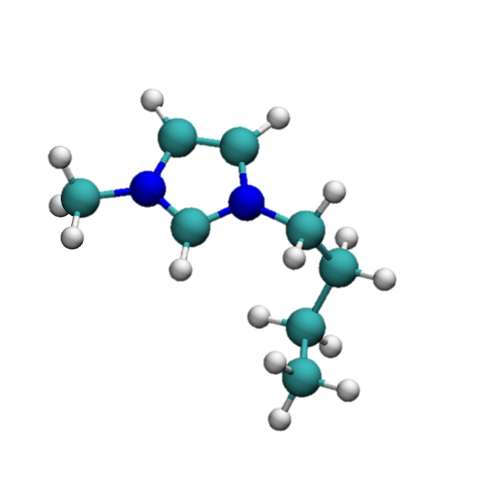
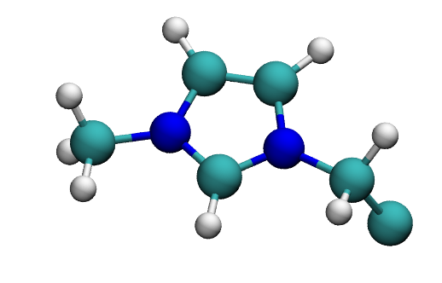
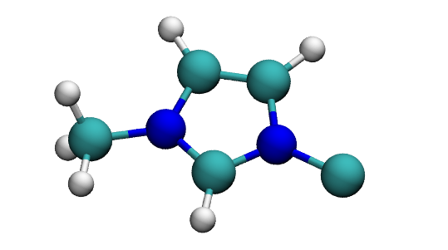
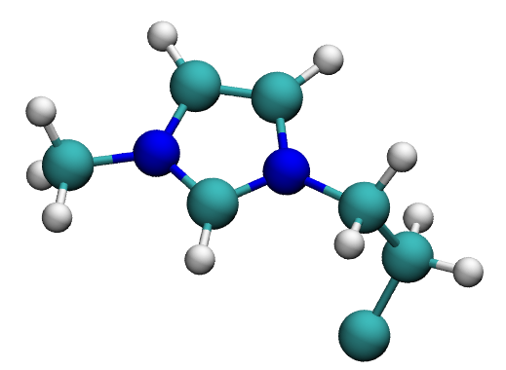
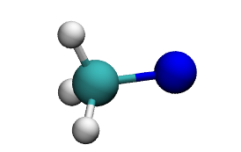
Reassembling an Ionic Liquid Cation
11

