Slide 1
Grand Canonical Monte Carlo
Jindal K. Shah
Associate Professor
Oklahoma State University
i-CoMSE 2022 MD-MC Summer School
1

Slide 2
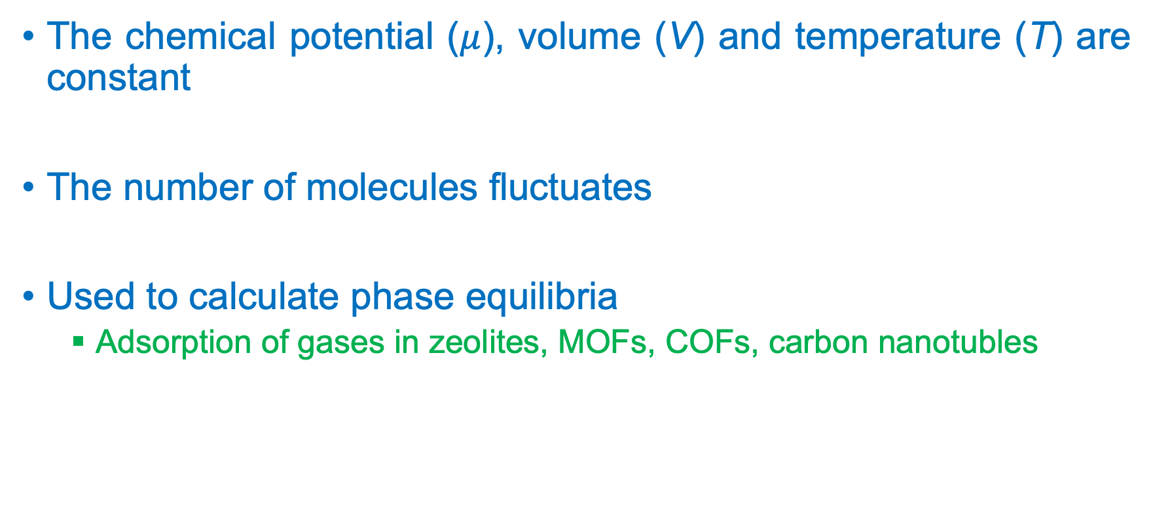
Basic Idea
The chemical potential ($μ$), volume (V) and temperature (T) are constant
The number of molecules fluctuates
Used to calculate phase equilibria
Adsorption of gases in zeolites, MOFs, COFs, carbon nanotubles
2

Slide 3
GCMC probability distribution
3

Slide 4
Monte Carlo Steps
Thermal moves
Translation
Rotation
Conformational moves via fragment sampling
Insertion/deletion moves
Chemical equilibrium

Slide 5
Outputs
Average number of molecules
Average density
Pressure
Equation of state
Temperature is imposed
Density and pressure are obtained

Slide 6
Open Q&A! Write at least one question on the index card that you would like answered from all of us (Eric/Neeraj/Sapna/Jindal/Michael)! Questions can be any topic, we will answer if we can!

