Slide 1
Metropolis Monte Carlo
Jindal K. Shah
Oklahoma State University
2022 i-CoMSE MD-MC Summer School

Slide 2
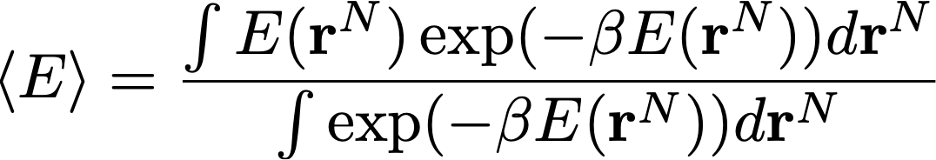
Averaging Properties
One of the primary goals of any molecular simulation techniques is to compute thermophysical and phase-equilibria properties.
From MD simulations, we take the time average of instantaneous properties, while in Monte Carlo method, we will want to compute ensemble-averaged properties, e.g. the average configurational energy <E> is computed as

Slide 3
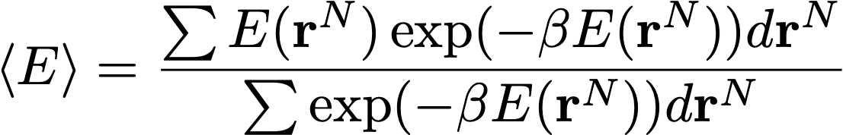
Averaging Properties
One way to do this is to calculate each of the integrals separately using a quadrature or Simpson’s rule.
What is the challenge?
The two integrals are of dimensions 3N where N is the number of particles.
For a 100-particle system, with 10 points along each of the dimensions, we need to evaluate 10^{3*100} = 10³⁰⁰ evaluations!

Slide 4
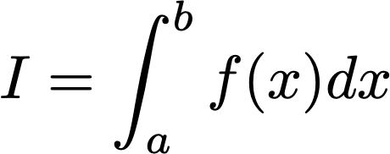
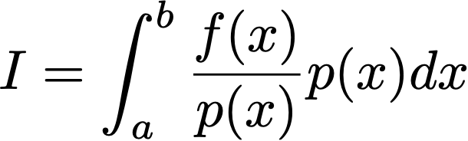

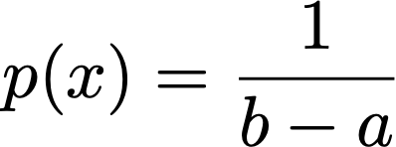

Is there another way?
Monte Carlo integration
a
b
Any probability distribution
Let’s choose uniform probability distribution

Slide 5

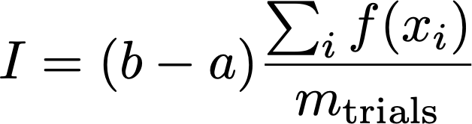
Monte Carlo Integration
Sample x uniformly between [a, b]
Let’s run an example to evaluate area under a curve

Slide 6
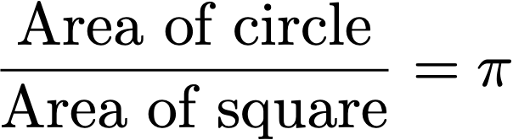
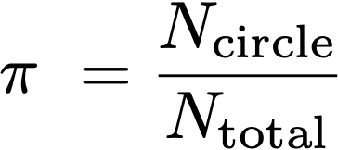

Canonical Example
Monte Carlo integration to compute $π$
L
L

Slide 7
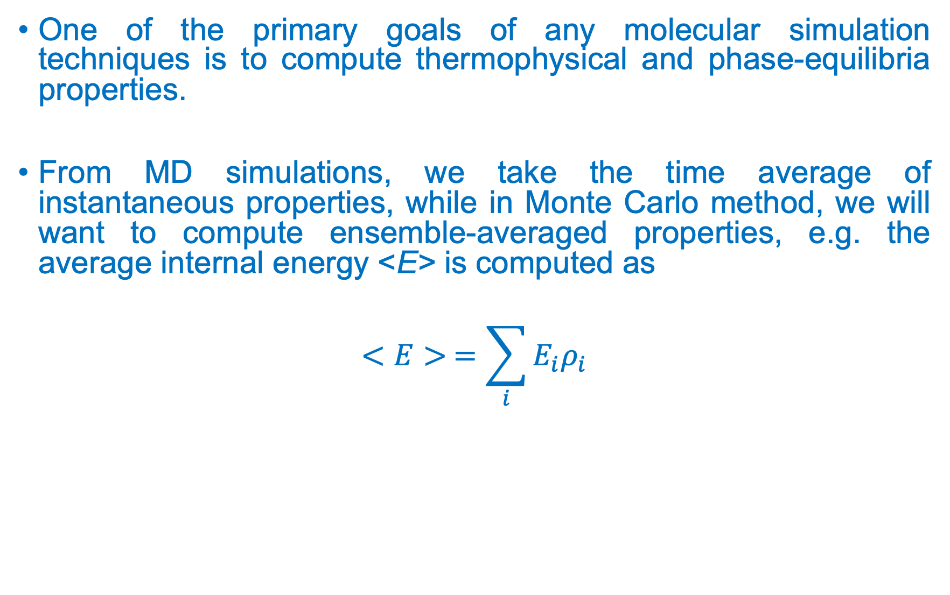
Averaging Properties
One of the primary goals of any molecular simulation techniques is to compute thermophysical and phase-equilibria properties.
From MD simulations, we take the time average of instantaneous properties, while in Monte Carlo method, we will want to compute ensemble-averaged properties, e.g. the average internal energy <E> is computed as
$$<E> =\sum_{i}{E_{i}ρ_{i}}$$
Probability density of the
Configuration
Configuration

Slide 8
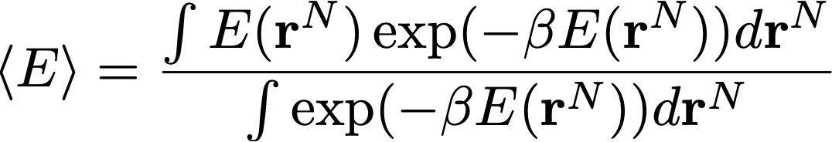
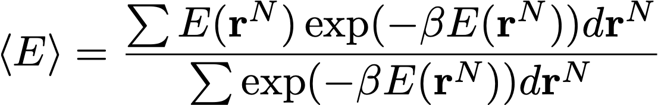
MC Integration for Averaging
Let’s say we want to calculate the average energy of a system in the canonical (constant N, V, T) ensemble
If we were to use Monte Carlo integration to compute the integrals, it would be

Slide 9
Possible Monte Carlo Alogrithm
One way we might to approximate the integrals is through random sampling
Randomly generate positions of N particles in the system
Compute energy E
Calculate the numerator and denominator
Repeat steps a-c until the convergence
The challenge is that, for an overwhelmingly large number of trials, two particles will overlap leading to the large positive energy with negligible Boltzmann weight
Poor convergence

Slide 10
Generating configurations in MC
Thus, we need an algorithm that samples the phase space that makes important contribution to the integral – importance sampling
We will use Metropolis Monte Carlo algorithm for moving from one configuration of the system to another – Stochastic in nature.
Metropolis, Rosenbluth, Rosenbluth, Teller & Teller, J. Chem. Phys. 21, 1087 (1953)

Slide 11

Ensemble Probability Distributions
To be able to compute averages, we need to generate configurations in Monte Carlo simulations that satisfy underlying probability distribution.

Slide 12
Markov Chain Monte Carlo
The Metropolis criterion is based on the concept of Markov Chain Monte Carlo, which satisfies the following two conditions:
The outcome of a trial (transition to a new configuration) depends only on the current state (configuration) of the system, i.e., the history of how the system arrived at the current state is unimportant
Given sufficient number of Monte Carlo trials, any state can be reached from any other state – ergodic hypothesis

Slide 13
Detailed Balance
For the derivation of the Metropolis criteria, we impose detailed balance such that the transition of the system from an old state m to a new state n is balanced by that from state n to m.
The detailed balance guarantees that underlying probability distribution is obtained once the system reaches equilibrium
Transition probabilities
Probabilities of configurations

Slide 14
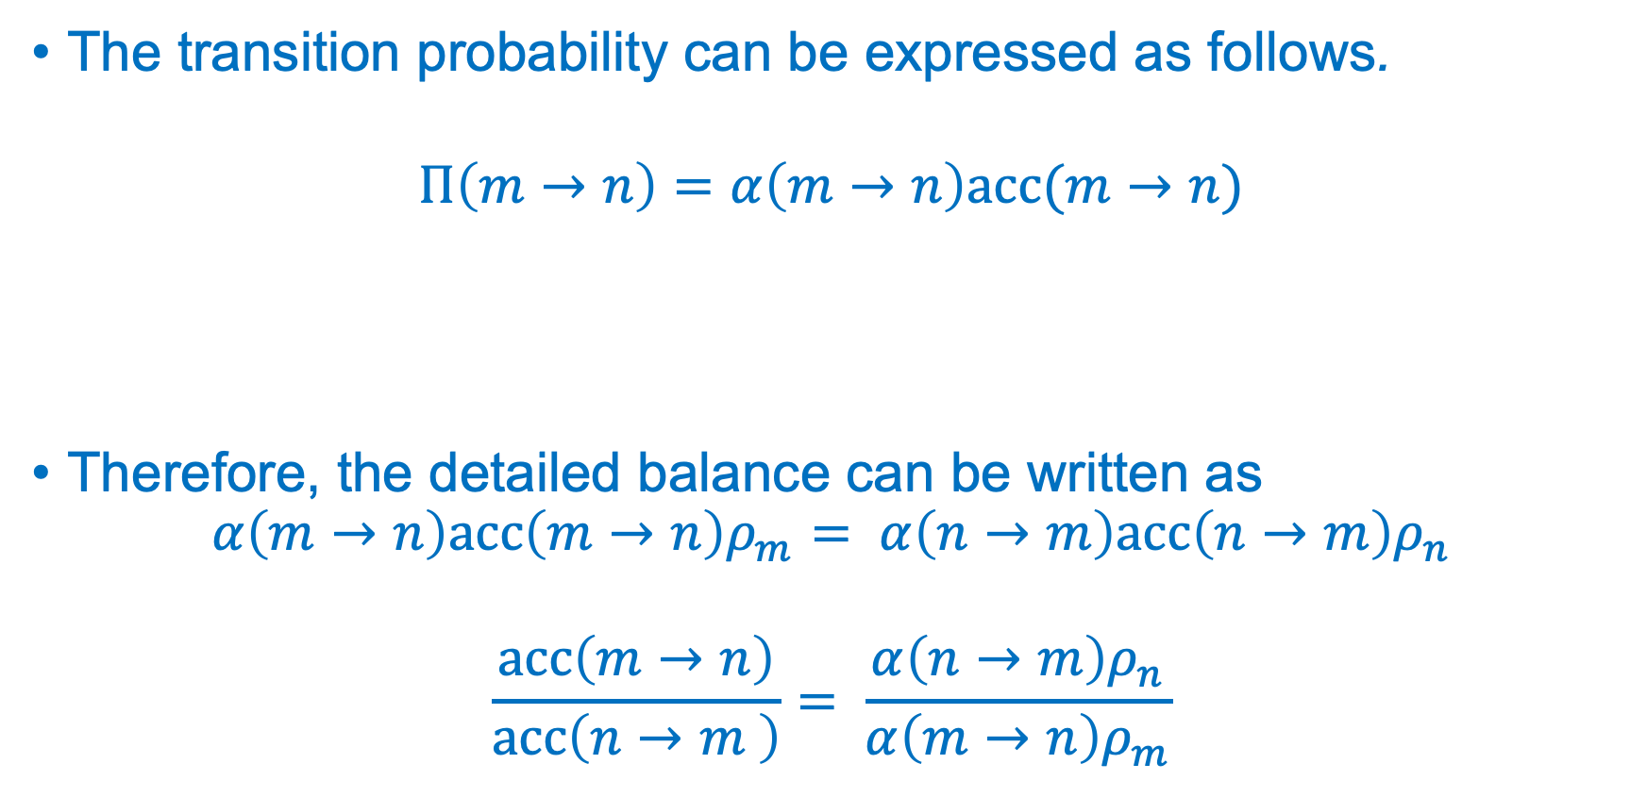
Detailed Balance Contd.
The transition probability can be expressed as follows.
$$Π\left(m→n\right)=α\left(m→n\right)acc(m→n)$$
Therefore, the detailed balance can be written as
$$α\left(m→n\right)acc\left(m→n\right)ρ_{m}= α\left(n→m\right)acc\left(n→m\right)ρ_{n}$$
$$\frac{acc\left(m→n\right)}{acc\left(n→m \right)}= \frac{α\left(n→m\right)ρ_{n}}{α\left(m→n\right)ρ_{m}}$$
Attempt probability
Acceptance probability

Slide 15
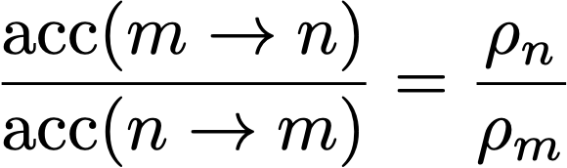
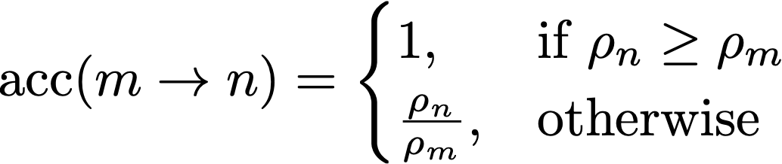
Metropolis Criteria
The attempt probabilities are usually symmetric
Therefore, the ratio of acceptance probabilities is
Metropolis criteria

Slide 16
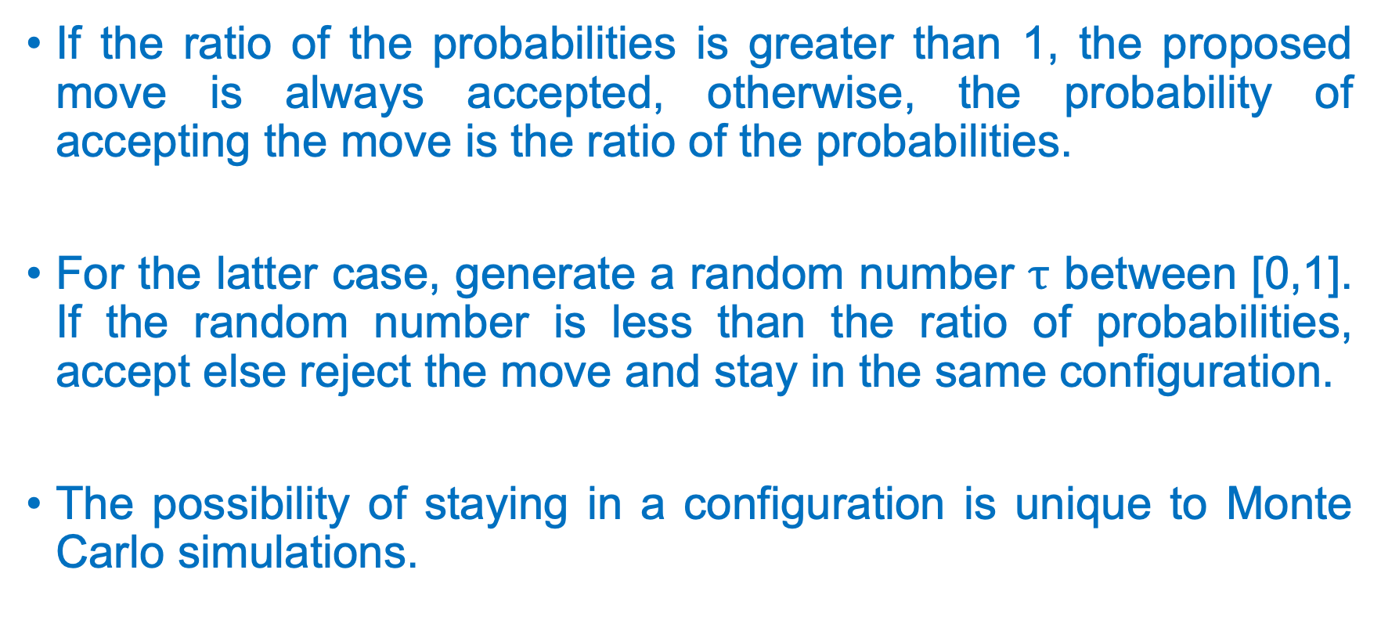
Metropolis Criteria
If the ratio of the probabilities is greater than 1, the proposed move is always accepted, otherwise, the probability of accepting the move is the ratio of the probabilities.
For the latter case, generate a random number $τ$ between [0,1]. If the random number is less than the ratio of probabilities, accept else reject the move and stay in the same configuration.
The possibility of staying in a configuration is unique to Monte Carlo simulations.

