Slide 1
Translation and Rotation Moves
Jindal K. Shah
Oklahoma State University
2022 i-CoMSE MD-MC Summer School

Slide 2

Ensemble Probability Distributions
To be able to compute averages, we need to generate configurations in Monte Carlo simulations that satisfy underlying probability distribution.

Slide 3
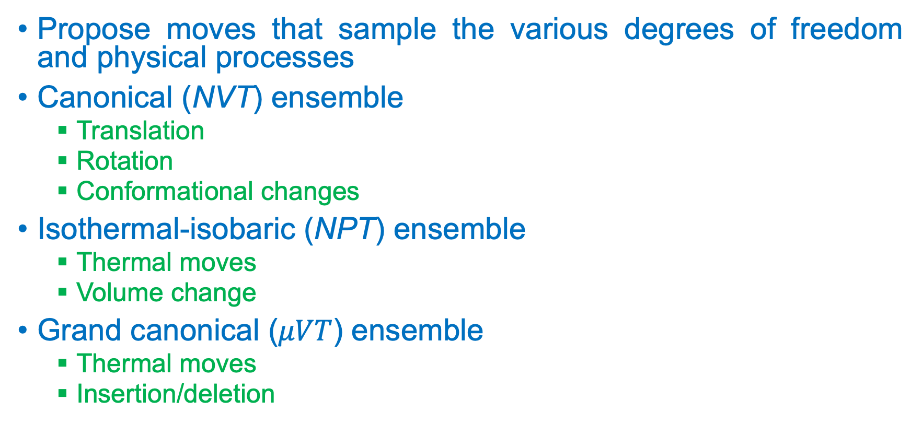
Generation of Probability Distributions
Propose moves that sample the various degrees of freedom and physical processes
Canonical (NVT) ensemble
Translation
Rotation
Conformational changes
Isothermal-isobaric (NPT) ensemble
Thermal moves
Volume change
Grand canonical ($μVT$) ensemble
Thermal moves
Insertion/deletion

Slide 4
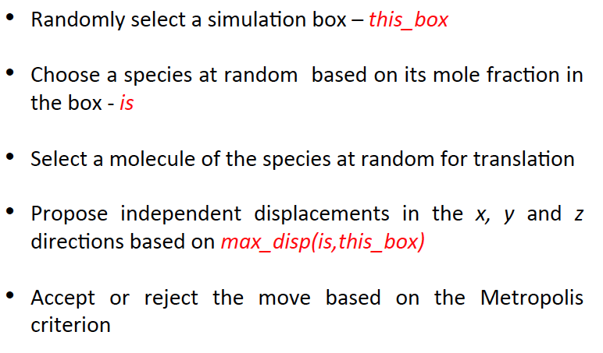
Translation of Center-of-Mass (COM)

Slide 5
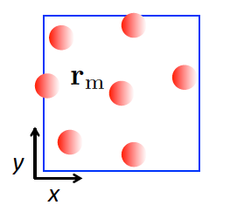
Proposed Move

Slide 6
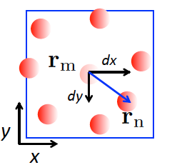
Proposed Move

Slide 7
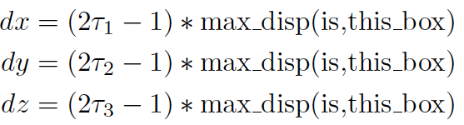
Proposed Move

Slide 8
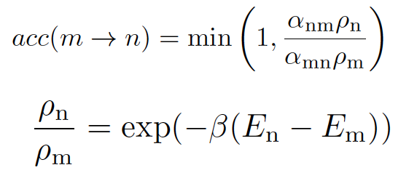
Acceptance Rule

Slide 9
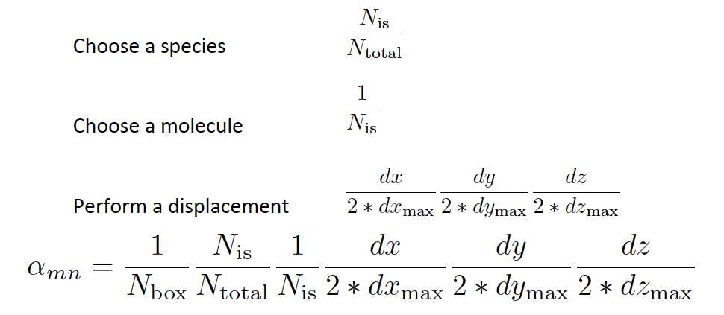

Forward Attempt Probability ($α_{mn}$)

Slide 10
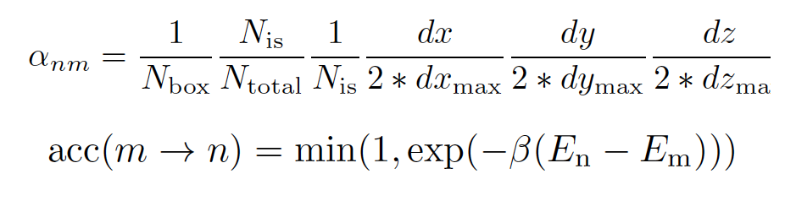

Reverse Attempt Probability ($α_{mn}$)

Slide 11
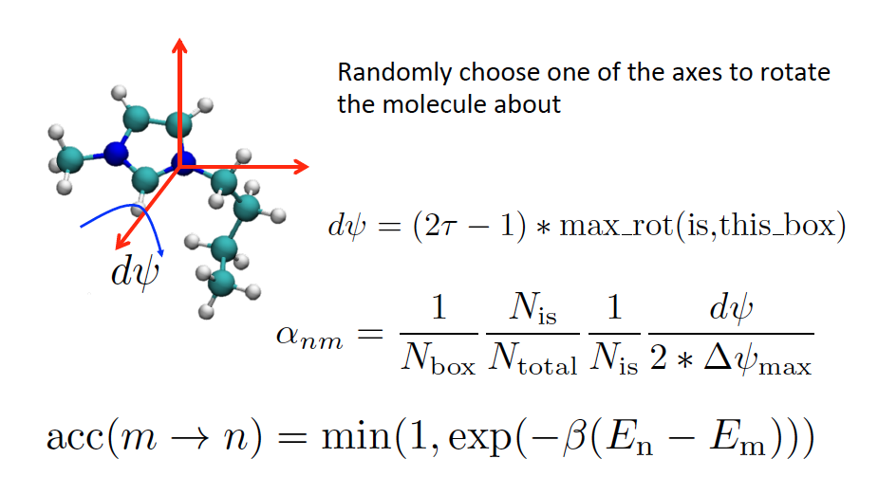
Rotation around COM

