Slide 1
A brief history of devops and containers
Liftoff class 8
3/2/21
Hank dedona

Slide 2
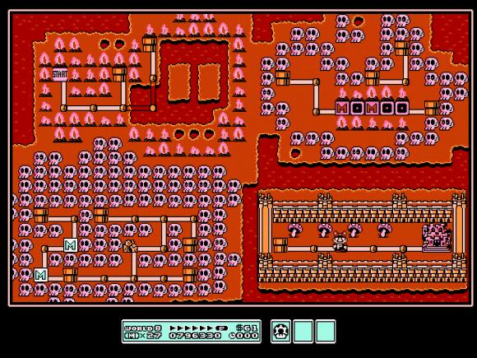
Welcome to world 8!!! :P

Slide 3
Devops
Devops = Developer Operations :-o
Developer -> Ya’ll doing coding
Operations -> Someone keeping the lights on

Slide 4
The old ways…
Back in the day, if you wanted to deploy a new web applications (or even a static website) you needed to requisition some physical server hardware
Note: Server hardware is expensive :-P
This took a lot of time and was a waste of money since most web applications (or sites) didn’t utilize all of the resources provided by a server

Slide 5
The slightly less old school way
Physical servers are expensive and a waste for a single application (or maybe two if you’re lucky).
Welcome virtual machines!
Take a single physical server and chop it up into multiple “virtual machines” each with their own hardware (CPU, Ram, Storage, etc)

Slide 6
The problems with vms
Virtual machines allowed companies to use more of the resources of a given physical server
The problem with VMs is that each virtual machine requires an entire operating system and all of the overhead associated with it.
This means more ram and storage dedicated to duplicate operating system software and tasks.

Slide 7
The new way, containers!
We went from one app per server, to multiple virtual machines per server, to now many many many apps per single server.
The difference between containers and virtual machines is that there is only 1 single operating system
All of the containers are in their own “bubble” and they can’t see the other containers resources

Slide 8
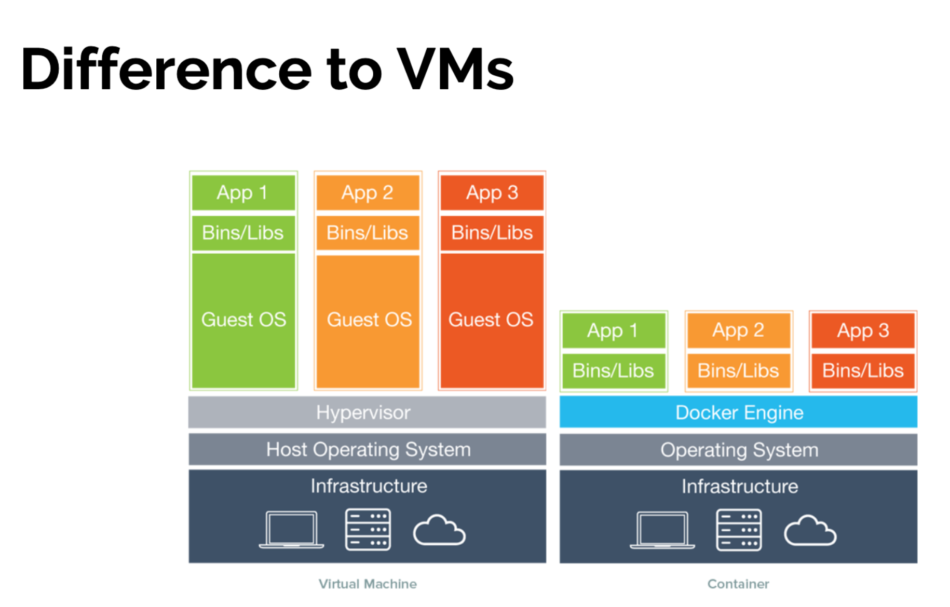
VMs vs containers

Slide 9
Devops (Containers) from a developer perspective
Developers perspective of containers
1) Checkout a project from git
2) Build the project and artifact (JAR, WAR, etc.)
3) Write the dockerfile (this file contains the info about the docker image)
4) Create a container image and publish it to the container repository (opt)
5) Run the docker image locally using something like docker desktop

Slide 10
Devops (Containers) from a operations perspective
Operations perspective of containers
1) Check out a docker image from the repository
2) Create the appropriate shared resources (SAN, network, databases, etc)
3) Using a container orchestration framework (like kubernetes) publish the container to the appropriate environment (dev, staging, prod)
4) Profit!

Slide 11
Devops & Public clouds
Everything we’ve talked to up to this point can be done locally or “on premises” or via a public cloud
Public clouds:
Amazon Web Services
Google Cloud Provider
Microsoft Azure
Etc.

Slide 12
There’s a lot more!
Devops is a burgeoning field in software!
There are different technologies for deploying software
Chef
Terraform
Cloud Foundry
Etc.
There are different host systems (linux vs windows)
There are different tech stacks with different hosting technologies (java, c#, python, JS, ruby, etc.)

Slide 13
What you should know
Be familiar with what devops is (hopefully this lecture helped a bit)
Understand the intricacies to deploying and maintaining web applications
Be ready to participate by writing dockerfiles, chef recipes, terraform docs, etc.
The modern software shop is no longer a world where developers kick the software over the “fence” to operations and wipe their hands clean, we’re all in this together!

Slide 14
Questions?
Any questions?

