Slide 1

BA Deep learning for NLP
Exercise Week 1 – February 5, 2021
Prof. dr. Stephan Raaijmakers

Slide 2

Hour 1: Getting started
Team up with a partner student. See table to the right.
Create a Google account (both).
Create a Google Colab account with your Google account (both).
Create a notebook for yourself.
Share the notebook with your partner (so you can look into each other’s work)
Upload data to your notebook
Start working on the exercise.

Slide 3
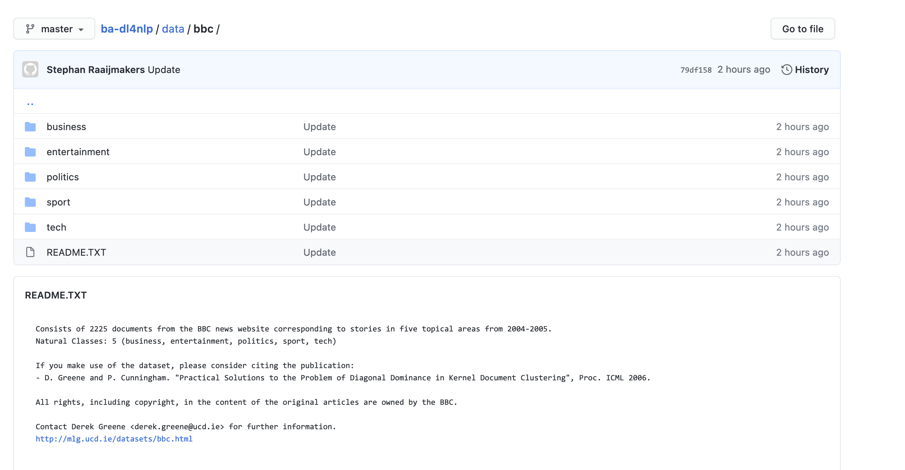
The exercise
You will learn to build a text classifier for news data: a system that automatically assigns documents to classes (labels, topics).
BBC data: https://github.com/stephanraaijmakers/ba-dl4nlp/blob/master/data/bbc/bbc-all.csv
5 classes
2,225 documents (short)
Task: build a 5-class classifier and measure its performance on some test cases.

Slide 4
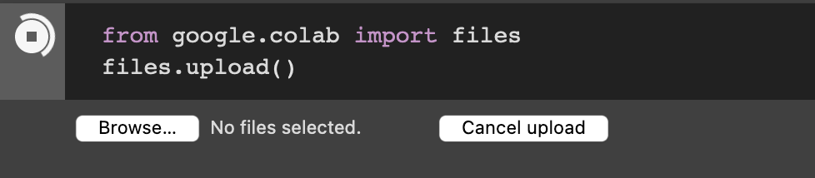
Upload data to your Colab account
Download to your computer/tablet:
https://github.com/stephanraaijmakers/ba-dl4nlp/blob/master/data/bbc/bbc-all.csv
Upload this file (see right)
Load this file into a so-called Pandas frame
A data structure that stores the data.
See next slide.

Slide 5
Reading data
import pandas as pd
df = pd.read_csv(”bbc-all.csv”)
label,news_item
tech,"Intel unveils laser breakthrough Intel has said it has found a way to put a silicon-based laser on a chip, raising hopes…”
sport,"Ronaldo considering new contract Manchester United winger Cristiano Ronaldo said he is close to agreeing…”

Slide 6
From text to input data: vector space
We can’t just input text to machine learning algorithms
We need to convert text to suitable input data
What is suitable? This differs per algorithm.
Generally speaking: we convert text into something numerical, like a vector.

Slide 7
From text to vectors
from sklearn.feature_extraction.text import TfidfVectorizer
import tfidf = TfidfVectorizer(sublinear_tf=True, min_df=5, norm='l2', encoding='latin-1', ngram_range=(1, 2), stop_words='english’)
vectors =tfidf.fit_transform(df.news_item).toarray()
labels = df.category_id
features.shape

Slide 8
Now for real…
import sys
from sklearn.model_selection import train_test_split
from sklearn.feature_extraction.text import CountVectorizer
from sklearn.feature_extraction.text import TfidfTransformer
from sklearn.linear_model import Perceptron
import pandas as pd

Slide 9
From text to vectors
df=pd.read_csv(”bbc-all.csv”,encoding= 'unicode_escape’)
X_train, X_test, y_train, y_test = train_test_split(df['news_item'], df['label'], random_state = 0)
count_vect = CountVectorizer()
X_train_counts = count_vect.fit_transform(X_train)
tfidf_transformer = TfidfTransformer()
X_train_vectors = tfidf_transformer.fit_transform(X_train_counts)

Slide 10
Let’s train a classifier: a Perceptron
clf=Perceptron().fit(X_train_tfidf, y_train)
print(clf.predict(count_vect.transform(["The game ended in a high score for the Lions"])))
=> [u'sport']

Slide 11
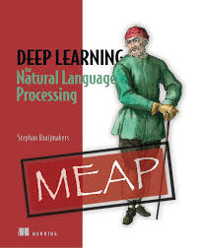
Homework
Finish exercise.
Come up with 50 text examples (in the 5 categories, so 10 each), and measure the error of the classifier, per class label. Get these examples from any English newspaper site. Select snippets comparable in size to the original data.
Document your results:
example, true class (you decide), predicted class.
Document number of errors per class
Finish the Week 1 Quiz at @@@
Read Chapter 1 of DL4NLP
Next week:
Classifier evaluation.
Machine learning ‘hygiene’.
Vectorization (turning text into vectors).

