Slide 1

BA Deep learning for NLP
Exercise Week 1 – February 5, 2021
Prof. dr. Stephan Raaijmakers

Slide 2

Hour 1: Getting started
Team up with a partner student. See table on Brightspace. Use Zoom break-out-room. Rejoin to plenary session after one hour (includes a 15 minutes break).
Create a Google account (both).
Create a Google Colab account with your Google account (both).
Create a notebook for yourself.
Share the notebook with your partner (so you can look into each other’s work)
Upload data to your notebook and start working on the exercise.
Questions (state your name, teacher connects to break-out room):

Slide 3
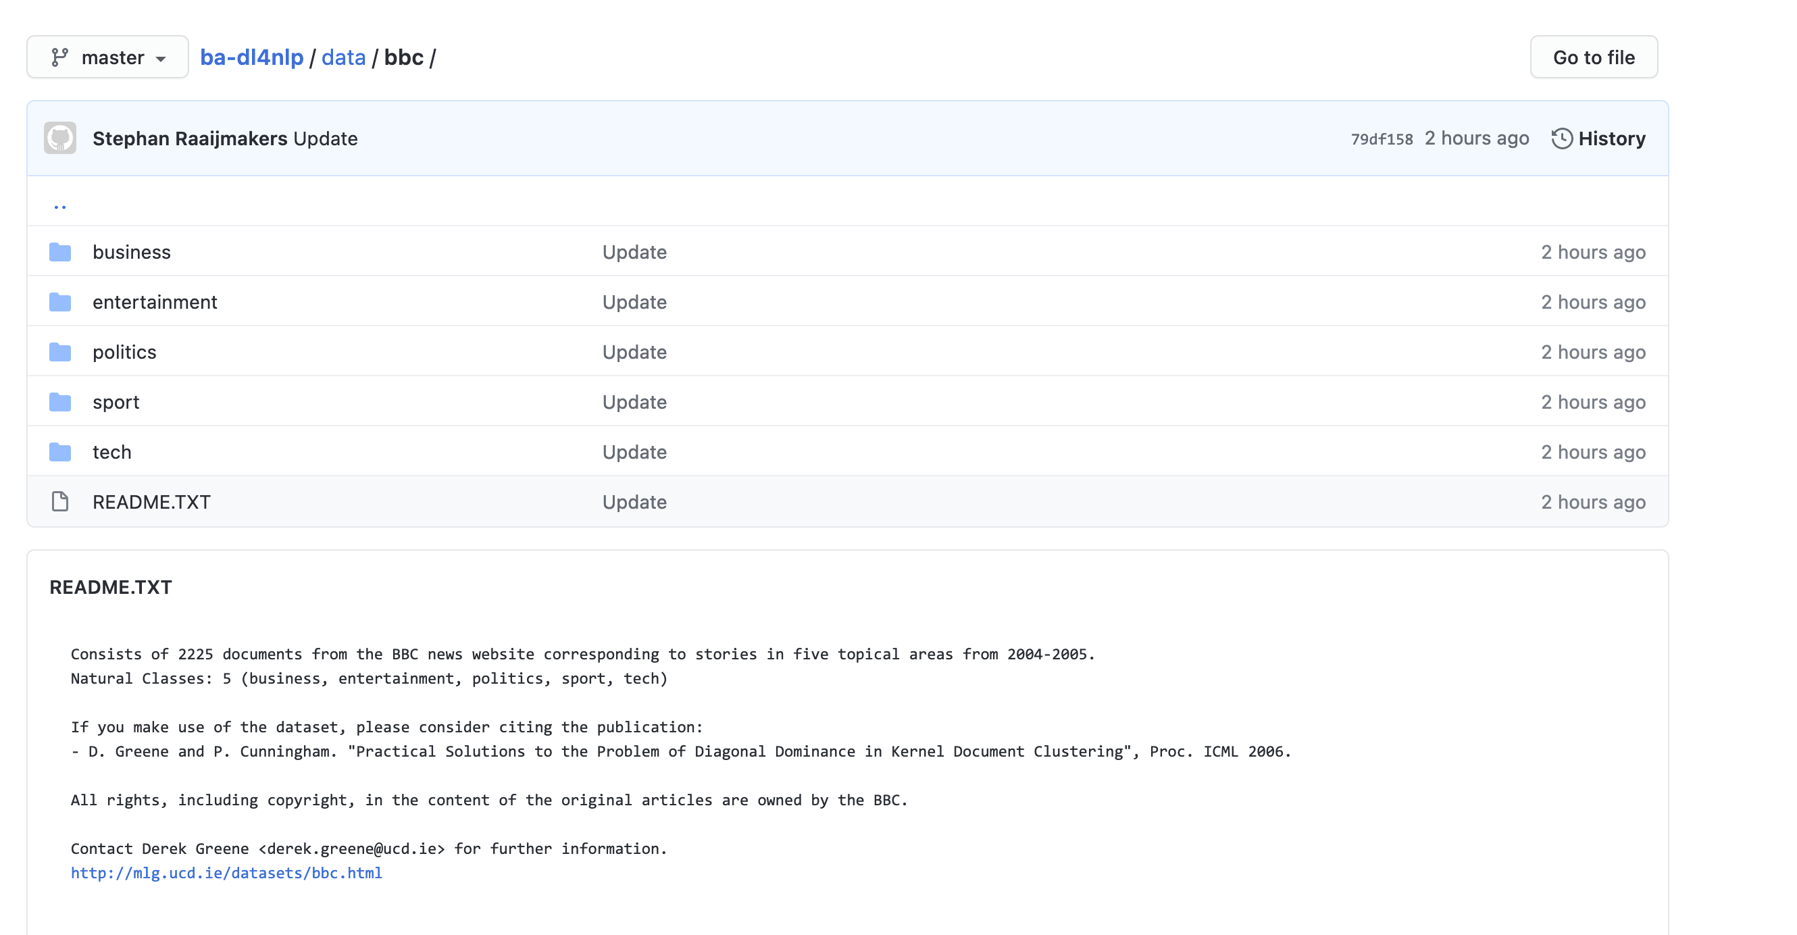
The exercise
You will learn to build a text classifier for news data: a system that automatically assigns documents to classes (labels, topics).
BBC data: https://github.com/stephanraaijmakers/ba-dl4nlp/blob/master/data/bbc/bbc-all.csv
5 classes
2,225 documents (short)
Task: build a 5-class classifier and measure its performance on some test cases.

Slide 4
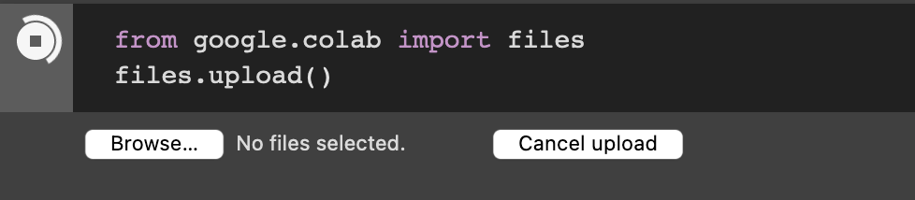
Upload data to your Colab account
Download to your computer/tablet:
https://github.com/stephanraaijmakers/ba-dl4nlp/blob/master/data/bbc/bbc-all.csv
Upload this file (see right)
Load this file into a so-called Pandas frame
A data structure that stores the data.
See next slide.

Slide 5
Reading data
import pandas as pd
df = pd.read_csv(”bbc-all.csv”)
label,news_item
tech,"Intel unveils laser breakthrough Intel has said it has found a way to put a silicon-based laser on a chip, raising hopes…”
sport,"Ronaldo considering new contract Manchester United winger Cristiano Ronaldo said he is close to agreeing…”

Slide 6
From text to input data: vector space
We can’t just input text to machine learning algorithms
We need to convert text to suitable input data
What is suitable? This differs per algorithm.
Generally speaking: we convert text into something numerical, like a vector.

Slide 7
From text to vectors
from sklearn.feature_extraction.text import TfidfVectorizer
import tfidf = TfidfVectorizer(sublinear_tf=True, min_df=5, norm='l2', encoding='latin-1', ngram_range=(1, 2), stop_words='english’)
vectors =tfidf.fit_transform(df.news_item).toarray()
labels = df.category_id
features.shape

Slide 8
Now for real…
import sys
from sklearn.model_selection import train_test_split
from sklearn.feature_extraction.text import CountVectorizer
from sklearn.feature_extraction.text import TfidfTransformer
from sklearn.linear_model import Perceptron
import pandas as pd

Slide 9
From text to vectors
df=pd.read_csv(”bbc-all.csv”,encoding= 'unicode_escape’)
X_train, X_test, y_train, y_test = train_test_split(df['news_item'], df['label'], random_state = 0)
count_vect = CountVectorizer()
X_train_counts = count_vect.fit_transform(X_train)
tfidf_transformer = TfidfTransformer()
X_train_vectors = tfidf_transformer.fit_transform(X_train_counts)

Slide 10
Let’s train a classifier: a Perceptron
clf=Perceptron().fit(X_train_tfidf, y_train)
print(clf.predict(count_vect.transform(["The game ended in a high score for the Lions"])))
=> [u'sport']

Slide 11
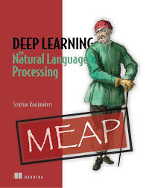
Homework
Finish exercise.
Come up with 50 text examples (in the 5 categories, so 10 each), and measure the error of the classifier, per class label. Get these examples from any English newspaper site. Select snippets comparable in size to the original data.
Document your results:
example, true class (you decide), predicted class.
Document number of errors per class
Finish the Week 1 Quiz at @@@
Read Chapter 1 of DL4NLP
Next week:
Classifier evaluation.
Machine learning ‘hygiene’.
Vectorization (turning text into vectors).

