Slide 1
Lung Adenocarcinoma Prostate Adenocarcinoma Head and neck squamous cell carcinoma
Comorbidity:
Bioinformatics II

Slide 2
I aim to present the findings of my project, where I explored the existence of potential relationships between three significant types of carcinomas to assess the possibility of any comorbidities.

Slide 3
TABLE OF CONTENTS
INVESTIGATING COMORBIDITY
PRESENTATION OF THE DISEASES
01
03
SWIMMER ANALISYS
PRESENTATION OF MY RESULTS
02
04
And identification of switch genes

Slide 4
WHAT IS COMORBIDITY?
Comorbidity, in the medical field, refers to the existence of one or more accompanying conditions that typically occur simultaneously with the primary condition. These conditions, which can be either physiological or psychological, have an impact on the patient's health and are considered in addition to the primary condition of interest. In other words, comorbidity encompasses all other conditions that a patient may have besides the primary condition.

Slide 5
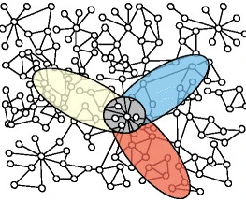
NETWORK MEDICINE THEORY:
overlapping of these disease modules can explain comorbidity.
Shared components hypothesis states that diseases that share disease-associated cellular components (genes, proteins, metabolites or microRNAs) show phenotypic similarity and comorbidity.

Slide 6
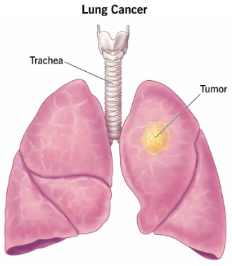
LUNG ADENOCARCINOMA
In the United States, lung adenocarcinoma is the most frequently occurring primary lung cancer and is classified as a non-small cell lung cancer (NSCLC). Interestingly, this subtype is the most commonly diagnosed lung cancer in individuals who have never smoked.

Slide 7
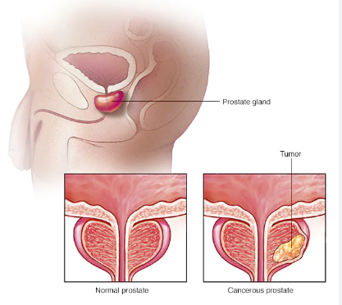
PROSTATE ADENOCARCINOMA
Prostate adenocarcinoma is a type of cancer that develops in the cells of the prostate gland, which is a small, walnut-shaped gland located in the male reproductive system. It is the most common type of prostate cancer, accounting for approximately 95% of all cases.

Slide 8
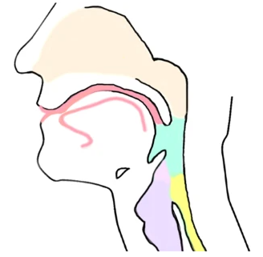
HEAD AND NECK SQUAMOUS CELL DISEASE
Head and Neck squamous cell carcinoma is a type of cancer that develops from the squamous cells lining the respiratory and digestive tracts in the head and neck region. These surfaces include the mouth, throat, tonsils, larynx, and pharynx. Risk factors for developing this type of cancer include tobacco smoking, excessive alcohol consumption, exposure to chemicals, human papillomavirus (HPV) infection, and a diet lacking in fruits and vegetables.

Slide 9

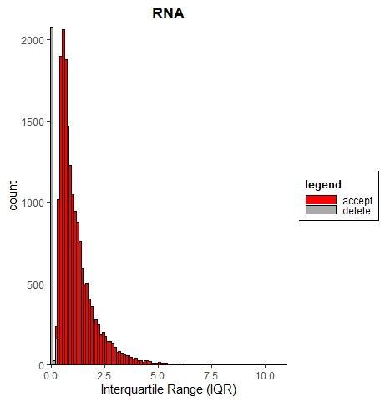
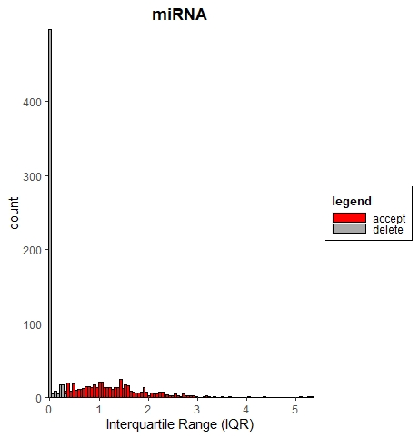
EXLPLORATORY DATA ANALYSIS EXAMPLE: LUAD

Slide 10
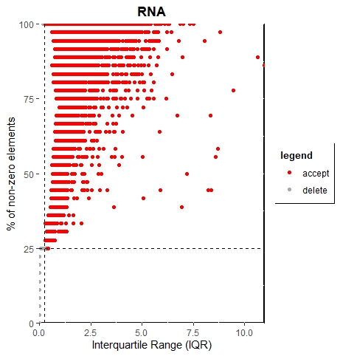
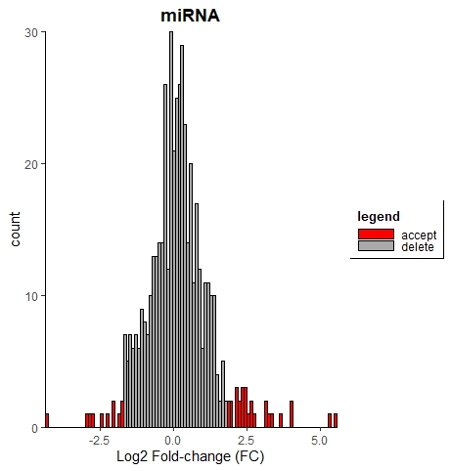
EXLPLORATORY DATA ANALYSIS: LUAD

Slide 11
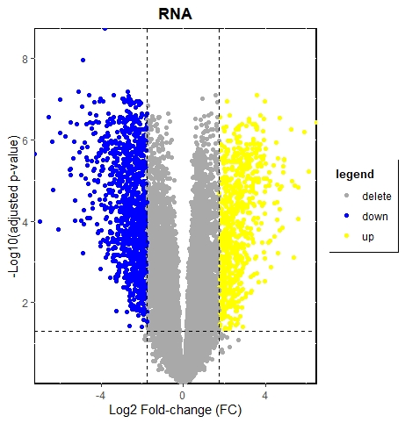
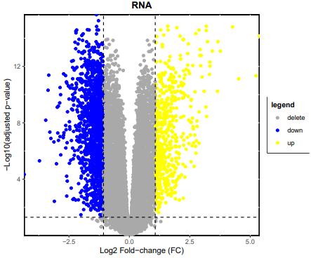
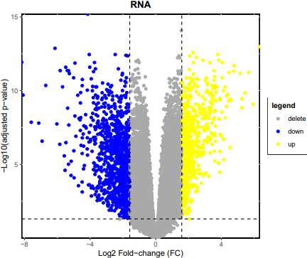
EXLPLORATORY DATA ANALYSIS: LUAD, PRAD, HNSCC

Slide 12
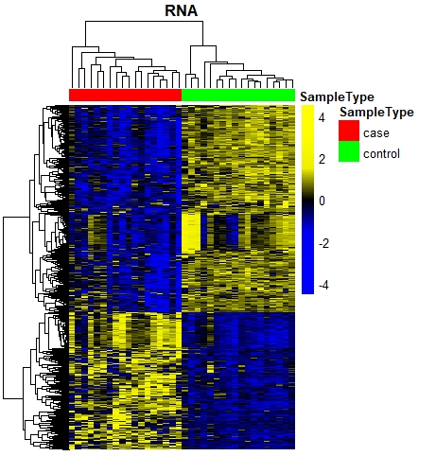
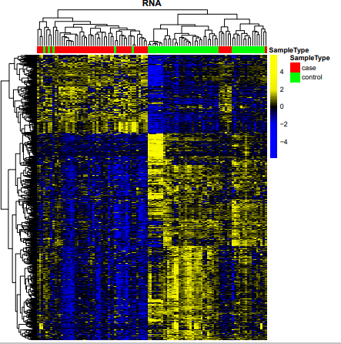
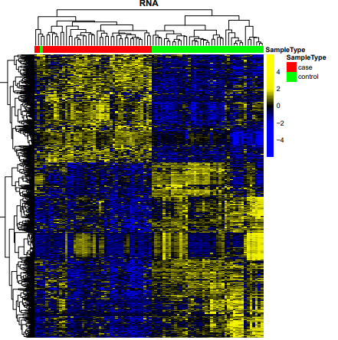
EXLPLORATORY DATA ANALYSIS: LUAD, PRAD, HNSCC

Slide 13
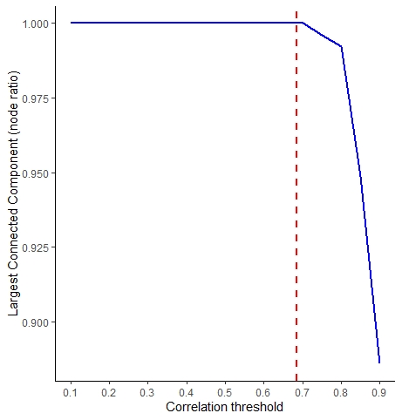
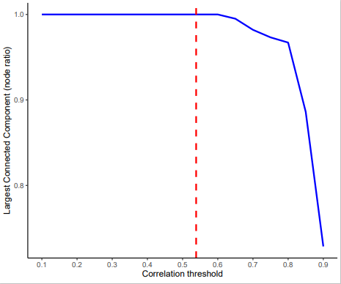
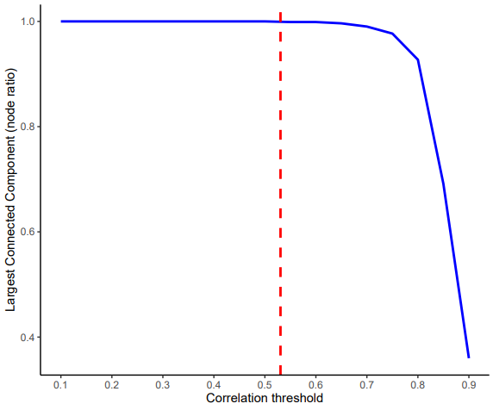
NETWORK CONSTRUCTION: LUAD, PRAD, HNSCC

Slide 14
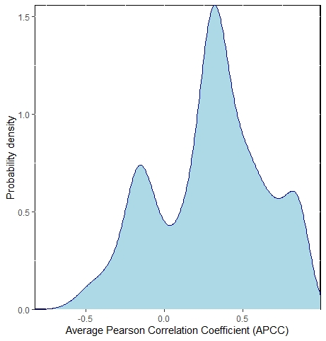
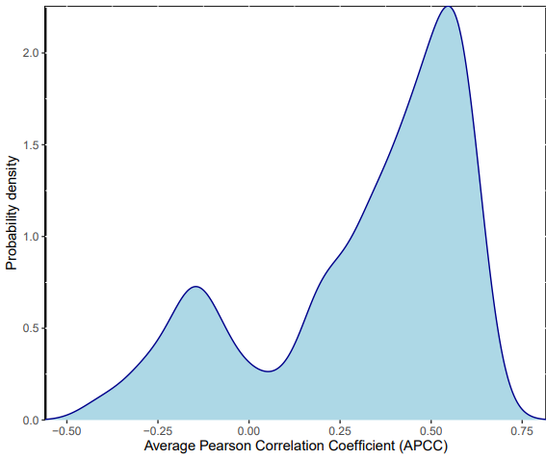
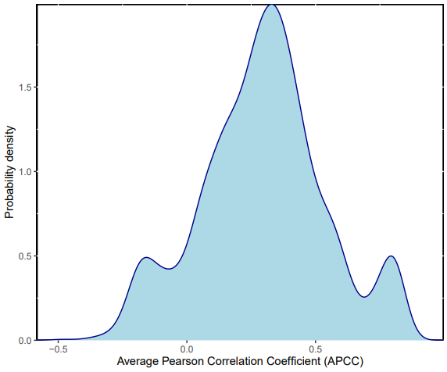
SWITCH MINING: LUAD, PRAD, HNSCC

Slide 15
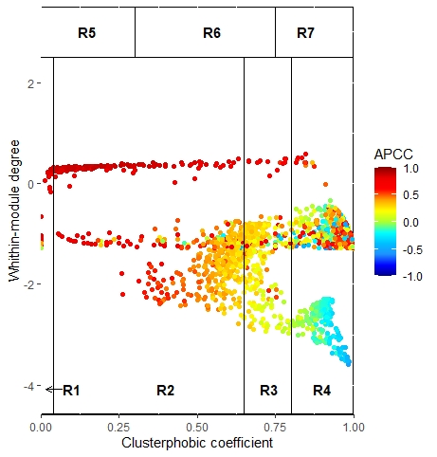
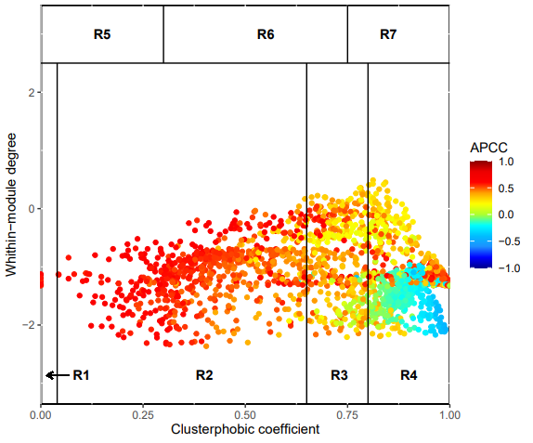
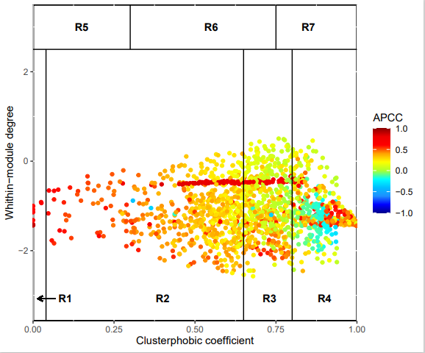
SWITCH MINING: LUAD, PRAD, HNSCC
Switch genes
Switch genes
Switch genes

Slide 16
MODULE SEARCH
I found three sets of switch genes, one for each disease. Then I used module search in order to verify local and disease module hypotesis.

Slide 17
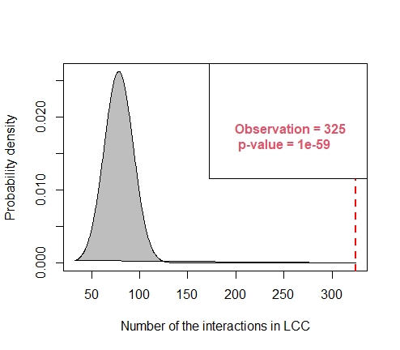
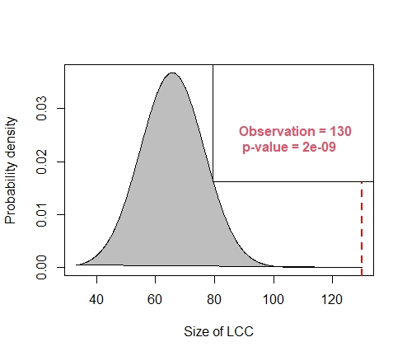
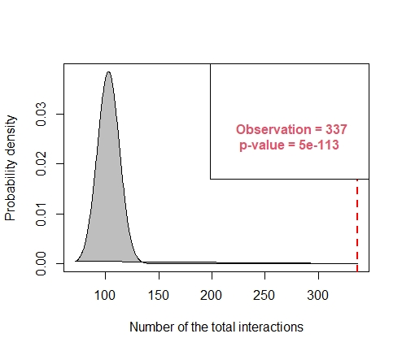
MODULE SEARCH: LUAD

Slide 18
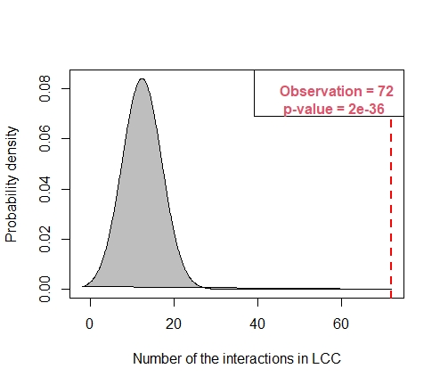
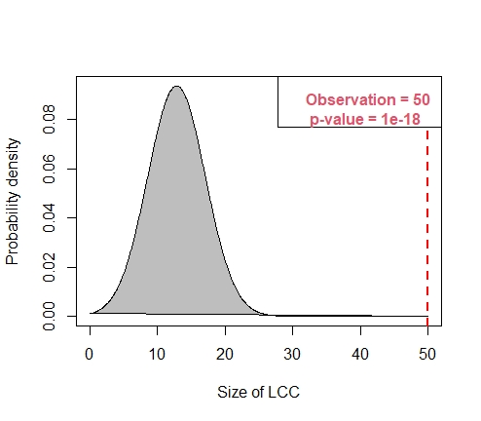
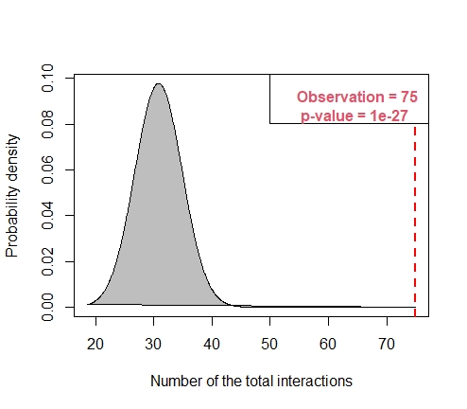
MODULE SEARCH: PRAD

Slide 19
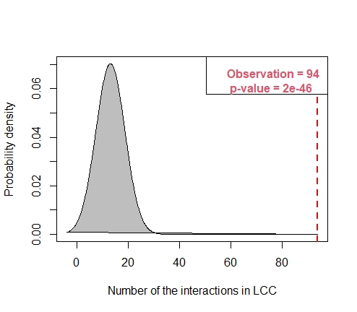
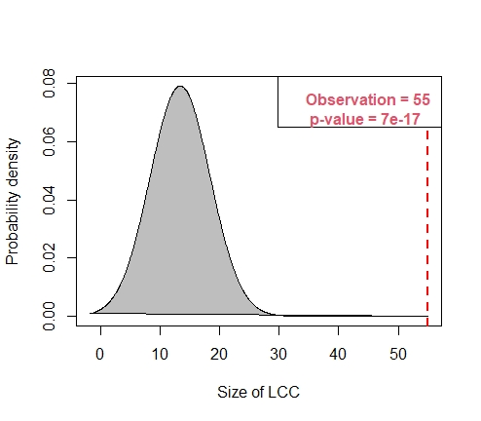
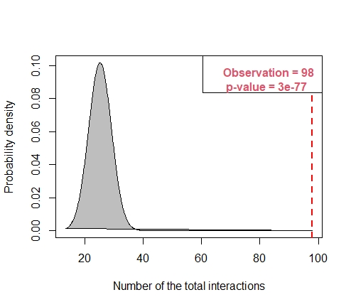
MODULE SEARCH: HNSC

Slide 20
As we can observe from the graphs, my p-values are extremely low for all of my switch genes: we have demonstrated that the probability to obtain randomly a subnetwork with these characteristics is extremely low. We can reject the null hypothesis; nodes show a higher tendency to interact and a bigger LCC with respect to the ones expected by chance.

Slide 21
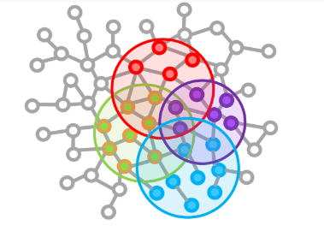
MODULE DISTANCE SEARCH

Slide 22

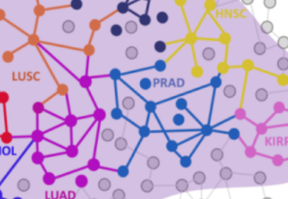

MY RESULTS:
Module separation: the negative values indicate a certain degree of overlapping.
P-value: All my results are statistically significant.

Slide 23
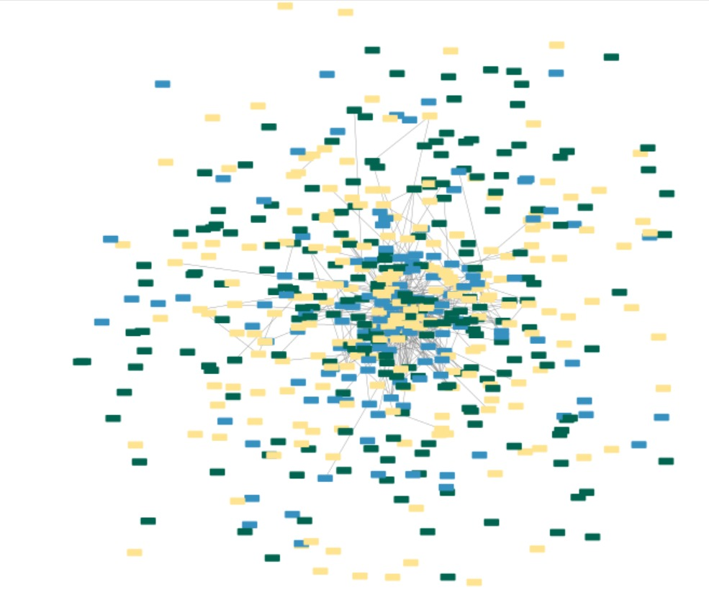
CYTOSCAPE:

Slide 24
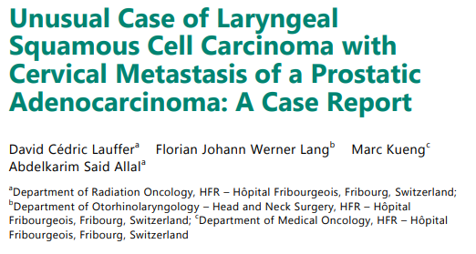
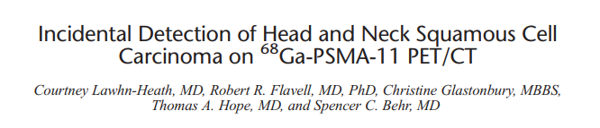

Slide 25

In order to make my results more robust, I decided to perform other bioinformatic analysis. Since we are computing the module separation, negative values will express an overlapping of the our switch genes of interest. Even if we have not observed extremely low values of module separation, we can observe a weak overlapping between all the three sets of switch genes; hence, a possible degree of comorbidity can be further investigated.
Enrichr is a web-based tool that allows users to perform various types of gene set enrichment analysis. It provides access to a large collection of gene sets from multiple sources.

Slide 26
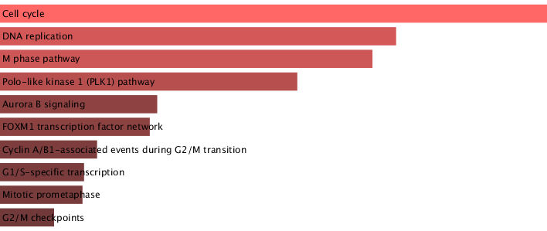
Biological pathway enrichment analysis: LUAD

Slide 27
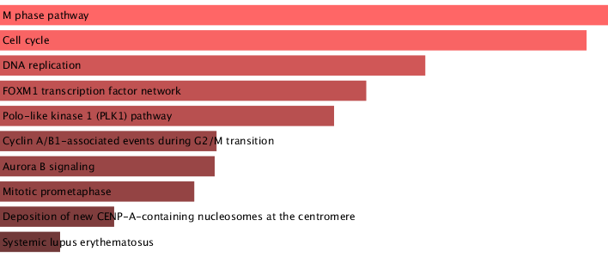
Biological pathway enrichment analysis: PRAD

Slide 28
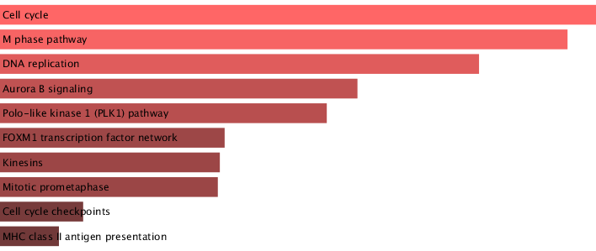
Biological pathway enrichment analysis: PRAD

Slide 29
MY RESULTS:
our diseases of interest show very similar pathways the one with the other. In order to evaluate which, among the shared genes between these three types of carcinoma, can be considered as the most important to be further investigated, I decided to compare my results to data obtained by previous literature.

Slide 30
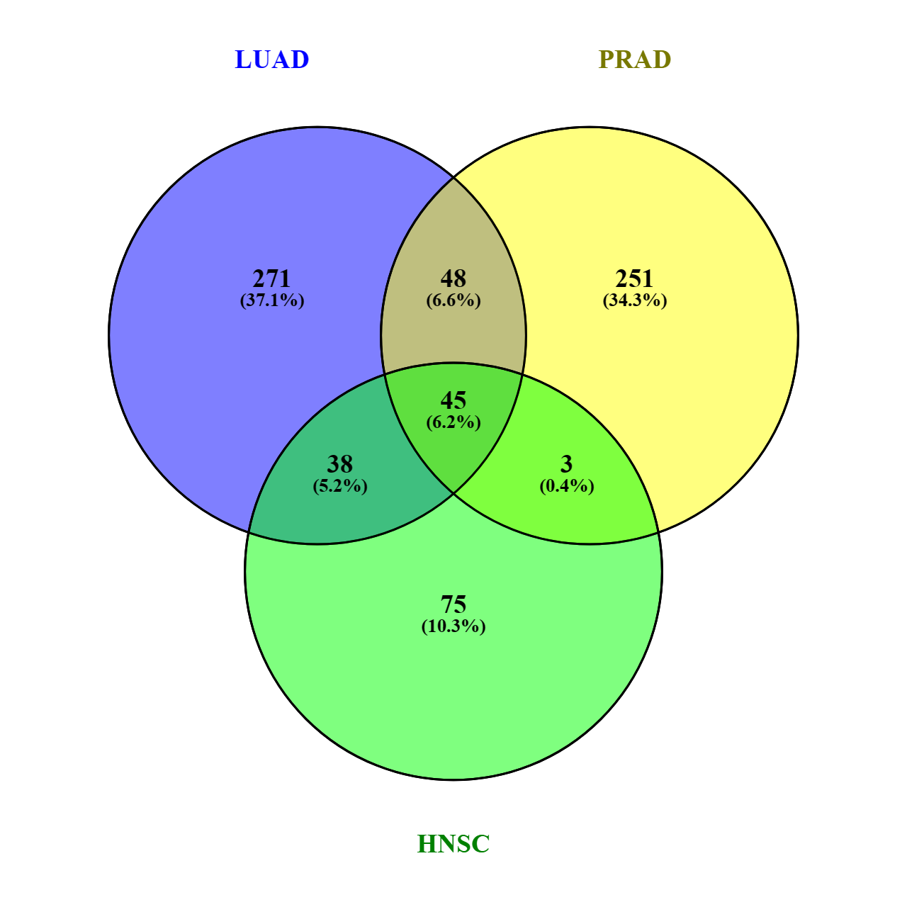
VENNY:
I put all the three dataset of switch genes I obtained using swimmer in Venny in order to see if there were some of them in common. I found that 45 switch genes were common to all of my datasets.

Slide 31
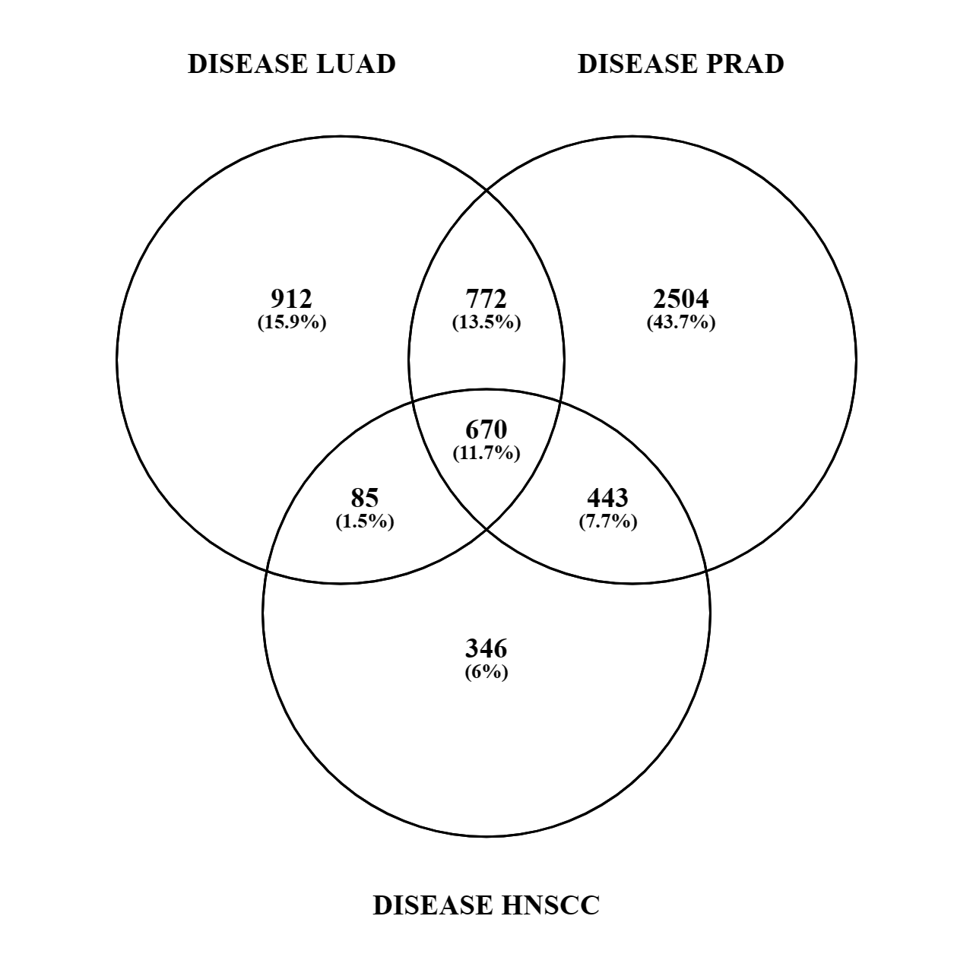

VENNY:
The second thing I did was to search, for all of the three diseases, a list of genes that are known to be associated with it. I did it using DisGeNET. I downloaded all the disease-associated genes for luad, prad and hnscc, and I found the ones in common (about 670).

Slide 32
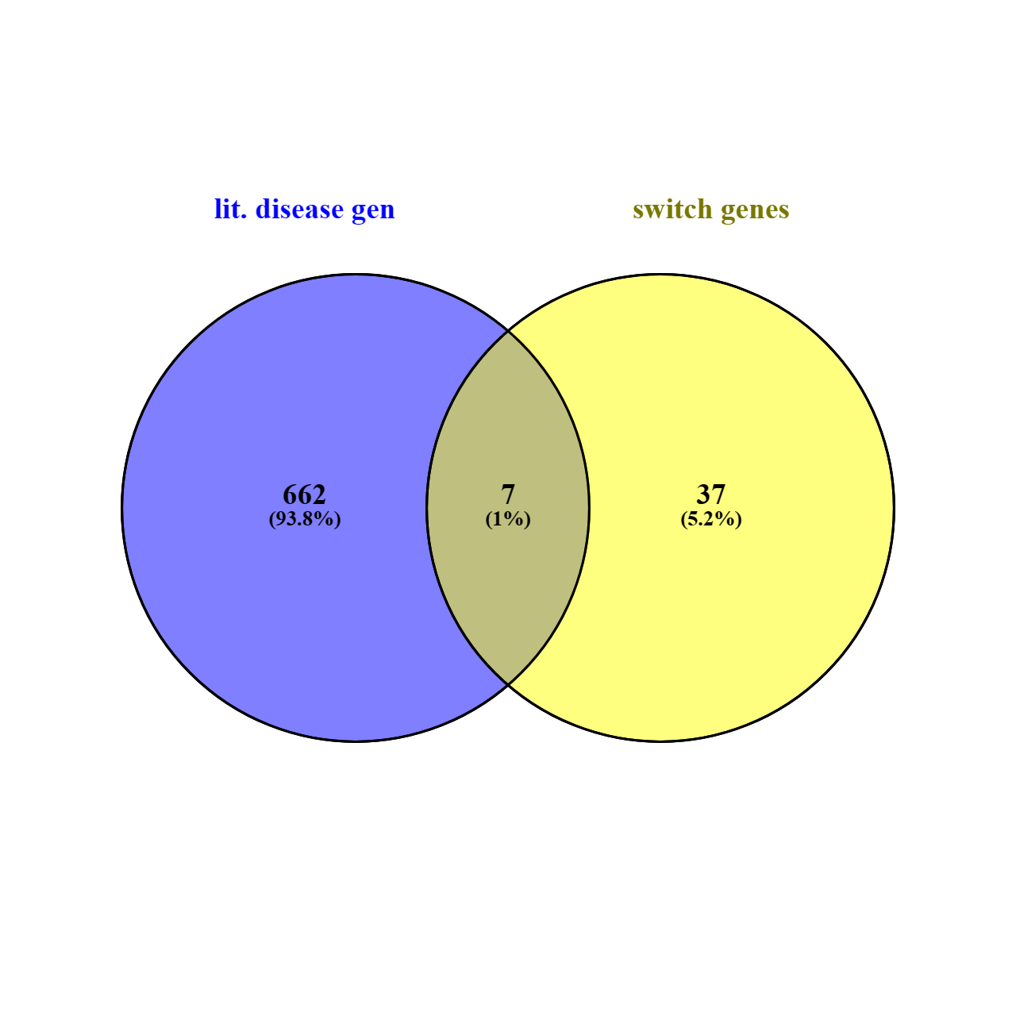
VENNY:
I observed 7 disease genes among the ones from DisGeNET that were switch genes too, for all three the diseases. These are:
FOXM1 – transcription factor
PLK1 – Kinase enzyme
TPX2 – regulating activity (also PLK1)
CEP55 – mitotic phosphoprotein
TTK – protein kinase
AURKB – protein kinase
TRIP13 - ATPase enzyme

Slide 33
FOXM1:
FOXM1 is a transcription factor protein that plays an important role in regulating the cell cycle and cell proliferation.
FOXM1 is involved in the regulation of various cellular processes, including cell cycle progression, DNA damage repair, cell differentiation, and angiogenesis. Given its importance in cancer biology, FOXM1 has emerged as a potential therapeutic target for cancer treatment. Various approaches have been explored to inhibit FOXM1 activity, including small molecule inhibitors, siRNA, and CRISPR/Cas9 gene editing.

Slide 34
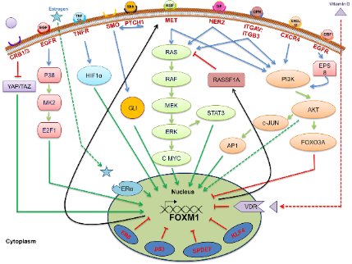
FOXM1:
In many types of cancer, FOXM1 has been shown to play a critical role in promoting cell proliferation, survival, and invasion. It is involved in regulating various key signalling pathways, including the PI3K/AKT, MAPK/ERK, and Wnt/beta-catenin pathways, which are known to be dysregulated in cancer.

Slide 35
AURKB:
AURKB (Aurora kinase B) is a protein that plays a key role in regulating cell division, particularly in the final stages of mitosis (cell division) when the chromosomes are segregated into two daughter cells. AURKB belongs to the family of serine/threonine kinases, which are enzymes that add phosphate groups to other proteins, thereby regulating their activity.
During mitosis, AURKB is involved in several processes, including the alignment of chromosomes at the metaphase plate, the separation of sister chromatids during anaphase, and the formation of the contractile ring during cytokinesis. AURKB is also involved in the regulation of the spindle checkpoint, which ensures that chromosomes are evenly distributed between the two daughter cells.

Slide 36
AURKB:
Overexpression of AURKB has been associated with tumour progression, increased invasiveness, and poorer prognosis.
Studies have shown that inhibition of AURKB can lead to the suppression of all these three cancers cell growth both in vitro and in vivo. For example, preclinical studies have demonstrated that AURKB inhibitors can induce apoptosis (programmed cell death) and cell cycle arrest in these cancer cells cells. Additionally, AURKB inhibition has been shown to sensitize carcinoma cells to chemotherapy and radiation therapy, suggesting that it may be a promising therapeutic target for combination therapy.

Slide 37
PLK1:
Serine/threonine-protein kinase PLK1 is an enzyme that in humans is encoded by the PLK1 (polo-like kinase 1) gene. Kinase activity is regulated at least in part, by the polo-boxes that are functionally important for both auto-inhibition and subcellular localization.
During interphase, PLK1 localizes to centrosomes. In early mitosis, it associates with mitotic spindle poles. A recombinant GFP-PLK1 protein localizes to centromere/ kinetochore region, suggesting a possible role for chromosome separation.
Plk1 is an early trigger for G2/M transition. Plk1 supports the functional maturation of the centrosome in late G2/early prophase and establishment of the bipolar spindle.
Studies have shown that the loss of PLK1 expression can induce pro-apoptotic pathways and inhibit growth.

Slide 38
THANK YOU!

