Slide 1
Competitive Programming CS 104C
TexPoint fonts used in EMF.
Read the TexPoint manual before you delete this box.: AAAAAAAAAAAAAAA

Slide 2

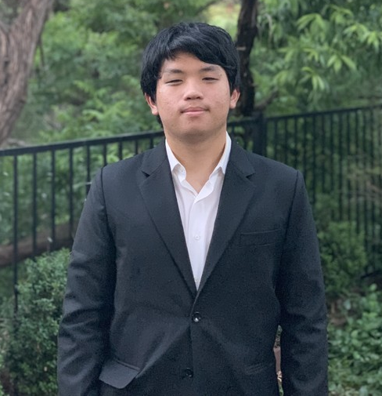
Introductions
Aditya Arjun
Kevin Li

Slide 3
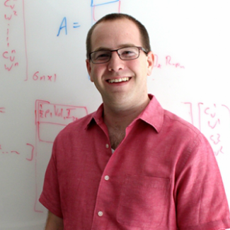
Introductions
Prof. Etienne Vouga
evouga@cs.utexas.edu
GDC 5.508
Coach of the ICPC teams
Office hours by appointment

Slide 4

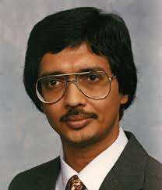
Other Affiliated Faculty
Glenn Downing
Shyamal Mitra

Slide 5
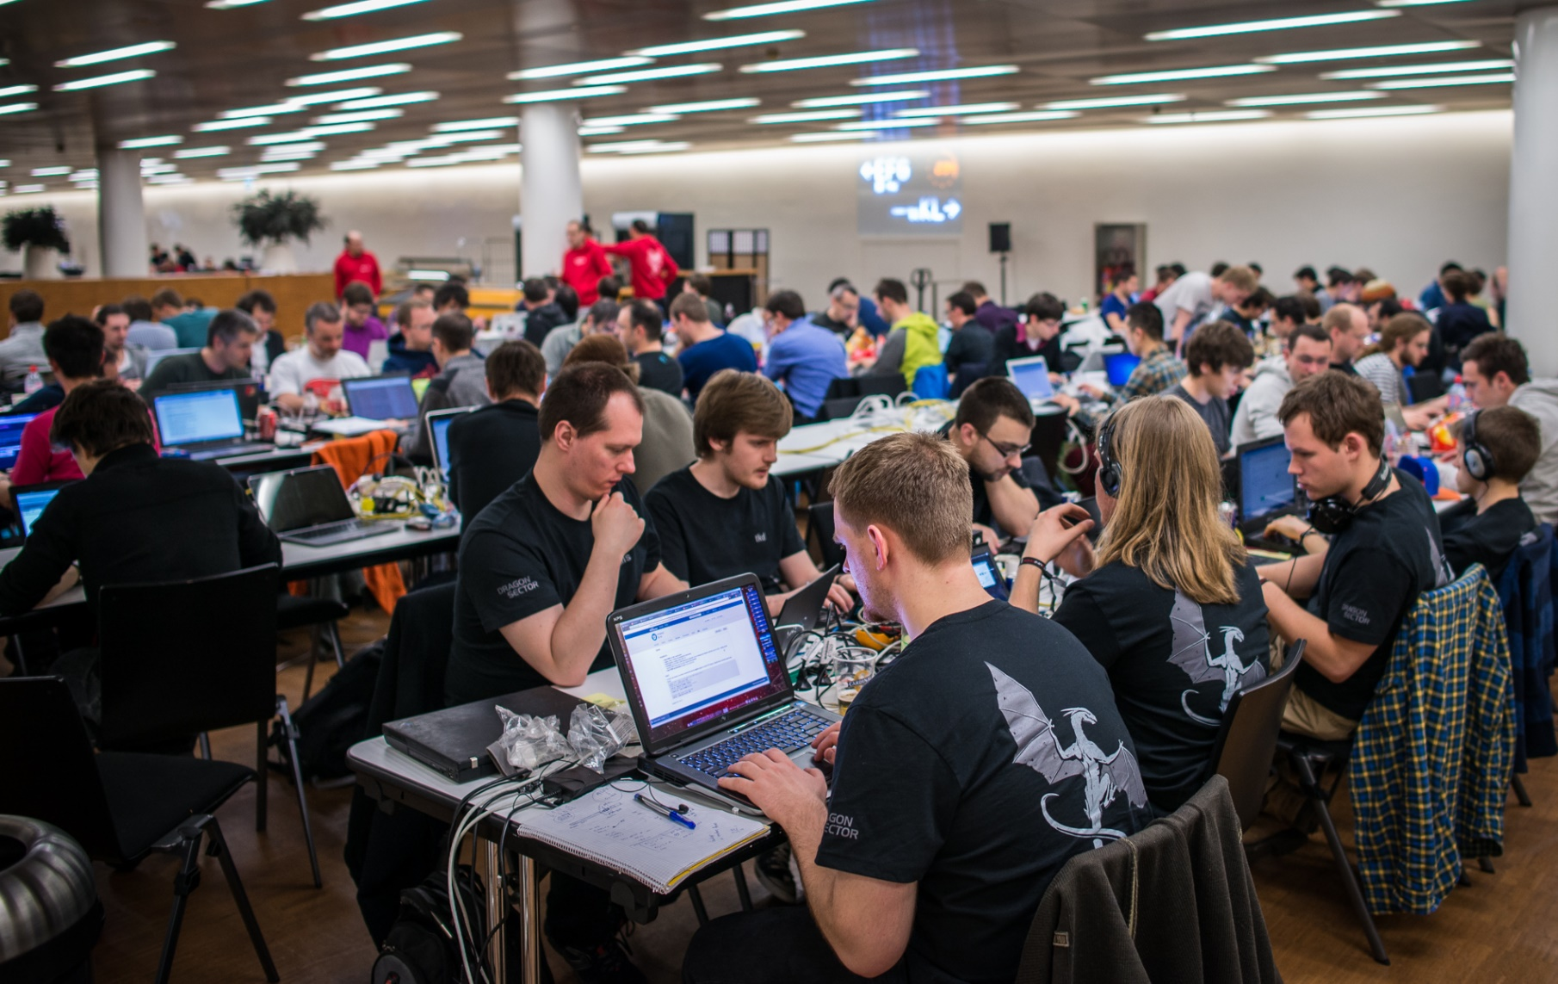
What is Competitive Programming?

Slide 6
Example Problem
Input: An integer N
0 <= N <= 10⁶
Output: The number of zeroes at the end of N!
Time limit: 1 sec
Memory limit: 10 MB

Slide 7
What is Competitive Programming?
Given a concrete problem statement:
Analyzing the problem and determining what algorithm can solve it;
Identifying the possible pitfalls and corner cases;
Quickly producing an implementation that “Just Works the first time”
In other words, efficiently analyzing and solving low-level programming problems

Slide 8
 | High-Level Design | Low-Level Design
Unit of Concern | Application; Library | Function
Main Goals | User Experience Maintainability | Correctness Performance
Key Questions | What libraries can I use? Will these features be useful? Will this design scale to more users/data? | What algorithm can I use? What are the corner cases? Will this run in reasonable time and memory?
Skills Needed | Planning Communication | Problem-solving Algorithms knowledge
Scope of Effort | Teams working for months | One programmer working for hours

Slide 9
Benefits of Competitive Programming
Improved problem solving skills
Improved knowledge of algorithms
Write more optimized code
Write less buggy code
Great practice for technical interviews
Have fun, win prizes and glory

Slide 10
Mechanics of a Competition
You receive several (5-10) problems of varying difficulty
Write solution, submit it to an automated judge that runs test suite

Slide 11
Mechanics of a Competition
You receive several (5-10) problems of varying difficulty
Write solution, submit it to an automated judge that runs test suite
Get back ~2 bits of information:
Accepted or Wrong Answer (Compile Error, Time Exceeded, or Memory Exceeded)
You are not told the failure cases!

Slide 12
Two Types: Online and Offline
Online: (HackerRank, TopCoder, CodeForces, Google CodeJam)
Individual
Can use Internet, your old code, …
Offline: (ICPC)
Team (shares one computer)
No Internet

Slide 13
Competitions vs Industry
In competitions:
Severe time pressure
no time for unit tests*
no time to write documentation
Style and code quality doesn’t matter*
Maintainability doesn’t matter
Problems self-contained

Slide 14
Example Problem II
Input: A sorted list of N integers x_{i} and an integer y
1 <= N <= 10⁶
-2³⁰ <= y, x_{i} <= 2³⁰
Output: The number of elements in the list strictly less than y Time limit: 1 sec
Memory limit: 10 MB

Slide 15
Efficiency Rule of Thumb
complexity | maximum N
(N) | 100 000 000
(N log N) | 40 000 000
(N^2) | 10 000
(N^3) | 500
(N^4) | 90
(2^N) | 20
(N!) | 11

Slide 16
Lessons?
Read the problem statement
Look at the limits
Check for corner cases
Almost always a performance vs complexity tradeoff – choose carefully!
Big-O critical (but don’t sweat log N)

Slide 17
Other Tips for Getting Started
Become proficient in one language, and know its libraries and I/O functions cold
C++, Java, Python
Get out there and code
Try out online contests: codeforces, codechef, projecteuler, hackerrank
you greatly improve by practicing

Slide 18
Assignment and Grading
80% homework exercises (3/week):
Vanilla Problem: tests key concepts
Codeforces Exercises
online judge
we pick three problems, you choose one
Find the Bug
our solution gets “wrong answer”; find the problem and explain a fix

Slide 19
Assignment and Grading
80% homework exercises (3/week)
20% programming contest participation
every two weeks on Friday night
first contest: tonight 5:00 pm
One contest (your choice) is required
Can do more for extra credit

Slide 20
Assignment and Grading
Questions about the class logistics?
Check the web site first:
https://www.cs.utexas.edu/users/downing/cs104c/Grading.html
Contains:
syllabus and grading breakdown
academic integrity policy
harassment-free conduct policy

Slide 21
Assignment and Grading
Questions about the class logistics?
Check the web site first:
https://www.cs.utexas.edu/users/downing/cs104c/Grading.html
Ask on Piazza / Email TAs

Slide 22
Prerequisites
Data Structures (or equivalent)
Working knowledge of Java (for Find the Bug problems)
Strong working knowledge of one of:
C/C++, Java, Python

Slide 23
Tentative List of Topics
state space search / graph algorithms
recursion / backtracking
binary search
greedy algorithms
dynamic programming
advanced graph algorithms
number theory
probability/combinatorics

Slide 24
Coming Soon on Canvas/Piazza
Links to online competitions
Instructions for setting up Codeforces and Hackerrank account (needed for assigments)
Office Hours?
First Codeforces and Vanilla Problem

