Slide 1
Graphs and Search Algorithms

Slide 2
Social Network Backend
Want to build social network app tracking:
users
friend relationship between some pairs of users
D
B
C
F
E
A

Slide 3
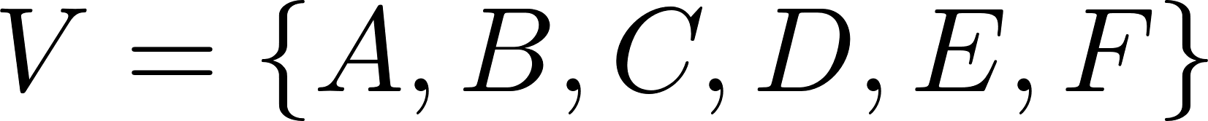
Graph Basics
Network is a graph:
nodes or vertices
D
B
C
F
E
A

Slide 4
Graph Basics
Network is a graph:
nodes or vertices
edges
D
B
C
F
E
A

Slide 5
Graph Basics
Network is a graph:
nodes or vertices
edges
can be directed (one-way) or undirected
D
B
C
F
E
A

Slide 6
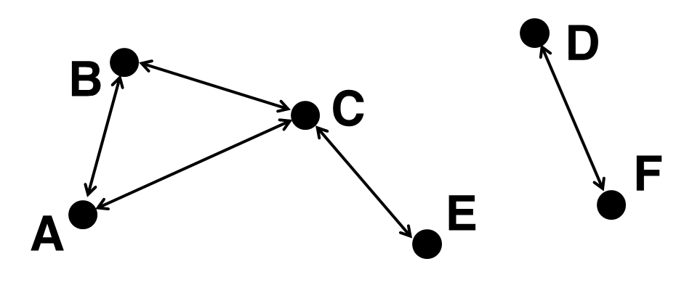
Graph Data Structs

Slide 7
Graph Data Structs
Raw vertex/edge lists

Slide 8
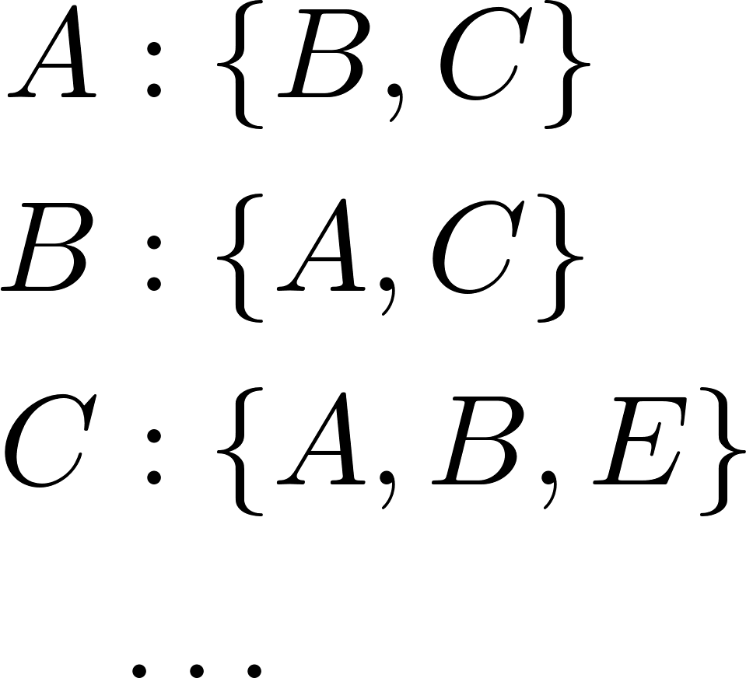
Graph Data Structs
Raw vertex/edge lists
Adjacency list

Slide 9
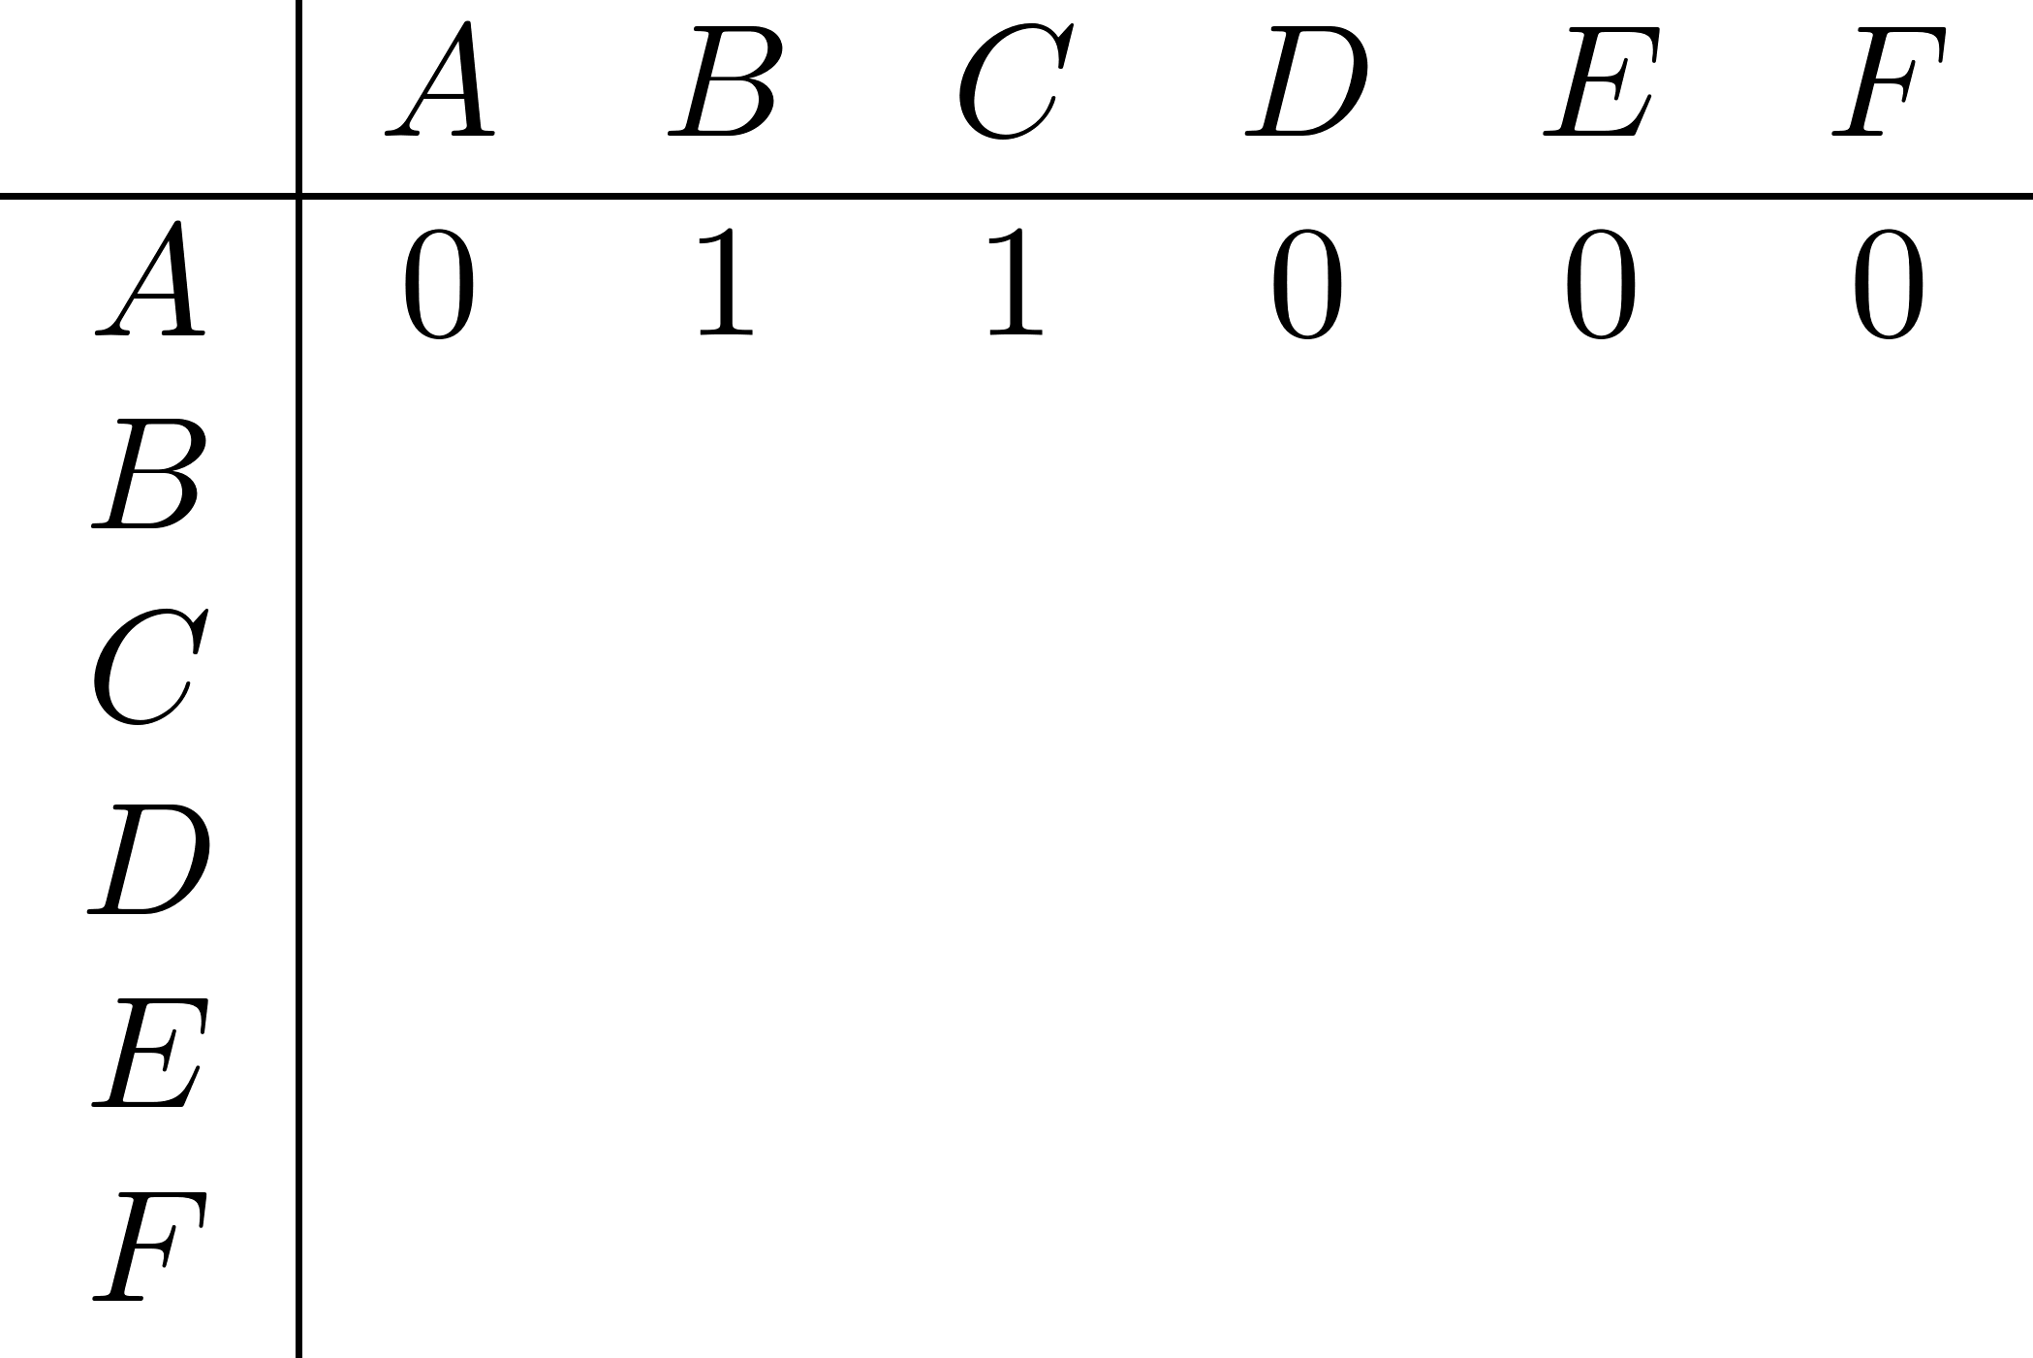
Graph Data Structs
Raw vertex/edge lists
Adjacency list
Adjacency matrix

Slide 10
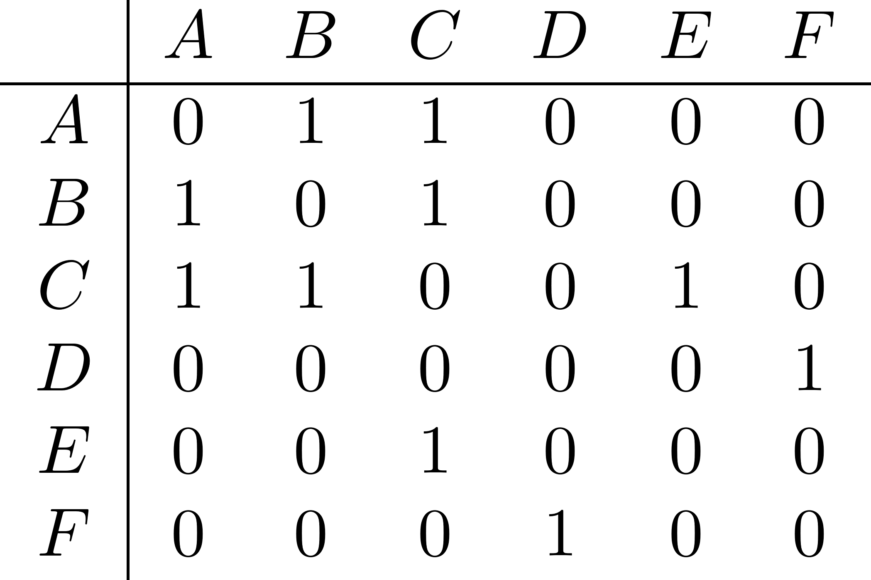
Graph Data Structs
Raw vertex/edge lists
Adjacency list
Adjacency matrix

Slide 11
Graph Data Structs
What is the space cost of each option?
Raw lists:
Adjacency list:
Adjacency matrix:

Slide 12

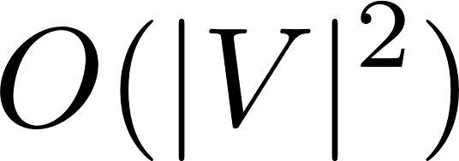
Graph Data Structs
What is the space cost of each option?
Raw lists:
Adjacency list:
Adjacency matrix:

Slide 13
Graph Operations
Given two vertices, are they neighbors?
Raw lists:
Adjacency list:
Adjacency matrix:

Slide 14

Graph Operations
Given two vertices, are they neighbors?
Raw lists: search entire edge list
Adjacency list:
Adjacency matrix:

Slide 15
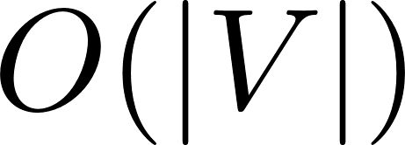
Graph Operations
Given two vertices, are they neighbors?
Raw lists: search entire edge list
Adjacency list: search one adjacency list (technically )
Adjacency matrix:

Slide 16

Graph Operations
Given two vertices, are they neighbors?
Raw lists: search entire edge list
Adjacency list: search one adjacency list (technically )
Adjacency matrix: look up entry

Slide 17
Graph Operations
Given a vertex, who are the neighbors?
Raw lists: search entire edge list
Adjacency list:
Adjacency matrix:

Slide 18

Graph Operations
Given a vertex, who are the neighbors?
Raw lists: search entire edge list
Adjacency list: nothing to do…
Adjacency matrix: search row of matrix

Slide 19
Friend Network
Given a social network containing people (vertices) and friend relationships (edges), X is in the same friend network as Y if
they are the same person
X is friends with someone that is in the same friend network as Y

Slide 20
Friend Network
Are A and E in the same friend network?

Slide 21
Friend Network
Are A and E in the same friend network?
Basic idea: start at A and “flood fill” along edges, and see if we ever hit E
(We will need to create a “visited” flag for vertices)

Slide 22
Friend Network
friendNetwork(A,B)
for each vertex v:
v.visited = false;
return search(A);
search(v)
if(v == B) return true;
if(v.visited) return false;
v.visited = true;
for each neighbor w:
if(search(w))
return true;
return false;

Slide 23
Friend Network
friendNetwork(A,B)
for each vertex v:
v.visited = false;
return search(A);
search(v)
if(v == B) return true;
if(v.visited) return false;
v.visited = true;
for each neighbor w:
if(search(w))
return true;
return false;
(are there potential issues?)

Slide 24
Iterative Version
friendNetwork(A,B)
for each vertex v:
v.visited = false;
stack S = {A};
while(!S.empty())
v = S.pop();
if(v == B) return true;
if(v.visited) continue;
v.visited = true;
for each neighbor w:
S.push(w);
return false;

Slide 25
Iterative Version
friendNetwork(A,B)
for each vertex v:
v.visited = false;
stack S = {A};
while(!S.empty())
v = S.pop();
if(v == B) return true;
if(v.visited) continue;
v.visited = true;
for each neighbor w:
S.push(w);
return false;
depth-first search (DFS)

Slide 26
Kevin Bacon Problem
Given a social network and two people A, B, what is the shortest chain of friends from A to B?
Ex:
bacon(A, A) = 0
bacon(A, E) = 2
bacon(C, D) = infinity

Slide 27
Kevin Bacon Problem
Intuition: when calculating bacon(A, *) we still want to flood-fill, but we need to guarantee we search friends before friends-of-friends
D
B
C
F
E
A

Slide 28
Breadth-First Search
friendNetwork(A,B)
for each vertex v:
v.visited = false;
queue Q = {A};
while(!Q.empty())
v = Q.pop();
if(v == B) return true;
if(v.visited) continue;
v.visited = true;
for each neighbor w:
Q.push(w);
return false;

Slide 29
Kevin Bacon Problem
bacon(A,B)
for each vertex v:
v.visited = false;
v.dist = infinity;
queue Q = {A};
A.dist = 0;
A.visited = true
while(!Q.empty())
v = Q.pop();
if(v == B) return v.dist;
for each neighbor w:
if not w.visited
Q.push(w);
w.dist = v.dist + 1;
w.visited = true
return infinity;

