Slide 1
Shortest-Path Algorithms II
TexPoint fonts used in EMF.
Read the TexPoint manual before you delete this box.: AAAAAAAAAAAAAAA

Slide 2
Shortest Path with Negative Costs
Given a weighted directed graph (weights can be negative), a start node s, and end node e, find the cost of the shortest path from s to e (or report that it does not exist)

Slide 3
Using Dijkstra’s Algorithm
Does Dijkstra’s Algorithm work for this problem?

Slide 4
Using Dijkstra’s Algorithm
Does Dijkstra’s Algorithm work for this problem?
Breaks invariants

Slide 5
Negative Costs
start state
goal states
?
1
?
1
?
-2
2
?
-4
3
2
4
?
?
?
-1

Slide 6
Negative Costs
start state
goal states
?
1
?
1
?
-2
2
?
-4
3
2
4
?
?
?
-1
Is there anything we know?

Slide 7
Adjustment: Adding Constant
Proposed Idea: What if we add a fixed constant to each edge such that all negative edges become positive?

Slide 8
Adjustment: Adding Constant
Proposed Idea: What if we add a fixed constant to each edge such that all negative edges become positive?
Doesn’t work because this penalizes paths with more edges

Slide 9
Edge Relaxation
for each edge e:
if(e.dest.cost > e.src.cost + e.cost)
e.dest.cost = e.src.cost + e.cost;

Slide 10
Edge Relaxation
for each edge e:
if(e.dest.cost > e.src.cost + e.cost)
e.dest.cost = e.src.cost + e.cost;
Questions:
Will this process terminate?
How many iterations are needed?

Slide 11
Key Observations
If the shortest path to a node involves L edges, it will be found in L iterations.

Slide 12
Key Observations
If the shortest path to a node involves L edges, it will be found in L iterations.
The shortest path to any node is either:
<= |V|
infinite

Slide 13
Bellman-Ford
start state
goal states
?
1
?
1
?
-2
2
_{≤0}
-4
3
2
4
?
?
?
-1

Slide 14
Bellman-Ford
start state
goal states
_{≤1}
1
_{≤2}
1
?
-2
2
_{≤0}
-4
3
2
4
?
_{≤2}
_{≤4}
-1

Slide 15
Bellman-Ford
start state
goal states
_{≤1}
1
_{≤2}
1
-2
2
≤ -1
_{≤0}
-4
3
2
4
?
_{≤2}
_{≤4}
-1

Slide 16
Bellman-Ford
start state
goal states
_{≤1}
1
_{≤2}
1
-2
2
≤ -1
_{≤0}
-4
3
2
4
≤ 2
_{≤2}
_{≤4}
-1

Slide 17
Bellman-Ford
start state
goal states
_{≤1}
1
_{≤2}
1
-2
2
≤ -1
_{≤0}
-4
3
2
4
≤ 2
_{≤2}
_{≤4}
-1

Slide 18
Bellman-Ford
start state
goal states
_{≤1}
1
≤ -2
1
-2
2
≤ -1
_{≤0}
-4
3
2
4
≤ 2
_{≤2}
_{≤4}
-1

Slide 19
Bellman-Ford
start state
goal states
1
≤ -1
≤ -2
1
-2
2
≤ -1
_{≤0}
-4
3
2
4
≤ 2
_{≤2}
_{≤4}
-1

Slide 20
Bellman-Ford
start state
goal states
1
≤ -1
≤ -2
1
-2
2
≤ -3
_{≤0}
-4
3
2
4
≤ 2
_{≤2}
_{≤4}
-1

Slide 21
Bellman-Ford
start state
goal states
1
≤ -1
≤ -2
1
-2
2
≤ -3
_{≤0}
-4
3
2
4
≤ 0
_{≤2}
_{≤4}
-1

Slide 22
Termination?
start state
goal states
1
1
-2
2
-5
3
2
4
-1

Slide 23
Termination?
start state
goal states
1
1
-2
2
-5
3
2
4
-1
changes on the V+1st iteration => negative cycle

Slide 24
Bellman-Ford
start state
goal states
What’s the run time?
1
1
-2
2
-5
3
2
4
-1

Slide 25
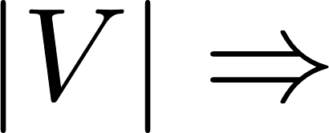
Bellman-Ford
start state
goal states
What’s the run time? O(|V||E|)
1
Changes past
iter cycle
1
-2
2
-5
3
2
4
-1

Slide 26
Bellman-Ford Pseudocode
for i from 1 to |V| - 1:
for edge (u, v) with weight w:
if( dist(v) > dist(u) + w)
dist(v) = dist(u) + w;
Time complexity O(|V||E|)

Slide 27
All-Pairs Shortest Path
Given a weighted, directed graph (negative weights possible). For each pairs of vertices (v, w), return length of shortest path from v to w.

Slide 28
All-Pairs Shortest Path
Given a weighted, directed graph (negative weights possible). For each pairs of vertices (v, w), return length of shortest path from v to w.
Run Bellman-Ford for each v: O(|V|²|E|)

Slide 29
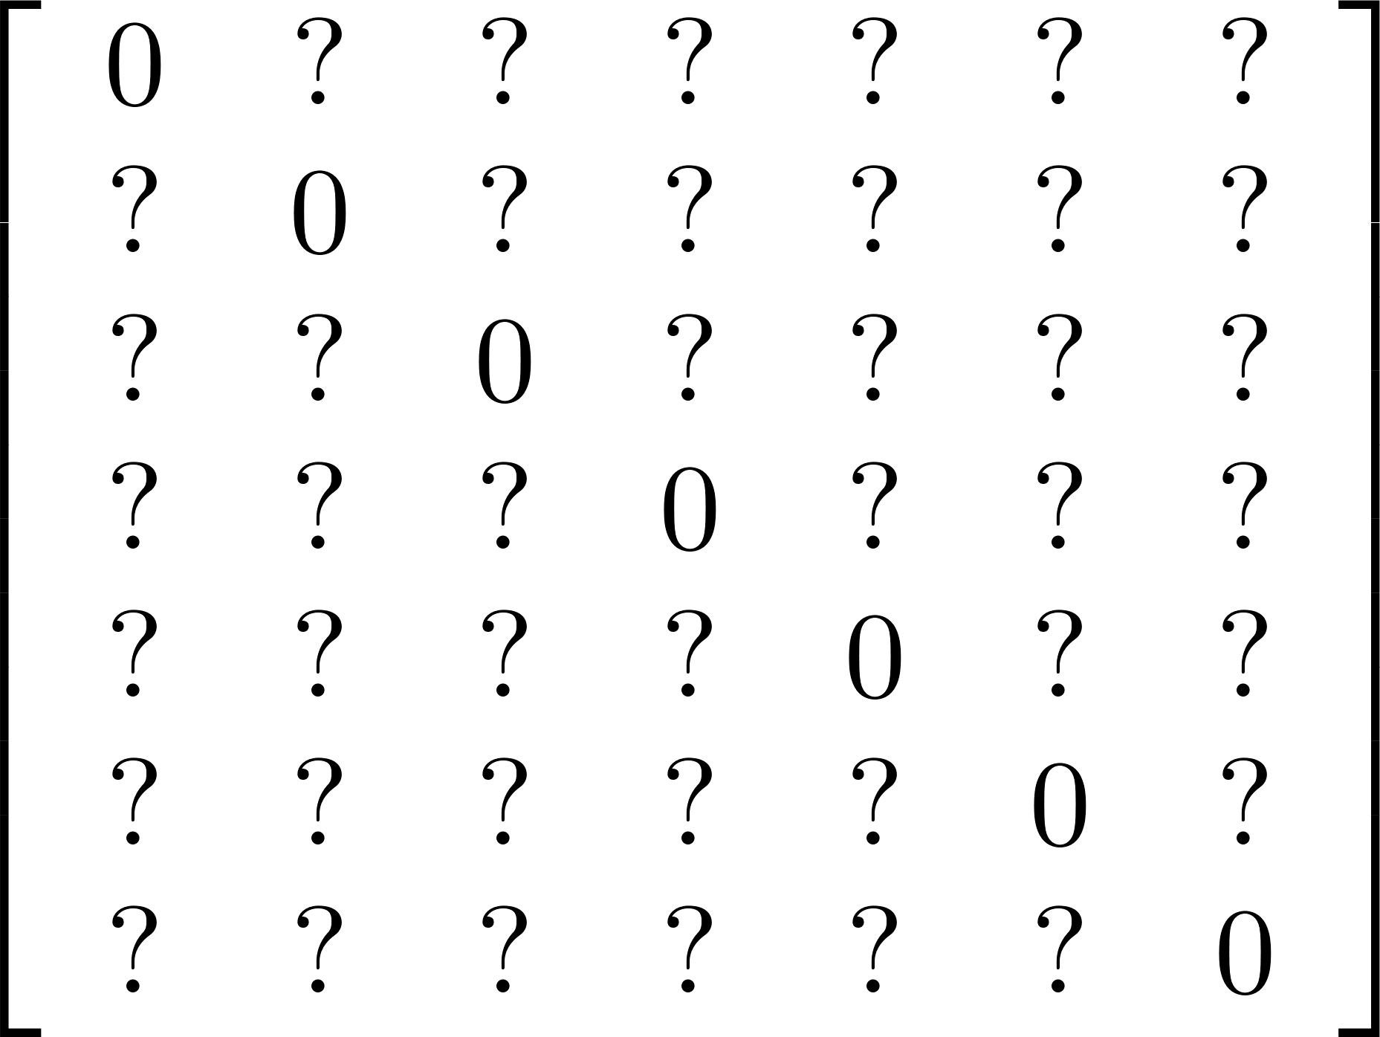
All-Pairs Shortest Path
₀
6
₁
1
₂
-2
2
₃
-1
3
2
4
₅
₄
₆
-1
Vertex costs no longer useful; create distance matrix

Slide 30
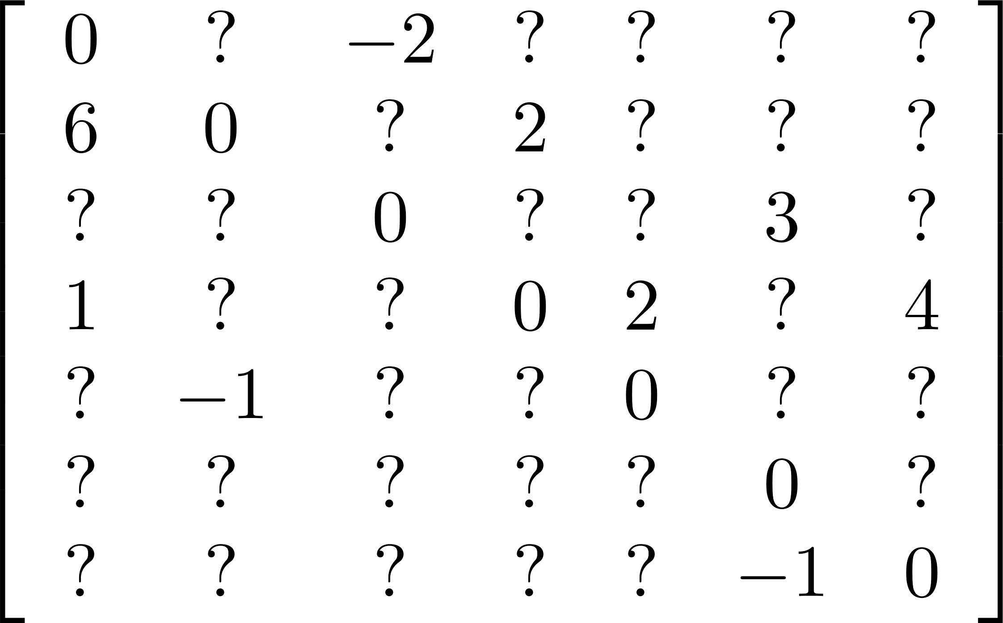
All-Pairs Shortest Path
₀
6
₁
1
₂
-2
2
₃
-1
3
2
4
₅
₄
₆
-1

Slide 31
All-Pairs Shortest Path
₀
6
₁
1
₂
-2
2
₃
-1
3
2
4
₅
₄
₆
-1
Which paths can improve by passing through node 0?

Slide 32
All-Pairs Shortest Path
₀
6
₁
1
₂
-2
2
₃
-1
3
2
4
₅
₄
₆
-1
Which paths can improve by passing through node 0?

Slide 33
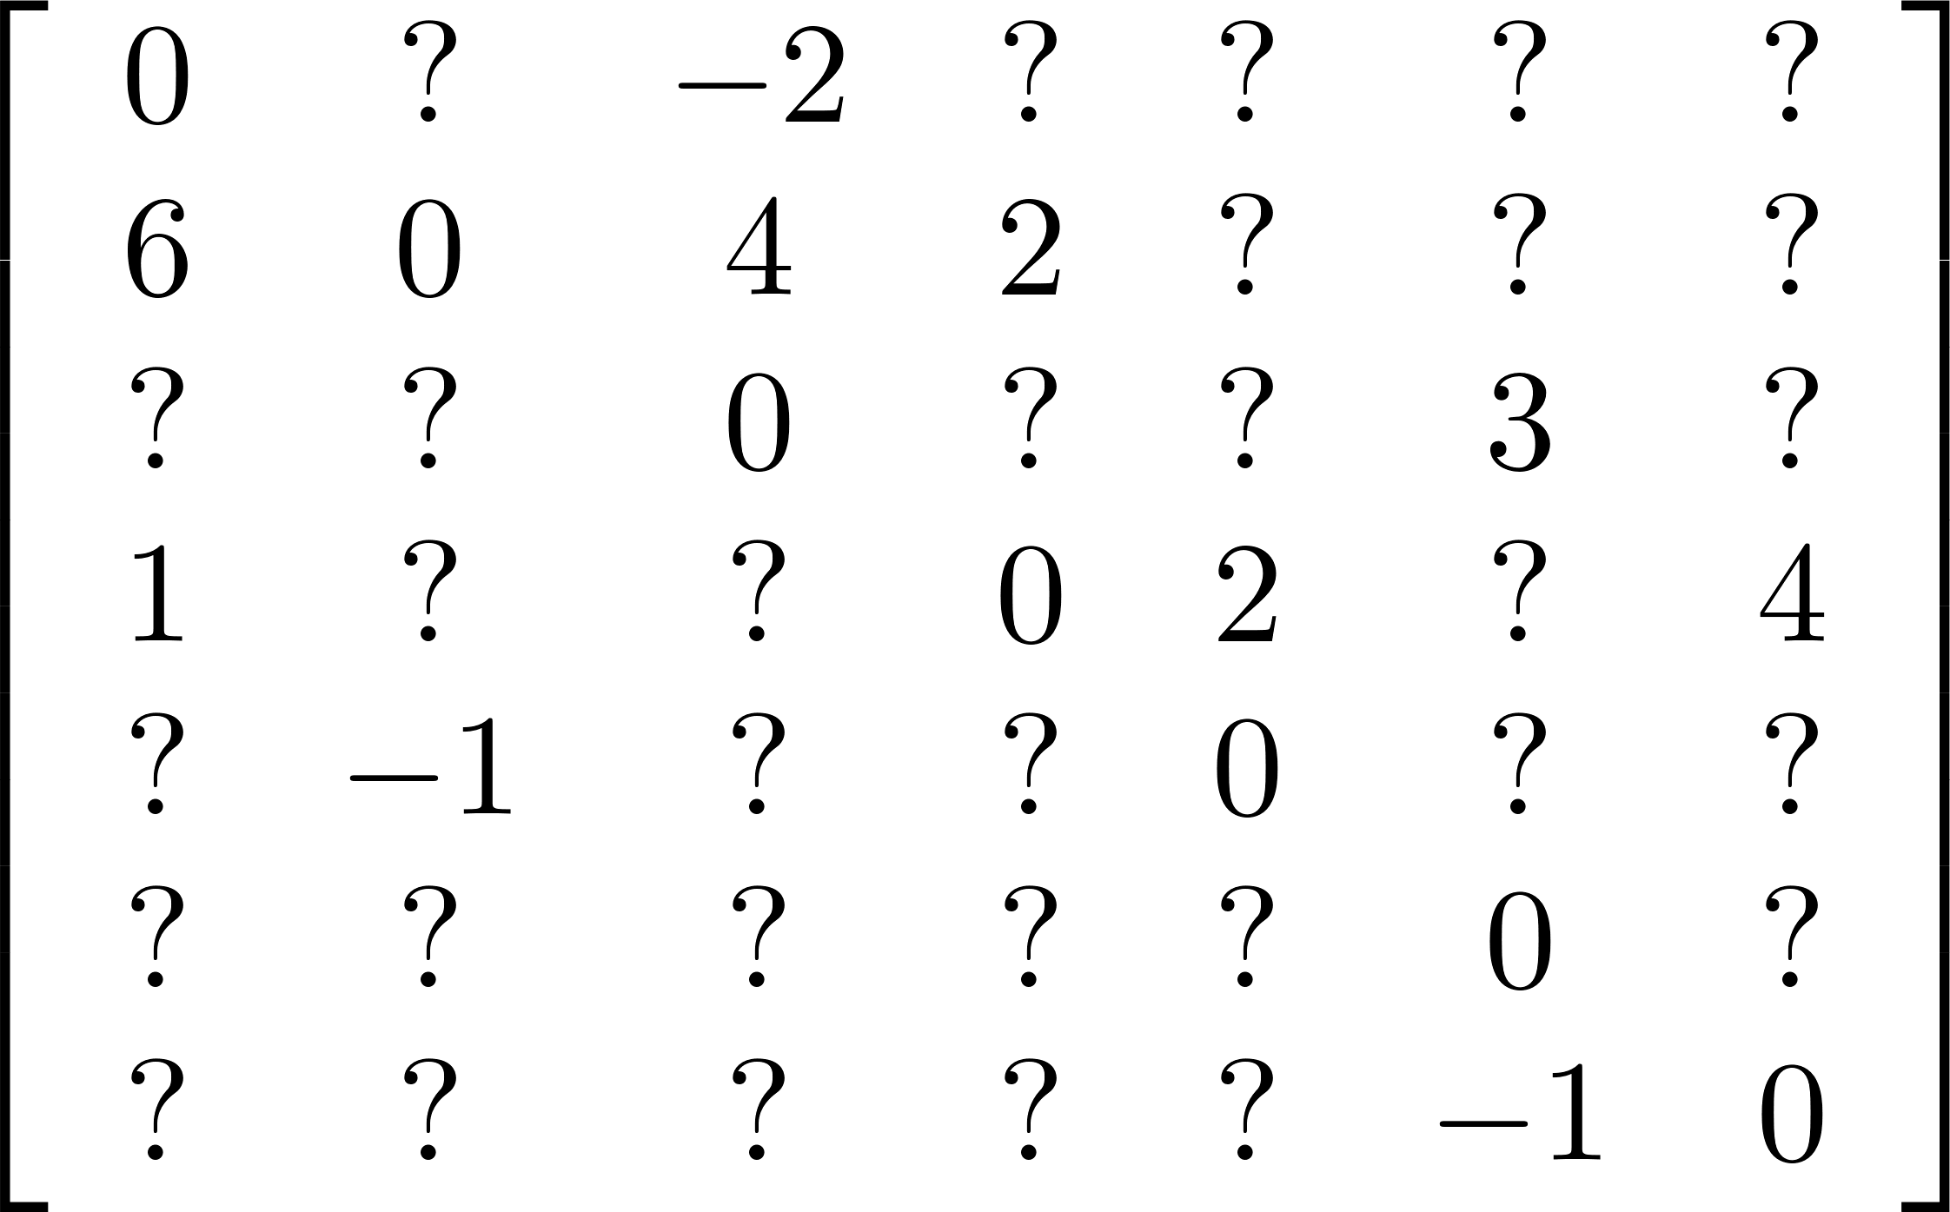
All-Pairs Shortest Path
₀
6
₁
1
₂
-2
2
₃
-1
3
2
4
₅
₄
₆
-1
Which paths can improve by passing through node 0?

Slide 34
All-Pairs Shortest Path
₀
6
₁
1
₂
-2
2
₃
-1
3
2
4
₅
₄
₆
-1
Which paths can improve by passing through node 0?

Slide 35
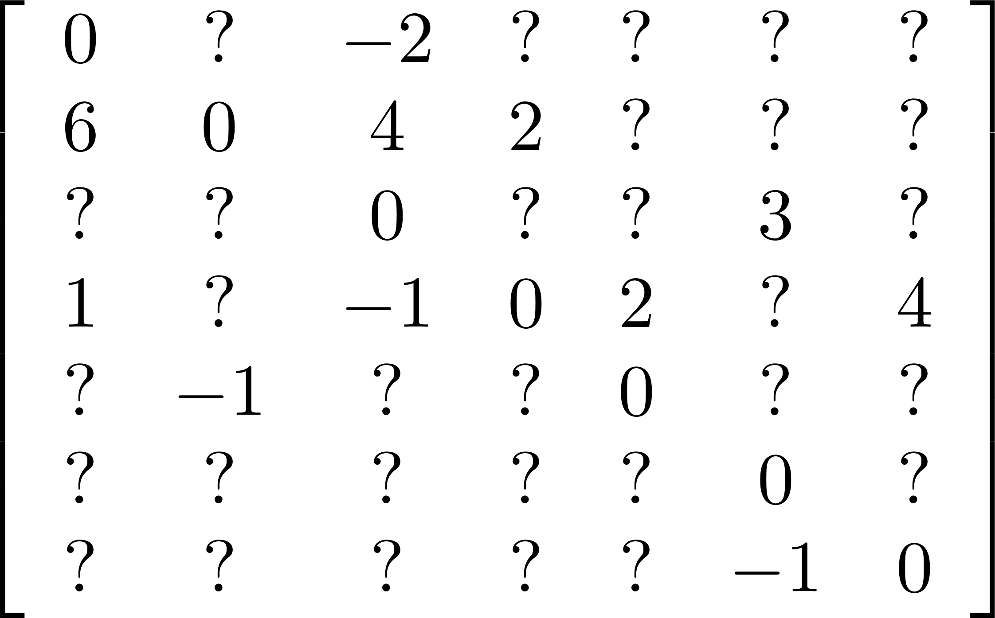
All-Pairs Shortest Path
₀
6
₁
1
₂
-2
2
₃
-1
3
2
4
₅
₄
₆
-1
Which paths can improve by passing through node 0?

Slide 36
All-Pairs Shortest Path
₀
6
₁
1
₂
-2
2
₃
-1
3
2
4
₅
₄
₆
-1
Which paths can improve by passing through node 1?

Slide 37
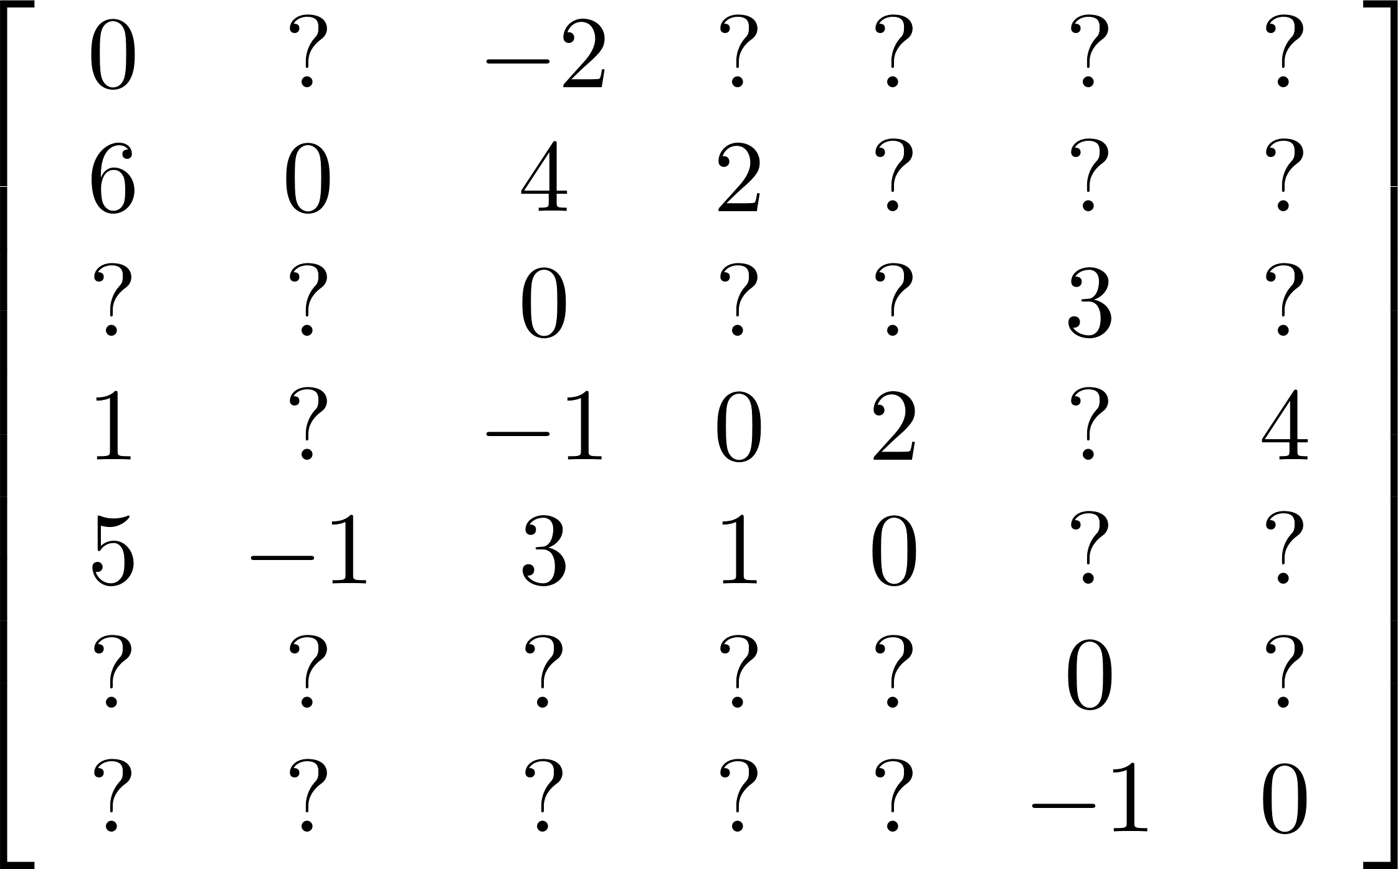
All-Pairs Shortest Path
₀
6
₁
1
₂
-2
2
₃
-1
3
2
4
₅
₄
₆
-1
Which paths can improve by passing through node 1?

Slide 38
Floyd-Warshall
for each vertex k:
for each vertex v:
for each vertex w:
if( dist(v,w) > dist(v,k) + dist(k,w) )
dist(v,w) = dist(v,k) + dist(k,w);

Slide 39
Floyd-Warshall
for each vertex k:
for each vertex v:
for each vertex w:
if( dist(v,w) > dist(v,k) + dist(k,w) )
dist(v,w) = dist(v,k) + dist(k,w);
Claim: if no negative cycles, will find all shortest paths

Slide 40
Floyd-Warshall
for each vertex k:
for each vertex v:
for each vertex w:
if( dist(v,w) > dist(v,k) + dist(k,w) )
dist(v,w) = dist(v,k) + dist(k,w);
How can we tell if there are negative cycles?

Slide 41
Floyd-Warshall
for each vertex k:
for each vertex v:
for each vertex w:
if( dist(v,w) > dist(v,k) + dist(k,w) )
dist(v,w) = dist(v,k) + dist(k,w);
How can we tell if there are negative cycles? Check for dist(v,v) < 0

Slide 42
Floyd-Warshall
for each vertex k:
for each vertex v:
for each vertex w:
if( dist(v,w) > dist(v,k) + dist(k,w) )
dist(v,w) = dist(v,k) + dist(k,w);
Danger: watch for overflow is using MAXINT to denote missing edges

Slide 43
Floyd-Warshall
for each vertex k:
for each vertex v:
for each vertex w:
if( dist(v,w) > dist(v,k) + dist(k,w) )
dist(v,w) = dist(v,k) + dist(k,w);
Time complexity O(|V|³)

