Slide 1
Union-Find
Aditya arjun, Kevin li

Slide 2
Introduction

Slide 3
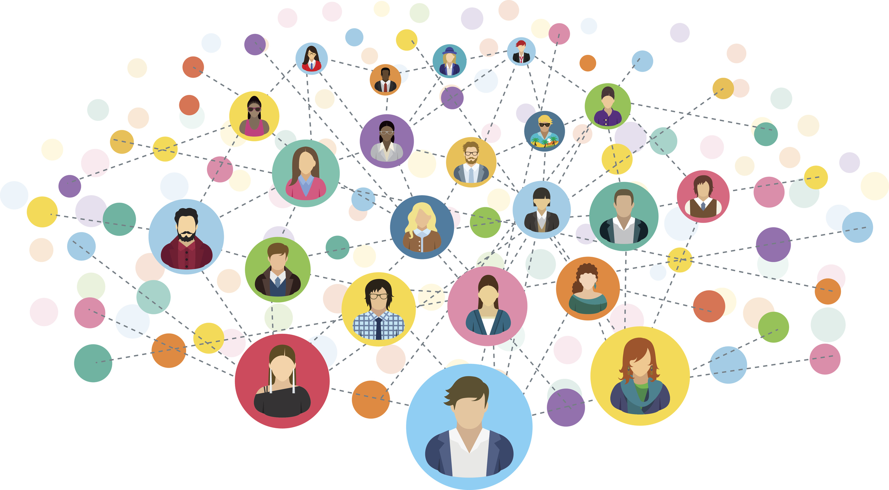
Social Networking, Revisited
Want to build a social network app with users
Functions:
Add users
Connect users
Determine if two users are connected directly, or indirectly

Slide 4
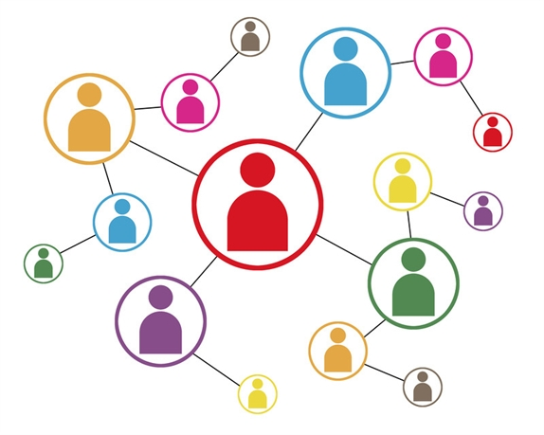
Graph Representation
Treat people as vertices
Adding a person is just adding a vertex in the graph
Treat connections as edges
Adding an edge is just adding an edge in the graph
How to check connectedness?
Flood Fill (DFS, BFS)

Slide 5
Graph Representation Runtime
Adding a person
O(1)
Adding a connection
O(1)
Checking if two people are connected
O(N)

Slide 6
Array Representation
Give each person an ID
Initially, each person has a unique ID
Once two people are merged, they will share the same ID
Anyone that is connected to either of these two people will also share that ID
Let’s make the ID of everyone in that group the smallest ID of the members
How to check if two people are connected?
Check if their IDs are the same

Slide 7
Array Representation Visualization
1 | 2 | 3 | 4 | 5 | 6 | 7
1 | 2 | 3 | 4 | 5 | 6 | 7
3
4
5
1
6
2
7

Slide 8
Array Representation Visualization
1 | 2 | 3 | 4 | 5 | 6 | 7
1 | 2 | 3 | 4 | 5 | 6 | 6
3
4
5
1
6
2
7

Slide 9
Array Representation Visualization
1 | 2 | 3 | 4 | 5 | 6 | 7
1 | 2 | 3 | 4 | 1 | 6 | 6
3
4
5
1
6
2
7

Slide 10
Array Representation Visualization
1 | 2 | 3 | 4 | 5 | 6 | 7
1 | 2 | 3 | 3 | 1 | 6 | 6
3
4
5
1
6
2
7

Slide 11
Array Representation Visualization
1 | 2 | 3 | 4 | 5 | 6 | 7
1 | 2 | 3 | 3 | 1 | 3 | 3
3
4
5
1
6
2
7

Slide 12
Array Representation Visualization
1 | 2 | 3 | 4 | 5 | 6 | 7
1 | 2 | 2 | 2 | 1 | 2 | 2
3
4
5
1
6
2
7

Slide 13
Array Representation Visualization
1 | 2 | 3 | 4 | 5 | 6 | 7
1 | 1 | 1 | 1 | 1 | 1 | 1
3
4
5
1
6
2
7

Slide 14
Array Representation Runtime
Adding a person
O(1)
Connecting two people (Union)
O(N)
Checking if two people are connected (Find)
O(1)

Slide 15
Union-Find
Data Structure with two primary functions, Union and Find
Union: Joins two elements together
Find: Determine the ID of an element
Two elements are connected if they have the same ID

Slide 16
Optimization

Slide 17
Array Representation Adjustments
Want to adjust our data structure to allow for optimization
Be a bit lazy with ID updating
Turn each group into a tree, where the ID of the tree is the ID of the root
8
1
1
8
2
3
6
7
4
5

Slide 18
Array Representation Adjustments
union(A, B):
Find root(A) and root(B)
Set either root(A)’s parent to be root(B), or visa versa
find(A):
Look for the ID of the root
Done recursively, basically keep calling find(parent(A)) until root is reached
Note: root and find are the same function, since ID of the root is itself

Slide 19
Adjusted Runtimes
Adding a person
O(1)
Connecting two people (Union)
O(1)
Checking if two people are connected (Find)
O(N)

Slide 20
Optimization 1: Path Compression
Modifying find(A)
Key Idea: when we get the ID of the root, we can store it at every step along the way
Now, the path never has to be traversed again (compressed)
Runtime: O(log N)
2 | 4 | 6 | 8
2 | 4 | 6 | 8
2
4
6
8
Recursion
2 | 4 | 6 | 8
8 | 8 | 8 | 8
2
4
6
8
Backtracking

Slide 21
Optimization 2: Union by Size
Modifying union(A, B)
Keep track of how many nodes are in each group
Assume size(A) < size(B), then set root(A) to be root(B)’s child
Runtime: O(log N)
8
8
8
1
6
7
2
3
4
5

Slide 22
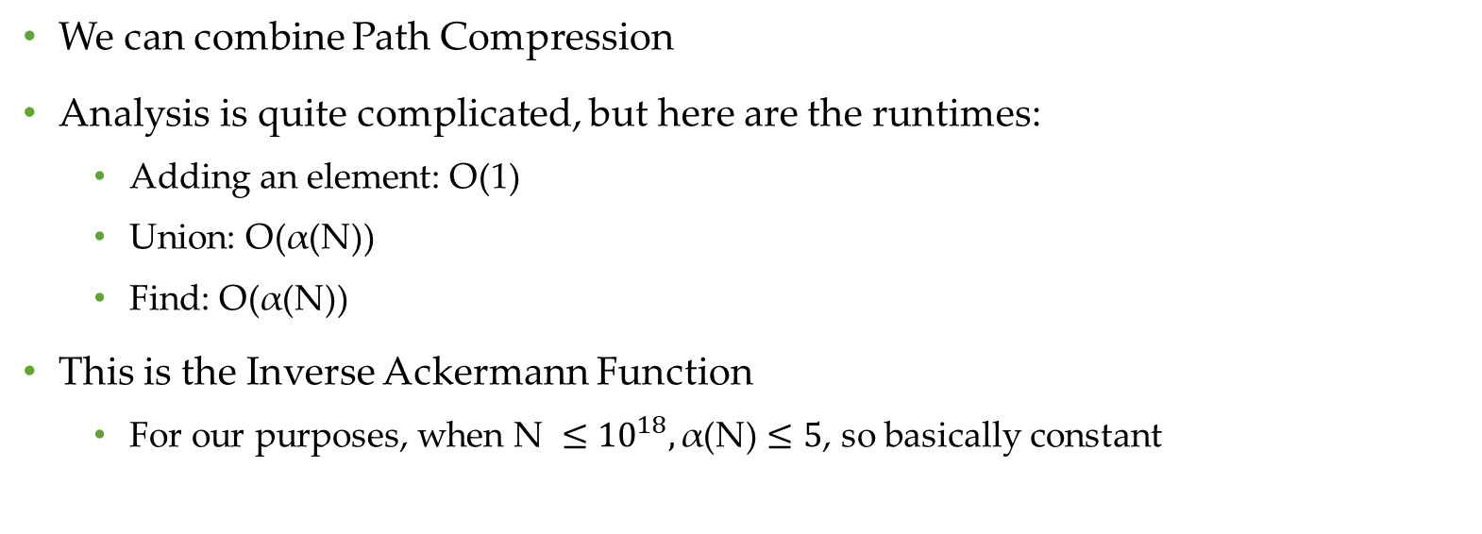
Combined Overall Runtime
We can combine Path Compression
Analysis is quite complicated, but here are the runtimes:
Adding an element: O(1)
Union: O(α(N))
Find: O(α(N))
This is the Inverse Ackermann Function
For our purposes, when $\text{N} ≤{10}^{18}, \text{α}\text{(}\text{N}\text{)}≤5$, so basically constant

Slide 23
Applications

Slide 24
Cycle Detection
Give an undirected graph G(V, E), determine if a cycle exists using Union-Find
Iterate through all edges, applying Union the two vertices it connects
If the two vertices were previously connected, then there is a cycle

Slide 25
Graph Connectedness
Given a Graph, determine if it is connected using Union-Find
Iterate through all the edges again, applying Union on both endpoints
Check that all IDs for vertices in the graph are the same

Slide 26
Minimum Spanning Tree

Slide 27
Fiber Network
Google is trying to build a fiber network for N houses. It has determined M possible interhouse connections, each with a cost w_{i}. The goal is to try to ensure that every house is connected to every other house, directly or indirectly.
How would we go about solving this?

Slide 28
Greedy Solution
Always take the shortest edge (Why?)
If shortest edge is not in graph, always optimal to swap
We can keep taking the shortest edge
Need to check that adding the connection helps
Do not want to waste money connecting two houses when they’re already connected

Slide 29
Utilizing Union-Find
Union-Find can help us determine if adding an edge connects two previously nonconnected vertices

Slide 30
Kruskal’s Algorithm
Given a graph G(V, E) of possible connections
Sort the edges in ascending order by weight
Repeatedly add the shortest edge that connects two unconnected vertices
Continue until graph is connected
Overall Runtime
O(E log E) + O(E ∙ α) = O(E log V)

Slide 31
Kruskal’s Visualization

Slide 32
Live Coding

