Slide 1
Plane Geometry Algorithms
TexPoint fonts used in EMF.
Read the TexPoint manual before you delete this box.: AAAAAAAAAAAAAA

Slide 2
Geometry Algorithms
Show up every now and then
0-1 questions per contest
Almost always 2D (plane) geometry

Slide 3
Geometry Algorithms
Show up every now and then
0-1 questions per contest
Almost always 2D (plane) geometry
3D algorithms “too hard”/specialized
test cases easier to create
diagrams easier to draw…

Slide 4
Blast Zone
Given:
list of points (x_{i}, y_{i})
epicenter (x_{c}, y_{c})
radius r
Count number of points distance <= r from epicenter
All inputs are ints between -2³⁰ and 2³⁰

Slide 5
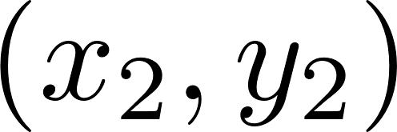
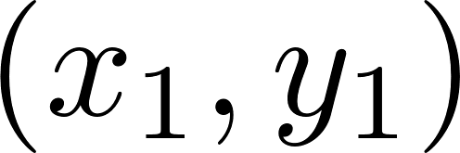
Vectors and Distance

Slide 6
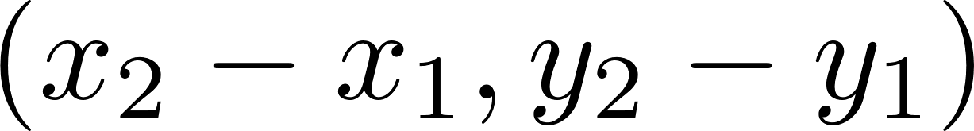
Vectors and Distance
vector from to :

Slide 7
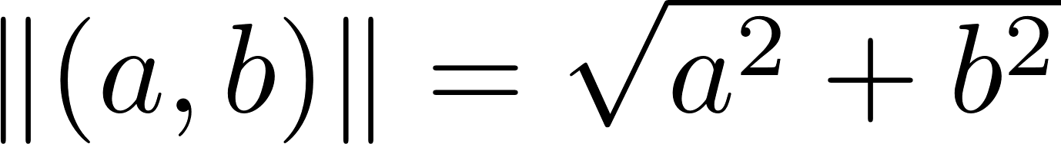
Vectors and Distance
vector from to :
length of vectors:

Slide 8
Vectors and Distance
vector from to :
length of vectors:
distance:

Slide 9

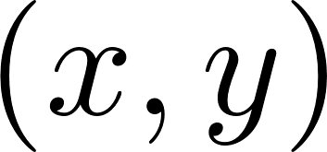
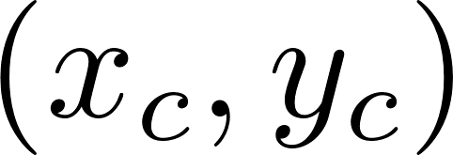
Circle-Point Queries

Slide 10
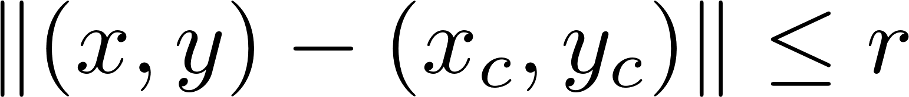
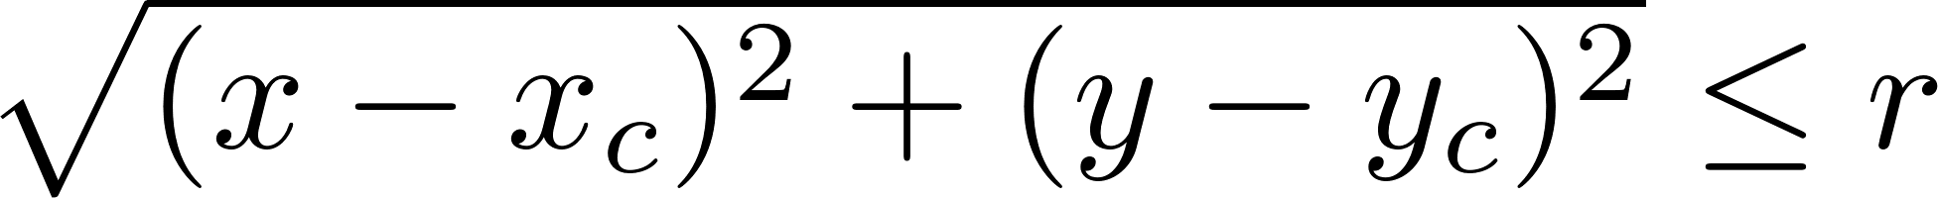
Circle-Point Queries
point inside circle if

Slide 11
Blast Zone?
Given:
list of points (x_{i}, y_{i})
epicenter (x_{c}, y_{c})
radius r
All inputs are ints between -2³⁰ and 2³⁰
O(points) solution: loop over all points, and check if

Slide 12
Blast Zone?
MAJOR decision: what data type should
we use for this calculation?
Given:
list of points (x_{i}, y_{i})
epicenter (x_{c}, y_{c})
radius r
All inputs are ints between -2³⁰ and 2³⁰
O(points) solution: loop over all points, and check if

Slide 13
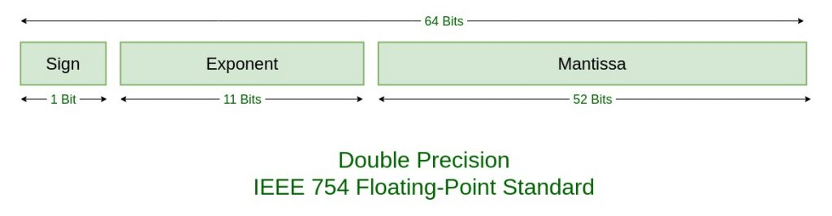
Doubles or Ints?
IEEE floating point is complicated, but there are some basics you should know
Structure of a double:

Slide 14
IEEE Floating Point
Integers up to 2⁵² (about 15 decimal digits) can be exactly represented

Slide 15
IEEE Floating Point
Integers up to 2⁵² (about 15 decimal digits) can be exactly represented
Other numbers have up to 52 bits of precision. This goes down as errors accumulate in intermediate calculations

Slide 16
IEEE Floating Point
Integers up to 2⁵² (about 15 decimal digits) can be exactly represented
Other numbers have up to 52 bits of precision. This goes down as errors accumulate in intermediate calculations
When in doubt, use exact arithmetic. (And never use floats…)

Slide 17
Blast Zone? Take II
Given:
list of points (x_{i}, y_{i})
epicenter (x_{c}, y_{c})
radius r
All inputs are ints between -2³⁰ and 2³⁰
O(points) solution: loop over all points, and check if
ints or doubles?

Slide 18
Circle-Point Queries
point inside circle if

Slide 19
Blast Zone? Take II
Given:
list of points (x_{i}, y_{i})
epicenter (x_{c}, y_{c})
radius r
All inputs are ints between -2³⁰ and 2³⁰
O(points) solution: loop over all points, and check if
ints or doubles?

Slide 20
Two Kinds of Geometry Problems
Exact Arithmetic
Floating Point
Inputs are doubles
Problem statement says “answer is accepted if it is within [tolerance]”
Problem statement says “answer will not change if inputs are slightly perturbed”

Slide 21
Two Kinds of Geometry Problems
Exact Arithmetic
Floating Point
Pretty much any other situation
Problem statements with “round the answer to n digits” are not safe for floating point!
Inputs are doubles
Problem statement says “answer is accepted if it is within [tolerance]”
Problem statement says “answer will not change if inputs are slightly perturbed”

Slide 22
Two Kinds of Geometry Problems
Exact Arithmetic
Floating Point
Pretty much any other situation
Problem statements with “round the answer to n digits” are not safe for floating point!
Inputs are doubles
Problem statement says “answer is accepted if it is within [tolerance]”
Problem statement says “answer will not change if inputs are slightly perturbed”
Incorrectly classifying the type of problem is a fatal noob trap!!

Slide 23
Geometry Algorithms
Key challenges:
Remembering (or deriving) formulas
Dealing with precision issues
Dealing with potential overflow

Slide 24
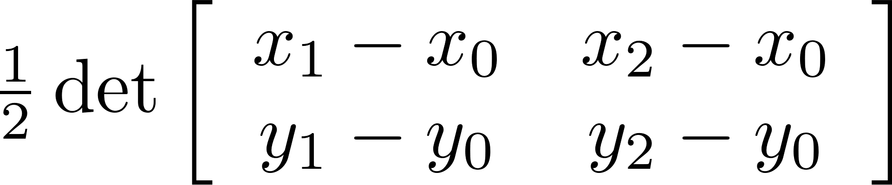
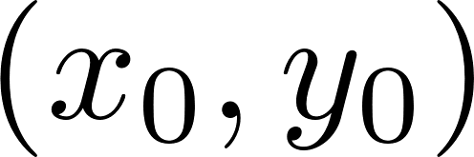
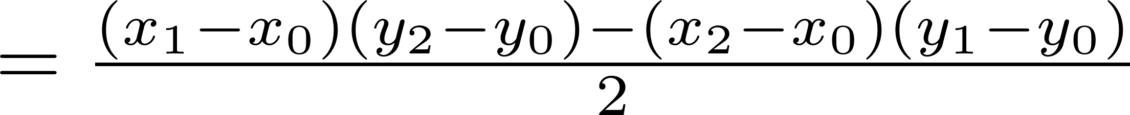
Triangle Area
Signed area:

Slide 25
Triangle Area
Signed area:
Why signed?

Slide 26
Triangle Area
Signed area:
Why signed?

Slide 27
Triangle Area
Signed area:
Why signed?

Slide 28
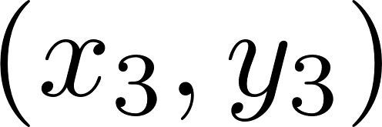
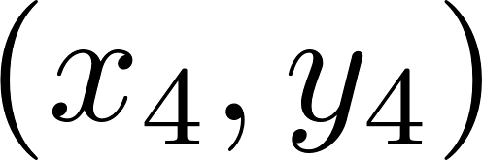
Polygon Area
Given a list of integer points in the plane, calculate area of polygon
All input ints between -2¹⁵ and 2¹⁵

Slide 29
Polygon Area
The hard way: divide and conquer “ear cutting”

Slide 30
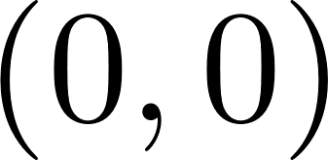
Polygon Area
The easy way:

Slide 31
Polygon Area
The easy way:

Slide 32
Polygon Area
The easy way:

Slide 33
Polygon Area
The easy way:

Slide 34
Polygon Area
The easy way:

Slide 35
Polygon Area
The easy way:

Slide 36
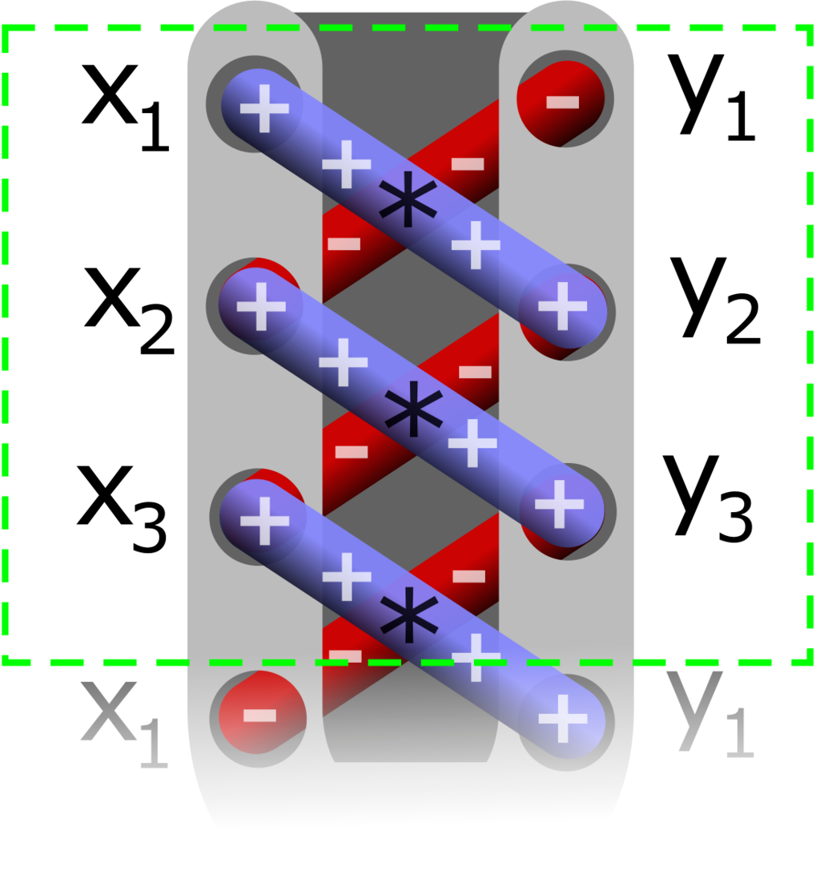
Polygon Area
The easy way: “shoelace formula”

Slide 37
Convex Hull
“Envelope” of set of points
rubber band analogy

Slide 38
Convex Hull
“Envelope” of set of points
rubber band analogy

Slide 39
Computing Convex Hull
1. Find one point on boundary
2. Until we have complete polygon, walk counterclockwise around boundary

Slide 40
Computing Convex Hull
1. Find one point on boundary

Slide 41
Computing Convex Hull
1. Find one point on boundary
e.g. point with min x coord

Slide 42
Computing Convex Hull
How to find next boundary point?
can it be this one?

Slide 43
Computing Convex Hull
How to find next boundary point?
can it be this one?

Slide 44
Computing Convex Hull
How to find next boundary point?
sweep through pts;
if we find better one,
switch to it

Slide 45
Computing Convex Hull
How to find next boundary point?
sweep through pts;
if we find better one,
switch to it

Slide 46
Computing Convex Hull
How to find next boundary point?
sweep through pts;
if we find better one,
switch to it

Slide 47
Jarvis Marching
Pros:
Intuitive
Easy to code
Cons:
Doesn’t work in 3D+
O(n^2)

Slide 48
Graham Scan
Idea: sort points by angle

Slide 49
Graham Scan
Idea: sort points by angle
Start adding edges

Slide 50
Graham Scan
Idea: sort points by angle
Start adding edges

Slide 51
Graham Scan
Idea: sort points by angle
Start adding edges

Slide 52
Graham Scan
Idea: sort points by angle
Start adding edges
Detect “left turns”

Slide 53
Graham Scan
Idea: sort points by angle
Start adding edges
Detect “left turns” and delete prev pt
Check again for a left turn

Slide 54
Graham Scan
Idea: sort points by angle
Start adding edges
Detect “left turns” and delete prev pt
Check again for a left turn
Now O(n log n)

Slide 55
Graham Scan
Pros:
Fast (O(n log n))
Cons:
Still doesn’t work in 3D+
Numerical robustness issues if points are close to colinear

