Slide 1
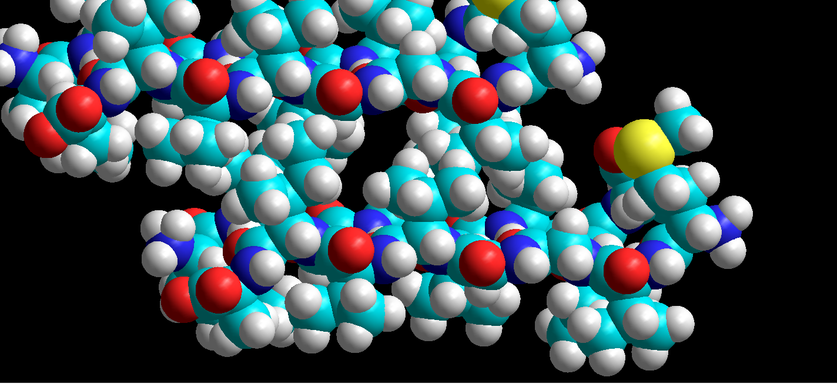
small holes in inter-layer region of 2y3l
(part opt str)

