Slide 1

Empowering Research through Computing Support
Research Support Computer Scientist Role at ICRA
Lluís Bosch
30-Nov-2023
lbosch@icra.cat

Slide 2
Overview of Services
Assistance in Programming
Assistance in Mathematical methods
Creation of Web Apps for data management
Assistance in Linux Command Line Interface ("CLI")
ICRA has a HPC Cluster (which I help maintain) running Linux
Assistance with Github ICRA's official account

Slide 3


My background
Degree in Biotechnology (UAB, 2011):
Molecular Biology, Genomics, Chemistry, Engineering
MSc in Computer Science (UdG, 2012):
Algorithms, Data manipulation, Machine Learning

Slide 4

Why coding?
Research often involves dealing with chaos
Chaos can take the form of unmanageable amounts of data
Computers can deal with chaos:
Leave the boring and repetitive tasks for computers
Use your brain for creative tasks instead
"Unix Philosophy": one program solves one single small problem
Make programs call other programs when complexity arises

Slide 5

(1/5) Programming support
My language expertise (ordered by mastery):
Javascript, Python, Unix Shell, SQL, C, Matlab/Octave, Erlang, Go, Rust, R.
I can assist in writing, debugging, and optimizing code.

Slide 6

(1/5) Programming support
When should you ask me for help?
If you find yourself editing cells in Excel one by one, or doing very manual and/or repetitive data manipulation
If you feel that you can’t just use Excel to manage all your data efficiently

Slide 7

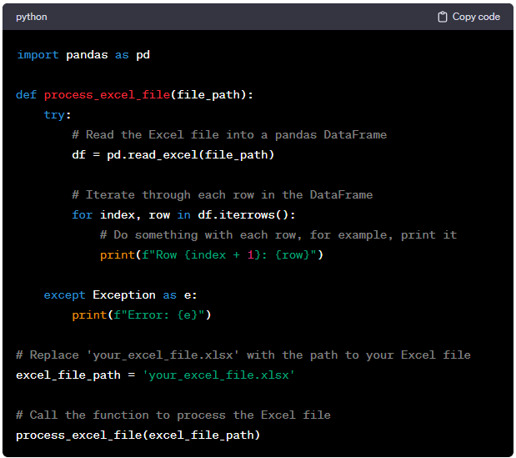
(1/5) Programming support
Example of a custom program that:
Reads an Excel file, computes something, then it might communicate with some database, create some plot, etc.
Everything you do by hand can be automated.
This way, you only care about the raw data: if your raw data changes, your script still works the same.

Slide 8

(2/5) Mathematical support
Statistical Analysis: hypothesis testing, regression, multivariate analysis...
Algorithmic Approaches: algorithms for data processing and pattern recognition is within my scope of support.
Data Modeling: From constructing mathematical models to interpreting their results, I can assist in optimizing your data-driven models.
If some method is new for me, I can learn it and create a program that implements it (usually I'll use a library that has that method implemented).
I also like creating libraries, for example I did one library for working with matrices. It can compute PCA (principal component analysis) inside the browser.

Slide 9

(3/5) Web development
Websites are useful in research projects
They are an efficient way to manage and share data.
They are OS independent (Windows, MacOS, Linux, Android)
I can create simple and quick websites for you, or big and complex ones if required.
Some examples (the 3 latest projects I've done):
Sarsaigua (platform and API)
TV at ICRA's hall
Electrical consumption at ICRA

Slide 10
SARSAIGUA (web forms)
Since 2020, 56 WWTPs sample every week and enter the data in a web form.
3 labs quantify the SARS-Cov-2 presence (PCR), they just enter the raw data from the machines in another web form, all calculations are done on the website.
Furthermore, some samples are sequenced to quantify the SARS-CoV-2 variants running among the population (mostly Omicron descendants nowadays). They insert the resulting files in another web form.
We have all the data centralized in a database; thus, we can share all the data easily.

Slide 11
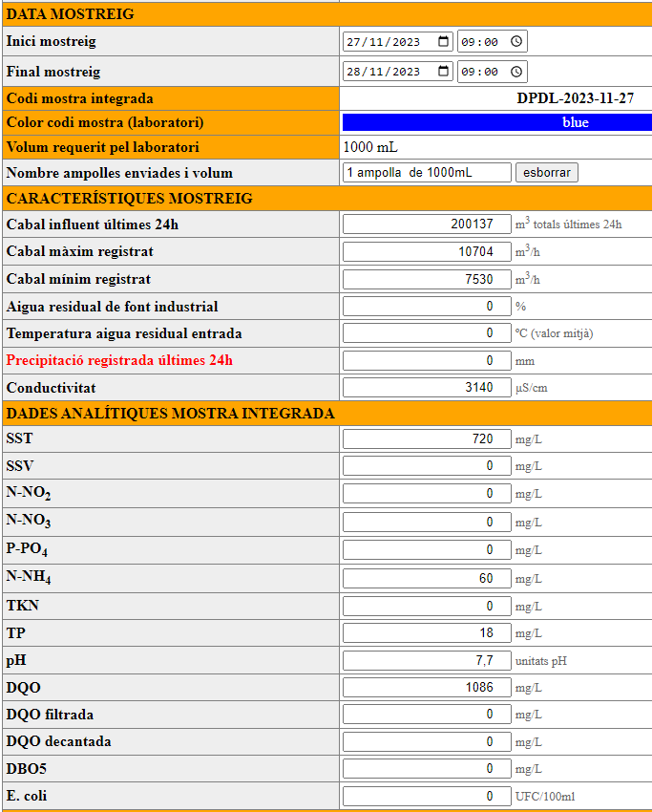
SARSAIGUA WWTP form

Slide 12
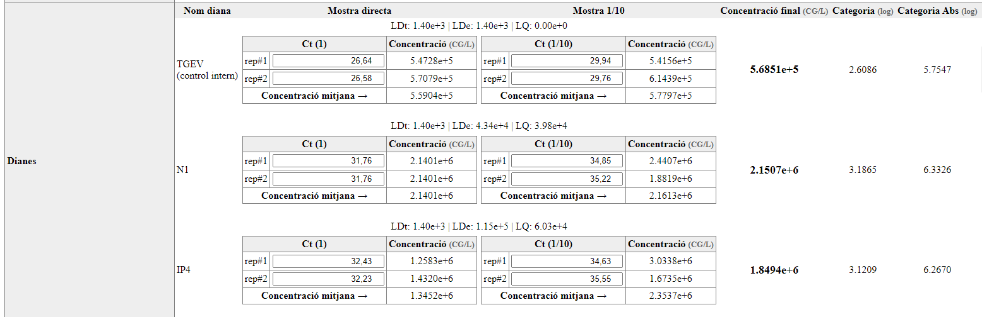
SARSAIGUA Lab form

Slide 13
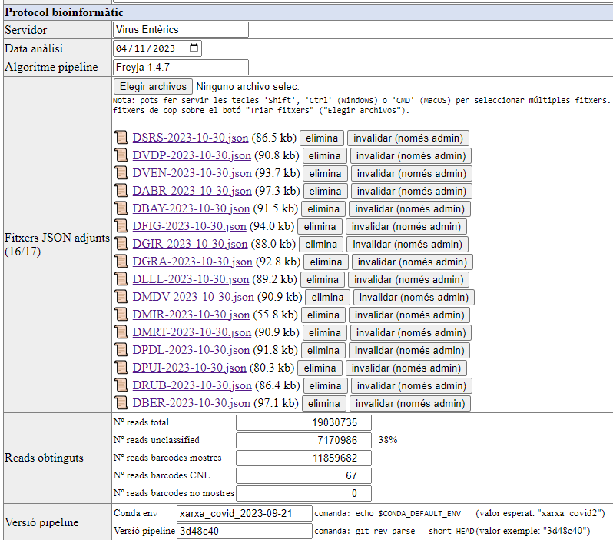
SARSAIGUA
Sequencing form

Slide 14
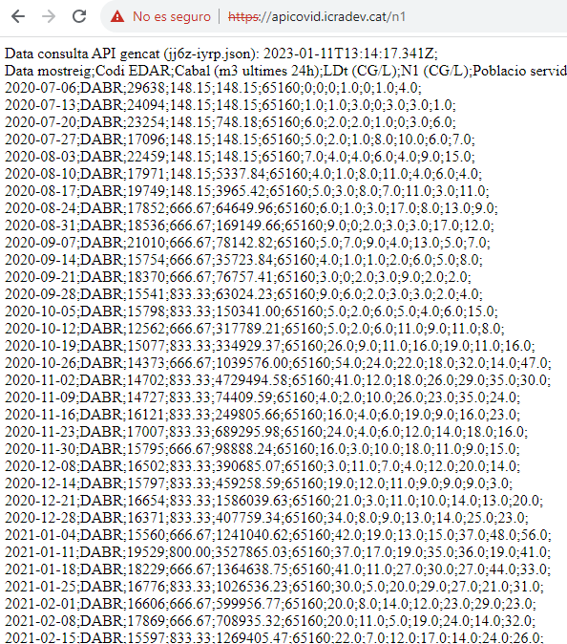
SARSAIGUA (API): on-demand generation of a CSV in a URL

Slide 15
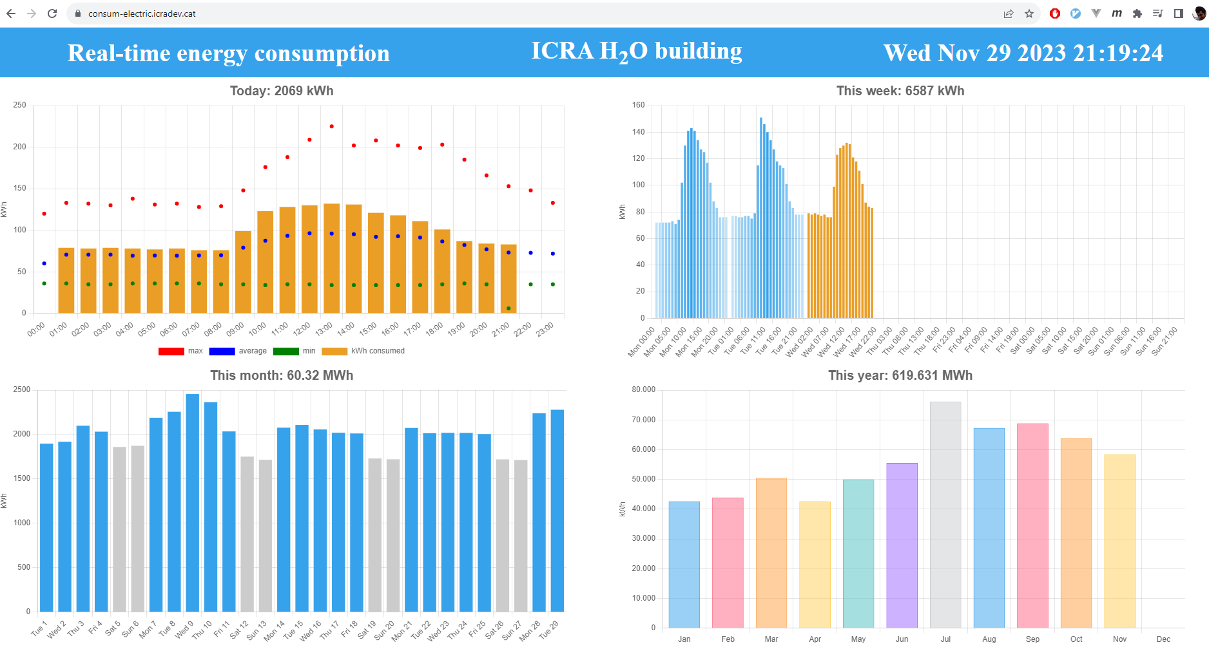
Real time electrical consumption of our building

Slide 16
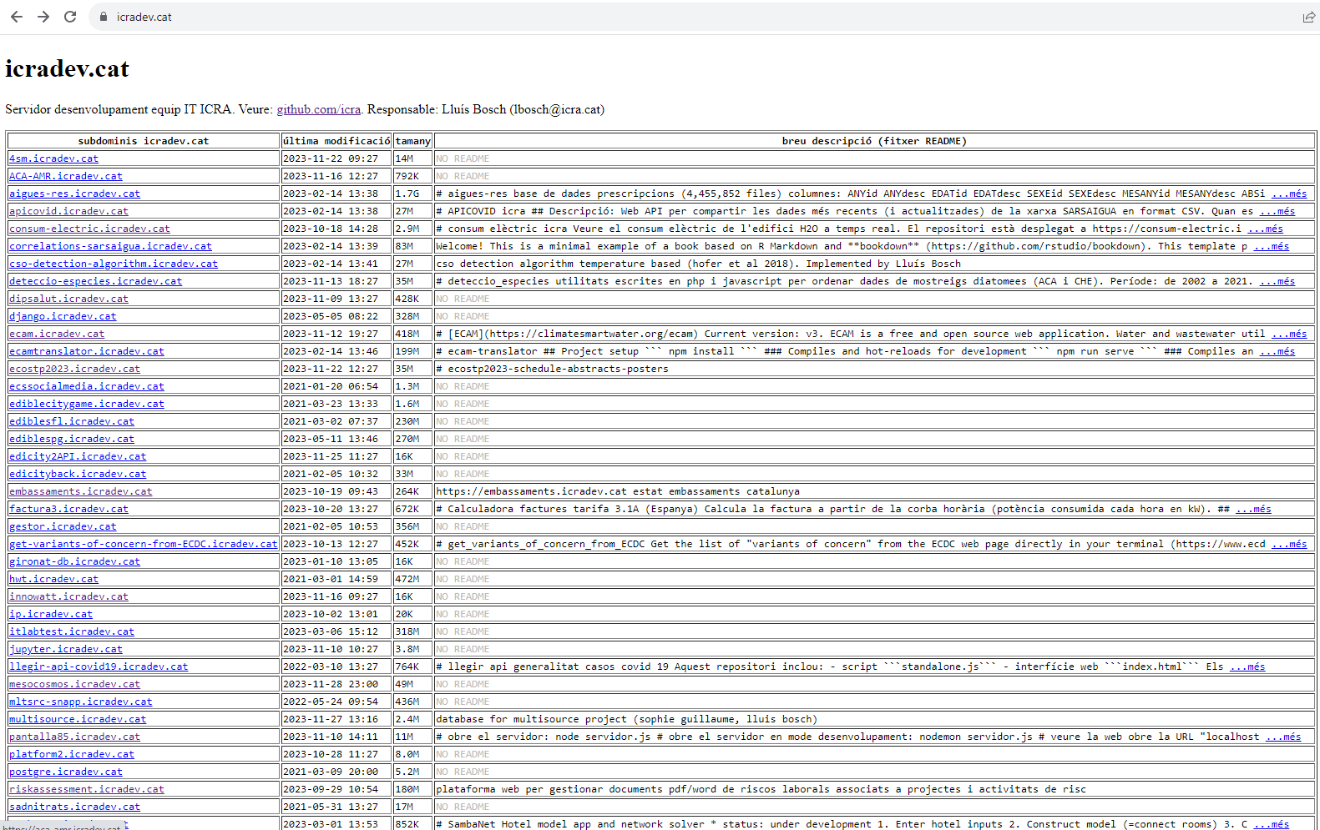
icradev.cat
As of today, We have 71 subdomains (subdomain.icra.cat and subdomain.icradev.cat)

Slide 17

(4/5) Linux
Linux is an open-source operating system.
It provides a stable and high-performance environment, for handling complex computational tasks in research.
Researchers often require customized computing environments. Linux allows for flexibility and tailoring of the operating system to specific research needs.
The use of containers technology (docker, singularity) makes dealing with custom environments very easy.

Slide 18
(4/5) Linux
The command-line interface (CLI) is a powerful tool for automation, scripting, and efficient data and files manipulation, making it indispensable for researchers working with large datasets.
Open-Source Collaboration: Linux's open-source nature fosters collaboration. Researchers can leverage a vast ecosystem of open-source tools and software for their projects.
Server Environments: Many research projects involve the use of servers for simulations, data storage, or analysis. Linux excels in server environments, providing a robust foundation for these tasks.
Highlight a Successful Application: SARSAIGUA sequencing data processed using Undarius (3 years aprox of samples).

Slide 19

(4/5) Linux (WSL)
I use Linux in my Windows 11 laptop using a Microsoft program called WSL
WSL lets you install a Linux distribution inside (I use Debian)
It can run all the Linux terminal programs and even graphical programs in the new version
Files are automatically shared between windows and linux: don't need a virtual machine

Slide 20

(4/5) Linux
The ICRA cluster consists of:
14 computers runnning Linux working in parallel, and all connected to the same drive ("/home")
Up and running 24/7: you can run tasks there
No more leaving your laptop open overnight!

Slide 21

(5/5) GitHub
GitHub today is a worldwide standard for hosting open-source and closed-source code.
When working with code, having a version control system (git) is very convenient
I maintain the official ICRA's GitHub account
GitHub lets you host your code in their servers, this way I work in the same codebase across different computers
GitHub enables collaborative work between researchers
It is also possible to publish a GitHub repository with a DOI (using Zenodo)
If you think it's relevant for your research, contact me

Slide 22

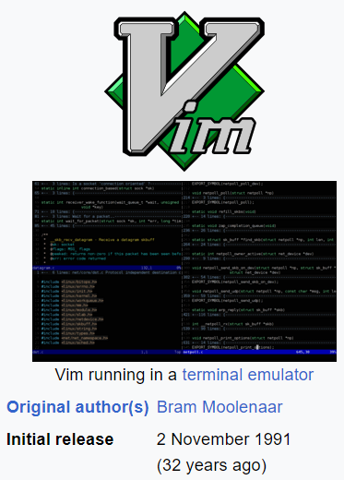
Bonus: Using Vim
vi
Vim (a text editor) is my main tool for programming (any form of text editing).
It is based on "vi", released in 1976.
I've been using it for 13-14 years.
Is a very efficient tool for manipulating text
Feel free to reach out if you're work is highly text-based, and you would be interested in incorporating Vim into your workflow.

Slide 23

Effective Collaboration: Best Practices RECAP
Programming Reach out for help with coding issues, debugging, or optimization.
Data Automation Strategies: I'm here to assist with automating data processes, enhancing efficiency in your research workflows.
Web Creation and Maintenance: Need a project website or assistance with an existing one? Let's discuss how a web interface can help your data management.
Linux Support: From basic commands to navigating the Linux environment, I'm happy to help with your computing needs.
GitHub support: If you want to share your code with the world, this is the place to do it (not the only one).

Slide 24

Q&A
Thank you for your attention!
Let's empower your research with computing!
Open floor for questions
If any researcher wants to share their specific needs and/or computing challenges they are facing, go ahead
Contact: lbosch@icra.cat

