Slide 1
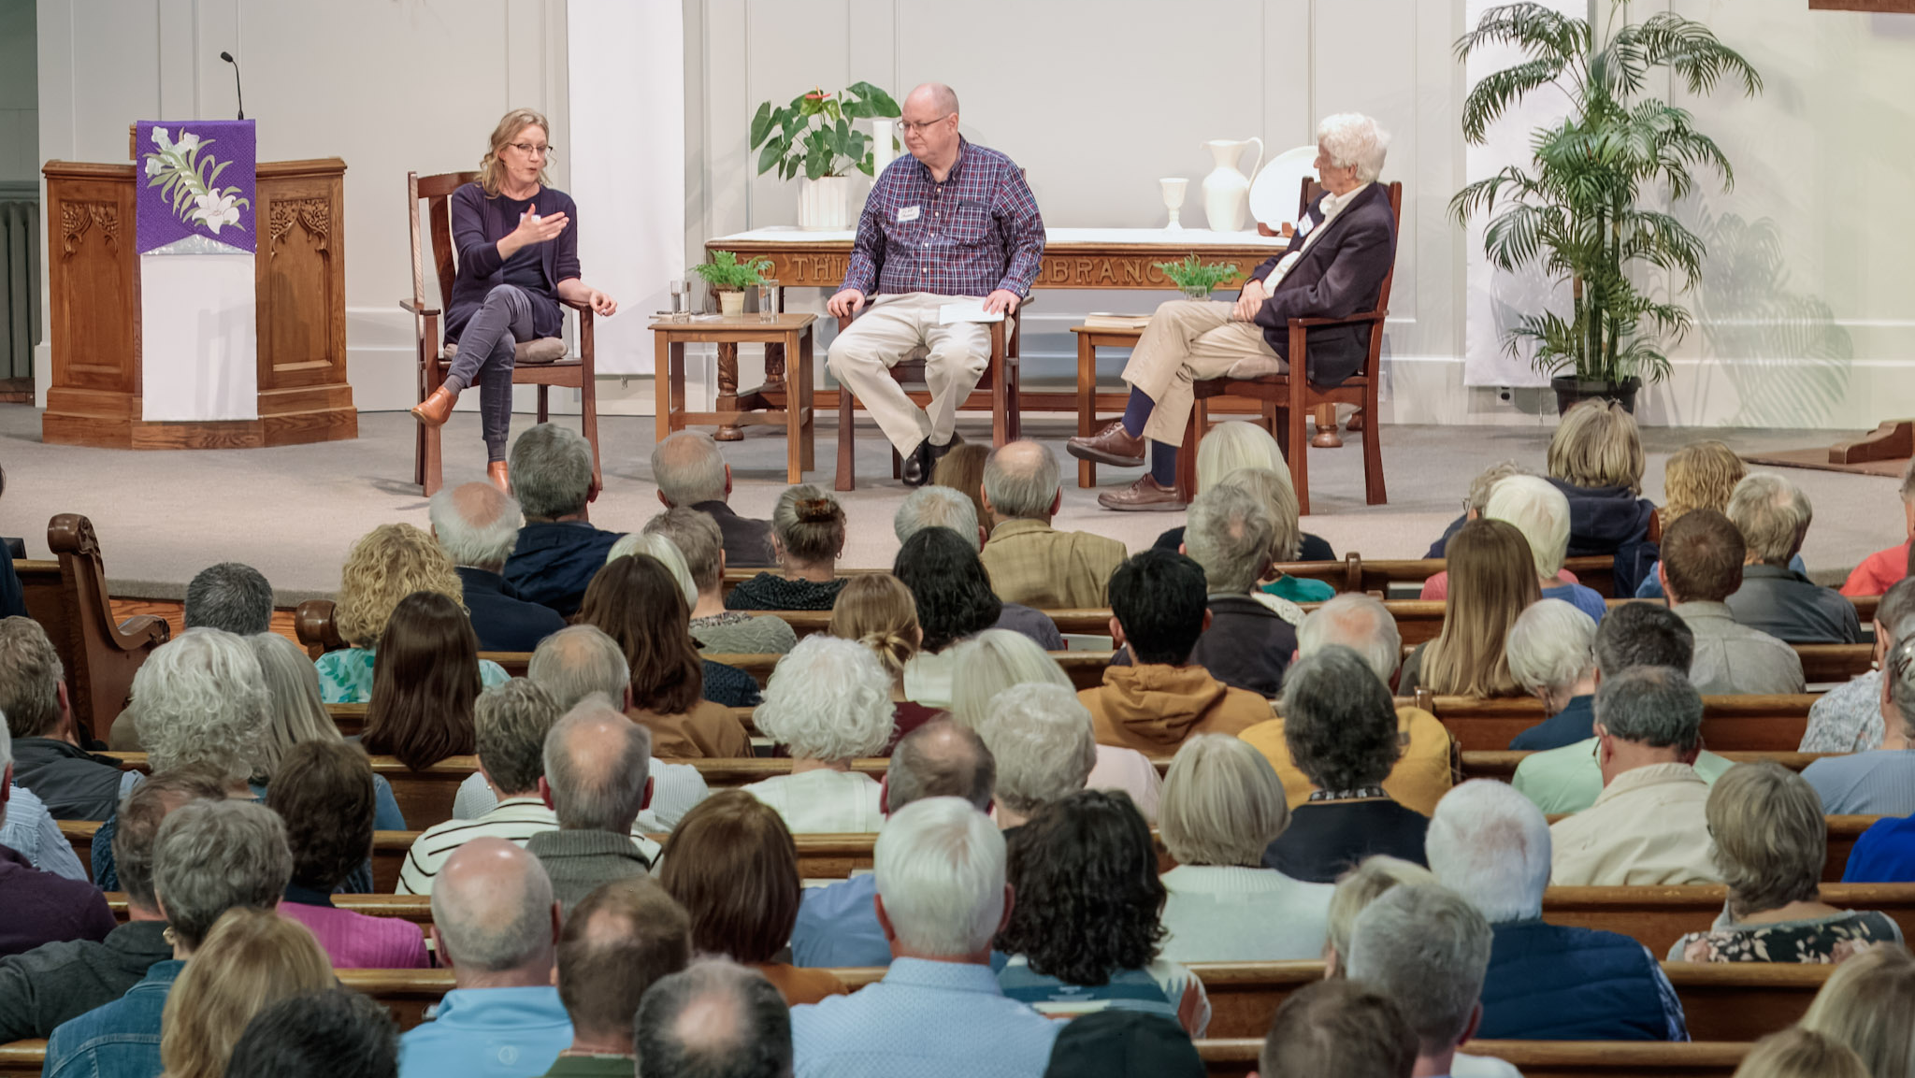
INSTITUTE FOR CHRISTIAN STUDIES
Free
to be
Faithful
Equipping Christians for Democratic Life.
2025 — 2026 SEASON

Slide 2
“
For freedom Christ has set us free.
Stand firm, therefore, and do not
submit again to a yoke of slavery.
GALATIANS 5 : 1

Slide 3
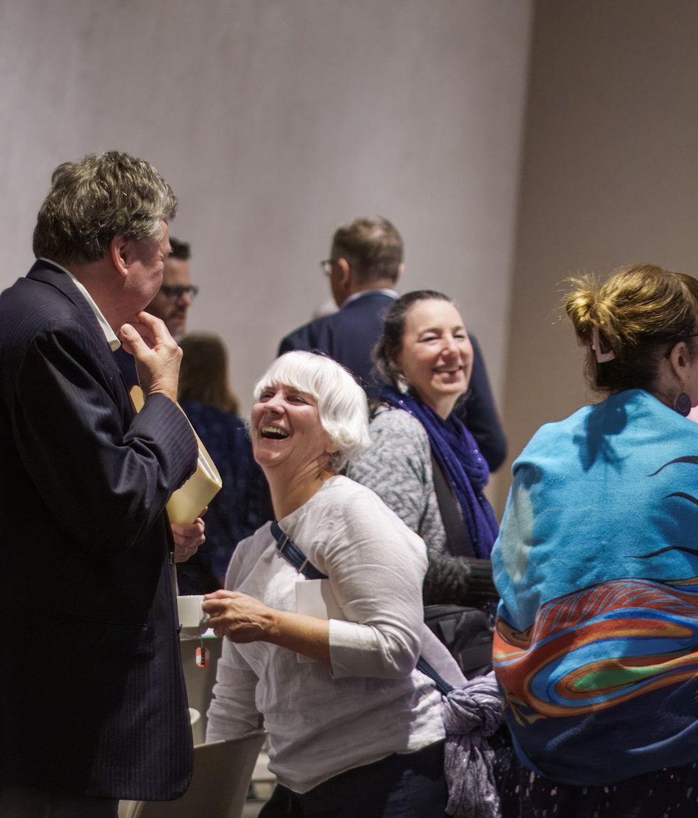
OUR MISSION
Finding a
Better Way.
Free to be Faithful is a program, a resource, and a community designed to help Christians meet our complex moment. Our courses, events, and community develop believers who are both faithfully Christian and deeply committed to the common good.
“For freedom Christ has set us free.”

Slide 4
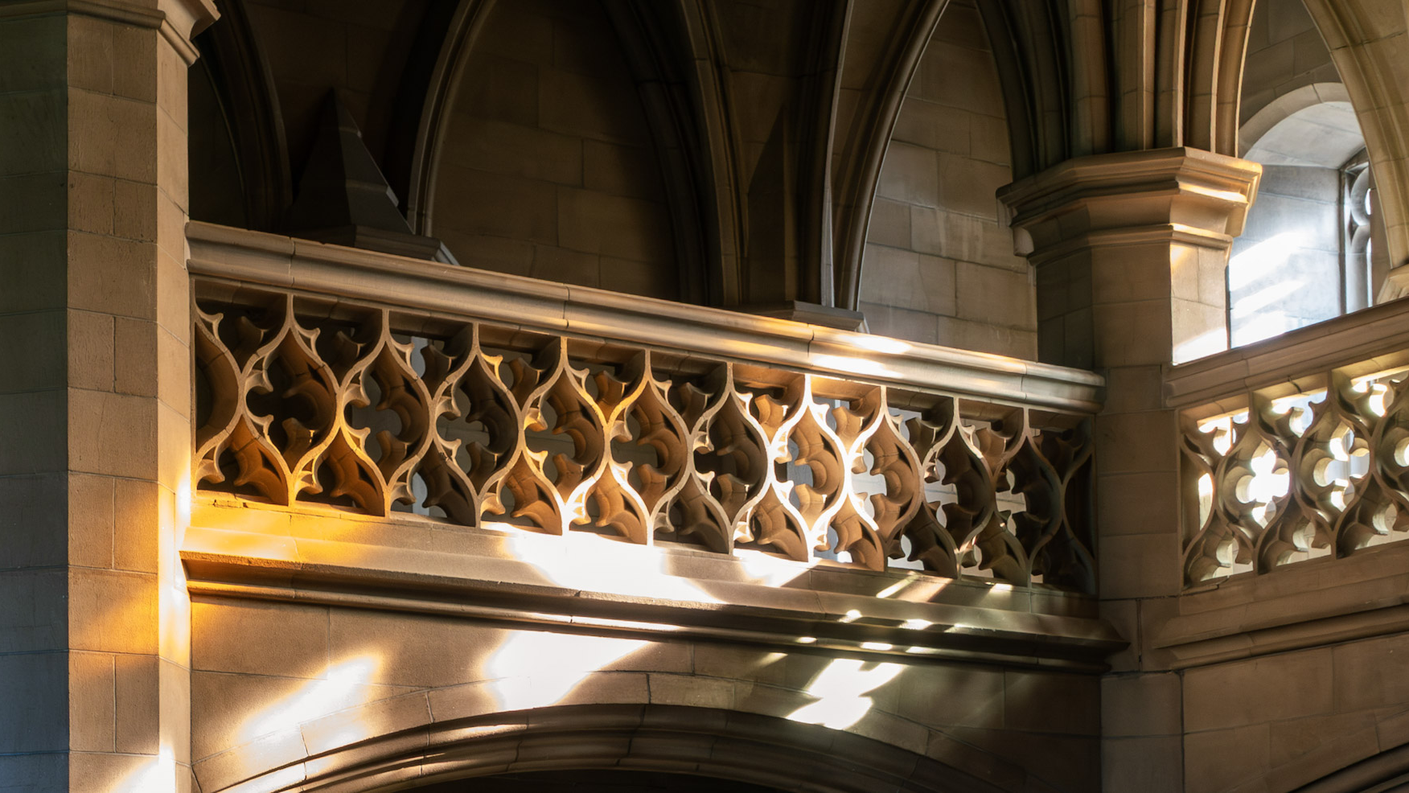
Rooted without becoming rigid.
Bold without becoming belligerent.
Faithful without becoming fearful.

Slide 5
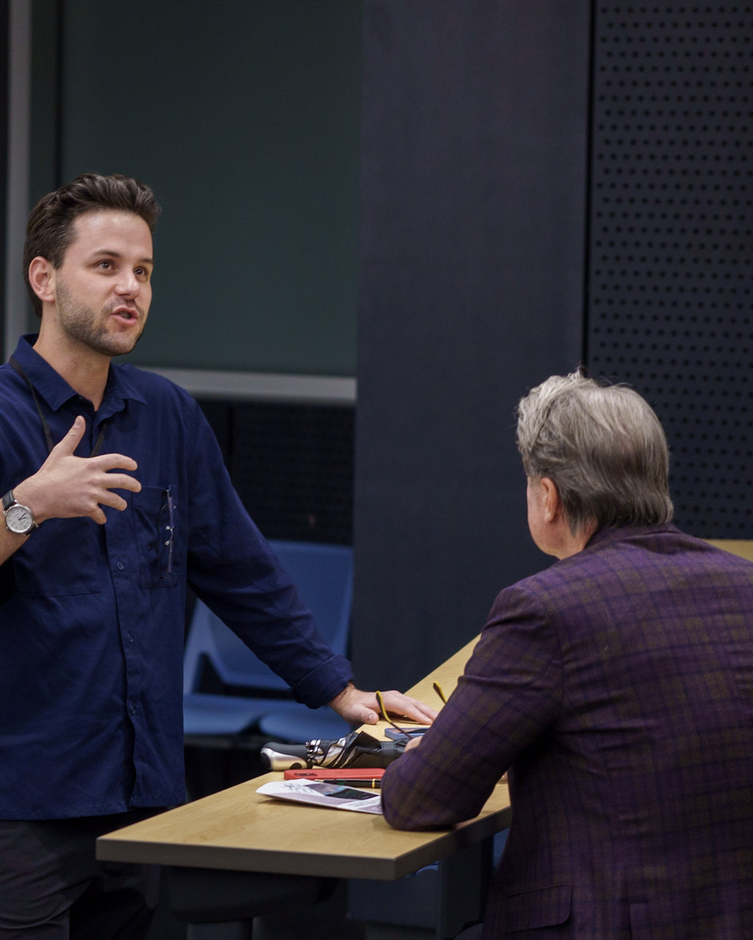
01
WHAT WE OFFER
Program
Six-week online seminars led by world-class scholars, with the option to earn ICS credit toward degree completion.
Courses to foster deeper understanding
Retreats and intensives for all walks
Pathways toward a Master of Worldview Studies

Slide 6
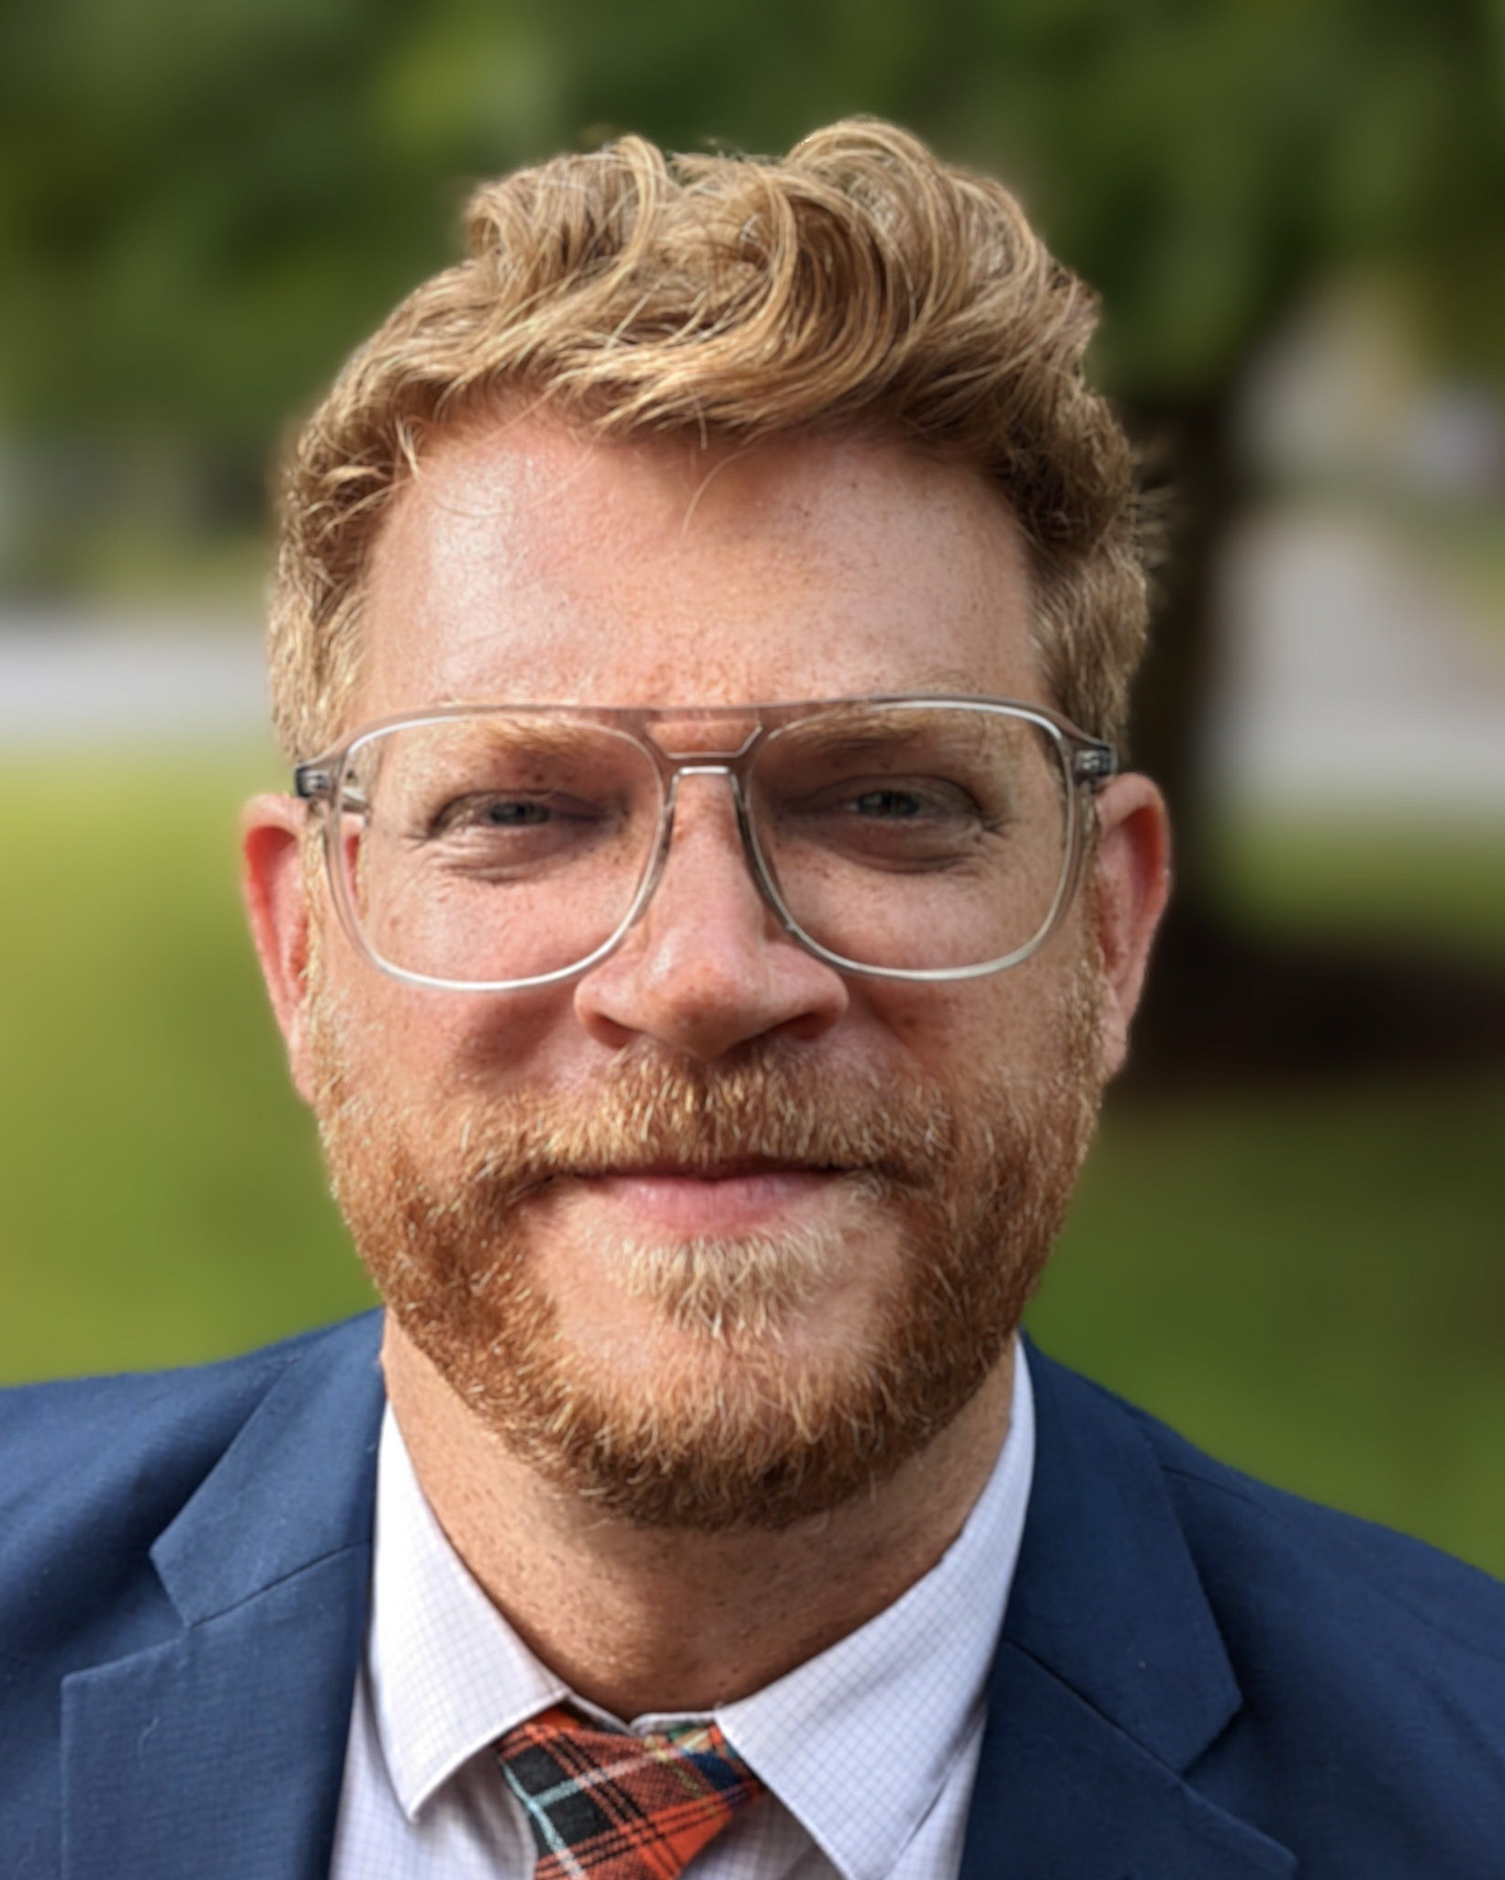
02
WHAT WE OFFER
Resource
Curated texts, essays, and dialogues on the issues facing Christians today — gathered, framed, and made shareable.
Curated texts to dive deeper
Shared expertise from scholars
Enriching dialogues to relive or discover

Slide 7
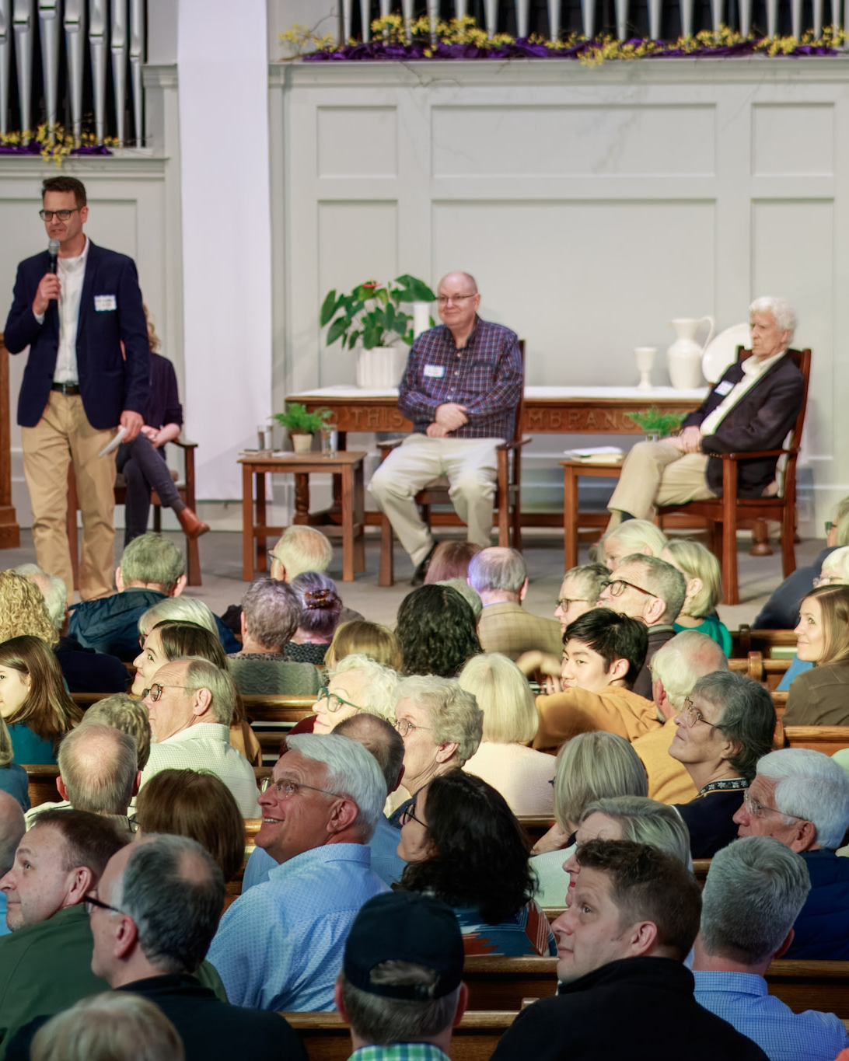
03
WHAT WE OFFER
Community
Open events, coalitions, and conversations with welcoming people from every Christian tradition.
Open events to strengthen coalitions
Timely writing to challenge and inform
Welcoming people from every tradition

Slide 8
2025
A YEAR OF FREE TO BE FAITHFUL
Where we’ve been
— since May 2025.
Courses, events, and community — a full season of faithful engagement.

Slide 9
MAY 2025
Free to be Faithful Launch
Grand Rapids
MAY 2025
Faithful Interpretation & Sexuality
Keesmaat & Vander Zee
JUL 2025
Summer Big Read
Berglund with Du Mez
SEP 2025
Gender, Sexuality, and the Bible
Sylvia Keesmaat
SEP 2025
Twentieth Century Authoritarianism
Bruce Berglund
SEP 2025
Fall Big Read
Reichel & Du Mez
OCT 2025
Reechanting the World Conference
OCT 2025
The Good, the True, the Beautiful
Karen Swallow Prior
Course
Event

Slide 10
2026
— AND WHERE WE’RE GOING.
JAN 2026
Reading the Ruins
Angela Reitsma Bick
MAR 2026
The Christian-Jewish Question Today
Matthew D. Taylor
MAR 2026
The Evangelical Imagination
Karen Swallow Prior
MAY 2026
Courageous Faith in a Time of Fear
Toronto · Public Conference
JUN 2026
The Contemplative Life in the Age of Distraction
Jacob Benjamins
Course
Event

Slide 11
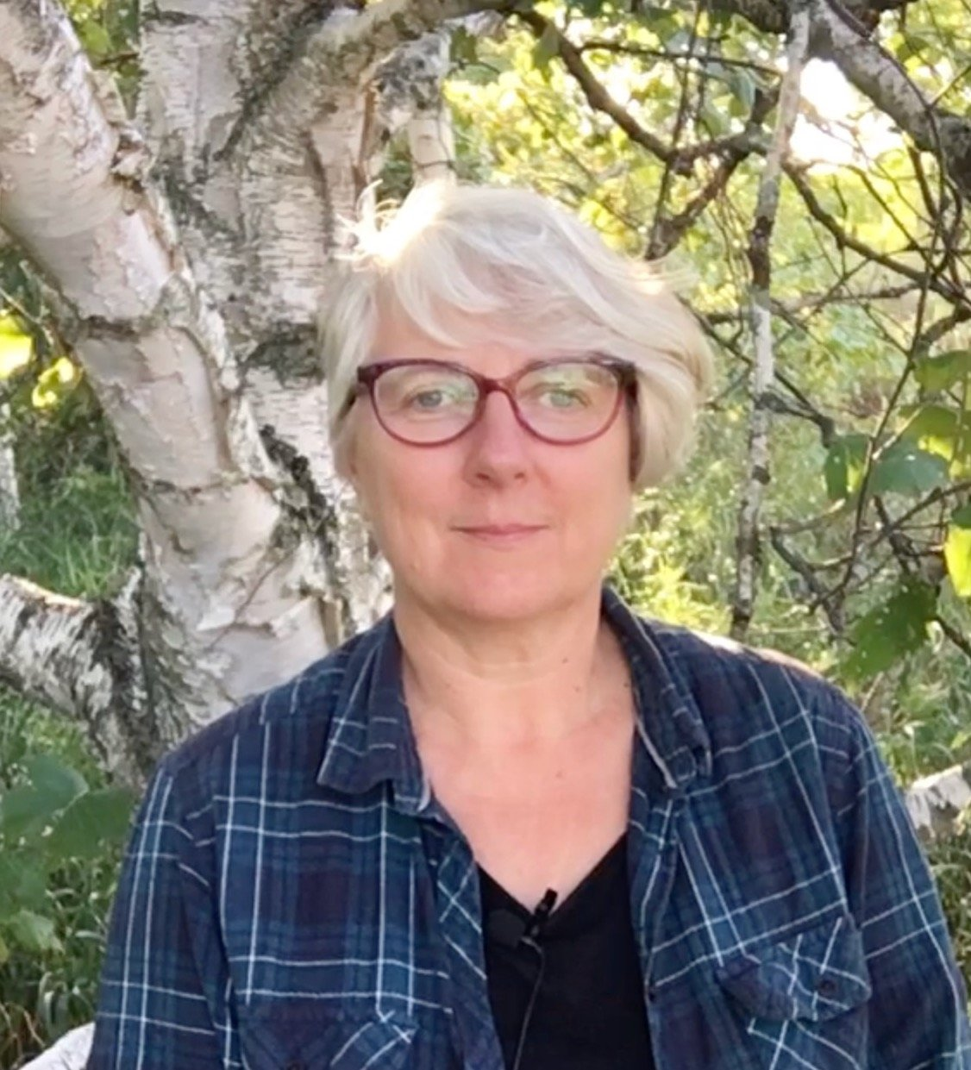
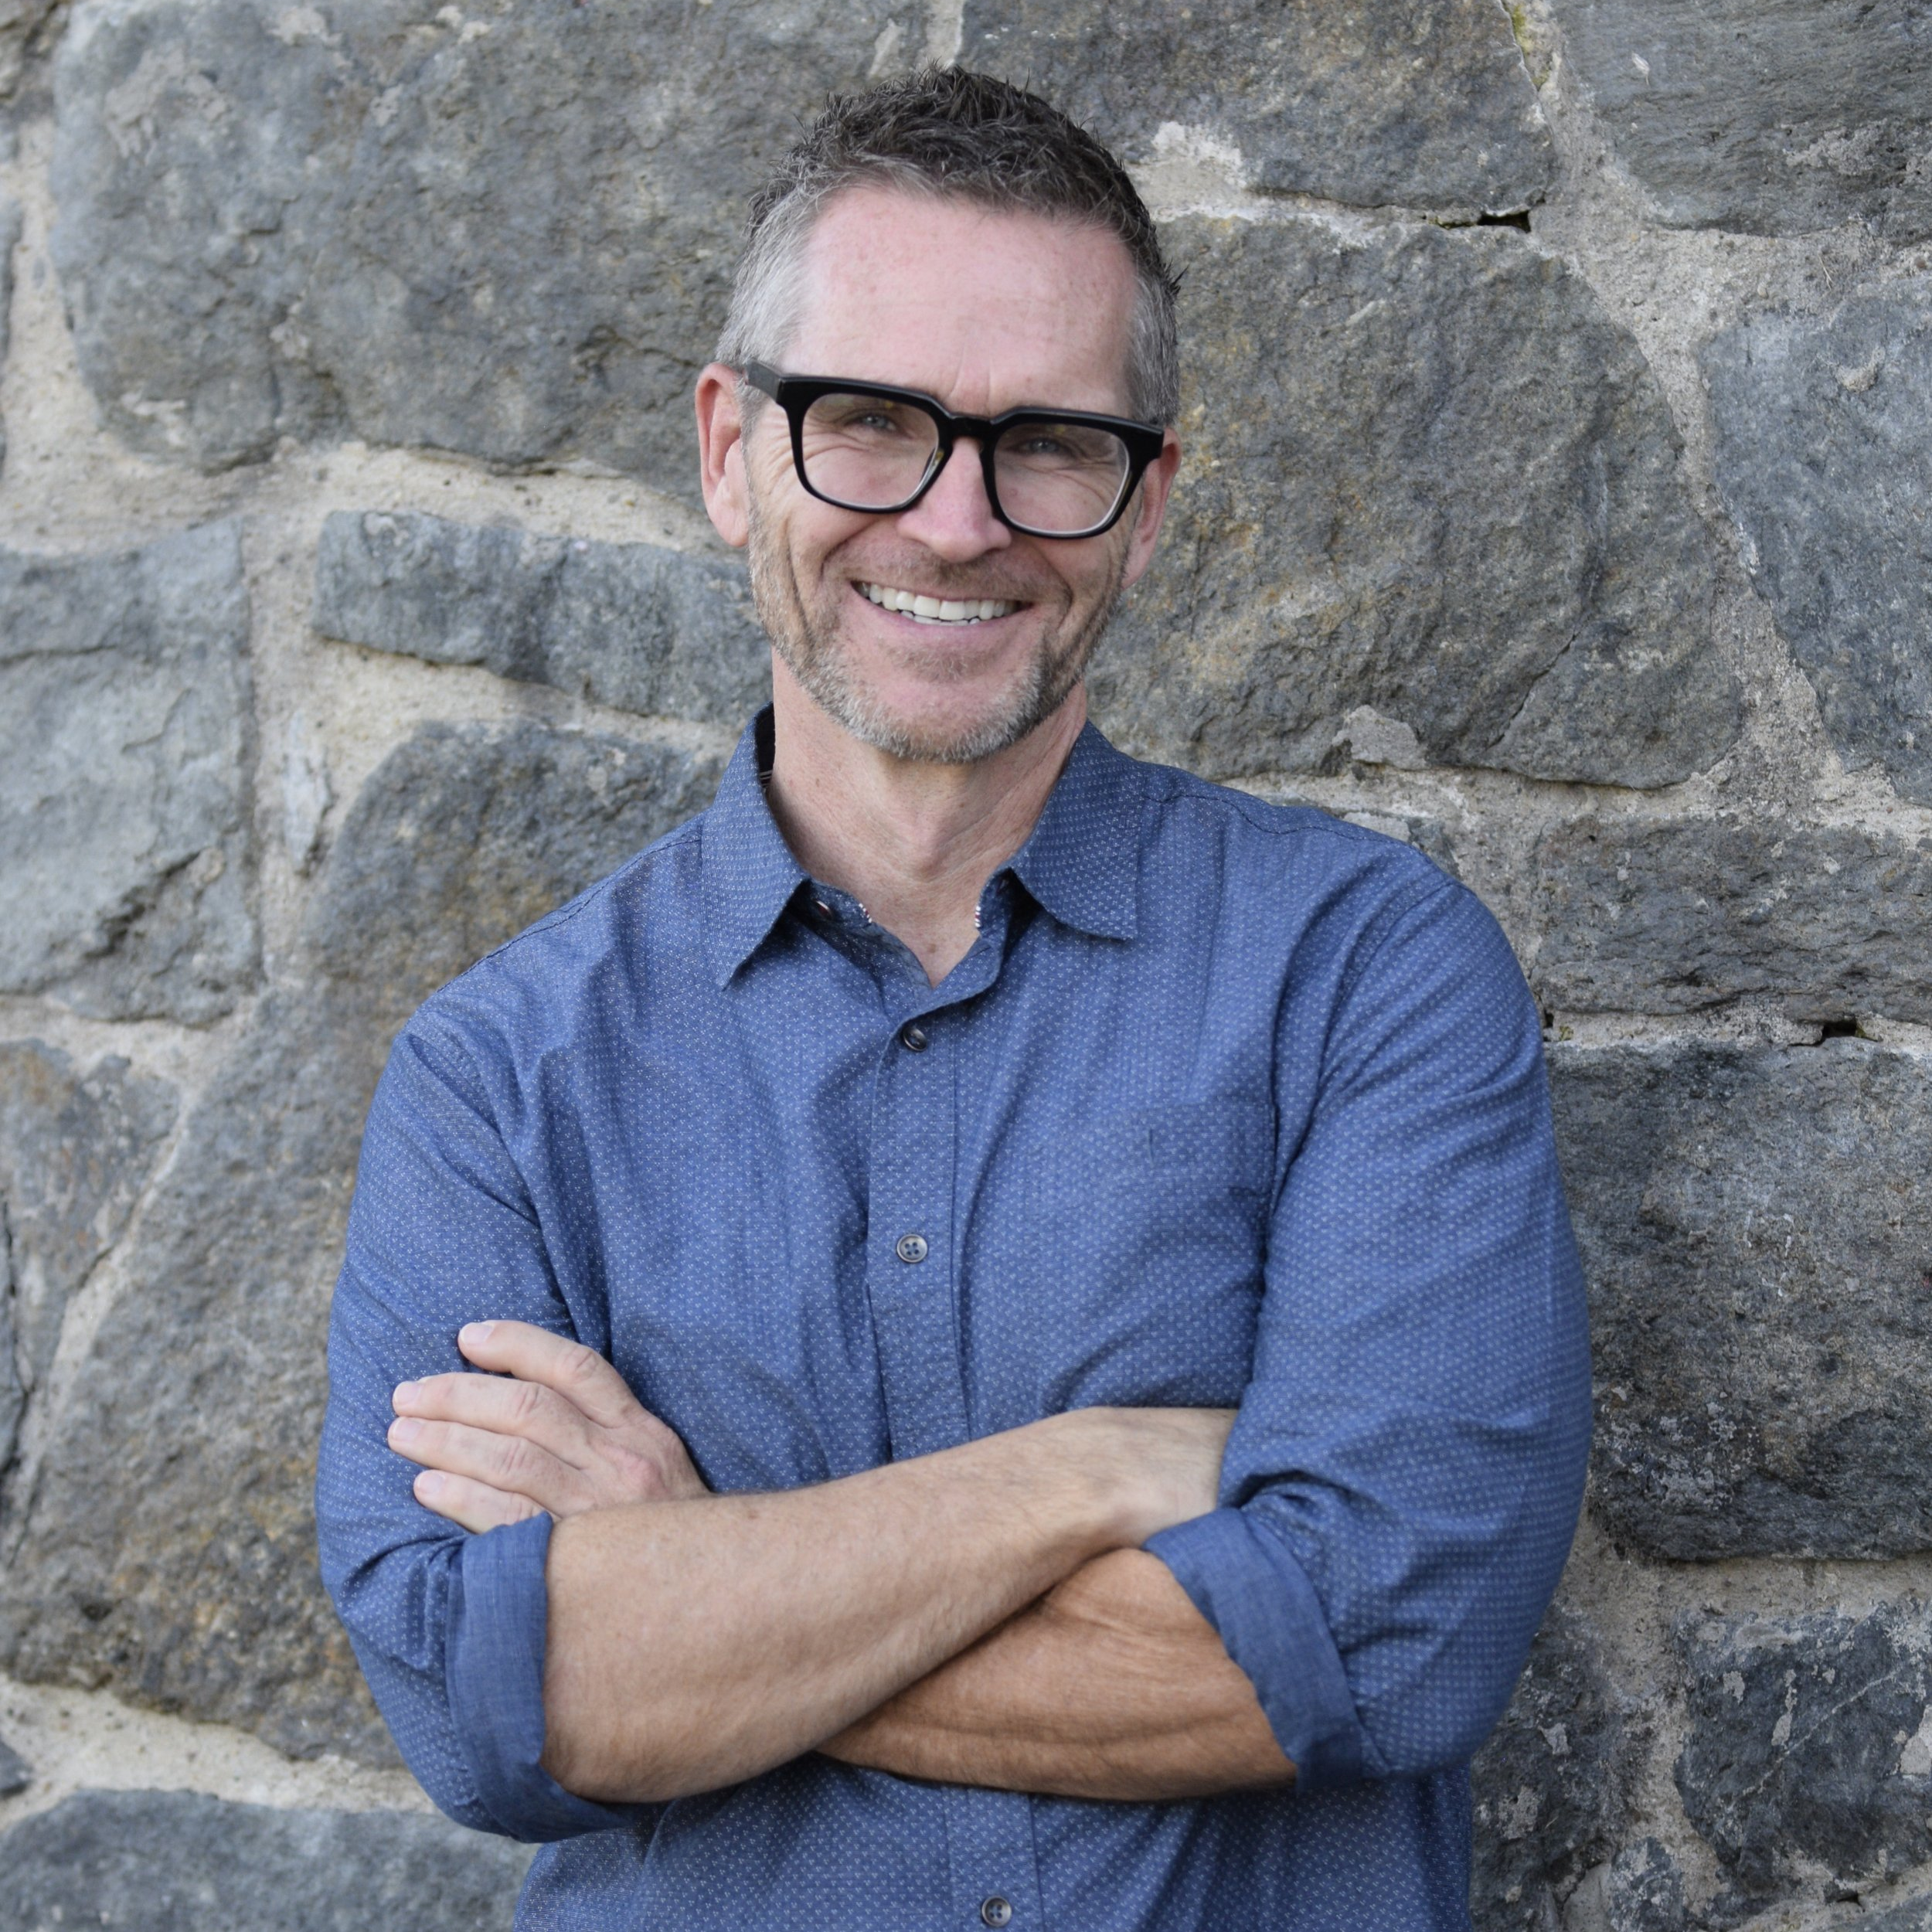
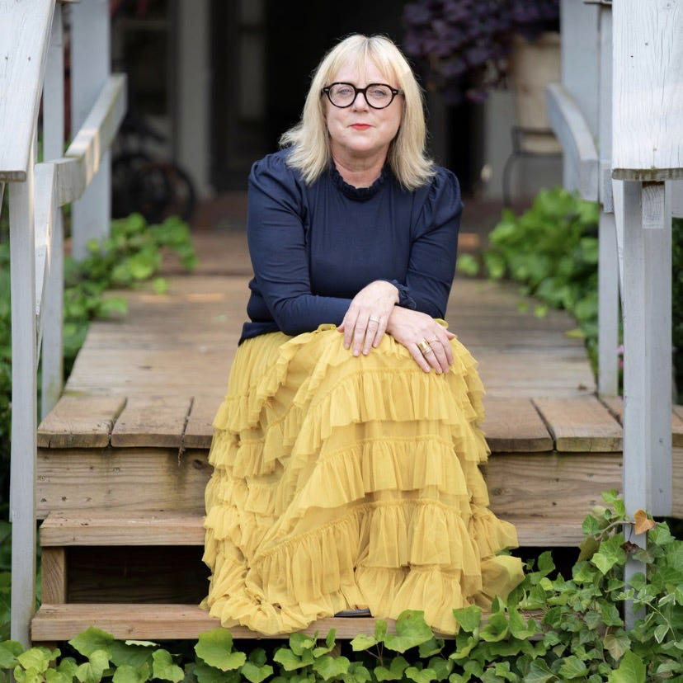
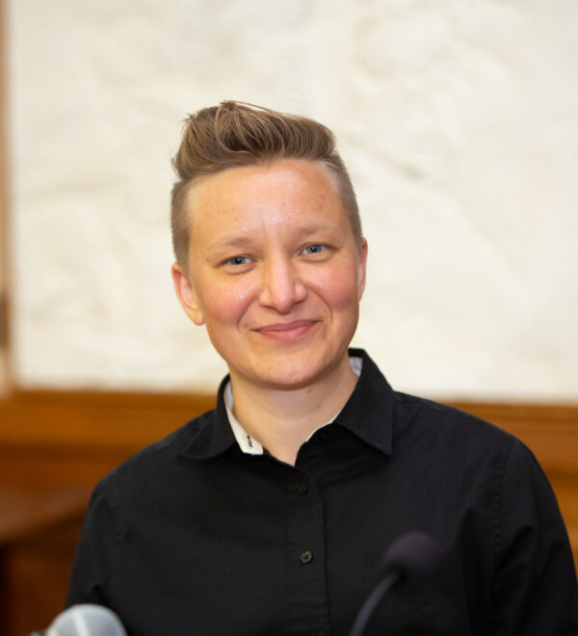
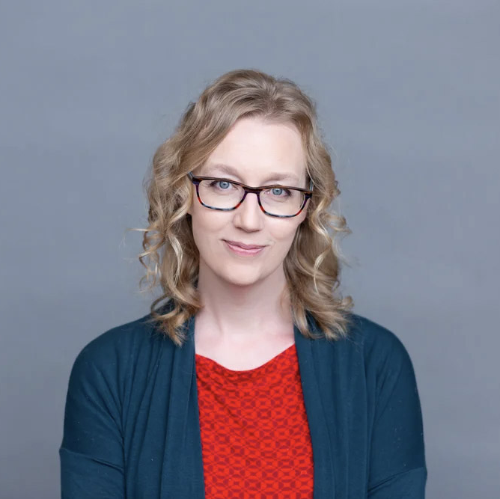
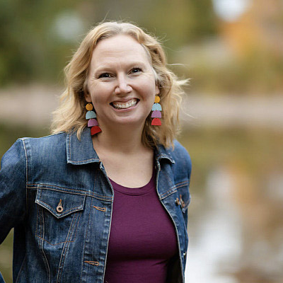
VOICES OF THE YEAR
The people shaping
the conversation.
Sylvia Keesmaat
Bruce Berglund
Karen Swallow Prior
Scholar · Activist
Author · Historian
Author · Bethel Seminary
Hanna Reichel
Kristin Kobes Du Mez
Angela Reitsma Bick
Theologian · Princeton
Historian · Calvin Univ.
Editor · Christian Courier

Slide 12
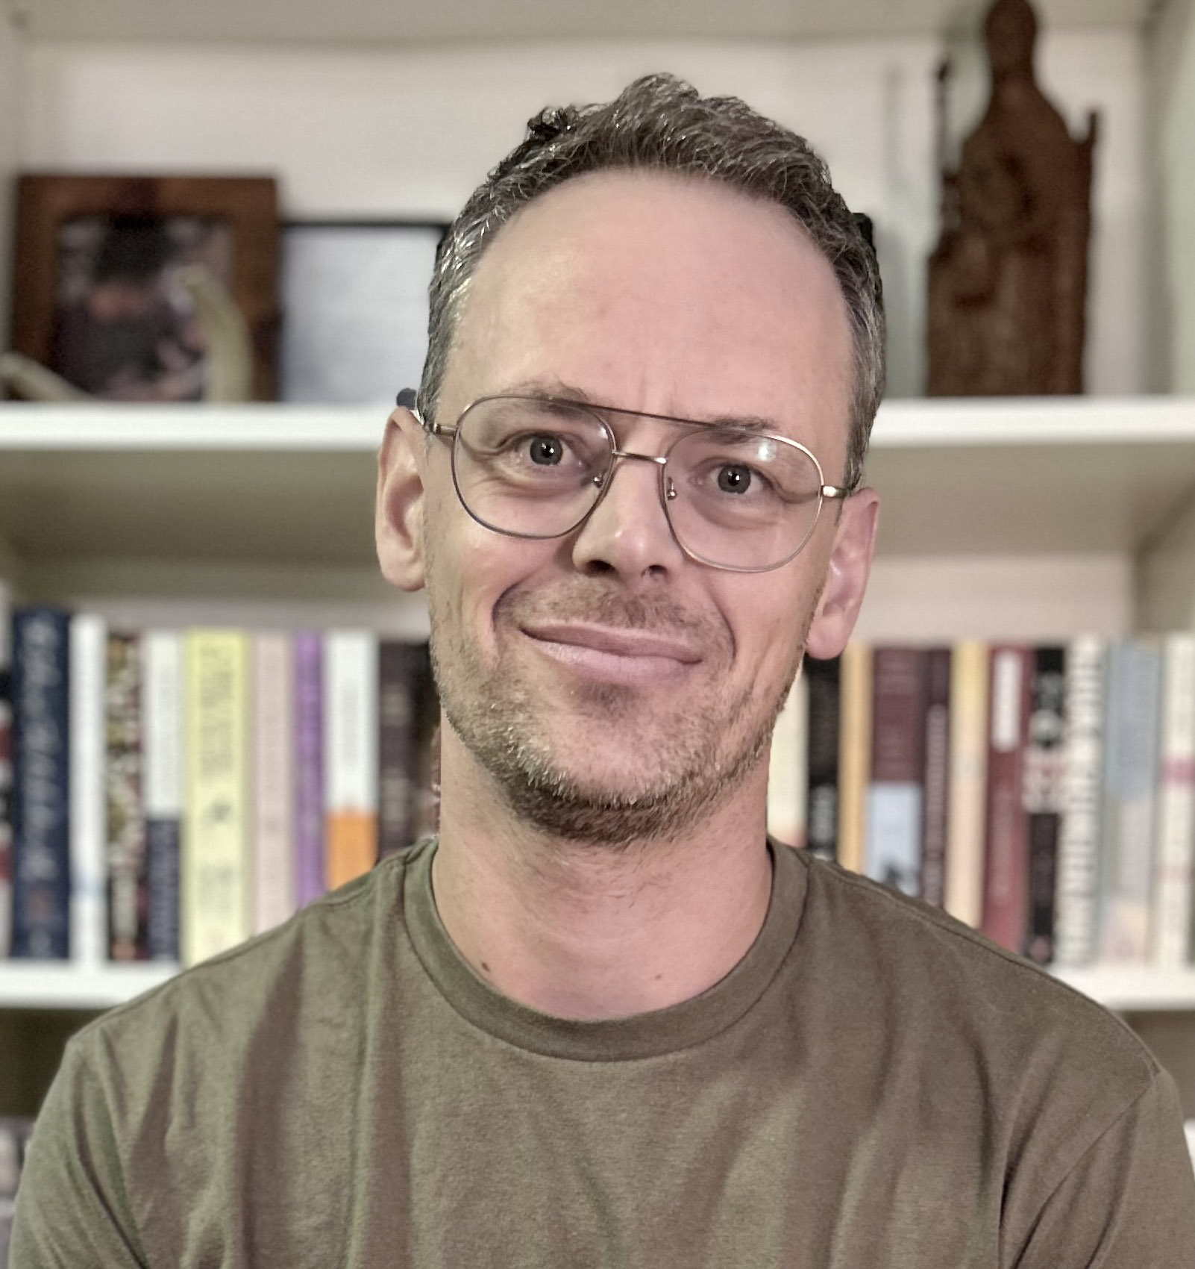
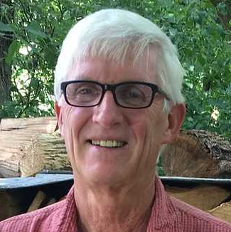
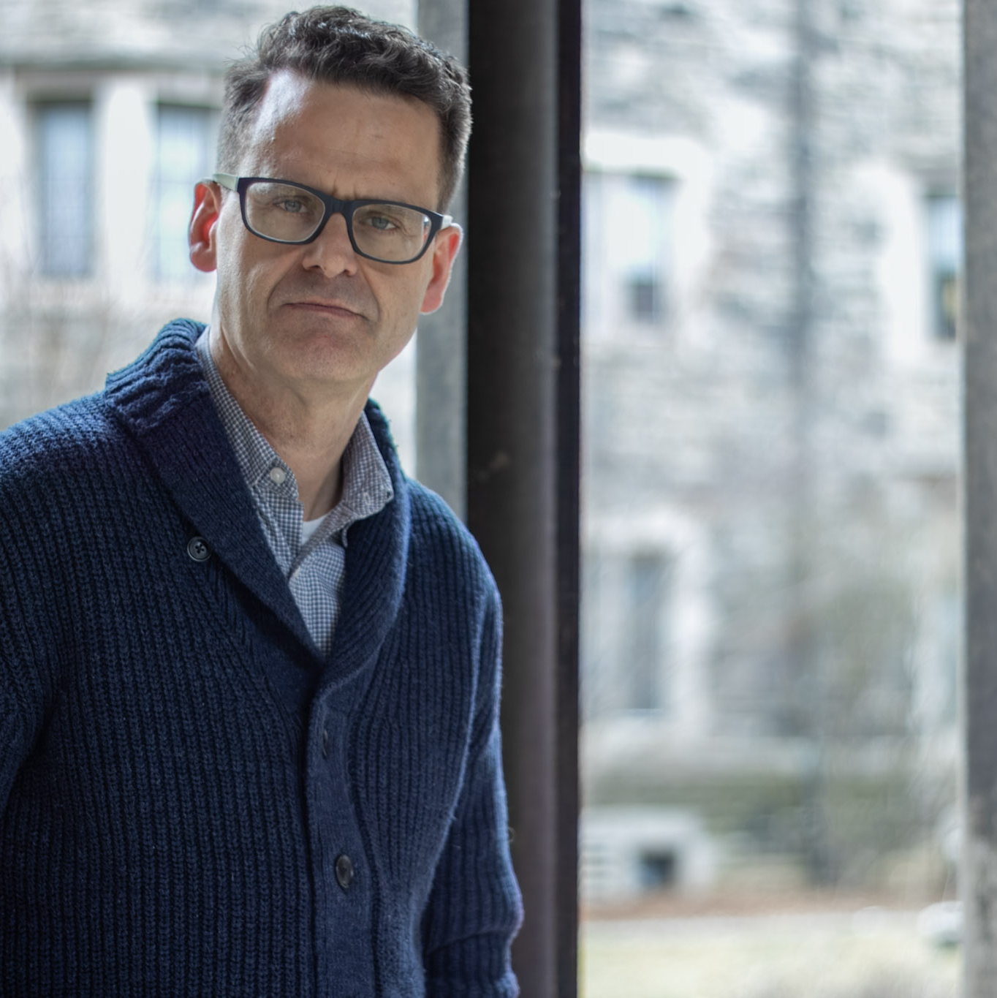
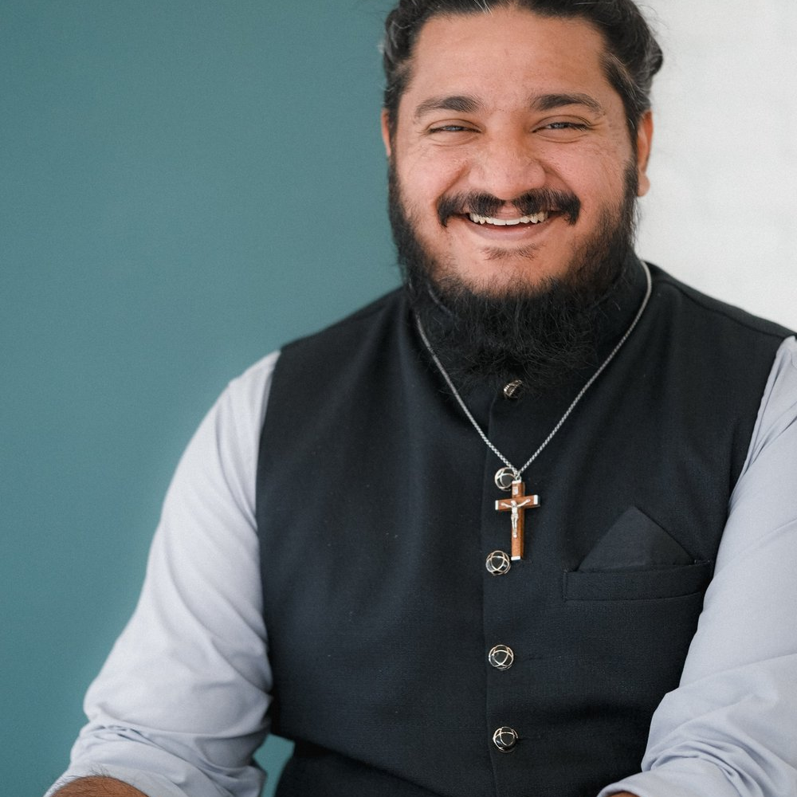
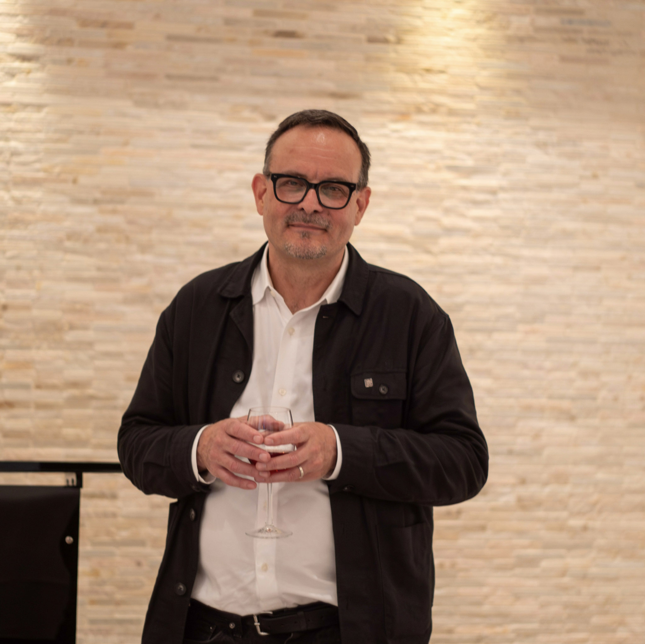
VOICES OF THE YEAR
Scholars, writers, and pastoral voices guiding our courses and gatherings.
Jacob Benjamins
Brian Walsh
Ron Kuipers
Postdoctoral Fellow · ICS
Theologian & Author
President · ICS
Joash P. Thomas
Gideon Strauss
Public Theologian
Philosopher · ICS

Slide 13
JOIN THE MOVEMENT
Embrace Your Freedom
to Be Faithful.
Join a growing community of Christians who believe that ancient faith can actively engage the pressing issues of our time.
01
02
03
Explore the courses.
Subscribe on Substack.
Support the work.
f2bf.icscanada.edu/f2bf-courses
instituteforchristianstudies.substack.com
icscanada.edu/donate

Slide 14
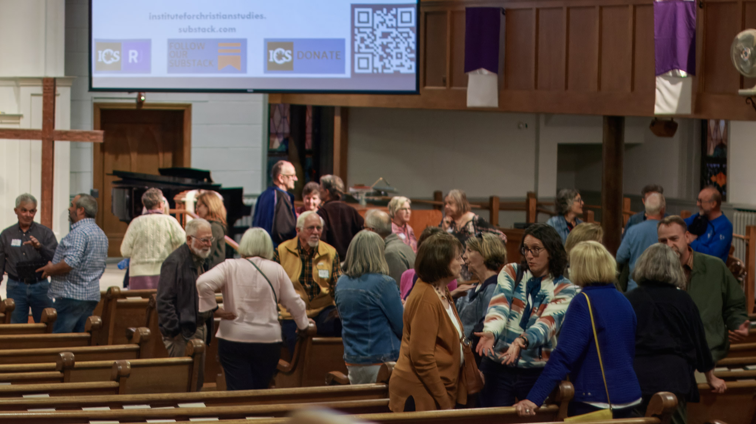
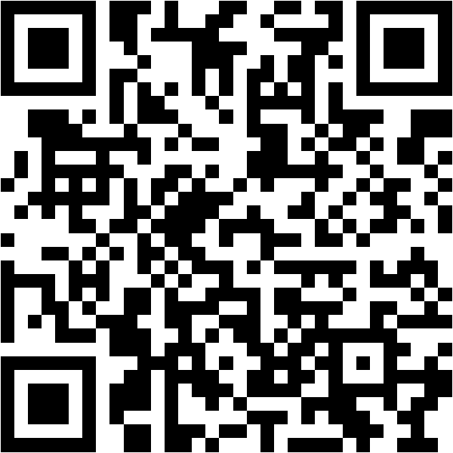
START HERE
Scan to visit
Free to be Faithful
Find the next course, resource, or gathering for you.
f2bf.icscanada.edu

Slide 15

FOR FREEDOM CHRIST HAS SET US FREE.
Free
to be
Faithful
Rooted without becoming rigid. Bold without becoming belligerent.
Faithful without becoming fearful.
f2bf.icscanada.edu
59 St. George Street, Toronto, Ontario M5S 2E6 · 1-888-326-5347 · info@icscanada.edu

