Slide 1
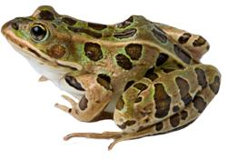
Frog Dissection

Slide 2
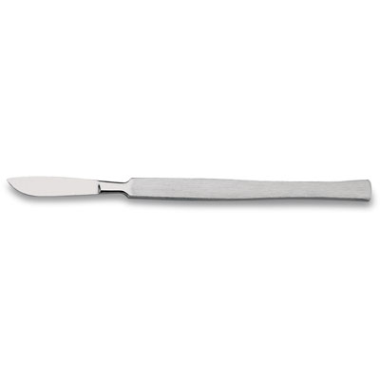
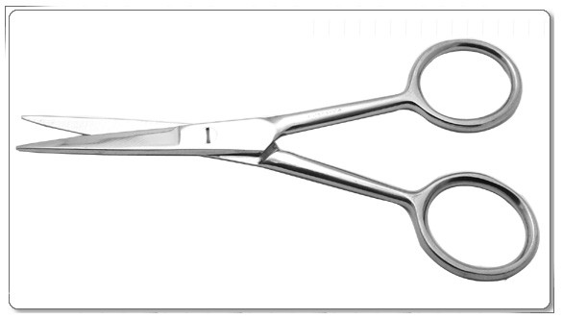
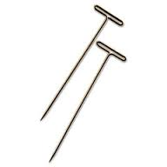
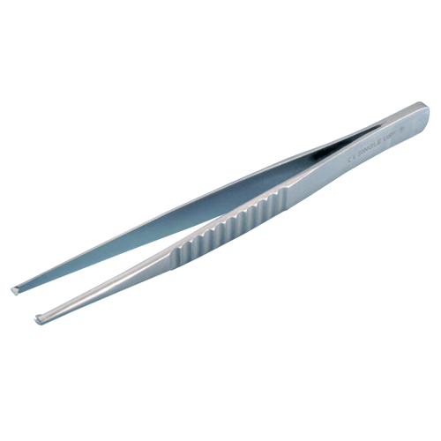
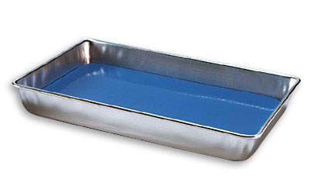
Tools
A dissecting tray
A frog
Scalpel
Forceps
Scissors
Pins

Slide 3
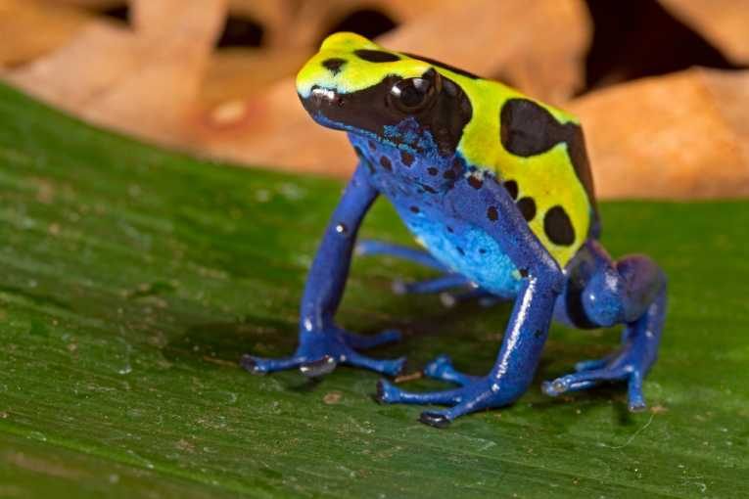
Terminology
Dorsal
Dorsal-on or relating to the upper side or back of an animal
Ventral-on or relating to the underside of an animal (opposite of dorsal)
Posterior-on or near the behind or back
Anterior-near the front or the head
Posterior
Anterior
Ventral

Slide 4
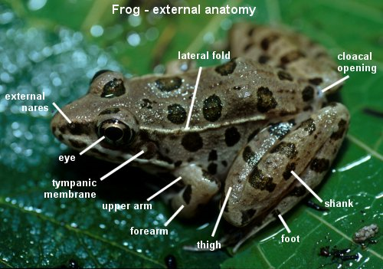
External Anatomy of the Frog

Slide 5
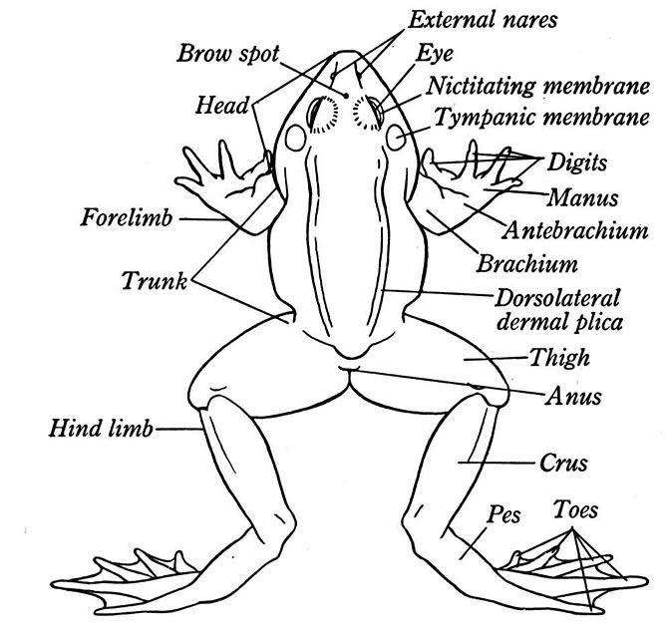
External Anatomy of the
Frog

Slide 6
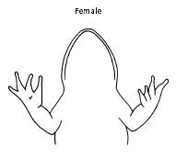
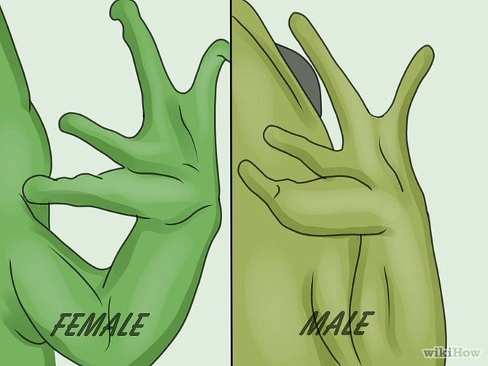
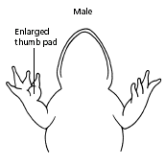
Determine if your frog is a Male or Female
The sex of a frog may be determined externally by examining the thumb pads on the front feet. The thumb pads of males are enlarged at the base as in the drawing on the right.

Slide 7
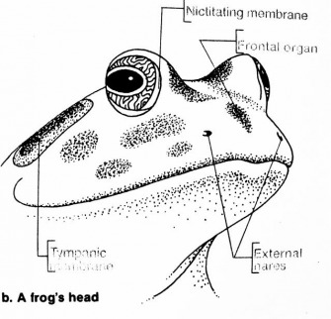
External Anatomy of the Frog’s Head
Nictating Membrane
Frontal
Membrane
Tympanic
Membrane
External
Nares

Slide 8
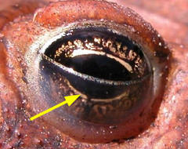
Nictating Membrane

Slide 9
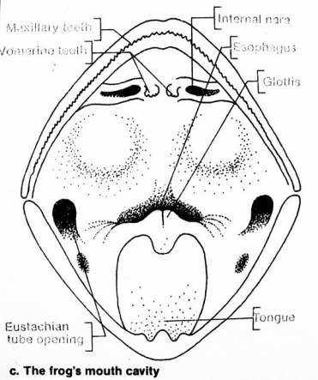
Internal Anatomy of the Frog’s Head
Internal Nares
Maxillary Teeth
Esophagus
VomerineTeeth
Glottis
Eustachian
tube opening
Tongue

Slide 10
Functions of the body parts that make up the frog’s head
External nares or nostrils - Anterior openings for the entry or exit of air.
Esophagus - Tube that connects the mouth and the stomach in a frog.
Tympanic Membrane - The eardrum - receives sound waves
Glottis - The opening from the mouth into the respiratory system

Slide 11
Functions of the body parts that make up the frog’s head
Tongue - Muscular structure attached to the front of the mouth which is extended to catch insects (its food).
Maxillary Teeth - Sharp teeth in the maxilla of a frogs mouth that function in holding captured prey.
Vomerine Teeth - Small projections in the top of a frog’s mouth that function in holding and captured prey.
Eustachian tube openings - Openings in the mouth that lead to tubes that connect to the middle ear to equalize air pressure

Slide 12
Functions of the External Anatomy of the Frog
Nictitating Membrane - A transparent part of a frog’s lower eyelid that moves over the eye to clean it and protect it.
Cloacal Opening - Opening of cloaca through which undigested food, urine, eggs, and sperm are passed.

Slide 13
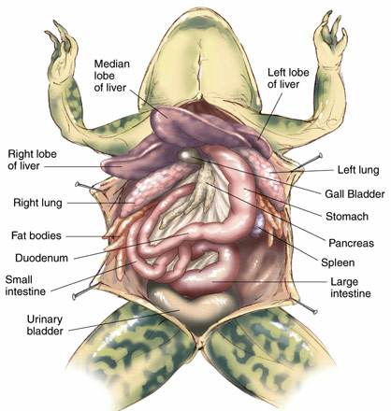
Internal Anatomy

Slide 14
Functions of the Internal Anatomy of a Frog:
Stomach - Stores food and mixes it with enzymes to begin digestion.
Small Intestine - The principal organ of digestion and absorption of digested food.
Duodenum - The anterior (front) part of the small intestine into which food passes from the stomach
Pancreas - Gland which secretes digestive enzymes into the duodenum.
Gall Bladder - Sac which stores bile.

Slide 15
Functions of the Internal Anatomy of a Frog:
Large Intestine - Posterior organ of the digestive system which stores undigested food.
Liver - Secretes bile and processes digested food molecules
Urinary Bladder - The organ that collects and stores urine until released.
Fat Bodies - Masses of fat in the body cavities of frogs. Needed for hibernating and mating
Spleen - Organ in the frog’s circulatory system that makes, stores, and destroys blood cells.
Cloaca - Organ through which the products of the frogs digestive and urogenital system pass when discharged from the body.

Slide 16
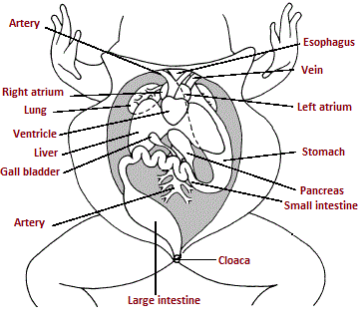
Digestive System

Slide 17
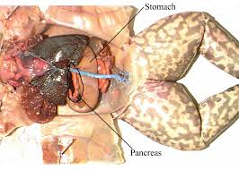

Slide 18
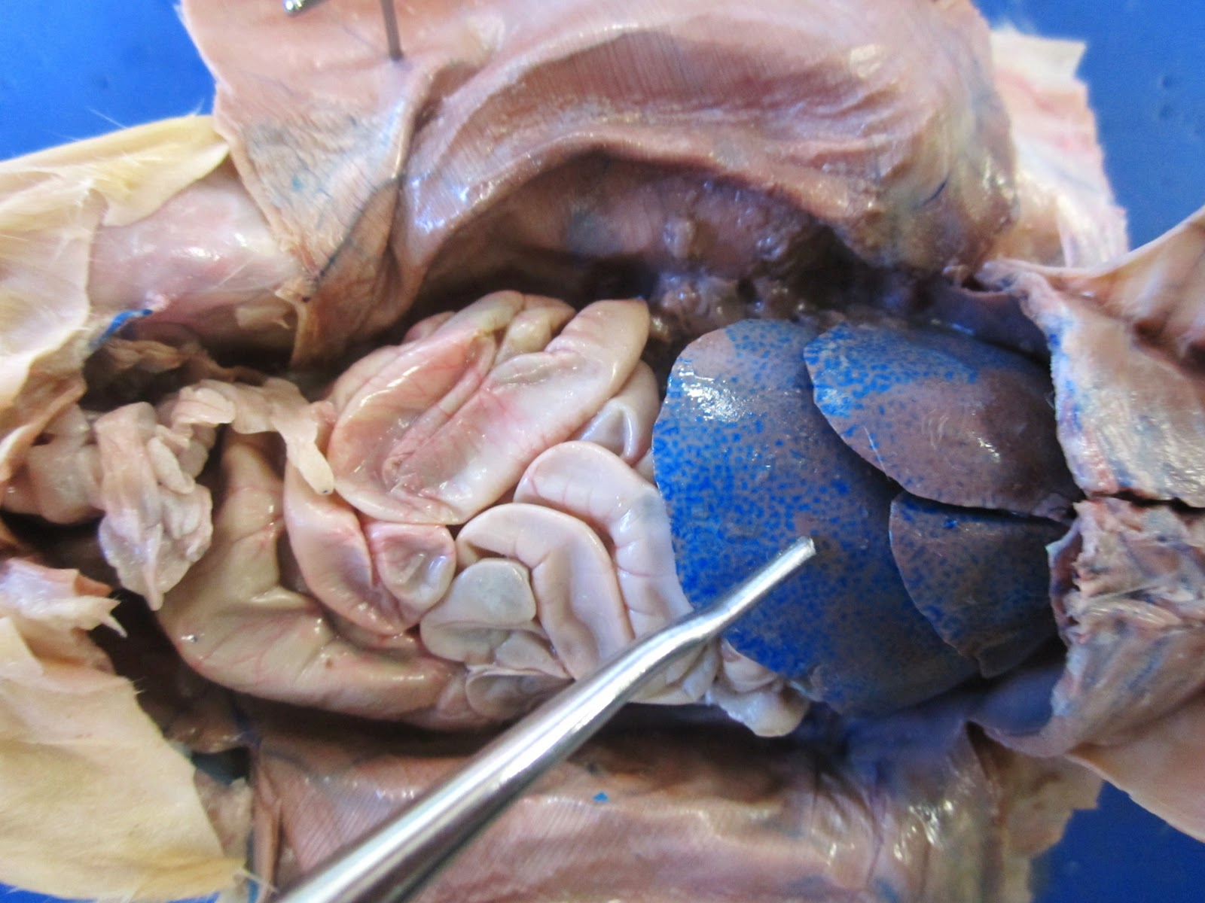
Small
Intestines
Liver

Slide 19
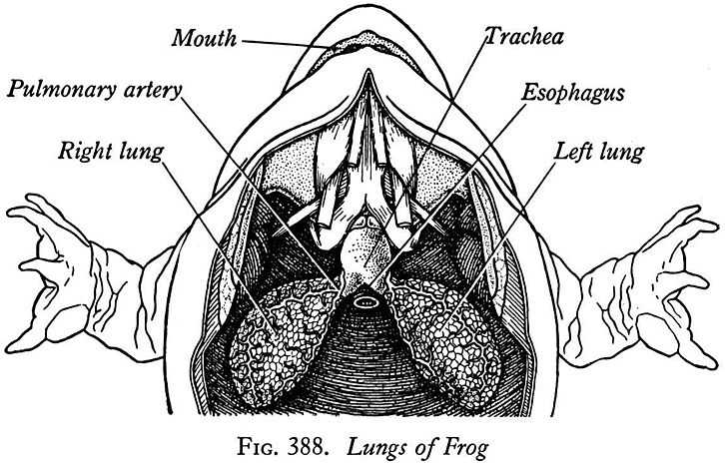
Respiratory System

Slide 20
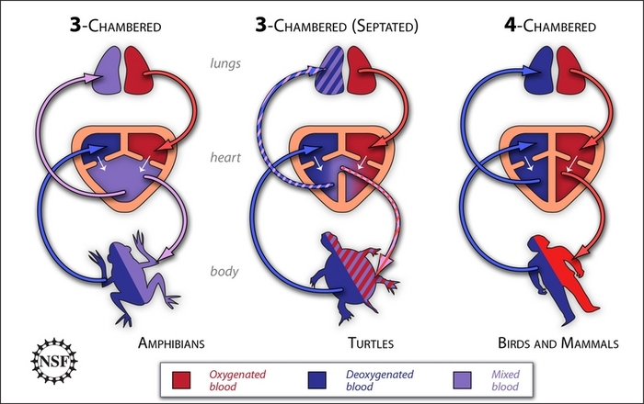
Circulatory System

Slide 21
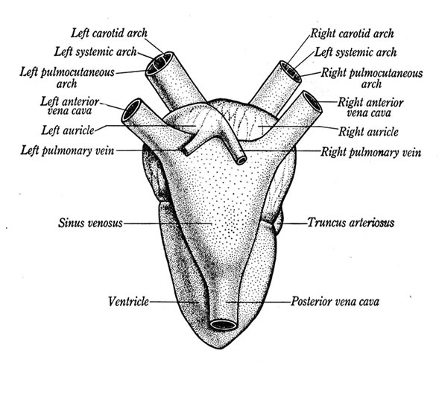
Anatomy of a Frog Heart

Slide 22
Functions of the Frog Heart
Heart - Pumping organ of the circulatory system (has 3 chambers).
Anterior Vena Cava - Large vein that carries blood from the anterior part of the body toward the heart.
Posterior Vena Cava - Large vein that carries blood from the posterior part of the body towards the heart.
Sinus Venosus - Sac that receives blood from the vena cava

Slide 23
Functions of the Frog Heart
Right Atrium - Chamber of the frogs heart which receives blood from the sinus venosus.
Left Atrium - The chamber of the heart that receives blood from the lungs.
Pulmonary Veins - The blood vessels that carry blood form the lungs to the left atrium.
Ventricle - Chamber of a frog’s heart that pumps blood out of the heart to the lungs and other parts of the body.
Truncus Arteriosis - Large artery in a frog that carries blood away from the ventricle into branches that lead to all parts of the body.

Slide 24
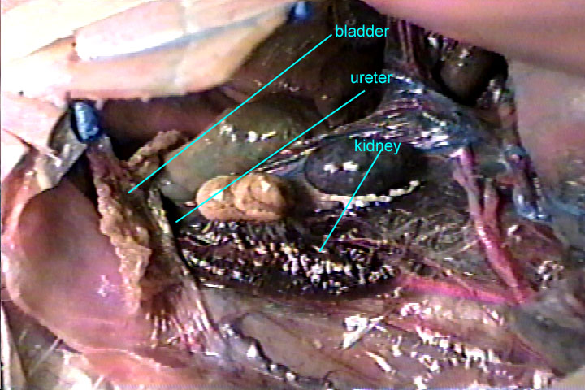
Urinary System

Slide 25
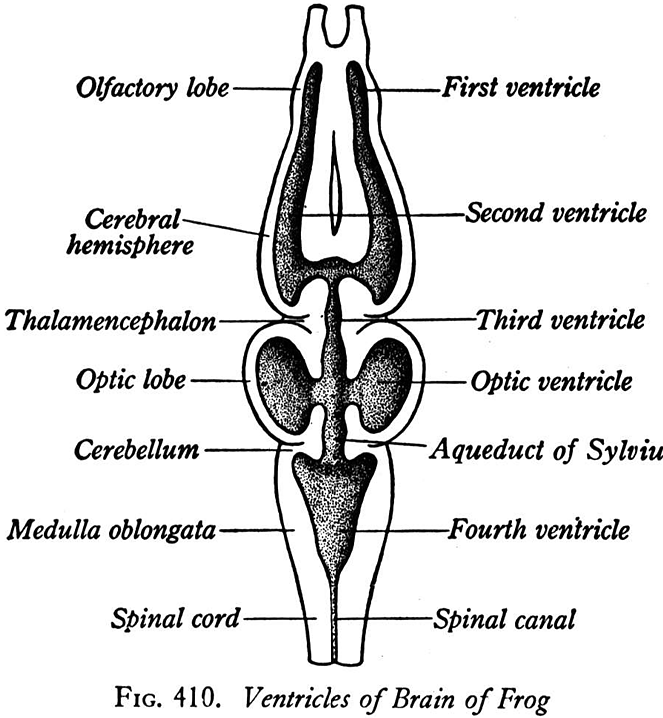
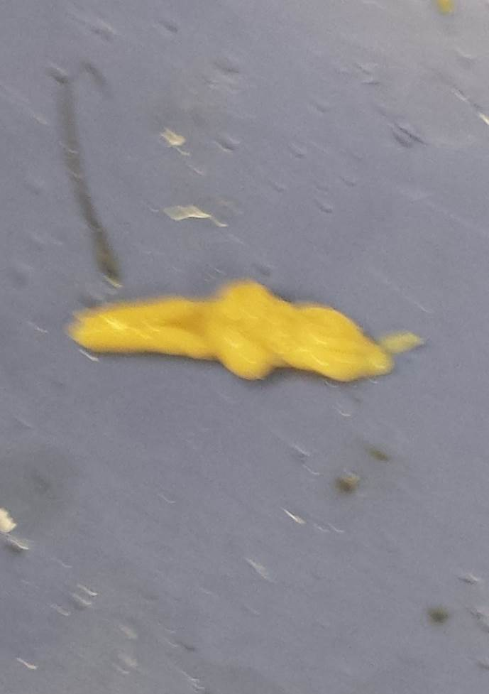
Frog Brain

Slide 26
Functions of the Frog Brain
Spinal Cord - Main pathway to and from the brain
Spinal Nerves - Nerves that lead to and from the spinal cord
Olfactory Lobe - Part of the frog’s brain associated with the sense of smell
Cerebrum - Part of the brain that is associated with memory, pain, and voluntary muscle control.
Optic Lobes - Part of the brain associated with vision.

Slide 27
Functions of the Frog Brain
Cerebellum - Part of a brain that influences balance and equilibrium.
Medulla Oblongata - Part of a brain that is the center for some involuntary functions.
Cranial Nerves - Nerves that lead to and from the brain.

Slide 28
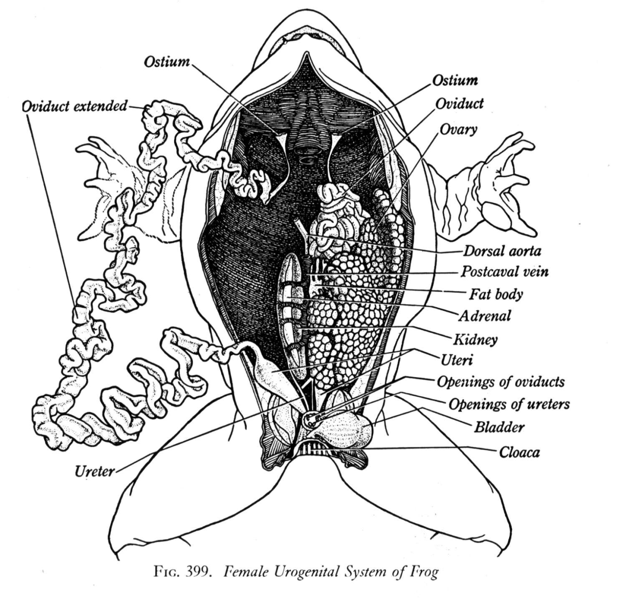
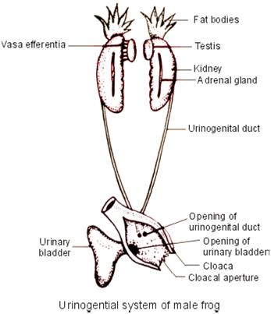
Frog Reproductive System

Slide 29
Frog Reproductive System Functions
Urinary Ducts - Tubes in a frog that carry urine from the kidneys to the cloaca
Urinary Bladder - The organ that collects and stores urine until released.
Adrenal Glands - Organs located near the kidneys which secrete hormones.
Ova or Eggs - Female sex cell or gametes

Slide 30
Frog Reproductive System Functions
Ovaries - Organs of the female reproductive system that produce the eggs.
Oviducts - Tubes of a female frog’s reproductive system that carry eggs from the ovaries to the cloaca.
Testes - Male sex organs that produce sex cells (sperm).
Sperm - Male sex cell or gametes.
Seminal Vesicles - Enlarged distal sections of the male frog’s urinary ducts that collect sperm prior to entry into the cloaca.

