Slide 1
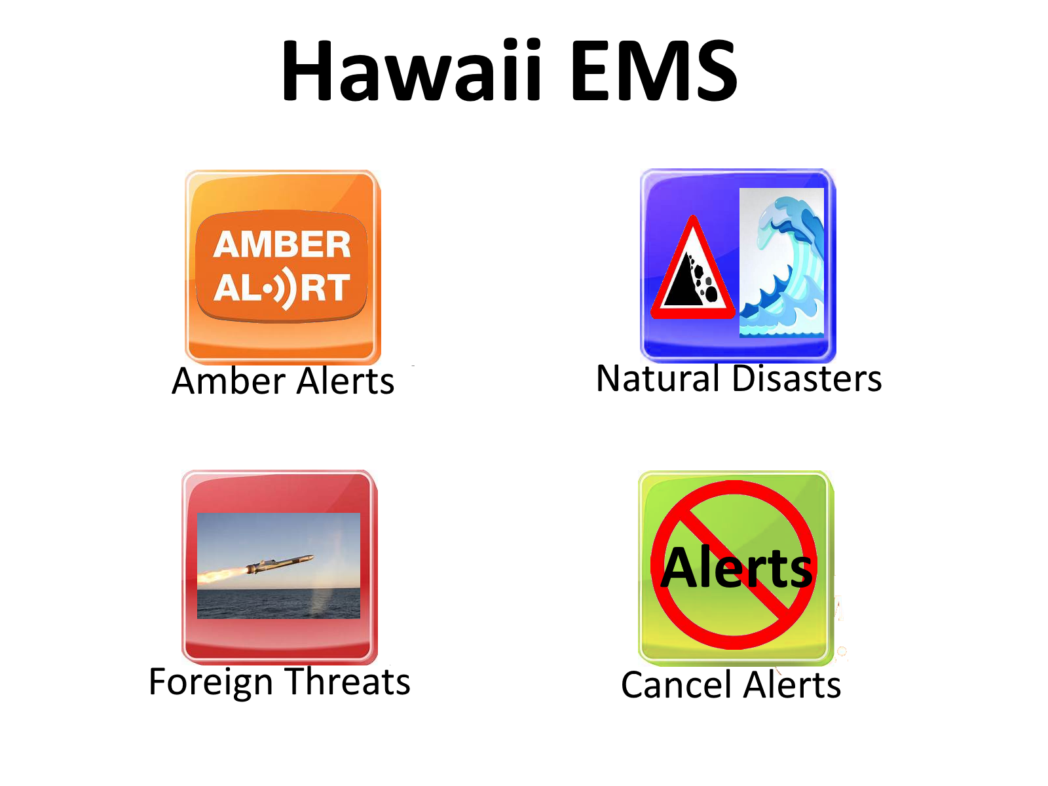
Notes:
Amber Alert links to Slide 10
Natural Disaster links to Slide 11
Foreign Threats links to Slide 2
Cancel Alerts links to Slide 8

Slide 2
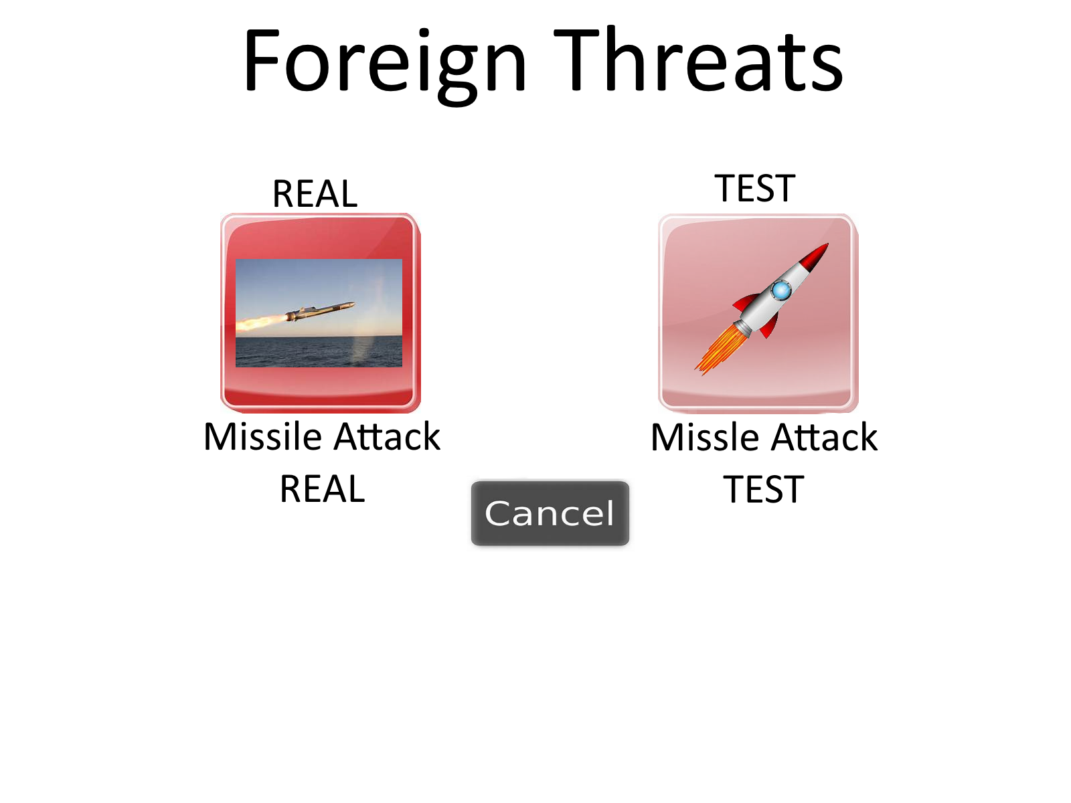
Notes:
Missile Attack Real links to Slide 3
Missile Attack Test links to Slide 12

Slide 3
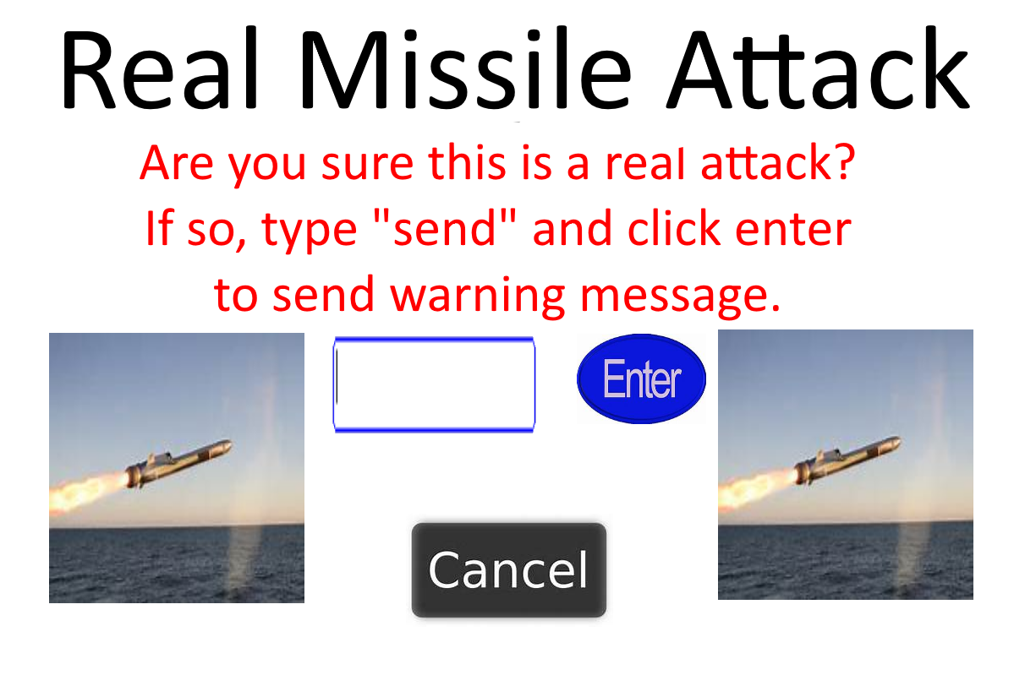
Notes:
Enter links to Slide 4
Cancel links to Slide 6

Slide 4
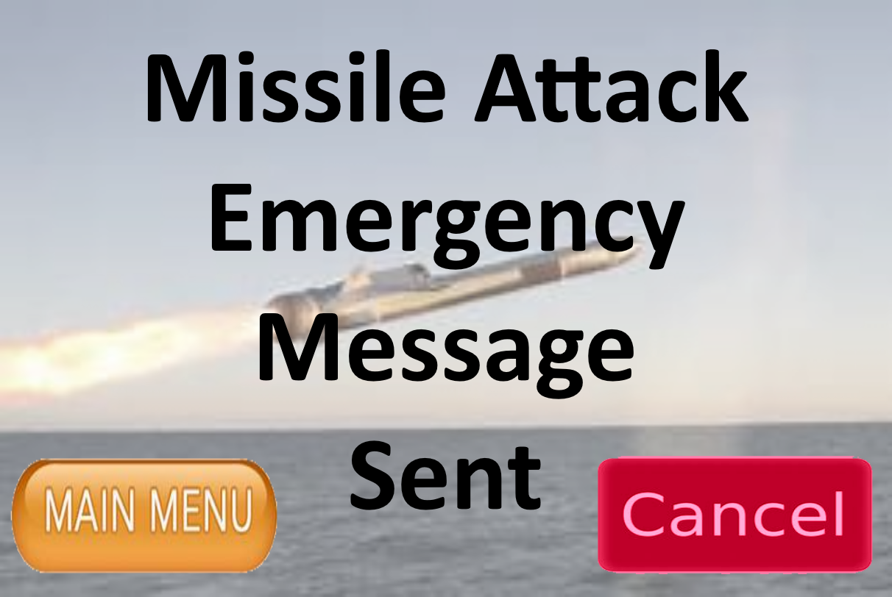
Notes:
Main Menu links to Slide 1
Cancel links to Slide 8

Slide 5
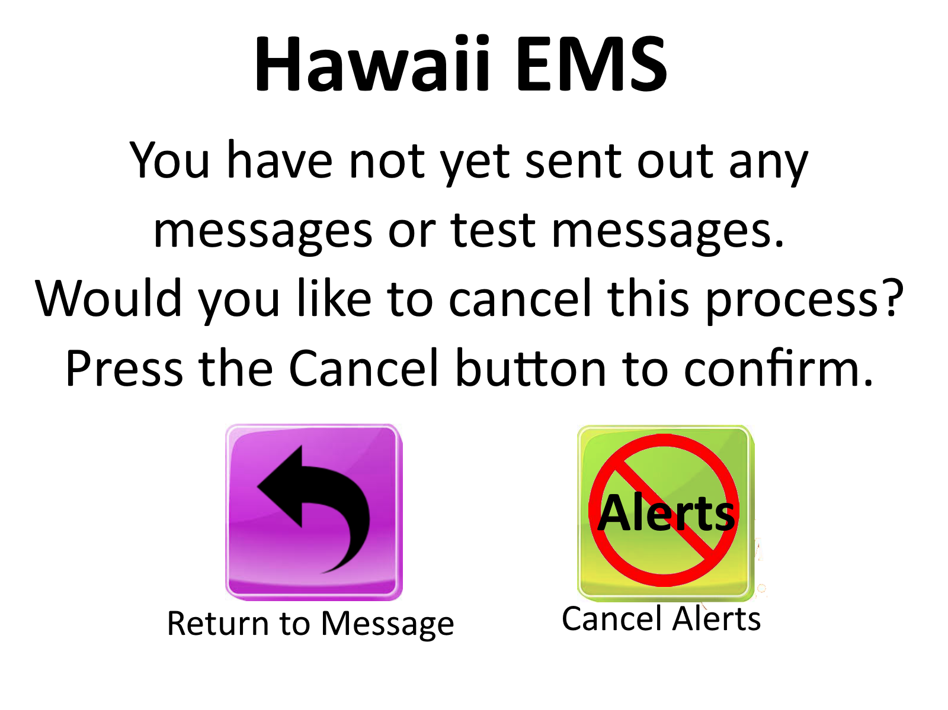
Notes:
Return to Message links to Slide 2
Cancel Alerts links to Slide 3

Slide 6
Notes:
Return to Message links to Slide 3
Cancel Alerts links to Slide 1

Slide 7
Notes:
Return to Message links to Slide 12
Cancel Alerts links to Slide 1

Slide 8
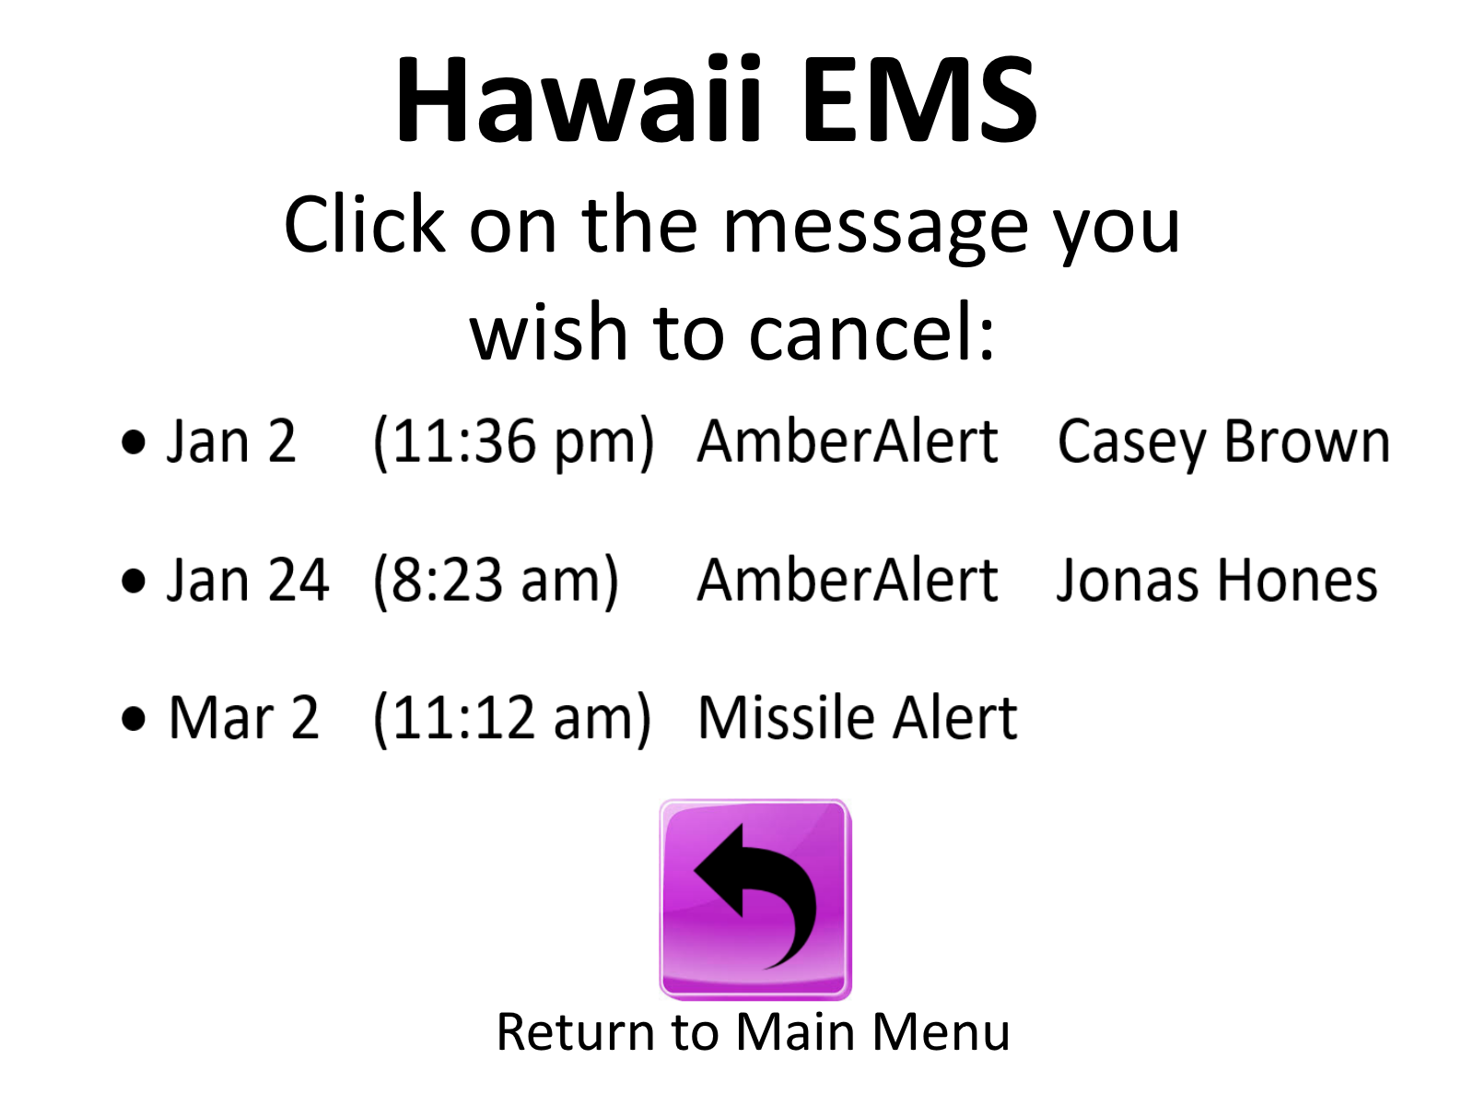
Notes:
Both AmberAlerts link to Slide 10
Missile Alert links to Slide 9
Return to Main Menu links to Slide 1

Slide 9
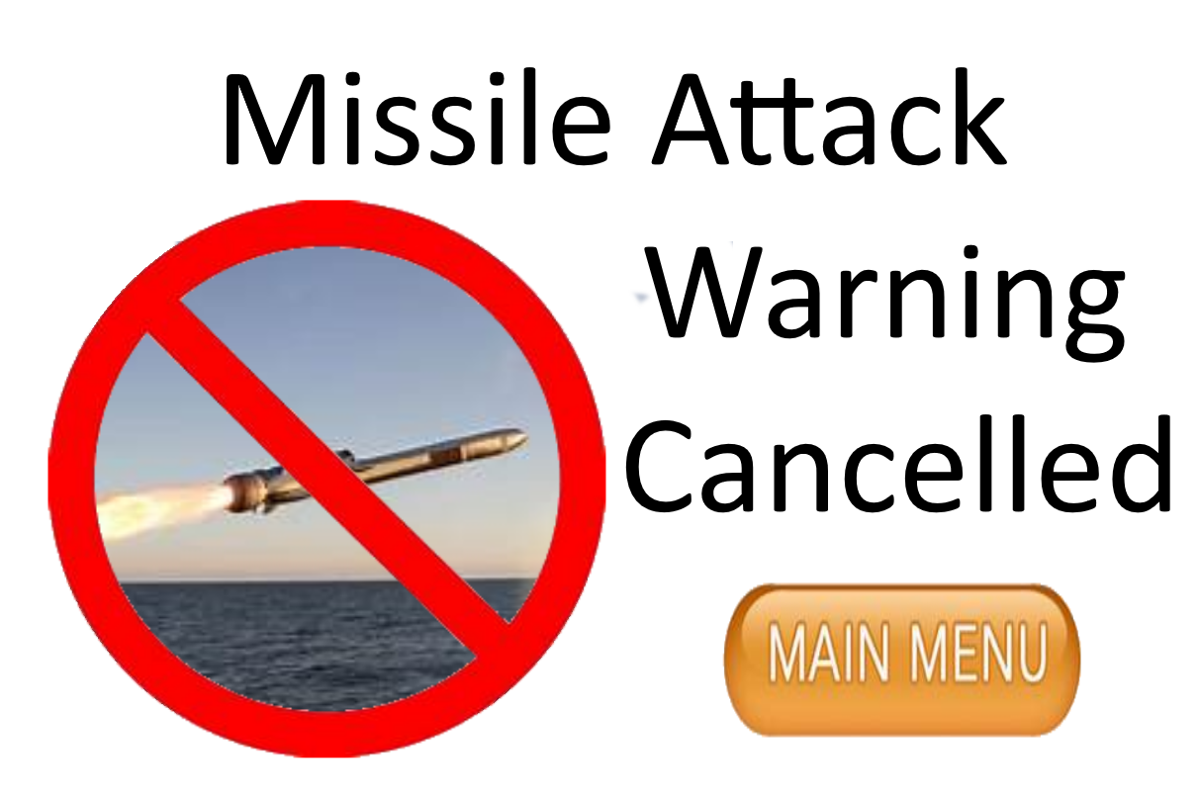
Notes:
Main Menu links to Slide 1

Slide 10



Notes:
Main Menu links to Slide 1

Slide 11
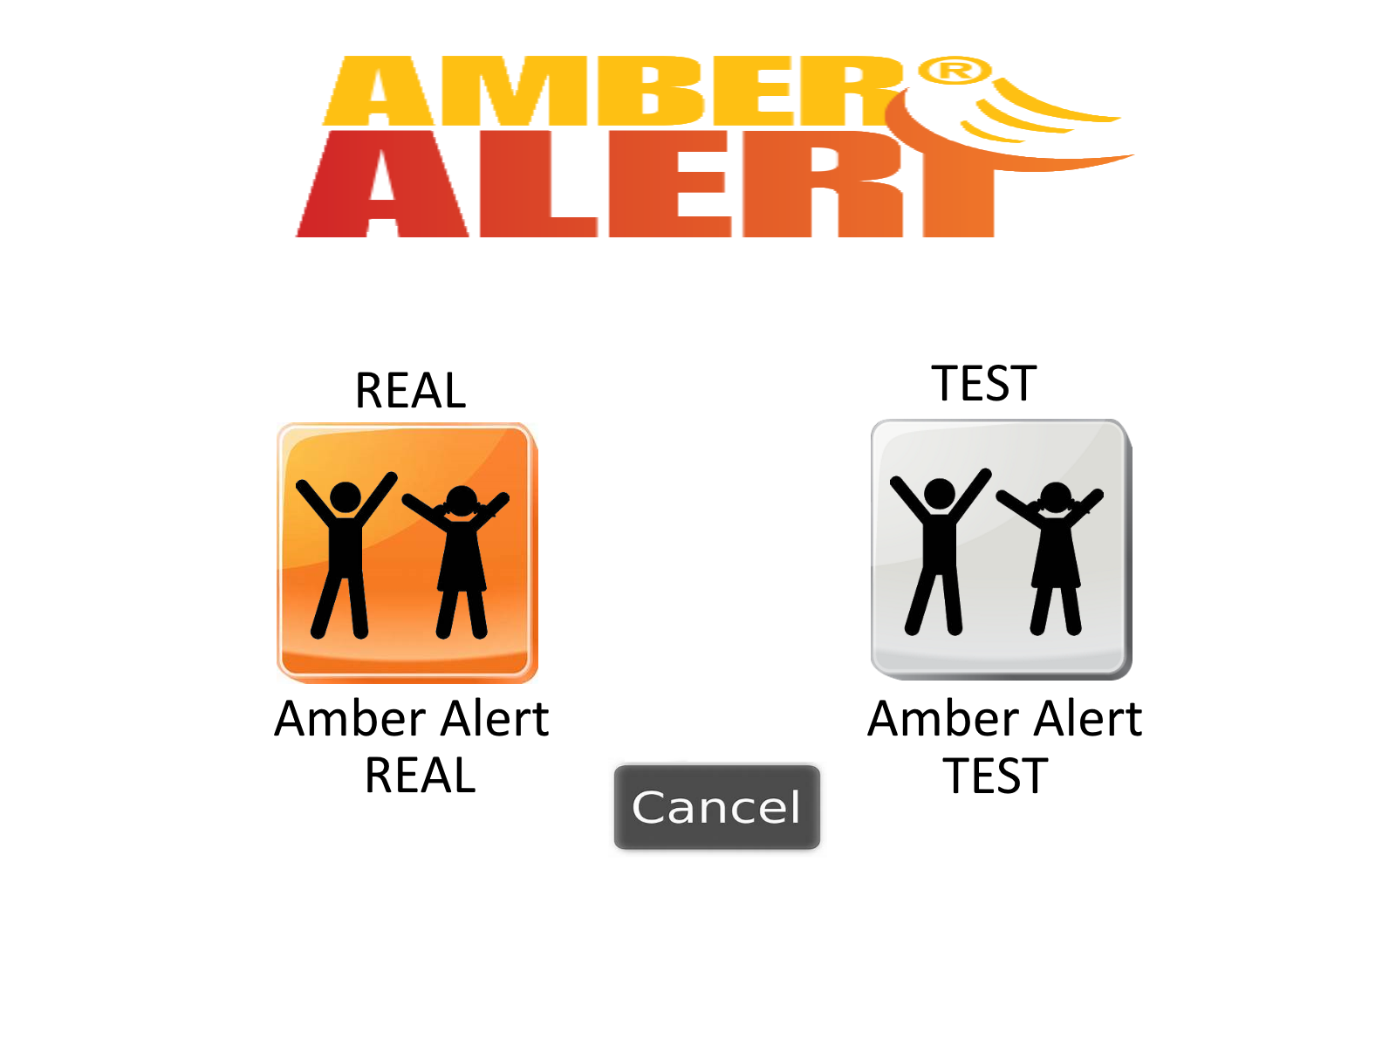
Notes:
Main Menu links to Slide 1

Slide 12

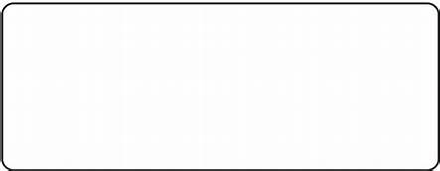
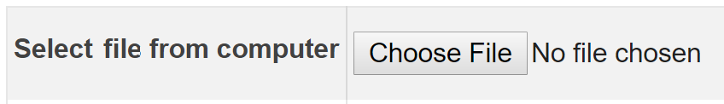


First Name:
Last Name:
Picture:
Age:
Note:
Notes:
Main Menu links to Slide 1

Slide 13

First Name:
Last Name:
Picture:
Age:
Note:
Notes:
Main Menu links to Slide 1

Slide 14
Confirmation Page
Notes:
Main Menu links to Slide 1

Slide 15
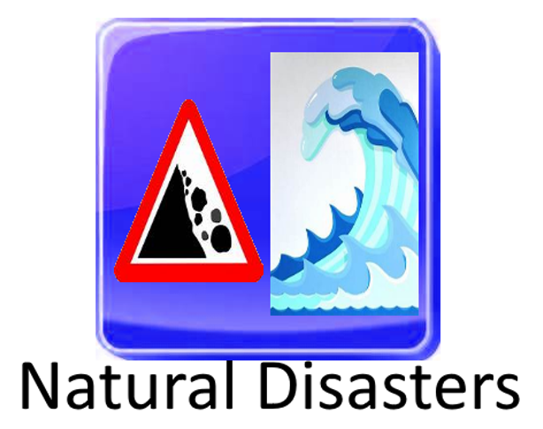
Notes:
Main Menu links to Slide 1

Slide 16
Natural Disaster
Tsunami
Hurricane
Notes:
Main Menu links to Slide 1

Slide 17
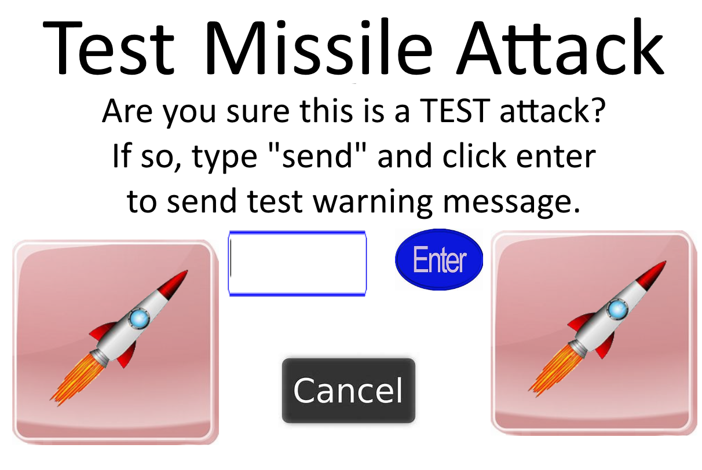
Notes:
Enter Links to Slide 13
Cancel links to Slide 7

Slide 18
Test successful
Notes:
Main Menu links to Slide 1

