Slide 1
Is odom msg received
Is mavros pose received ?
Republish
as posestamped
(mavros/vision_pose/pose)
Publish the initial mavros pose
as setpoint pose
(/mavros/setpoint_position/local)

Slide 2
LOCK
During mission | T | F | F
isMissionUpload | T | T | F

Slide 3
RESUME
Lock button still Lock button just
re init setpoint with current mavros pose
Mission exist? (not STANDBY)
Resume from the last emit pose

Slide 4
Traj. following
Just make current mission to the traj
Is current position is too far from
start of received mission traj.
Make smooth start traj.

Slide 5

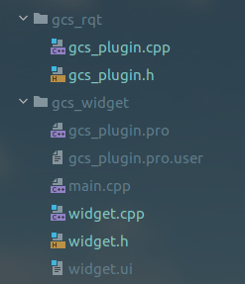


Slide 6
Server
  Publish current mission
Client

Slide 7
Terms
Mission
  Trajectory [ts,xs,ys,zs,yaws]

Slide 8
Notice
This study room runs for experiment until the end of Feb. under the authorization.
We are performing an experiment with multiple drones. Any access except lab members is strictly forbidden for your safety.
Please do not distract us while performing experiment (e.g. “unnecessarily looking around”)

