Slide 1
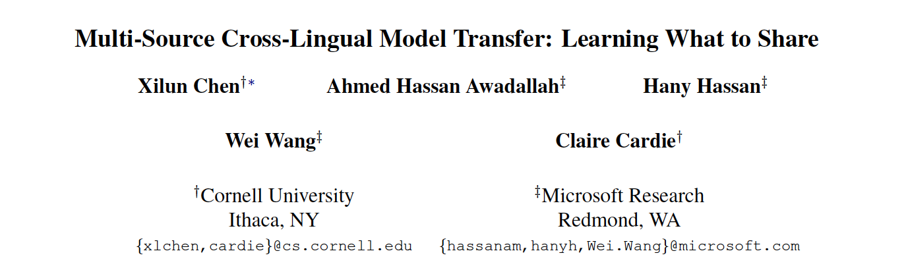

Slide 2
Cross-Lingual Transfer Learning (CLTL)
Bilingual transfer --> multilingual transfer
Using language adversarial training to extract language-invariant features (too sparse to be informative in multilingual setting) --> allow the target language to dynamically and selectively leverage language-specific features
Able to operate in a zero-resource setting where neither task-specific target language annotations nor general-purpose cross-lingual resources are available

Slide 3
Tasks
Semantic slot filling
Text classification
Named entity recognition

Slide 4
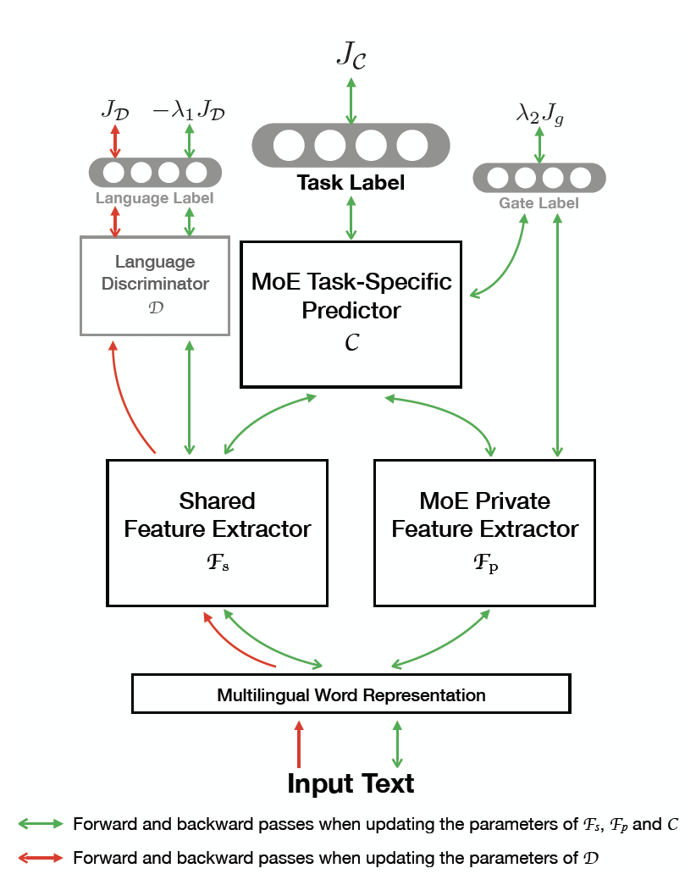
Model

Slide 5
Multilingual Word Representation
Unsupervised multilingual word embedding, mainly using MUSE

Slide 6
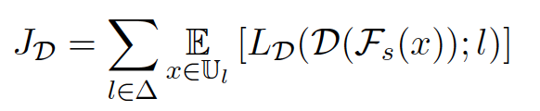
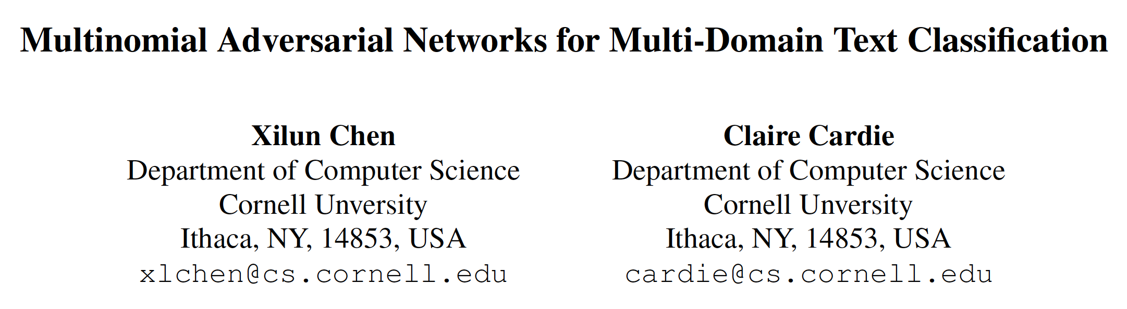
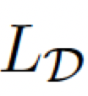
MAN Shared Feature Extractor
Multinomial Adversarial Networks (MAN)
: NLL Loss

Slide 7
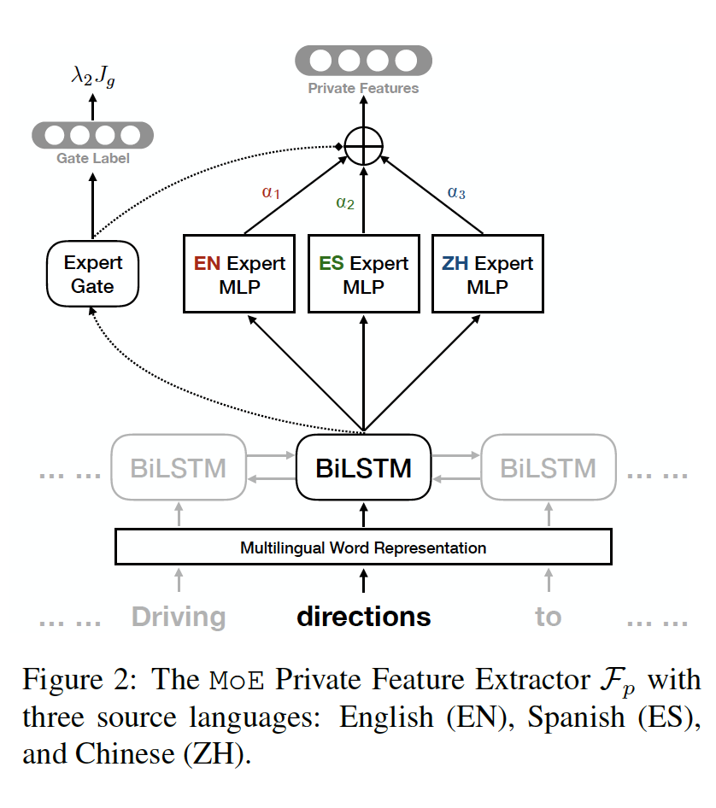
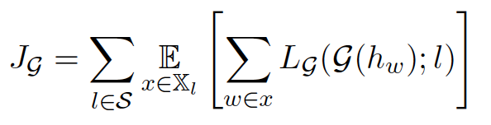
MoE Private Feature Extractor
Mixture-of-Experts model
Shared BiLSTM

Slide 8
MoE Task-Specific Predictor
Concatenate the shared and private feature
Use another MoE module to put different weights between the language-invariant and language-specific feature for different target language

Slide 9
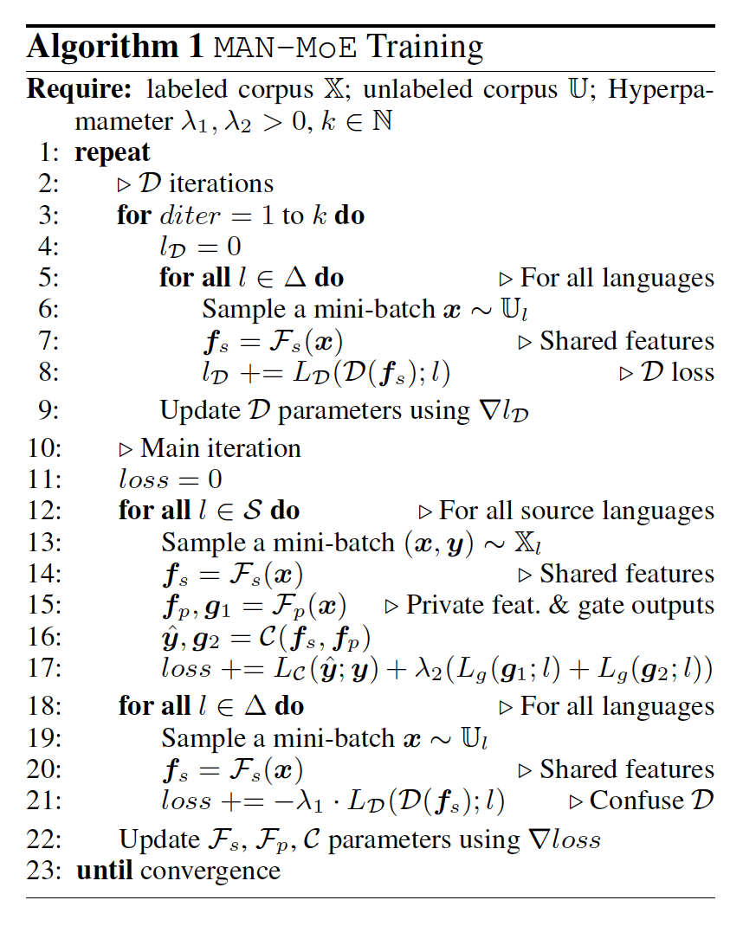
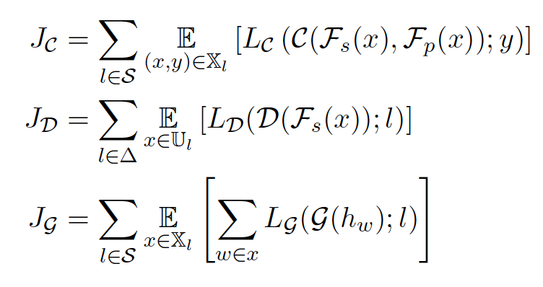

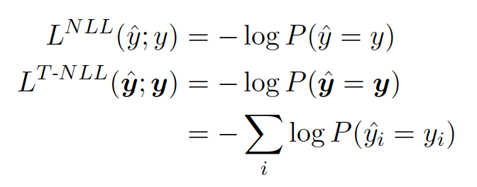
Training Procedure

Slide 10
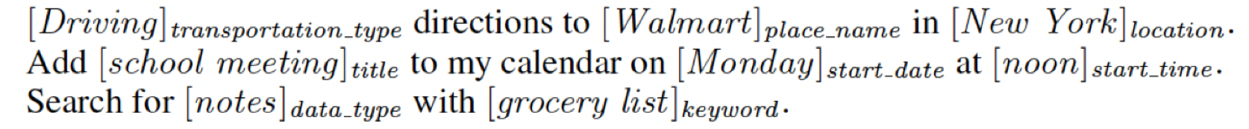
Cross-Lingual Semantic Slot Filling
Languages : English, German, Spanish, Chinese
Domains : Navigation, Calendar, Files
Formulated as a sequence tagging problem
Baselines : MT baselines, BWE baselines (MUSE)

Slide 11
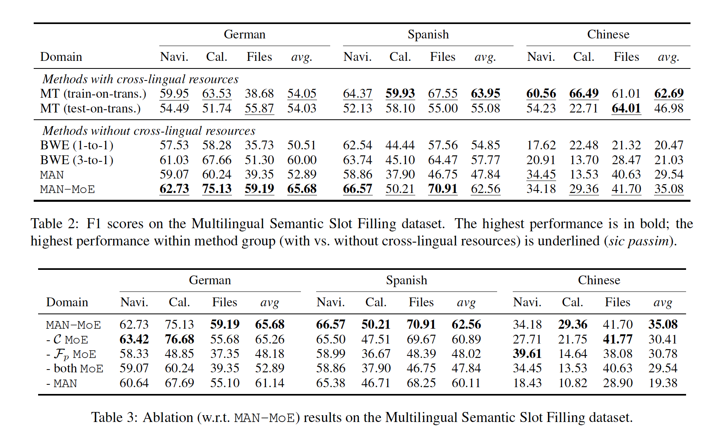

Slide 12
Cross-Lingual Named Entity Recognition
CoNLL 2002 & 2003 multilingual named entity recognition (NER) dataset
Languages : English, German, Spanish, Dutch
Formulated as a sequence tagging problem
OOV problem is severse and morphological features are crucial --> add character-level word embeddings

Slide 13
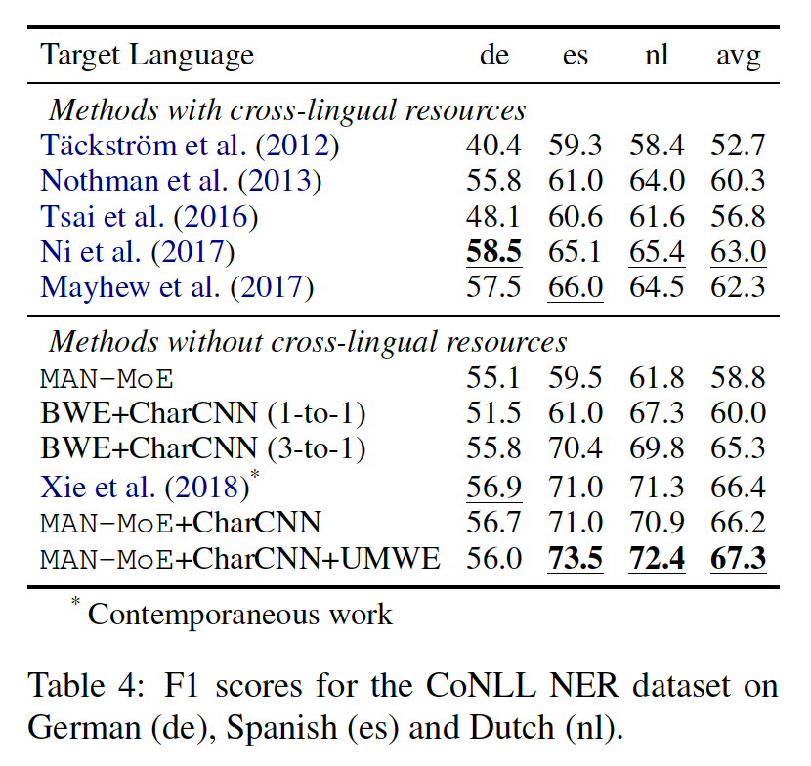
Xie et al. (2018) : BiLSTM-CRF

Slide 14
Cross-Lingual Text Classification
Amazon Reviews Dataset
Language : English, German, French, Japanese
Domain : books, music, dvd

Slide 15
