Slide 1
Dealing with multi-modal task distribution in Meta Learning
Chang Liu

Slide 2
A brief introduction to meta learning.
Main spirit:
Distilling prior knowledge from a set of related tasks to equip the model with the ability to fast adapt to a new task.
Prior knowledge: different forms of prior knowledge(parameter initialization, optimizer, vector space, etc.) results in different categories of meta-learning algorithms. In this report we will focus the optimization-based meta-learning algorithms that learn a good parameter initialization for fast adaptation, i.e., the variants of the well known MAML.
Related tasks: tasks for training and testing are drawn from the same task distribution, also under the i.i.d assumption as typical supervised learning
Fast adaptation: small labeled dataset/few gradient updates

Slide 3
A brief introduction to meta learning.
Main applications: few-shot learning
Medical imaging
Robotics
Personalized applications
Rare languages
Continual learning with new classes
…
Some published papers(classification not involved, as is well studied in CV.)
EMNLP18 Meta-Learning for Low-Resource Neural Machine Translation
NAACL18 Natural Language to Structured Query Generation via Meta-Learning
ACL2019 Domain Adaptive (task-oriented) Dialog Generation via Meta-Learning
ACL2019 Personalizing Dialogue Agents via Meta-Learning
……

Slide 4
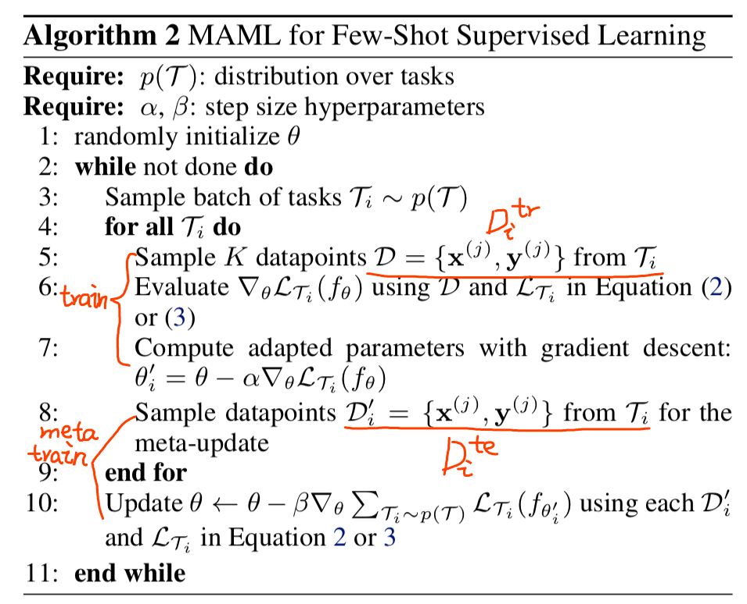
A brief introduction to MAML:
Model-Agnostic Meta-Learning for Fast Adaptation of Deep Networks
——Finn, ICML17

Slide 5

A brief introduction to MAML:
Model-Agnostic Meta-Learning for Fast Adaptation of Deep Networks
——Finn, ICML17
Comparation to multi-task learning(MTL)/transfer learning：
MTL can be considered as a special case of MAML, the only difference lies in meta-update step:
MAML:
MTL:
In the parameter space:
MAML: peak
MTL: Plateau

Slide 6
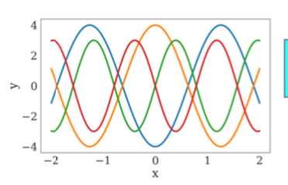
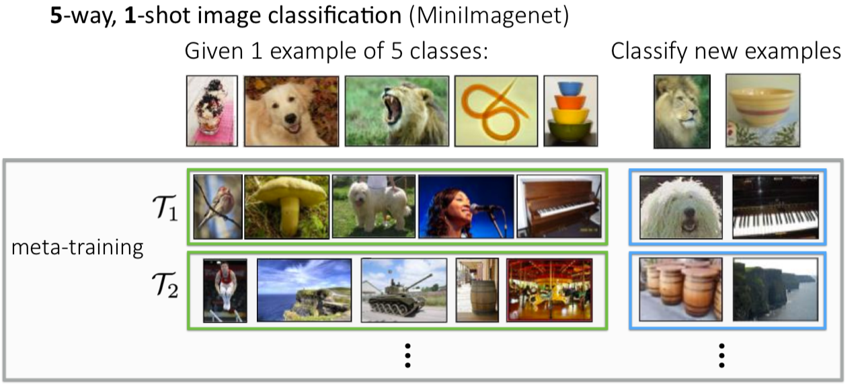
About the term “task distribution”
Task distribution can be thought of as analogous to the distribution of data points, where the “point” is a dataset which contains many (true)data points. That is something like a distribution of cluster centroids.
For example:
Regression: learning to fit different quadratic/linear/sinusoid functions
Few-shot image classification:

Slide 7
About the term “task distribution”
Task distribution can be thought of as analogous to the distribution of data points, where the “point” is a dataset which contains many (true)data points. That is something like a distribution of cluster centroids.
But… can it be directly compared to data points distribution of a single dataset/task ?
In a single dataset, data points often obey some single-modal distribution(or it will fall into the paradigm of multi-task learning or multi-domain learning)
But for a task distribution, the tasks are heterogeneous and there might exist sophisticated relations among tasks. In some desired feature space, the task distribution can be a multi-model distribution, but the previously introduced MAML(as well as most existing meta-learning algorithms, optimization-based or not) treat tasks equally, leaving the relations(e.g., clustering information) among tasks unutilized.

Slide 8
Dealing with multi-modal task distribution in meta-learning
Analogous to multi-modal data distribution, we can incorporate ideas from multi-task learning into meta-learning algorithms to better utilize the multimodal nature of task distributions and avoid it from collapsing down to joint training.
Toward Multimodal Model-Agnostic Meta-Learning ——arxiv
Hierarchically Structured Meta-learning ——ICML19

Slide 9
Toward Multimodal Model-Agnostic Meta-Learning ——arxiv
Observation:
One important limitation of existing frameworks is that they seek a common initialization shared across the entire task distribution, substantially limiting the diversity of the task distributions that they are able to learn from.
A simple method that directly come in mind:
When the modes of a task distribution are disjoint and far apart, one can imagine that a set of separate meta-learners with each covering one mode could better master the full distribution.
But, this not only requires additional identity information about the modes, which is not always available or could be ambiguous when the task modes are not clearly disjoint, but also eliminates the possibility of associating transferable knowledge across different modes of a task distribution.

Slide 10
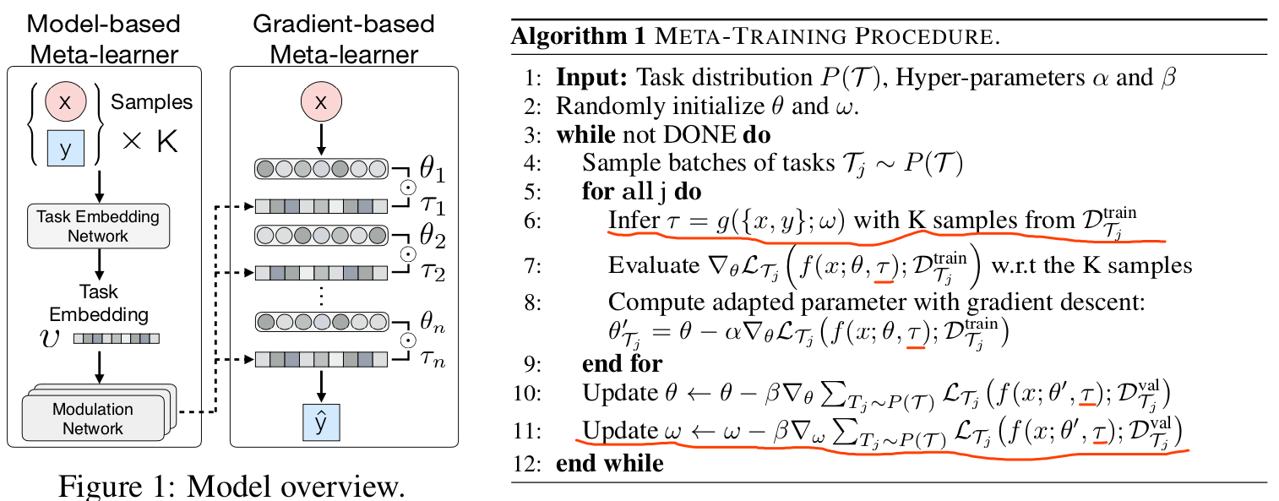
Toward Multimodal Model-Agnostic Meta-Learning ——arxiv
Method:(augmentation upon MAML)
Firstly identify tasks sampled from a multimodal task distribution.
Then modulate its meta-learned prior according to the identified task.

Slide 11
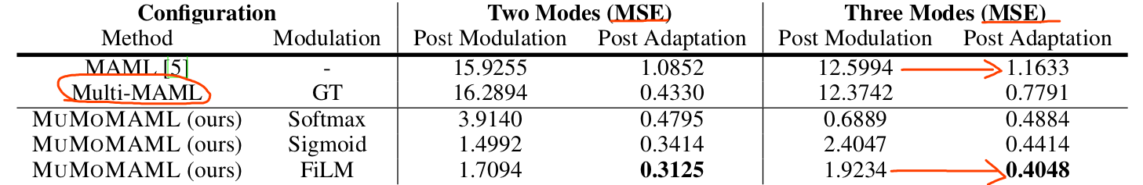
Toward Multimodal Model-Agnostic Meta-Learning ——arxiv
Experiments

Slide 12
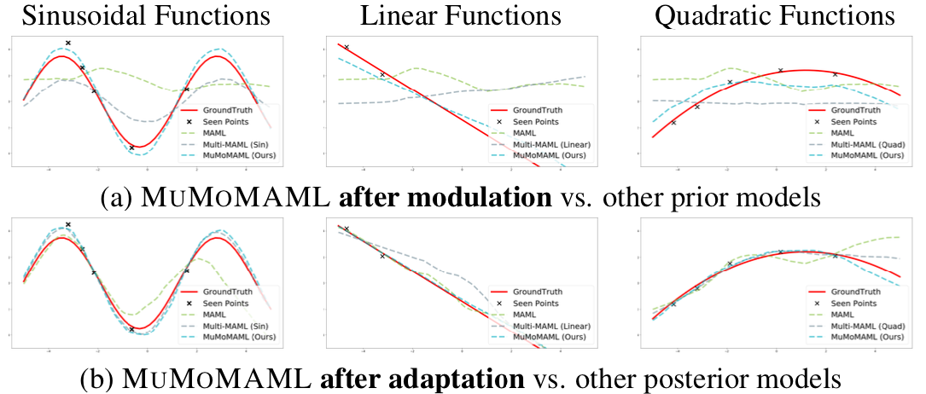
Toward Multimodal Model-Agnostic Meta-Learning ——arxiv
Experiments

Slide 13
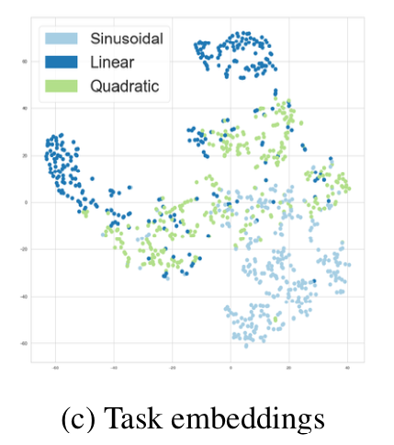
Toward Multimodal Model-Agnostic Meta-Learning ——arxiv
Experiments

Slide 14
Hierarchically Structured Meta-learning ——ICML19
Motivation:
Due to the uncertainty and the heterogeneity of tasks, globally sharing knowledge among tasks might not be a good idea.
Promoting knowledge customization to different clusters of tasks but simultaneously preserving knowledge generalization among a cluster of closely related tasks.

Slide 15
Hierarchically Structured Meta-learning ——ICML19
Methods: through hierarchically clustering of tasks
Overview: when a new task arrives, it can either quickly take advantage of the knowledge learned within the cluster it belongs to or initiate a new cluster if it is wildly different from any existing clusters.(from a continual learning’s perspective, much more reasonable than Online Meta-Learning, ICML19)
Firstly, using autoencoder aggregator to represent each input task.
Secondly, the HSML resorts to a hierarchical clustering structure to perform soft clustering on tasks.
Thirdly, a globally shared parameter initialization is tailored to each cluster via a parameter gate, to serve as the initializations for all tasks belonging to the cluster.
What’s more, continual adaptation when encountering new tasks.

Slide 16
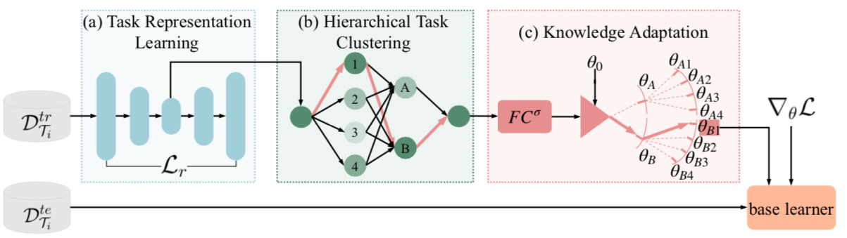
Hierarchically Structured Meta-learning ——ICML19
Methods: through hierarchically clustering of tasks

Slide 17
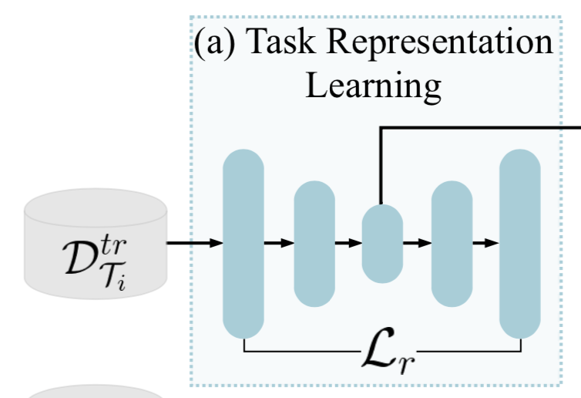
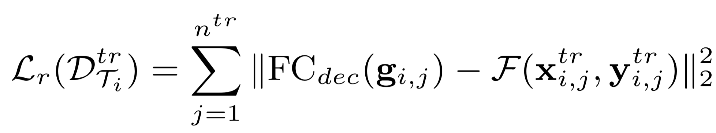
Hierarchically Structured Meta-learning ——ICML19
Methods:
Firstly, using autoencoder aggregator to represent each input task.
Pooling Autoencoder Aggregator
Recurrent Autoencoder Aggregator

Slide 18
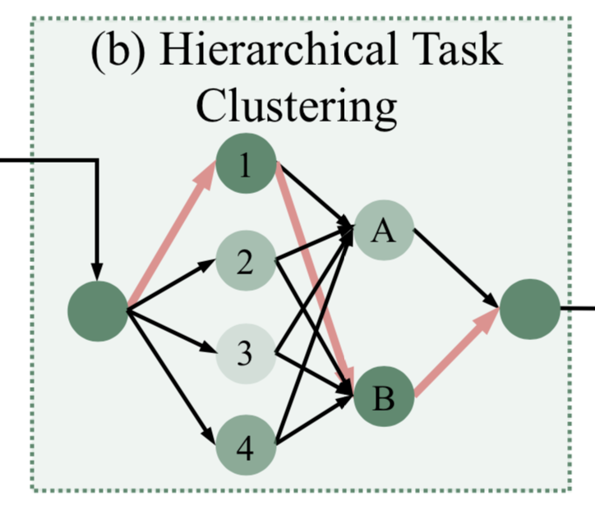
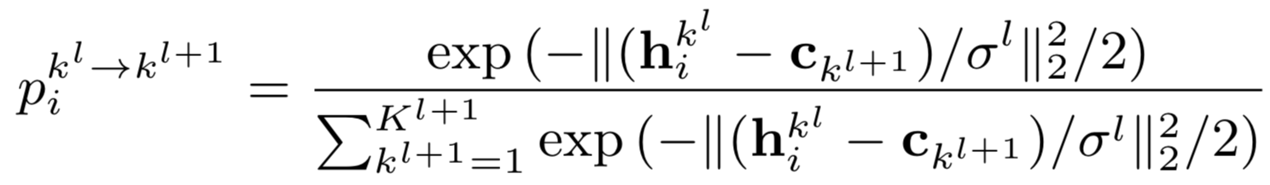
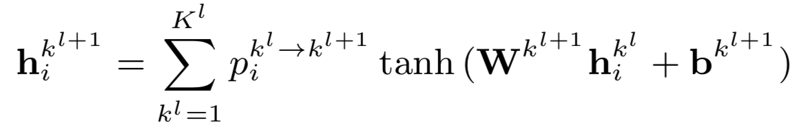
Hierarchically Structured Meta-learning ——ICML19
Methods:
Secondly, the HSML resorts to a hierarchical clustering structure to perform soft clustering on tasks.

Slide 19
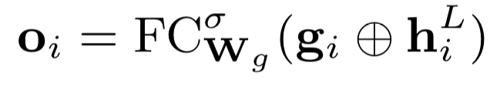
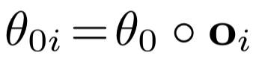
Hierarchically Structured Meta-learning ——ICML19
Methods:
Thirdly, a globally shared parameter initialization is tailored to each cluster via a parameter gate, to serve as the initializations for all tasks belonging to the cluster.

Slide 20
Hierarchically Structured Meta-learning ——ICML19
Methods:
What’s more, continual adaptation when encountering new tasks.
What if a new task does not fit any of the learned task clusters? Additional clusters should be introduced to the hierarchical clustering structure.
When to expand the clustering structure? What’s the criterion? Loss value.

Slide 21
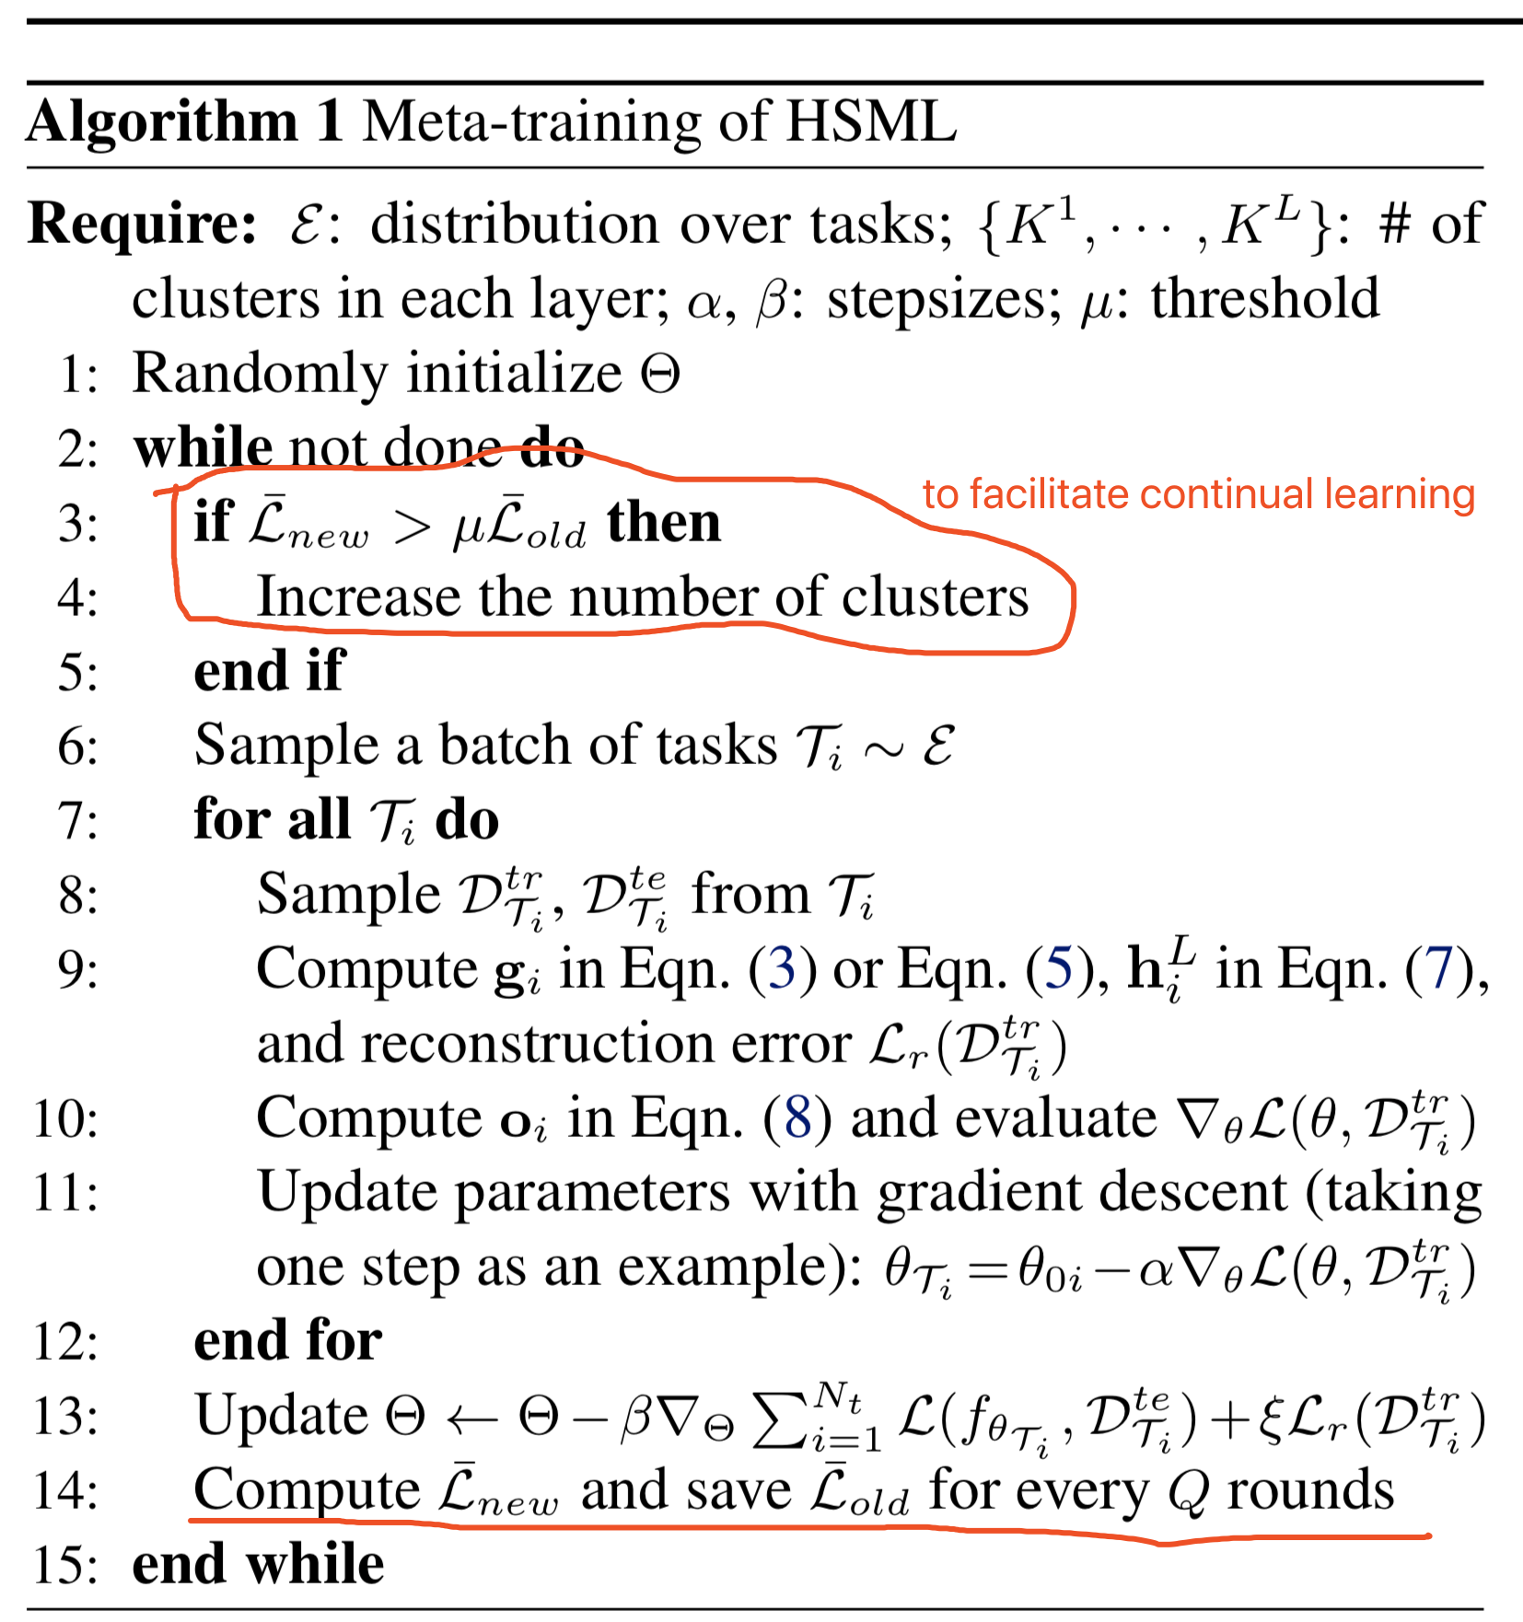
Hierarchically Structured Meta-learning ——ICML19
Methods:
Training protocol

Slide 22
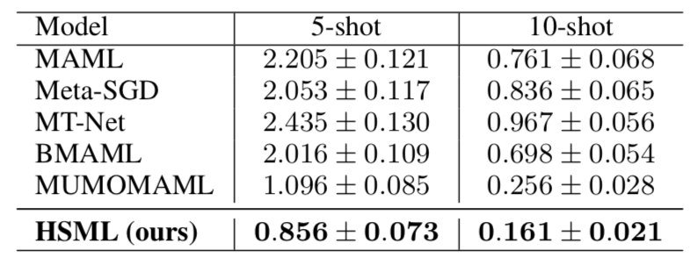
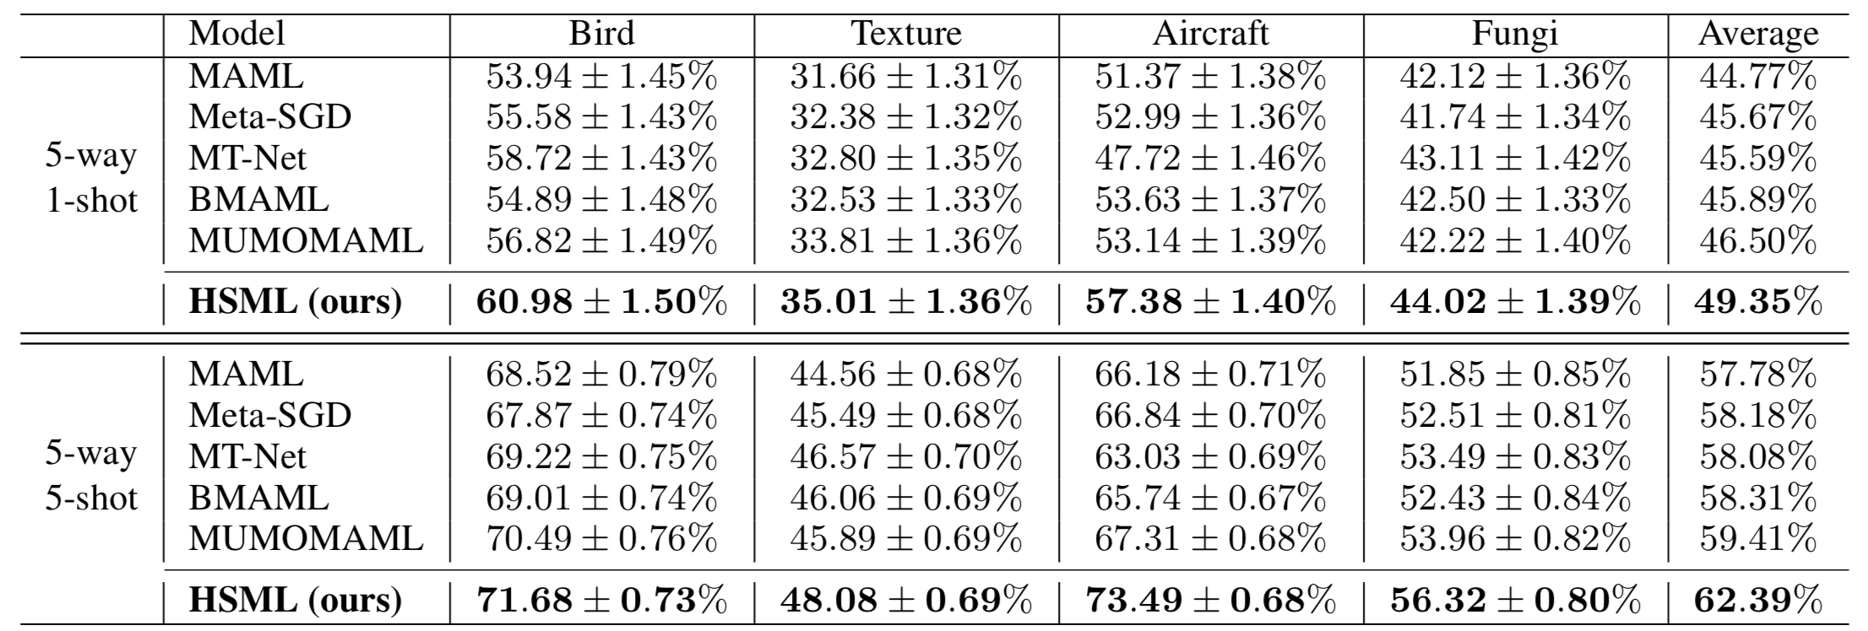
Hierarchically Structured Meta-learning ——ICML19
Experiments:
Can our approach outperform other meta-learning algorithms in toy regression and few-shot image classification tasks? ——Yes

Slide 23
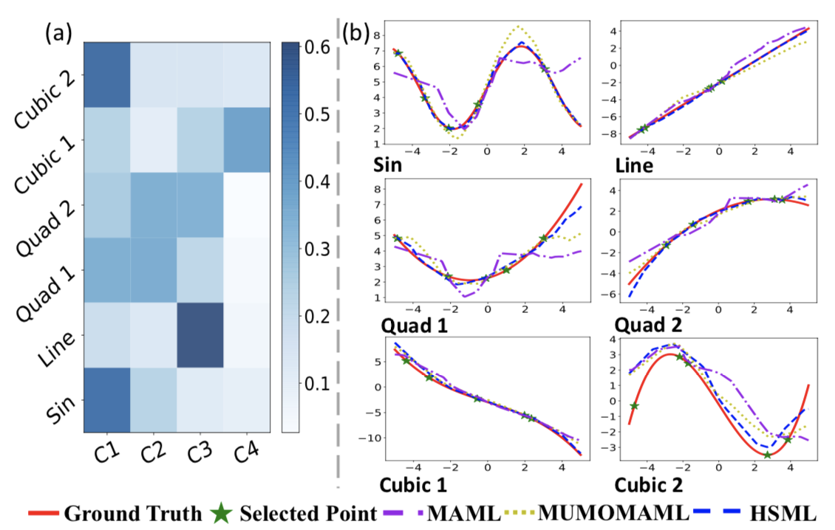
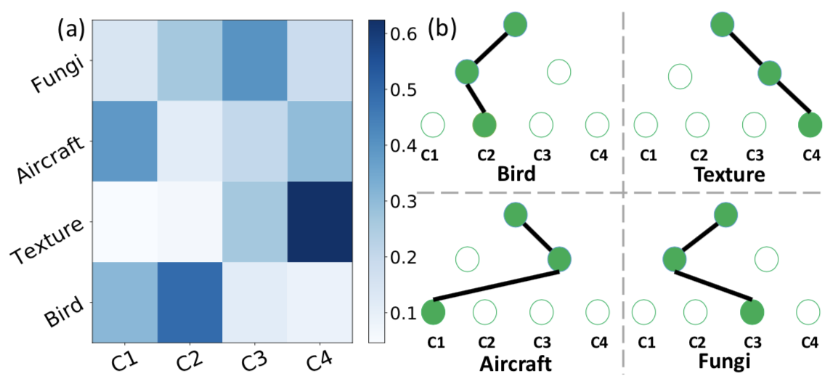
Hierarchically Structured Meta-learning ——ICML19
Experiments:
Can our approach discover reasonable task clusters? ——Yes

Slide 24
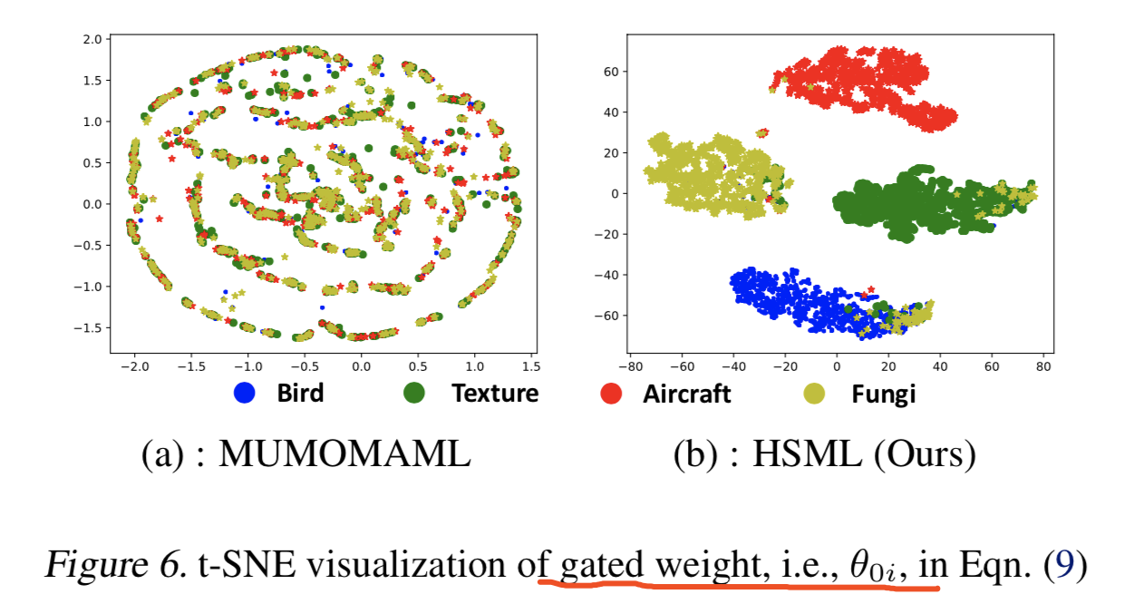
Hierarchically Structured Meta-learning ——ICML19
Experiments:
Can our approach discover reasonable task clusters? ——Yes

Slide 25
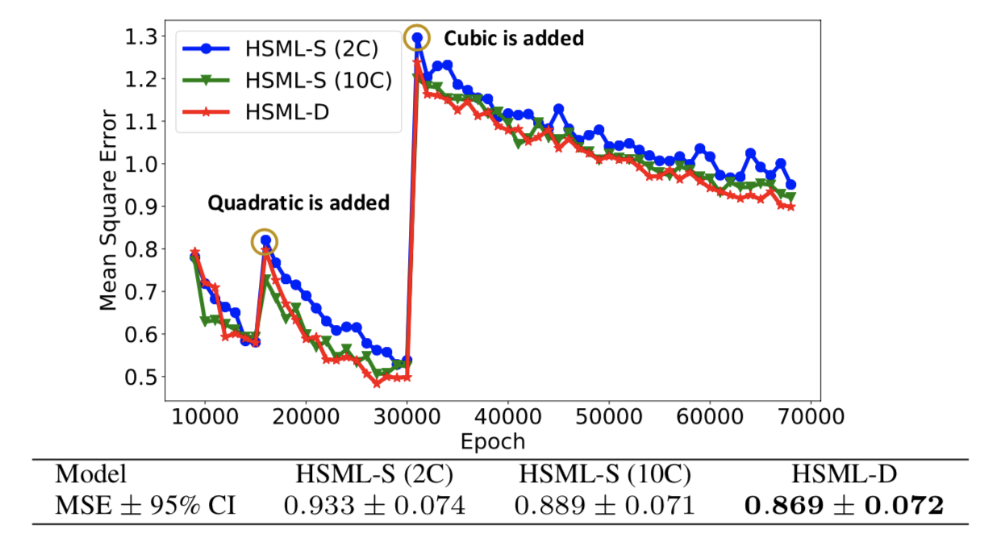
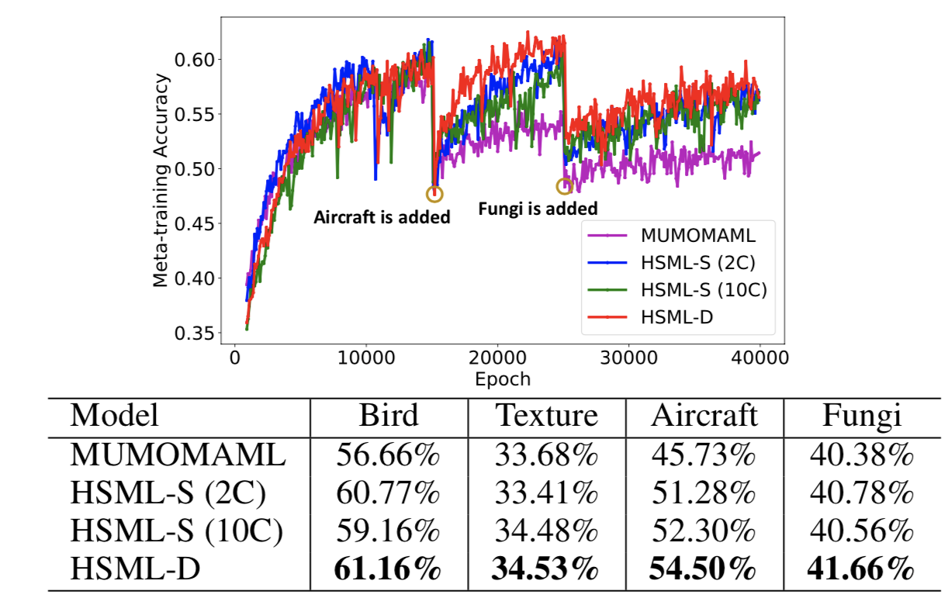
Hierarchically Structured Meta-learning ——ICML19
Experiments:
Can our approach update the clustering structure in the continual learning manner and achieve better performance? ——Yes

Slide 26
Thanks for listening!

