Slide 1

Read, Attend and Comment: A Deep Architecture for Automatic News Comment Generation
EMNLP 2019

Slide 2
Overview
In this paper, we propose a “read-attend-comment” procedure for news comment generation and formalize the procedure with a reading network and a generation network.
The reading network comprehends a news article and distills some important points from it, then the generation network creates a comment by attending to the extracted discrete points and the news title.
We optimize the model in an end-to-end manner by maximizing a variational lower bound of the true objective using the back-propagation algorithm.

Slide 3
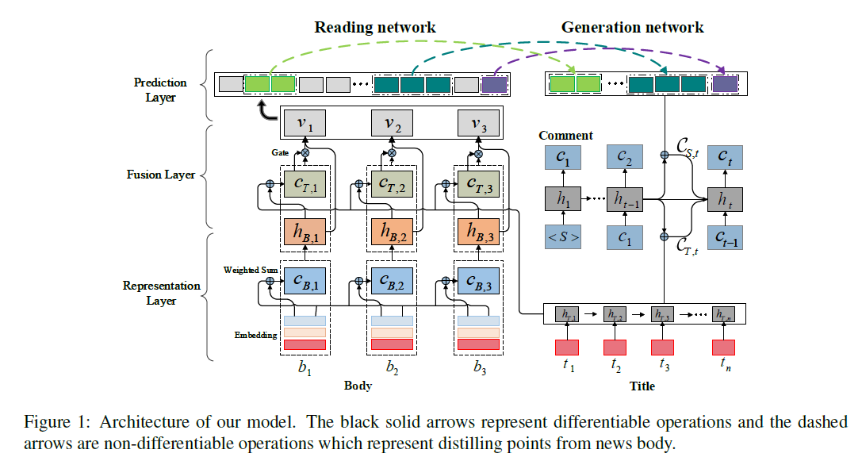
Model

Slide 4





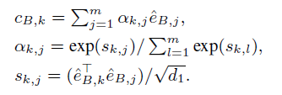
Reading network
Representation layer
word embedding
position embedding
title representation transforms into a sequence of hidden vectors with a
recurrent neural network with gated recurrent units (RNN GRUs).
body representation transforms into hidden vectors with self-attention.

Slide 5




Reading network
Fusion layer
The fusion layer takes as inputs, and produces as new representation
of the entire news article by fusing into .
$$c_{T, k}=dot−attn(H_{T}, h_{B, k})$$
With this step, we aim to recognize useful information in the title.
combine the new title representation and body representation with a gate which balances the impact and filters noise.

Slide 6





Reading network
Prediction layer
refers to a two-layer MLP, and is a probability distribution with the first entry as and the second entry as
The advantage of the approach is that it allows us to efficiently and flexibly detect a variable
number of spans from a variable-length news article.
Recognize the i-th word as a start position if

Slide 7

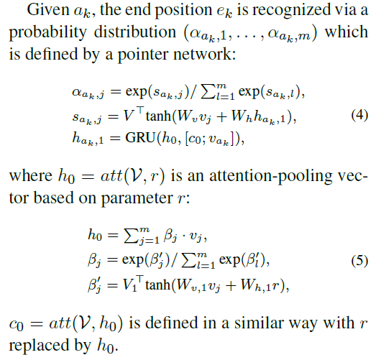
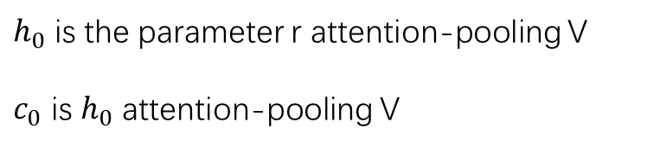
Reading network
Prediction layer
Calculate the end position
$h_{0}$ is the parameter r attention-pooling V
$c_{0}$ is $h_{0}$ attention-pooling V

Slide 8

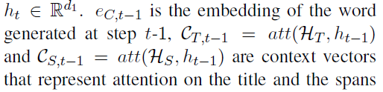
Generation network
as input

Slide 9
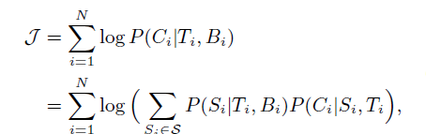

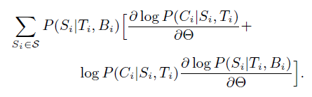
Learning method
Objective is difficult to optimize, as logarithm is outside the summation.

Slide 10
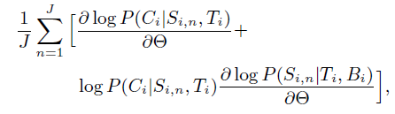
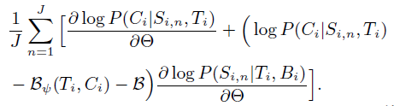



Learning method
To calculate the gradient, we have to enumerate all possible start positions, so employ a Monte Carlo sampling method.
Although the Monte Carlo estimator is unbiased, it typically suffers from high variance.
To calculate , we first encode the word sequences of with GRUs respectively,
and then feed the last hidden states of the GRUs to a three-layer MLP.
is calculated as an average of over the current mini-batch.

Slide 11
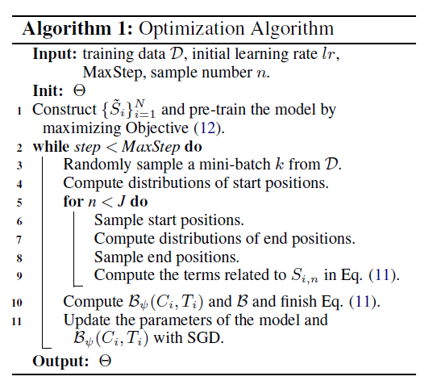

To speed up convergence, we initialize our model through pre-training the reading network and the generation network.
we construct an artificial span set, and learn the parameters of the two networks by maximizing the following objective.

Slide 12
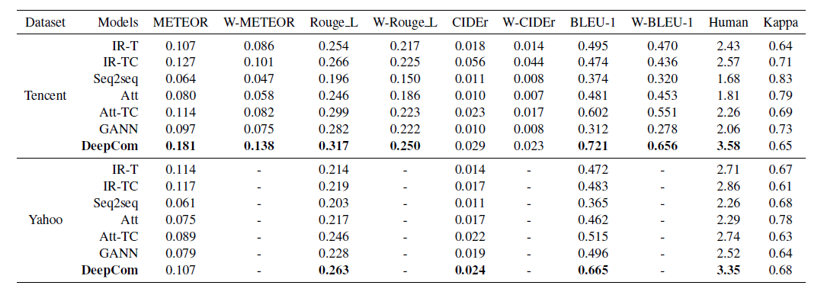
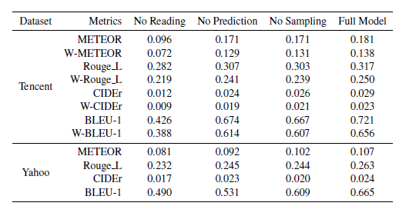
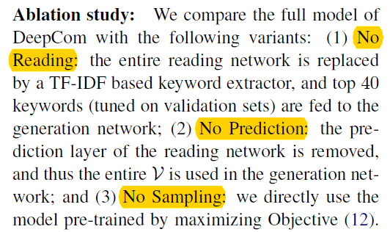

Slide 13
Coherent Comment Generation for Chinese
Articles with a Graph-to-Sequence Model
ACL 2019

Slide 14
Overview
We propose to represent the article with a topic interaction graph, which organizes the sentences of the article into several topic centered vertices.
We propose a graph-to-sequence model that generates comments based on the topic interaction graph.
We collect and release a large scale (200,000) article-comment corpus that contains title, content and the comments of the news articles.

Slide 15
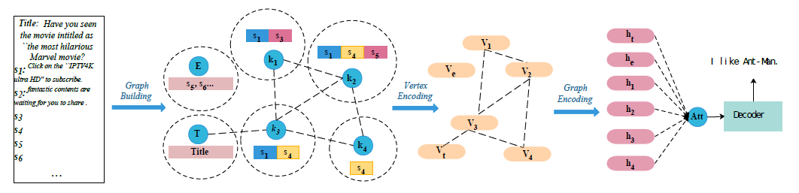
Model

Slide 16
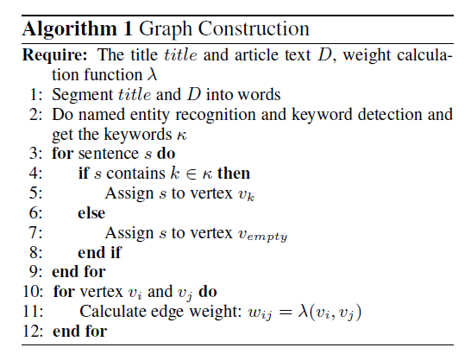
Graph construction
Do word segmentation and named entity recognition on the news articles
Apply keyword extraction algorithms like TextRank to obtain additional keywords.
If vertices vi and vj share at least one sentence, we add an edge eij between them, the weight of which is calculated by the number of shared sentences.

Slide 17

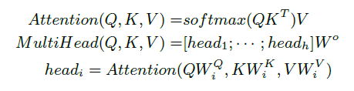
Vertex Encoder
word embedding + position embedding
Keywords at position 0
Since the keyword k is the most important information in the vertex, we use the hidden vector of the inserted keyword a0 in the last layer as the vector that represents the whole vertex.

Slide 18


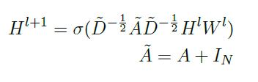
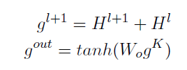
Graph Encoder
based graph convolutional model (GCN).

Slide 19
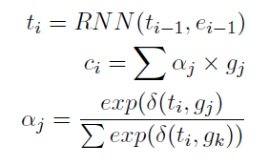
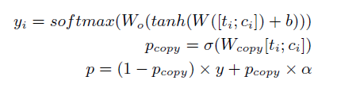
Decoder
At each decoding step, a context vector ci is calculated by doing attention on the outputs of the GCN.
we adopt copy mechanism by merging the predicted word token probability distribution with the attention distribution.

Slide 20
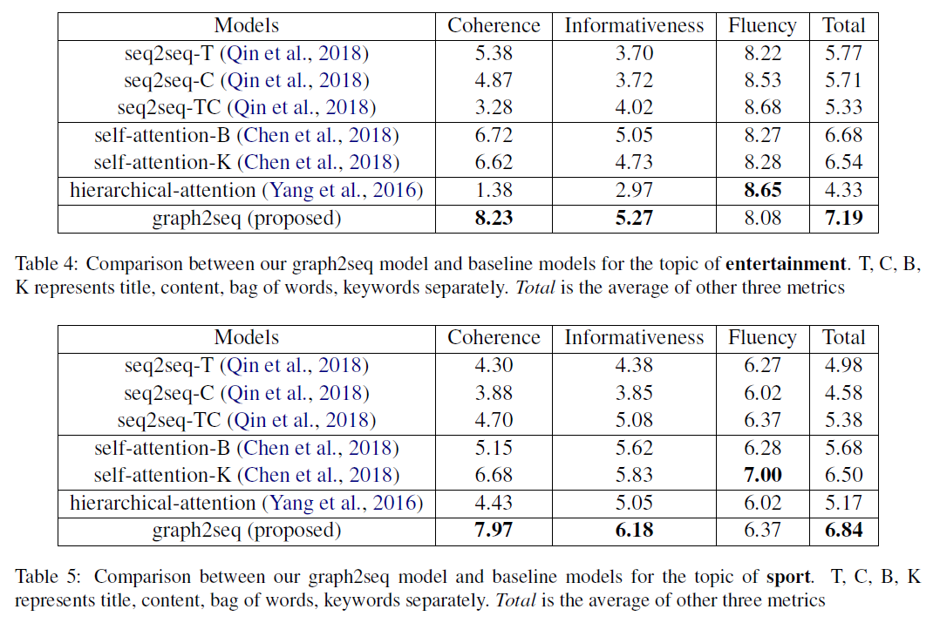

Slide 21
Automatic Generation of Personalized Comment Based on User Profile
ACL 2019

Slide 22
Overview
Motivation:
since different user has different expression habits, it is necessary to take the user’s profile into consideration when generating comments.
For example, a user with individual description “只爱朱一龙” (I only love Yilong Zhu), tends to writes a positive and adoring comments on the microblog related to Zhu.
The model utilizes user feature embedding with a gated memory and attends to user description to model personality of users. In addition, external user representation is taken into consideration during the decoding to enhance the comments generation

Slide 23
Data Preparation
Each instance in the dataset has province, city, gender, age, marital status, individual description of user’s, comment added by user and homologous blog content.
Individual description: We tokenized all text like individual description, comment and blog content into words.
Numeric feature: discrete variables such as province, city, gender and marital status were treated uniformly by one-hot coding.

Slide 24
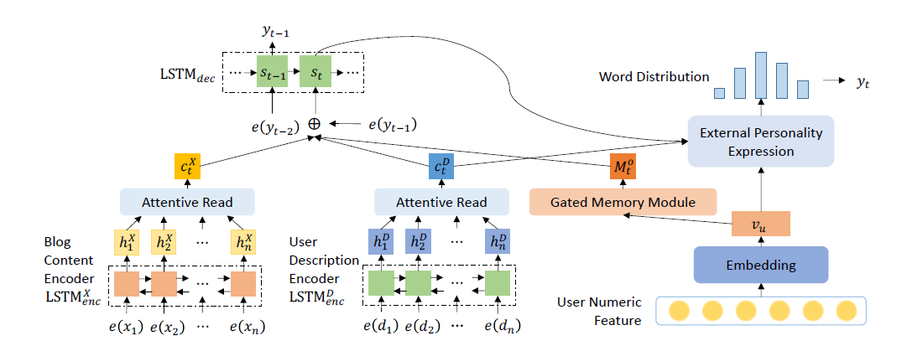
Model

Slide 25
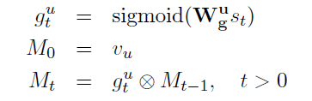


User Feature Embedding with Gated Memory
Map user’s numeric feature F to a dense vector through a fully-connected layer.
However, if the user feature embedding is static during decoding, the grammatical correctness of sentences generated may be sacrificed.
To tackle this problem, we design an gated memory module to dynamically express personality during decoding.
at each time step t, the model computes an update gate according to the current state of the decoder.
update
update
output

Slide 26

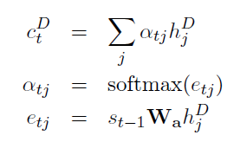

Blog-User Co-Attention
Decoder state at each time step make attention attend blog representation and user’s individual description.
Concat as context vector.

Slide 27



External Personality Expression
To fully exploit the user information when selecting words for generation, we first compute a user representation with user feature embedding and user description context.

Slide 28
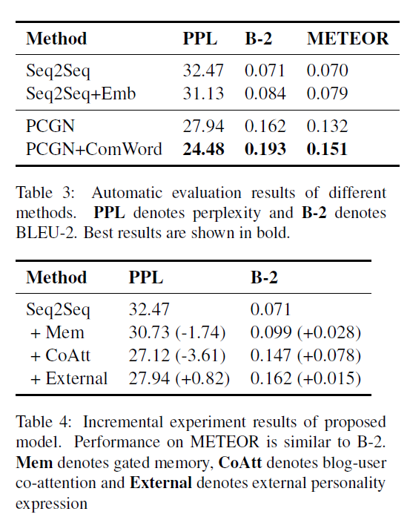
To further enrich the information provided by
user description, we collected most common k
words in user historical comments (k = 20 in our
experiment). We concatenate the common words
with the user individual description.

