Slide 1
Attention and Explanation
By 王孟宇

Slide 2
NAACL 2019
Attention is not Explanation
Attention weights should correlate with feature importance measures (e.g., gradient-based measures)
Alternative (or counterfactual) attention weight configurations ought to yield corresponding changes in prediction (and if they do not then are equally plausible as explanations)

Slide 3
NAACL 2019
Attention is not Explanation
To what extent do induced attention weights correlate with measures of feature importance – specifically, those resulting from gradients and eave-one-out (LOO) methods?
Would alternative attention weights (and hence distinct heatmaps/“explanations”) necessarily yield different predictions?

Slide 4
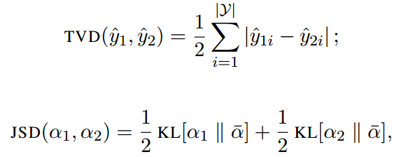
NAACL 2019
Attention is not Explanation
Kendall correlation coefficient

Slide 5
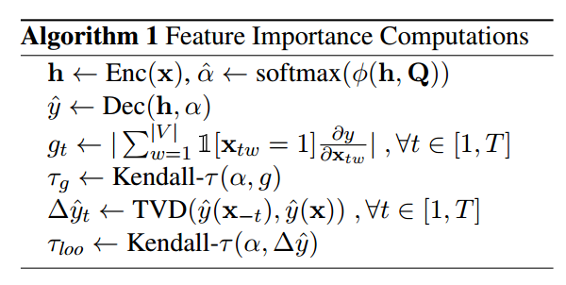
NAACL 2019
Attention is not Explanation
Correlation Between Attention an Feature Importance Measures

Slide 6
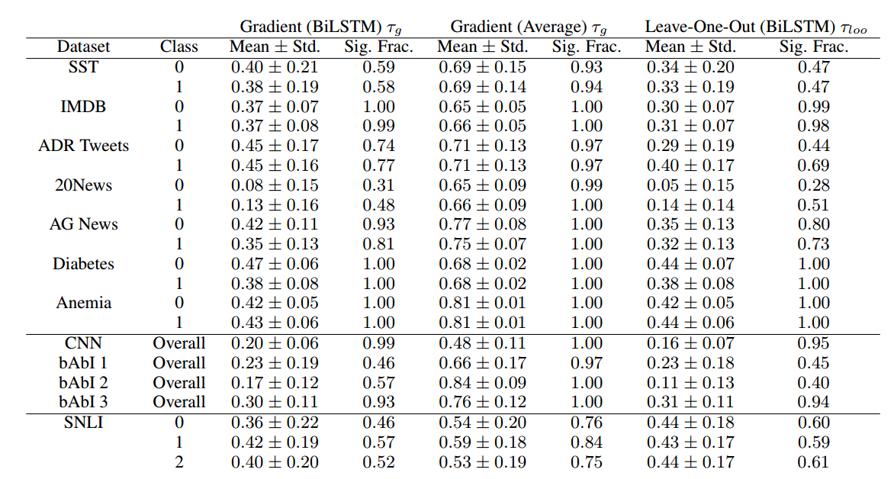

Slide 7
NAACL 2019
Attention is not Explanation
Correlation Between Attention an Feature Importance Measures
In general, observed correlations are modest for the BiLSTM model. The centrality of observed densities hovers around or below 0.5 in most of the corpora considered.
The more consistently significant correlations observed on these datasets is likely attributable to the increased length of the documents that they comprise
Gradients for inputs in the “average” (linear projection) embedding based models show much higher correspondence with attention weights
The results here suggest that, in general, attention weights do not strongly or consistently agree with standard feature importance scores. The exception to this is when one uses a very simple (averaging) encoder model

Slide 8
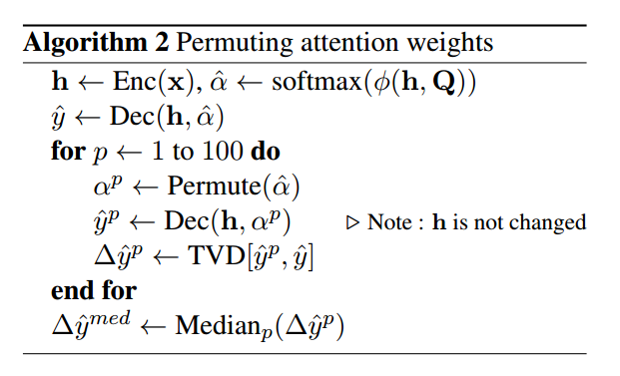
NAACL 2019
Attention is not Explanation
（ii）Counterfactual Attention Weights
Attention Permutation

Slide 9
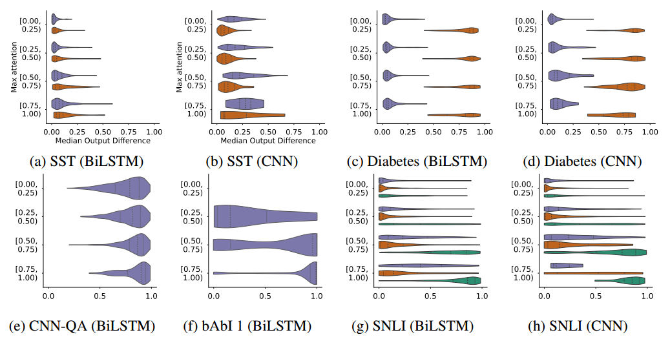
NAACL 2019
Attention is not Explanation
（ii）Counterfactual Attention Weights
Attention Permutation

Slide 10
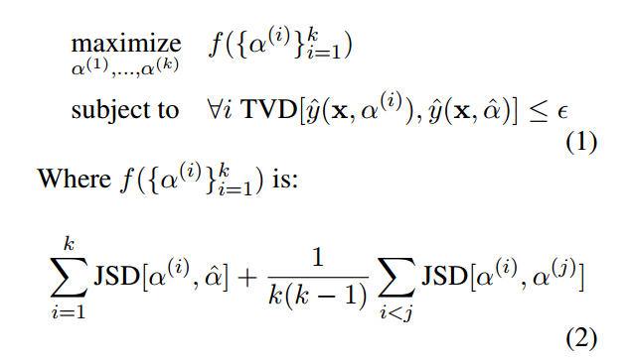
NAACL 2019
Attention is not Explanation
（ii）Counterfactual Attention Weights
Adversarial Attention

Slide 11
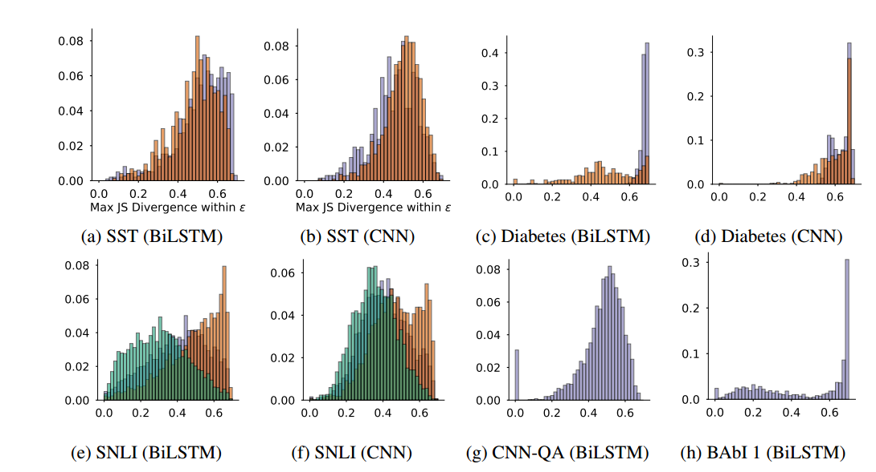
NAACL 2019
Attention is not Explanation
（ii）Counterfactual Attention Weights
Adversarial Attention

Slide 12
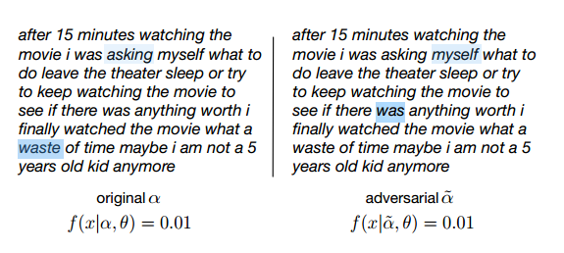
NAACL 2019
Attention is not Explanation
（ii）Counterfactual Attention Weights
Adversarial Attention

Slide 13
EMNLP 2019
Attention is not not Explanation
They detach the attention distribution and output layer of their pretrained network.
They compute an independent adversarial distribution for each instance.
Attention Distribution is not a Primitive.
Existence does not Entail Exclusivity.
Jain and Wallace have not shown the existence of an adversarial model that produces the claimed adversarial distributions

Slide 14
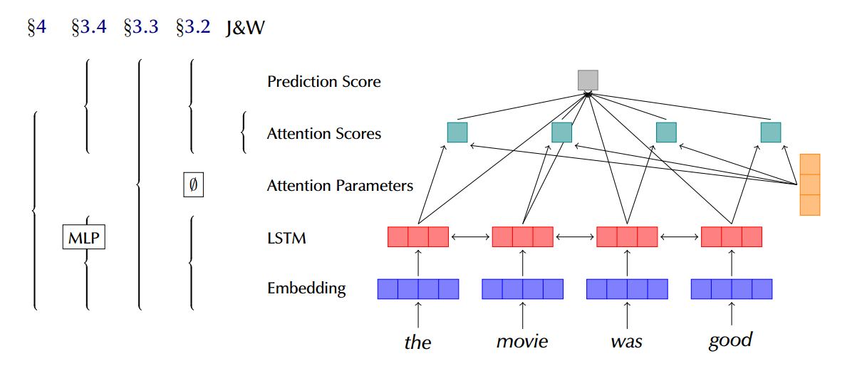
EMNLP 2019
Attention is not not Explanation

Slide 15
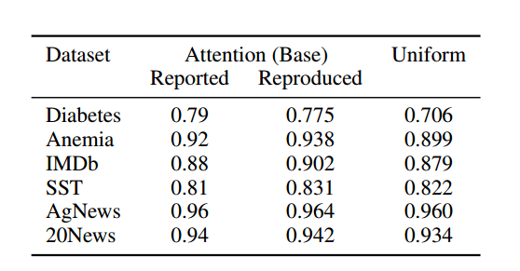
EMNLP 2019
Attention is not not Explanation
(3.2) whether attention is really needed

Slide 16
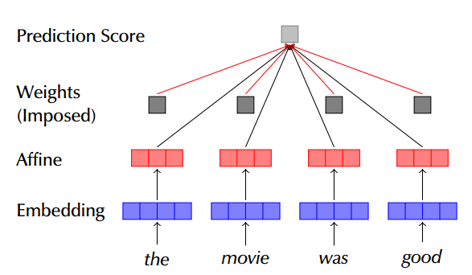
EMNLP 2019
Attention is not not Explanation
(3.4) Diagnosing Attention Distributions by Guiding Simpler Models

Slide 17
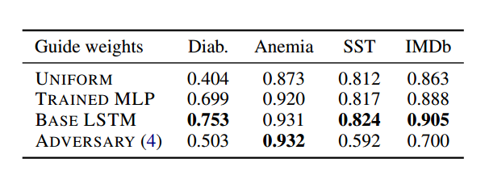
EMNLP 2019
Attention is not not Explanation
(3.4) Diagnosing Attention Distributions by Guiding Simpler Models
These findings strengthen the case counter to the claim that attention weights are arbitrary

Slide 18
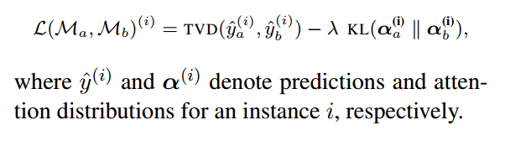
EMNLP 2019
Attention is not not Explanation
(4) Training an Adversary

Slide 19
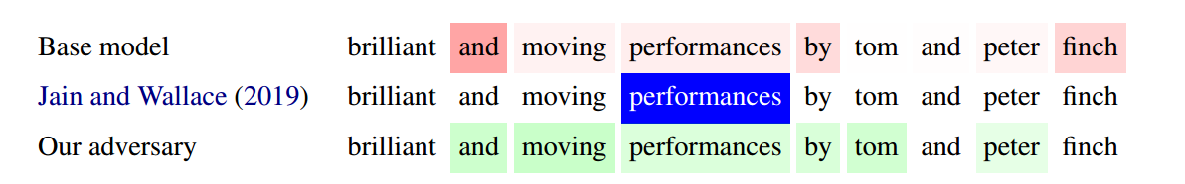
EMNLP 2019
Attention is not not Explanation
(4) Training an Adversary

Slide 20
EMNLP 2019
Attention is not not Explanation
Conclusion
Whether or not attention is explanation depends on the definition of explainability one is looking for: plausible or faithful explanations (or both).
Adversarial distributions can be found for LSTM models in some classification tasks

Slide 21
ACL 2019
Is Attention Interpretable?
Conclusion
What is clear is that in the settings we have examined, attention is not an optimal method of identifying which attended elements are responsible for an output.
Attention may yet be interpretable in other ways, but as an importance ranking, it fails to explain model decisions.

Slide 22
Summary

Slide 23
Thanks

