Slide 1

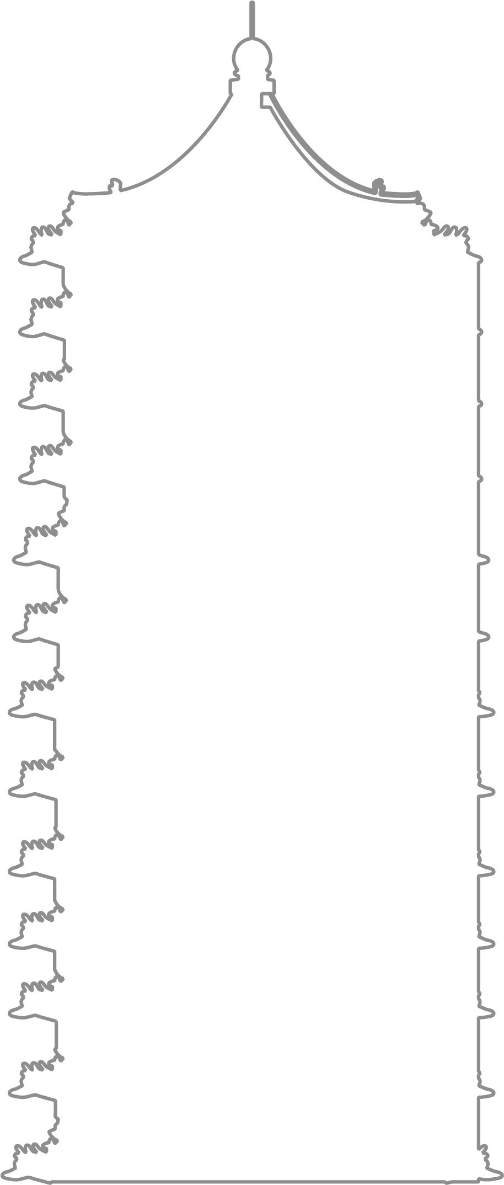
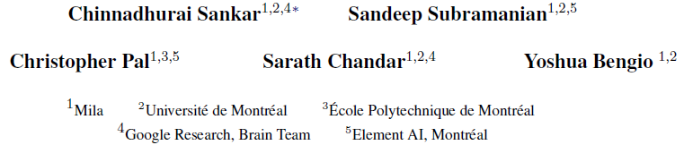
Do Neural Dialog Systems Use the Conversation History Effectively?
An Empirical Study
ACL 2019
汇报人：徐瑞健
Notes:
不必主动提及这一点：短文)
比较少人做这个，但是我挺喜欢看这种做分析研究的
揭示了目前对话系统仍存在的一些需要改进的地方
Bengio署名，但其实不复杂。

Slide 2

Result
confirm that models do not make use of a lot of the information available to it, by subjecting the dialog history to a variety of synthetic perturbations.
both recurrent and transformer-based seq2seq models are insensitive to most kinds of perturbations considered in this work
both are particularly insensitive even to extreme perturbations such as randomly shuffling or reversing words within every utterance in the conversation history
recurrent models are more sensitive to the ordering of utterances within the dialog history, suggesting that they could be modeling conversation dynamics better than transformers.
Notes:
实际上我想很多人都想到了这个结论，另一篇文章也提到BERT只是基于统计线索。不过很少有人会去验证这些东西
这和我的想法是一致的,循环神经网络理论上潜力更大, 但是,他的transformer加了顺序信息了吗?他没有提到。默认是应该有的

Slide 3
Central Premise & Method
models make minimal use of certain types of information if they are insensitive to perturbations that destroy them
Perturbations: word level & utterance level
Metrics: how much the per-token perplexity increases under these changes
Experiment setup: All models are trained without any perturbations and sensitivity is studied only at test time.

Slide 4
Perturbations
Utterance-level
Shuf that shuffles the sequence of utterances in the dialog history
Rev that reverses the order of utterances in the history
Drop that completely drops certain utterances
Truncate that truncates the dialog history to contain only the k most recent utterances where k<= n, where n is the length of dialog history
Word-level
word-shuffle that randomly shuffles the words within an utterance
reverse that reverses the ordering of words
word-drop that drops 30% of the words uniformly
noun-drop that drops all nouns
verb-drop that drops all verbs
Notes:
其实我个人认为顺序也是信息，但是呢，有一些网络文章提到顺序的稍微更改不太影响人类阅读。
所以主观上我觉得这是没能处理好顺序信息，客观上这反而可能有点揭示了抗干扰强。
但这是其中一点有待讨论的

Slide 5
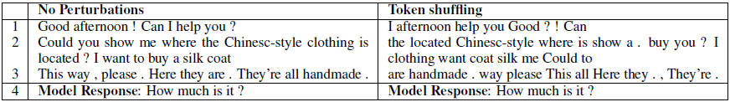
Perturbations
Notes:
你回复可不能改顺序

Slide 6
Models
Recurrent model
encoder and decoder are parameterized as LSTMs. The encoder and decoder LSTMs have 2 layers with 128 dimensional hidden states with a dropout
rate of 0.1.
Recurrent model with Bahdanau attention
Transformer
uses 300 dimensional embeddings and hidden states, 2 layers and 2 attention heads with no dropout.
No pretraining, avoiding overfit.
“While the models considered in this work might not be state-of-the-art on the datasets considered, we believe these models are still competitive and used commonly enough at least as baselines, that the community will benefit by understanding their behavior.

Slide 7
Datasets
Dataset | Cases | Avg turns
bAbI dialog (Task 5) | 1,000 | 13
Persona Chat | 10,900 | 14.8
Dailydialog | 13,000 | 7.9
MutualFriends | 11,000 | 11.41

Slide 8
Result
Notes:
Babi和persona

Slide 9
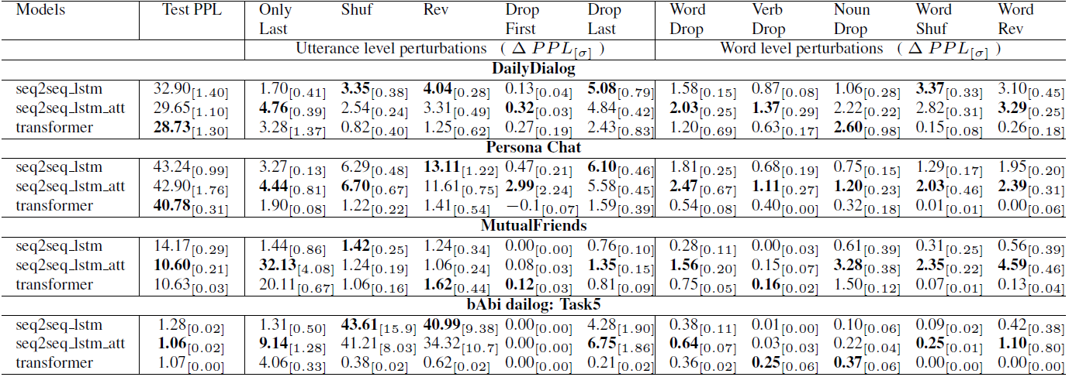
Result

Slide 10
Models
Models tend to show only tiny changes in perplexity in most cases, even under extreme changes to the dialog history, suggesting that they use far from all the information that is available to them.
Transformers are insensitive to wordreordering, indicating that they could be learning bag-of-words like representations.
The use of an attention mechanism in seq2seq lstm att and transformers makes these models use more information from earlier parts of the onversation than vanilla seq2seq models as seen from increases in perplexity when using only the last utterance.
While transformers converge faster and to lower test perplexities, they don’t seem to capture the conversational dynamics across utterances in the dialog history and are less sensitive to perturbations that scramble this structure than recurrent models.
Notes:
他们希望这成为一种测试对话系统真实有效性的又一范式

Slide 11
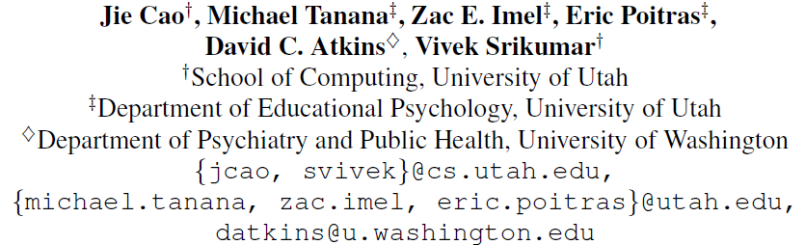
Observing Dialogue in Therapy:
Categorizing and Forecasting Behavioral Codes
ACL 2019
Notes:
我对于他研究的内容感兴趣，但是其实觉得他的方法有些无聊，plug-and-play这种

Slide 12
Motivation
“we argue for modeling dialogue observers instead of participants, and focus on
Psychotherapy. ”
Such assistance would be especially helpful in the increasingly prevalent online or text-based counseling services.
Previous models use information from utterances yet to be said, thus can not be used in ongoing session.
Notes:
显然是不适合面对面的，这太傻了

Slide 13
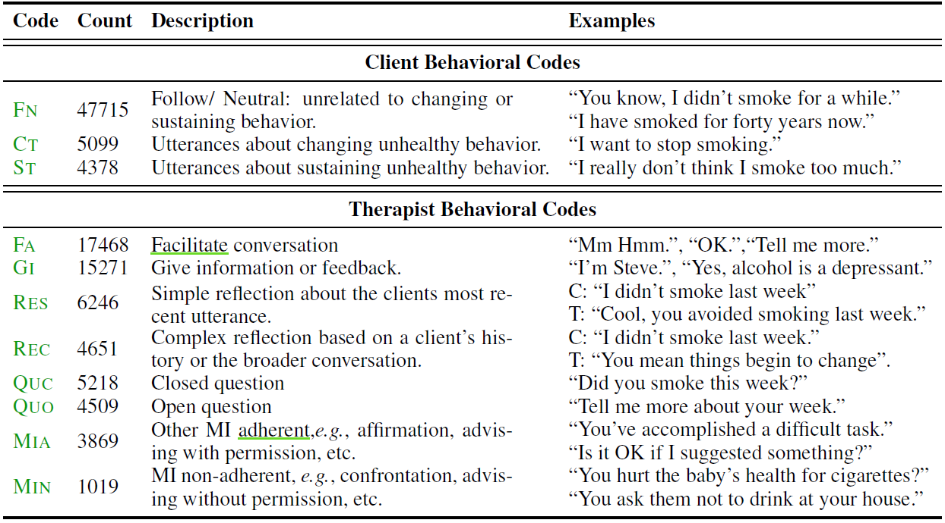
Categories & Labels：
Motivational Interviewing Skill Codes （MISC）
Notes:
实际上在我大学前生活的环境里面，MIN这种类别的对话是非常少的，总的来说闽南人相对温文尔雅

Slide 14
Contribution
define the tasks of categorizing and forecasting Motivational Interviewing Skill Codes to provide real-time assistance to therapists
propose neural models for both tasks that outperform several baselines
show the impact of various modeling choices via extensive analysis.

Slide 15
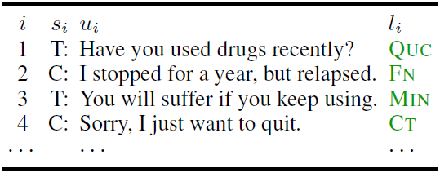
Example

Slide 16
4 Tasks with corresponding Models
 | Categorization | Forecasting
Therapist
patient

Slide 17
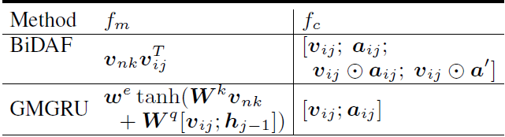
Models
Encoding Dialogue
Hierarchical recurrent encoder (HGRU)
Bidirectional on word-level, unidirectional on utterance-level
Word-level attention
“we may need to discover that the therapist is mirroring a recent client utterance.”
If word attention is used, attended vectors will be treated as word encodings, and encoded a second time using a BiGRU.
Notes:
Plug and play
也就是复读机

Slide 18
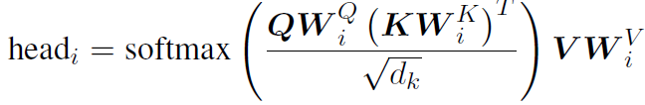
Models
3) Utterance-level attention
Transformer style
4) Output layer
Two layer MLPs over the vector that use a ReLU hidden layer and a softmax layer for the outputs.
Notes:
Plug and play
也就是复读机

Slide 19

Dataset & Experiment
243 training MI sessions and 110 testing sessions. We used 24 training sessions for development. 500 utterances on average.
Use a sliding window of size N = 8 utterances with padding for the initial ones.
Glove, Elmo, Spacy…
Focal loss for label extremely imbalance problem
The minority label is the most important in this task.

Slide 20
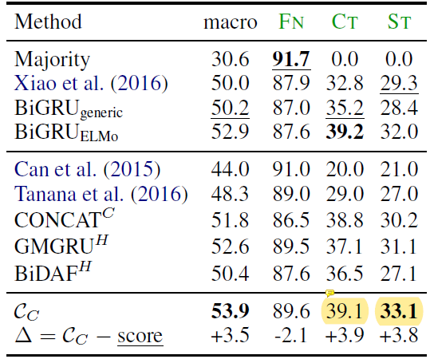
Result: Categorization
Notes:
第一部分是单句，第二部分是利用全部历史
仍然不高，但是似乎没多少baseline。他有个好，别人的baseline他也给加了Glove和Elmo来跑
说实话，这种baseline，还不如在咨询师电脑前面贴个“我们现在处于什么MISC状态”的纸条，但凡对此稍微有些注意的人，都能够意识到那种错误。当然也可能是数据集不够大的缘故

Slide 21
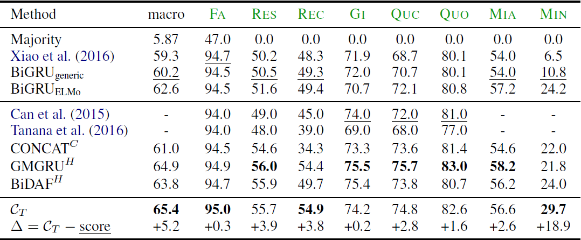
Result: Categorization

Slide 22
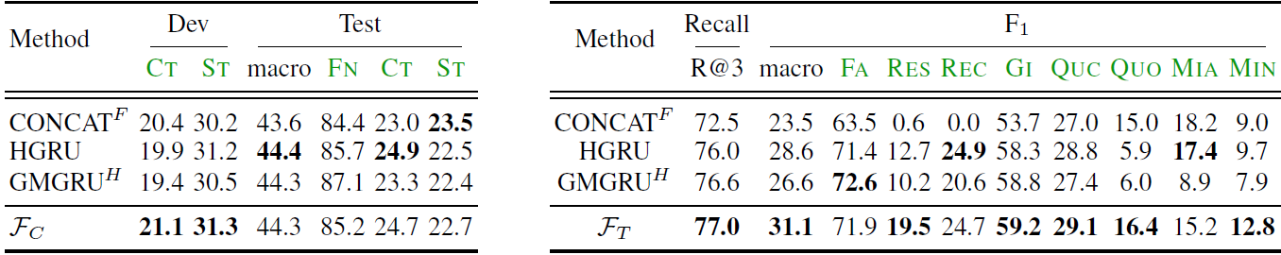
Result： Forecasting

Slide 23
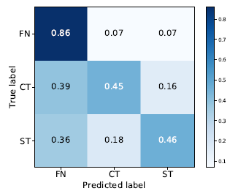
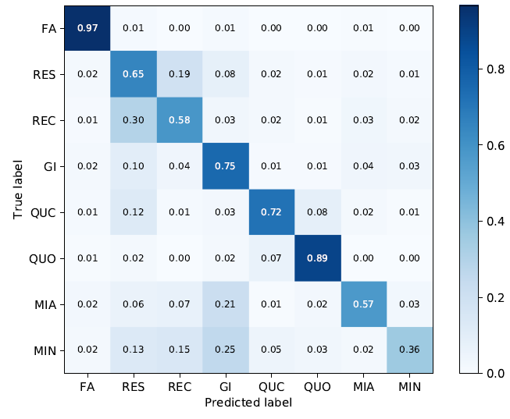
Result: Confusion matrix
Notes:
从混淆矩阵上直观来看，分类的结果不会离谱
有一些ablation study就不提了，毕竟这种plug & play，换一个任务的话，不同模块不同参数设置的最优解是不同的

Slide 24
THANK YOU
Notes:
这篇心理咨询对话状态分类偏应用了，而且方法并不高明，结果比之前好得多但还是不实用，为什么会中呢，是因为是新任务吗

