Slide 1
Disentangled Representation Learning
2019/10/21 Qin Wentao

Slide 2












Definition: Disentangled Representation
A disentangled representation should separate the distinct, informative factors of variations in the data (Bengio et al., 2013)
A change in a single underlying factor of variation $z_{i}$ should lead to a change in a single factor in the learned representation $r(x)$ (Locatello et al., 2019)
$$z_{1}$$
$$X$$
$$r\left(x\right)$$
$$z_{3}$$
$$p\left(x\right)\sim p(z_{1},…)$$
$$z_{2}$$
$$f_{1}(z_{1})$$
$$f_{2}(z_{2})$$
$$f_{…}(z_{…})$$
$$z_{i}$$
$$…$$
Data
Disentanglement
Model
Disentangled
Representation
Generative factors

Slide 3
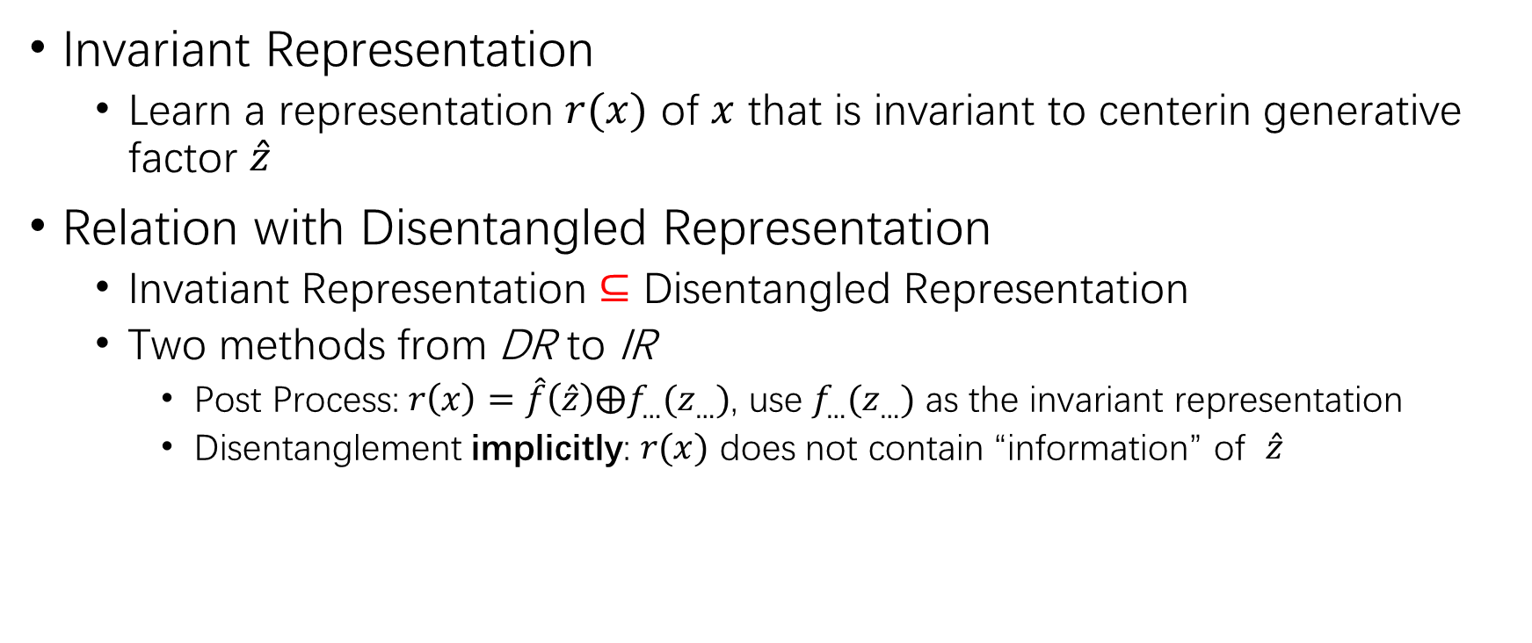
Relation bewteen Disentangled Representation and Invariant Representation
Invariant Representation
Learn a representation $r(x)$ of $x$ that is invariant to centerin generative factor $\hat{z}$
Relation with Disentangled Representation
Invatiant Representation $⊆$ Disentangled Representation
Two methods from DR to IR
Post Process: $r\left(x\right)=\hat{f}\left(\hat{z}\right)⨁f_{…}(z_{…})$, use $f_{…}(z_{…})$ as the invariant representation
Disentanglement implicitly: $r(x)$ does not contain “information” of $\hat{z}$

Slide 4
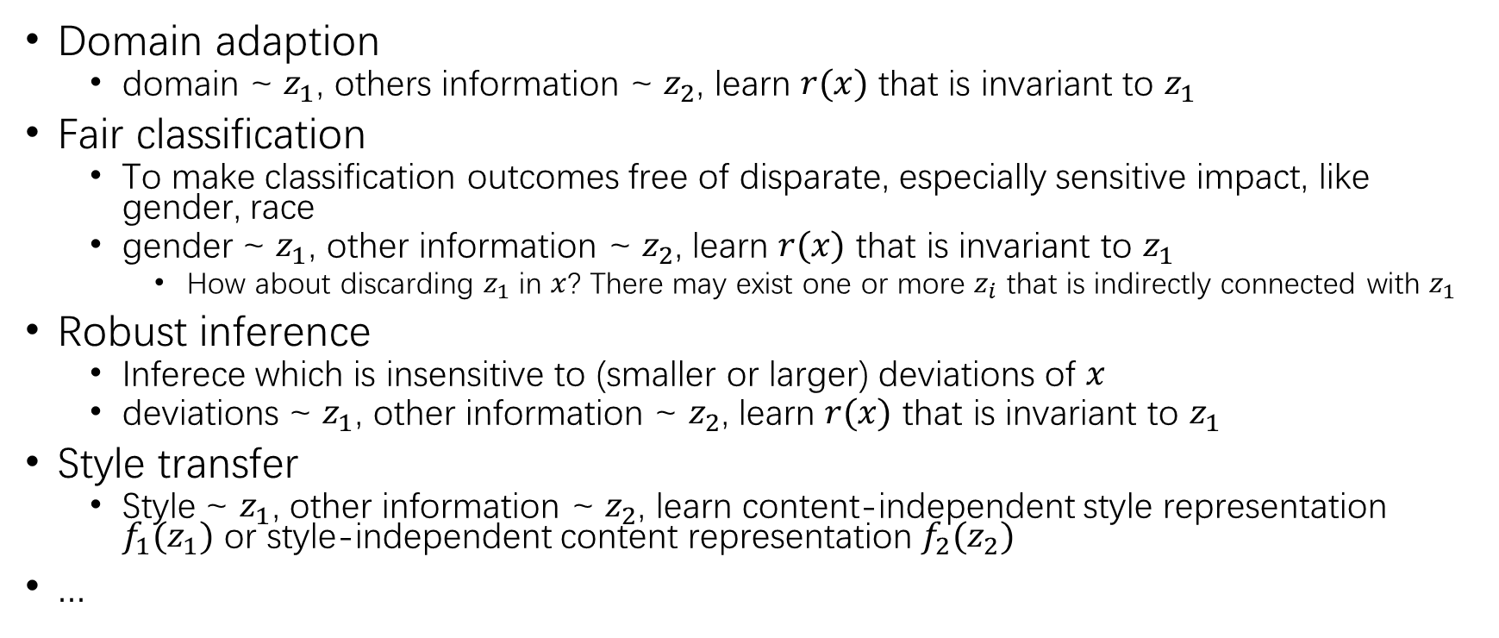
Downstream Fields
Domain adaption
domain ~ $z_{1}$, others information ~ $z_{2}$, learn $r(x)$ that is invariant to $z_{1}$
Fair classification
To make classification outcomes free of disparate, especially sensitive impact, like gender, race
gender ~ $z_{1}$, other information ~ $z_{2}$, learn $r(x)$ that is invariant to $z_{1}$
How about discarding $z_{1}$ in $x$? There may exist one or more $z_{i}$ that is indirectly connected with $z_{1}$
Robust inference
Inferece which is insensitive to (smaller or larger) deviations of $x$
deviations ~ $z_{1}$, other information ~ $z_{2}$, learn $r(x)$ that is invariant to $z_{1}$
Style transfer
Style ~ $z_{1}$, other information ~ $z_{2}$, learn content-independent style representation $f_{1}(z_{1})$ or style-independent content representation $f_{2}(z_{2})$
...

Slide 5
Unsupervised Adversarial Invariance NIPS 2018

Slide 6

Motivation: Problem
In prediction tasks, the model learns a conditional probabilty $p(y|x)$ from data samples $(x)$ to target variables $(y)$
However, data often contains nuisance factors $(z)$ that are irrelevant to prediction, thus leading to overfitting
e.g, angle in face recognition

Slide 7
Motivation: Existing Methods
Model architecture design
e.g, convolutional operations + pooling strategies can capture shift-invariant spatial information
cons: need huge effort for engineering custom networks modules; inflexible
Data augmentation
use synthetic versions of real data, such as rotation of original images
cons: only robust to seen variations, perform poorly under unseen variations
Supervised invariance representation

Slide 8
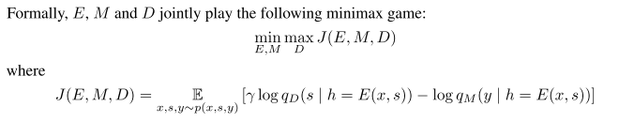
Motivation: Existing Methods
Supervised invariance representation: need annotated data
Controllable Invariance through Adversarial Feature Learning, NIPS 2017
cons: requirement of domain knowledge of possible nuisance factors and their variations; need annotated data for nuisance factors

Slide 9
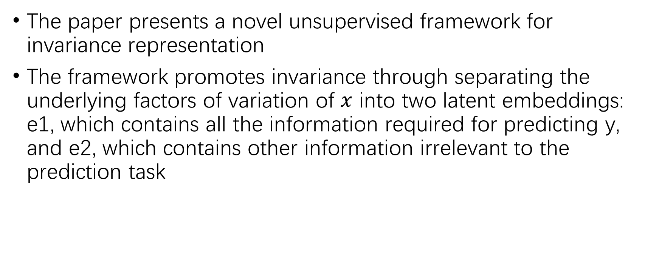
Overview
The paper presents a novel unsupervised framework for invariance representation
The framework promotes invariance through separating the underlying factors of variation of $x$ into two latent embeddings: e1, which contains all the information required for predicting y, and e2, which contains other information irrelevant to the prediction task

Slide 10
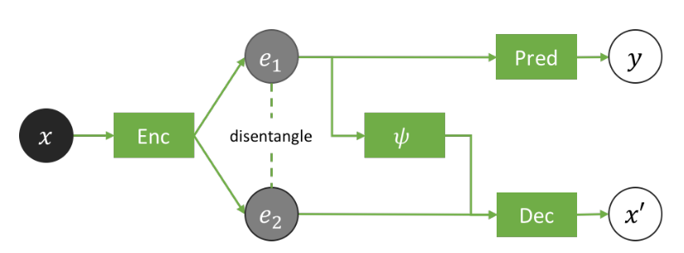

Unsupervised Invariance Induction Framework
$ψ$: a noisy-transformer that converts $e_{1}$ into its noisy version ${\tilde{e}}_{1}$

Slide 11

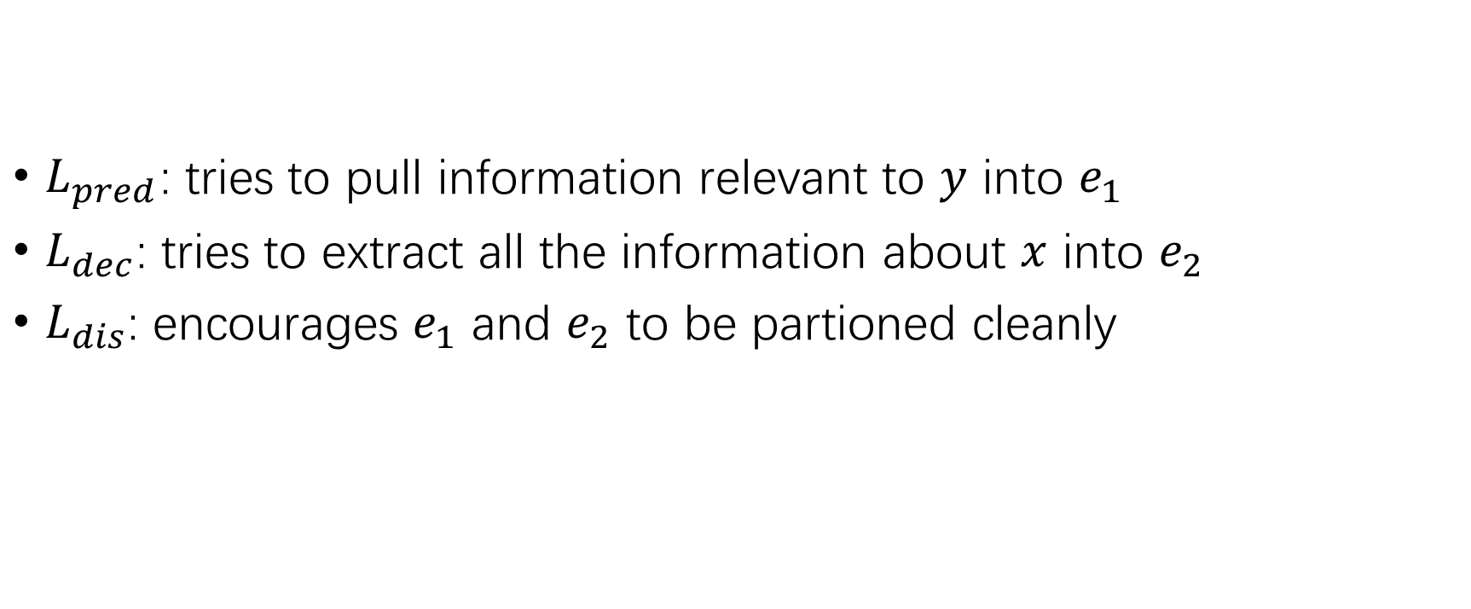
Training Objective
$L_{pred}$: tries to pull information relevant to $y$ into $e_{1}$
$L_{dec}$: tries to extract all the information about $x$ into $e_{2}$
$L_{dis}$: encourages $e_{1}$ and $e_{2}$ to be partioned cleanly

Slide 12
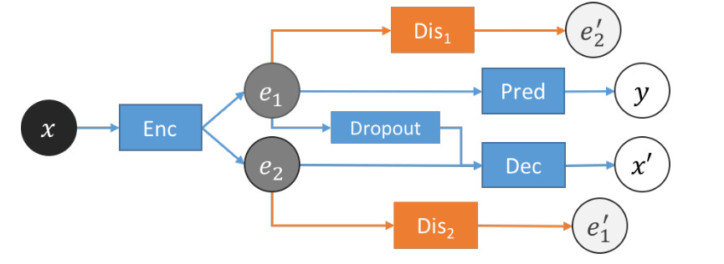
Adversarial Model Design

Slide 13
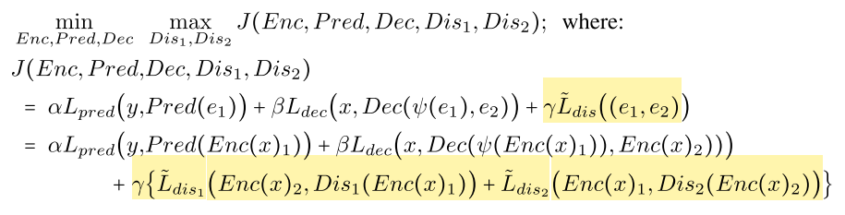

Training Objective
${\tilde{L}}_{dis1}$ and ${\tilde{L}}_{dis2}$ are computed by mean squard error

Slide 14
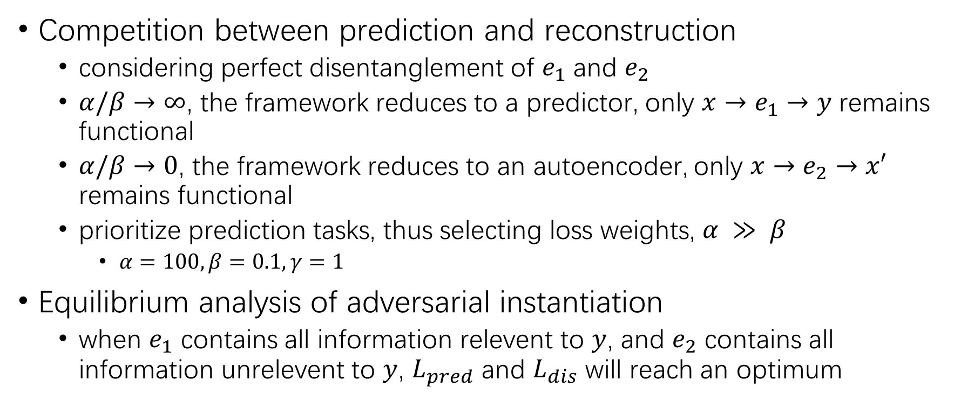
Analysis
Competition between prediction and reconstruction
considering perfect disentanglement of $e_{1}$ and $e_{2}$
$α/β→∞$, the framework reduces to a predictor, only $x→e_{1}→y$ remains functional
$α/β→0$, the framework reduces to an autoencoder, only $x→e_{2}→x′$ remains functional
prioritize prediction tasks, thus selecting loss weights, $α ≫ β$
$α=100, β=0.1, γ=1$
Equilibrium analysis of adversarial instantiation
when $e_{1}$ contains all information relevent to $y$, and $e_{2}$ contains all information unrelevent to $y$, $L_{pred}$ and $L_{dis}$ will reach an optimum

Slide 15
Training
update (Enc, Pred, Dec) and (Dis1, Dis2) in the frequency ratio of 1:k
k=5 in the experiments

Slide 16
Experiment
Invariance to inherent nuisance factors
Effective use of synthetic data augmentation for learning invariance
Domain Adaptation

Slide 17
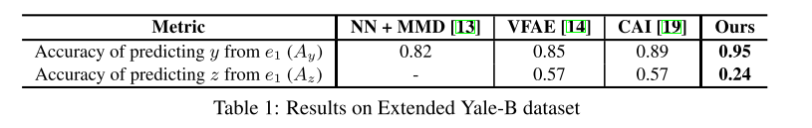
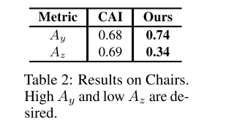
Experiment1
Dataset
Extended Yale-B: face-images of 38 subjects under various lighting conditons, which are classified into 5 groups – front, upper-left, upper-right, lower-left and lower-right
Chairs: 1393 different chair types rendered at 31 yaw angles and two pitch angles, which are classfied into 4 groups: front, left, right and back

Slide 18
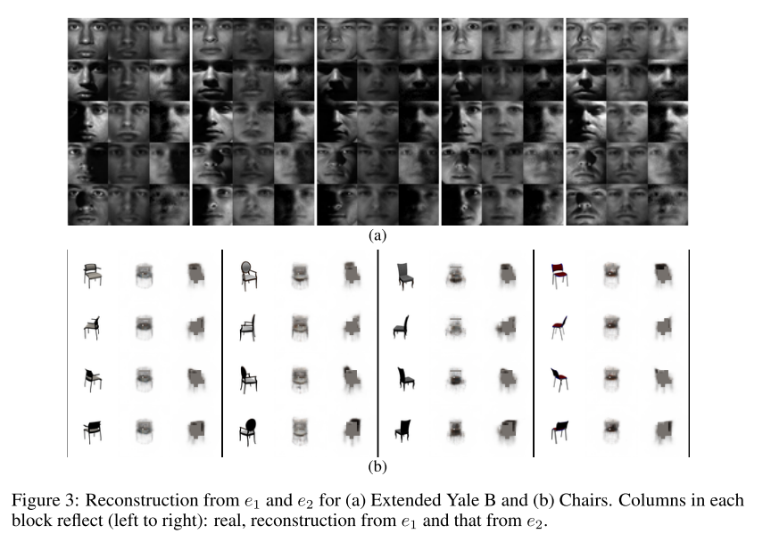
Experiment1

Slide 19
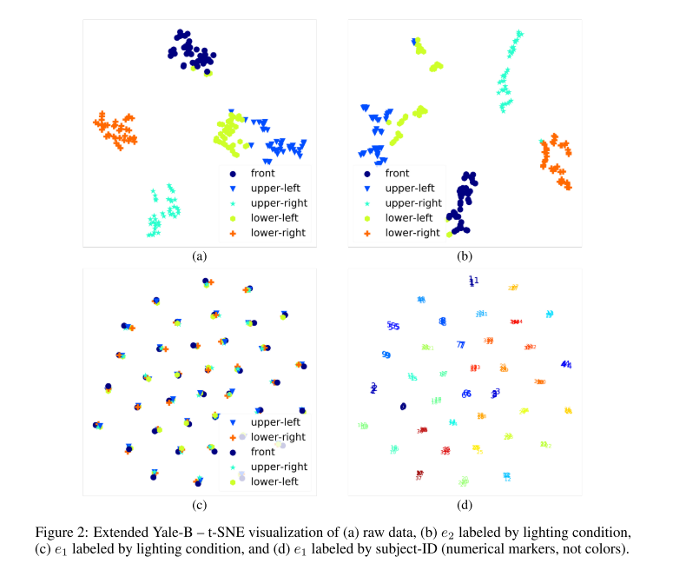
Experiment1

Slide 20

Experiment2
Bring unisance factors into data by data augmentation
Dataset: MNIST
MNIST-ROT: by randomly rotating each image by an angle $θ∈\{−45°, −22.5°, 0°,22.5°,45°\}$ anout Y-axis
Test on $θ∈\{±55°,±65°\}$

Slide 21
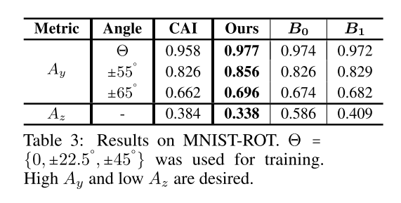
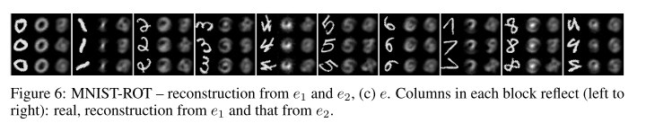
Experiment2

Slide 22
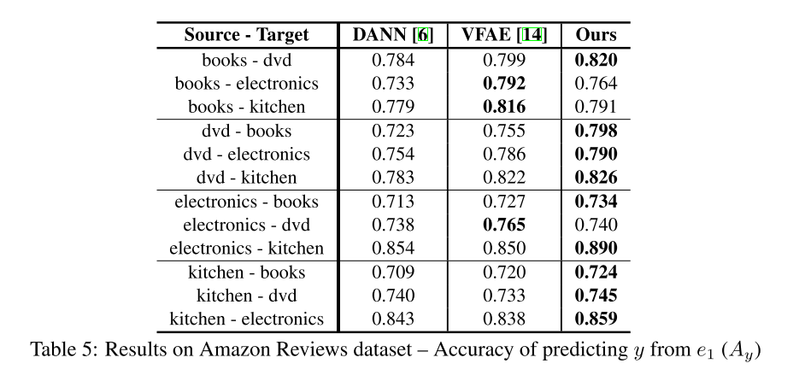
Experiment3

Slide 23
Unified Adversial Invariance PAMI 2019

Slide 24
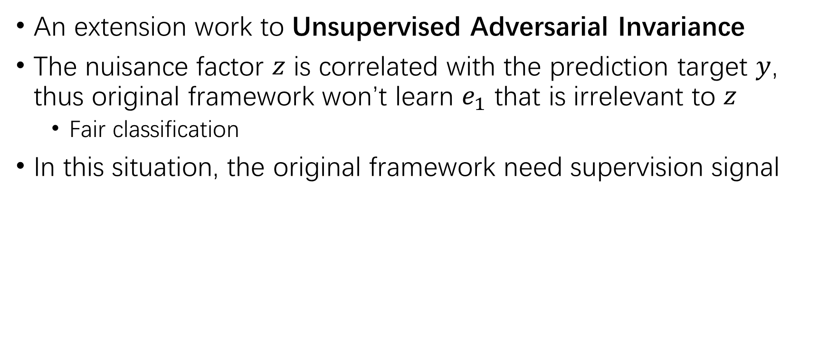
Overview
An extension work to Unsupervised Adversarial Invariance
The nuisance factor $z$ is correlated with the prediction target $y$, thus original framework won’t learn $e_{1}$ that is irrelevant to $z$
Fair classification
In this situation, the original framework need supervision signal

Slide 25
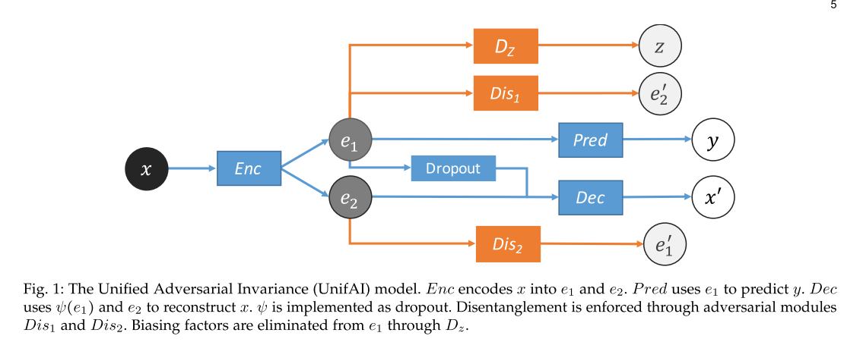
The Unified Adversarial Invariance Model

Slide 26
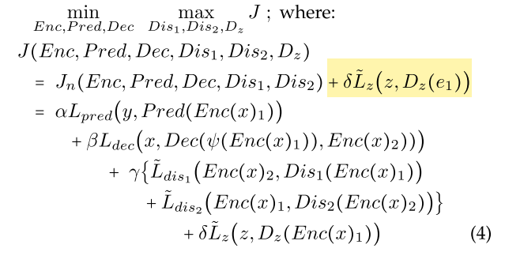
Training Objective

Slide 27
Experiment
Fair classification
Dataset
Adult: an income dataset of 45,222 individuals with various attributes
Predict whether a person has more than $50,000 savings
factor z: age
binarized

Slide 28
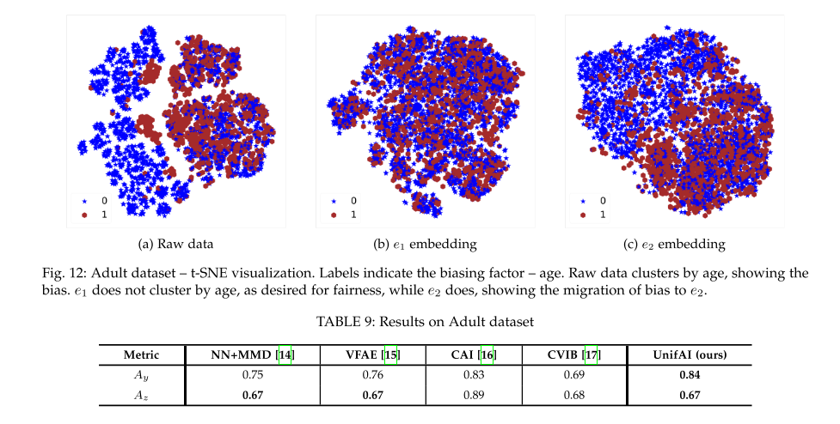
Experiment

Slide 29
Related Papers
Disentangling factors of variation in deep representation using adversial training, NIPS 2016
Controllable Invariance through Adversial Feature Learning, NIPS 2017
Fader Networks: Manipulating Images by Sliding Attributes, NIPS 2017
Unsupervised Adversial Invariance, NIPS 2018
Disentangling by Factorising, ICML 2018
Unified Adversial Invariance, PAMI 2019
The Variational Fair Autoencoder, ICLR 2016
Beta-VAE: Learning Basic Visual Concepts with A Constrained Vatiational Framework, ICLR 2017
Understanding Disentangling in Beta-VAE, NIPS 2017
Isolating Sources of Disentanglement in VAES, NIPS 2018
Invariant Representations without Adversial Training, NIPS 2018
Challenging Common Assumptions in the Unsupervised Learning of Disentangled Representations, IMCL 2019, Best Paper Award
Notes:
VAE系解纠缠：从VAE到βVAE，再到β-TCVAE：https://blog.csdn.net/l7H9JA4/article/details/102512622

Slide 30
QA

