Slide 1
Reactive Streams
Lunch and Learn
Cepoi Scarletia Sorin & George Cristian Stoica

Slide 2
Preface
Reactive Streams
This presentation will talk about:
What is Reactive Programming?
What are Reactive Streams?
Reactive Streams API
Reactive Flow description
Code Examples

Slide 3
What is Reactive Programming?
according to Wikipedia
In computing, reactive programming is a declarative programming paradigm concerned with data streams and the propagation of change. This means that it becomes possible to express static (e.g. arrays) or dynamic (e.g. event emitters) data streams with ease via the employed programming language(s), and that an inferred dependency within the associated execution model exists, which facilitates the automatic propagation of the change involved with data flow.
For example, in an imperative programming setting A:=B + C, {\displaystyle a:=b+c} would mean that A{\displaystyle a} is being assigned the result of B + C {\displaystyle b+c} in the instant the expression is evaluated, and later, the values of {\displaystyle b} B and/or C {\displaystyle c} can be changed with no effect on the value of A {\displaystyle a}. However, in reactive programming, the value of {\displaystyle a} A is automatically updated whenever the values of {\displaystyle b} B and/or C {\displaystyle c} change; without the program having to re-execute the sentence {\displaystyle a:=b+c} to determine the presently assigned value of A {\displaystyle a}.

Slide 4
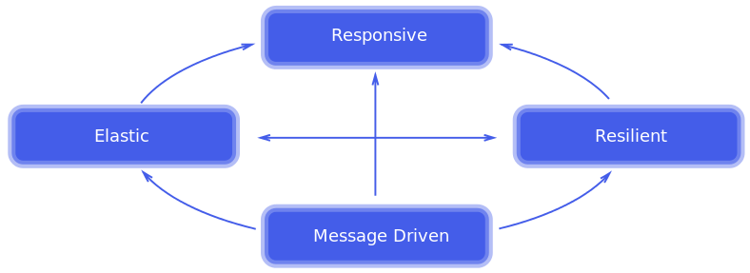
What is Reactive Programming?
Reactive systems principals

Slide 5
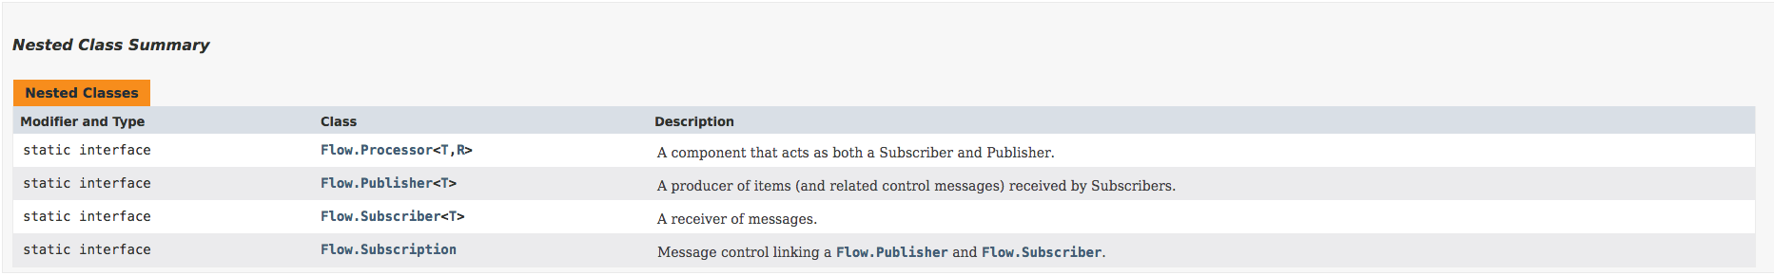
What are Reactive Streams?
The Reactive Streams is an initiative that defined a standardized API which offers to developers the tools they need to make use of Reactive Programming
Reactive Streams has become part of the JDK once with the release of Java 9 and consistent on the following functional Interfaces all grouped under the Flow class.

Slide 6
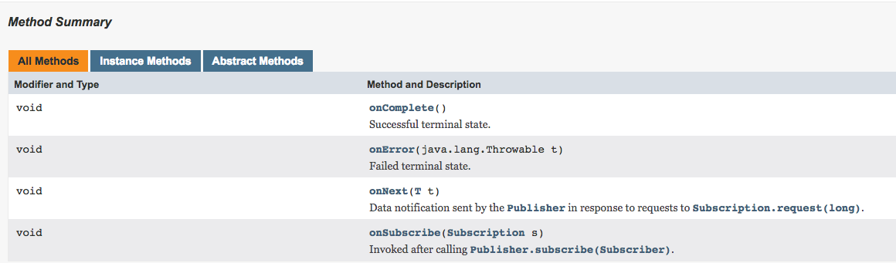
Reactive Streams API
Subscriber Interface
onSubscribe() method - Invoked after a Publisher has completed the subscription for this Subscriber (but before sending any Subscription's item). The newly created Subscription object is passed via this method. The Subscriber typically assigns this instance to an instance variable for further use.
onNext() method Invoked with a Subscription's next item of type T.
onError() method Invoked upon an unrecoverable error encountered by a Publisher or Subscription.
onComplete() method Invoked when no additional Subscriber method invocations will occur including onNext() method.

Slide 7
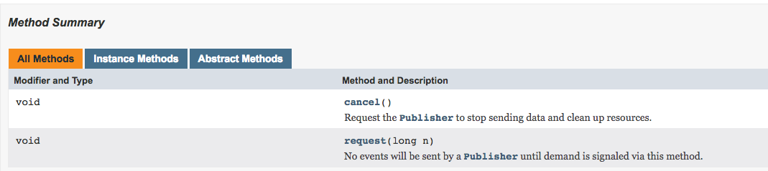
Reactive Streams API
Subscription Interface
This is the same interface whose instance is passed to the Subscriber.onSubscribe() method.
Request() method -> This is the key method behind non-blocking back-pressure concept. The Subscriber uses it to request n more items for consumption. This way the Subscriber controls how many items it is currently capable to receive (probably it will want to limit the consumption according to what resources it has).
Cancel(long n) method -> Used by the Subscriber to cancel its subscription. After this call, no further items will be received.

Slide 8
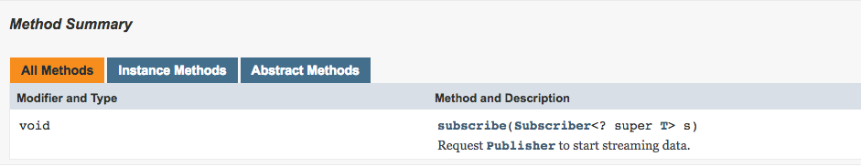
Reactive Streams API
Publisher Interface
Subscribe(Subscriber<? Super T> s) method -> Used by the Subscribers for subscribing to receive the items of type T.

Slide 9
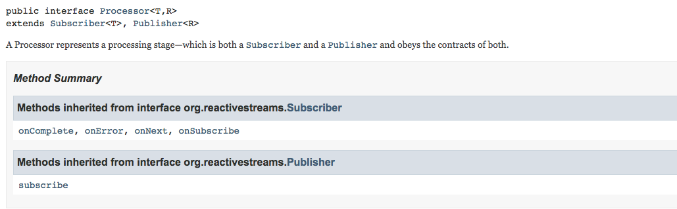
Reactive Streams API
Processor Interface
Processor is a component that acts as both a Subscriber and Publisher.

Slide 10
Reactive Streams API
SubmissionPublisher class
This is the only concrete class provided in the Reactive Streams API. It implements the Publisher interface. We can use its submit() method to publish the provided item to each subscriber. In the following example we will see how to use this class and at the same time we will get familiar with the usage of above interfaces.

Slide 11

Reactive Streams -> Flow description
Create a Publisher and a Subscriber.
Subscribe the subscriber with Publisher::subscribe.
The publisher creates a Subscription and calls Subscriber::onSubscription with it so the subscriber can store the subscription.
At some point the subscriber calls Subscription::request to request a number of items.
The publisher starts handing items to the subscriber by calling Subscriber::onNext. It will never publish more than the requested number of items.
The publisher might at some point be depleted or run into trouble and call Subscriber::onComplete or Subscriber::onError, respectively.
The subscriber might either continue to request more items every now and then or cut the connection by calling Subscription::cancel.
X

Slide 12
Useful Links
- The Technology Compatibility Kit (TCK)
https://github.com/reactive-streams/reactive-streams-jvm
- Reactive Streams organization official site
http://www.reactive-streams.org/
- Spring Reactive Web Framework introduction
http://www.baeldung.com/spring-5-functional-web
- Journey into Reactive Streams
https://blog.redelastic.com/a-journey-into-reactive-streams-5ee2a9cd7e29
- The Reactive Manifesto
https://www.reactivemanifesto.org/

Slide 13
Q&A Session
Thank you !

