Slide 1
Reactive Streams
Lunch and Learn
Cepoi Scarletia Sorin & George Cristian Stoica

Slide 2
RxJava 2
This presentation will talk about:
What is RxJava?
Observable, Subscriber, Scheduler
Operators
Hot/cold observables
Subjects and processors
Backpressure
Code Examples

Slide 3
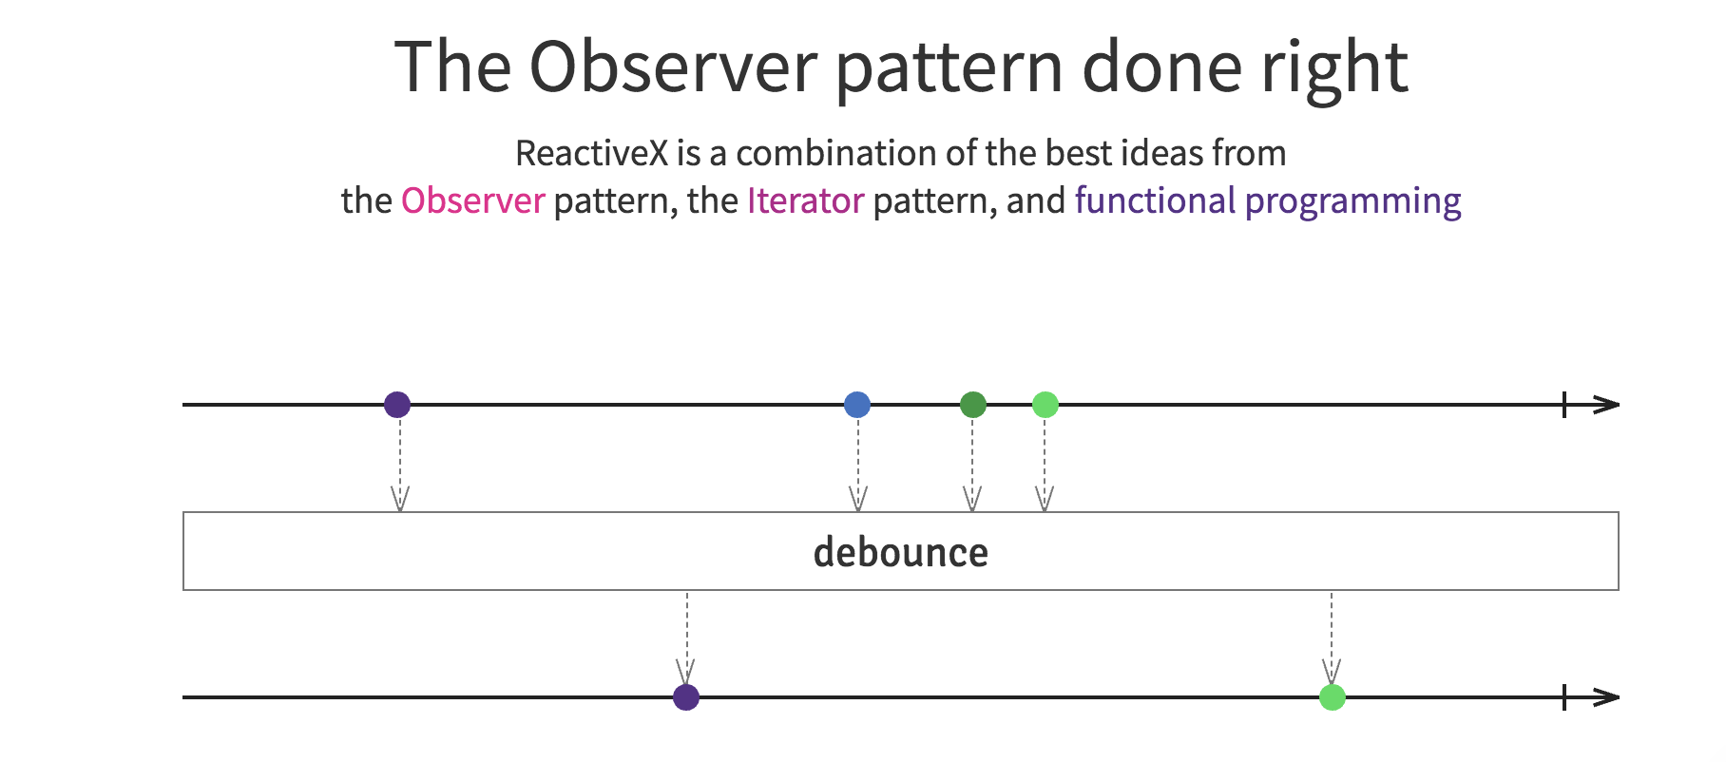
What is RxJava?
ReactiveX is a library for composing asynchronous and event-based programs by using observable sequences
It extends the observer pattern by providing tools for transforming and combining streams and for managing flow-control
Abstracts away concerns about things like low-level threading, synchronization, thread-safety, concurrent data structures, and non-blocking I/O.

Slide 4
What is RxJava?
The build blocks for RxJava code are the following:
observables representing sources of data
subscribers (or observers) listening to the observables
a set of methods for modifying and composing the data

Slide 5
Observable, Subscriber, Scheduler
The Observable
Observable are nothing but the data streams. Observable packs the data that can be passed around from one thread to another thread
ReactiveX Observables support not just the emission of single scalar values (as Futures do), but also of sequences of values or even infinite streams
Observable model allows you to treat streams of asynchronous events with the same sort of simple, composable operations that you use for collections of data items like arrays
An Observable is the asynchronous/push “dual” to the synchronous/pull Iterable
With an Iterable, the consumer pulls values from the producer and the thread blocks until those values arrive.
an Observable the producer pushes values to the consumer whenever values are available. This approach is more flexible, because values can arrive synchronously or asynchronously.
event | Iterable (pull) | Reactive (push)
Retrieve data | T next() | onNext(T)
Discover error | throws Exception | onError(exception)
complete | !hasNext() | onCompleted()

Slide 6
Observable, Subscriber, Scheduler
The Observable
The Observable type adds two missing semantics to the Gang of Four’s Observer pattern:
the ability for the producer to signal to the consumer that there is no more data available (a foreach loop on an Iterable completes and returns normally in such a case; an Observable calls its observer’s onCompleted method)
the ability for the producer to signal to the consumer that an error has occurred (an Iterable throws an exception if an error takes place during iteration; an Observable calls its observer’s onError method)
Observables are less opinionated:
Observables can be implemented using thread-pools, event loops, non-blocking I/O, actors (such as from Akka), or whatever implementation suits your needs, your style, or your expertise.
Client code treats all of its interactions with Observables as asynchronous, whether your underlying implementation is blocking or non-blocking and however you choose to implement it.

Slide 7
Observable, Subscriber, Scheduler
The Flowable
io.reactivex.Flowable is the backpressure-enabled version of the Observable
When to use an Observable:
Few events over time, no risk of OOME
GUI events where we don’t need backpressure
When your platform is essentially synchronous and the Observable introduces less overhead
When to use a Flowable:
When we have a very large number of events and we need to tell the source to limit the amount it generates
Reading files (blocking) as we need to specify how many lines to read
Reading from database
Network IO where the protocol allows to requests for specific amounts of data

Slide 8
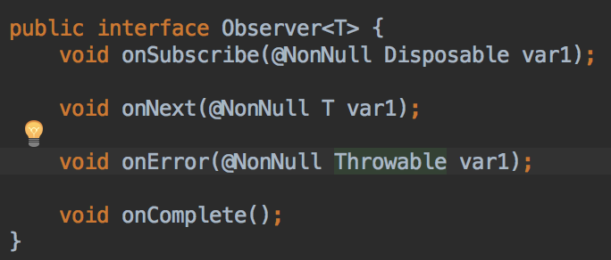
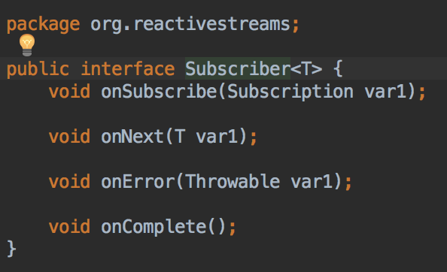
Observable, Subscriber, Scheduler
The subscriber
In ReactiveX an subscriber or observer subscribes to an Observable (or Flowable).
Then that observer reacts to whatever item or sequence of items the Observable emits.
This pattern facilitates concurrent operations because it does not need to block while waiting for the Observable to emit objects
In RxJava 1, we had both Observer and Subscriber interfaces
In RxJava 2, in order to adhere to the Java 9 jdk implementation, Observer is used to subscribe to an Observable, and Subscriber is used to subscribe to a Flowable.
if you want to be able to unsubscribe, you need to use ResourceObserver and ResourceSubscriber respectively.

Slide 9
Observable, Subscriber, Scheduler
The Scheduler
By default, an Observable and the chain of operators that you apply to it will do its work, and will notify its observers, on the same thread on which its Subscribe method is called
In order to introduce multithreading into the cascade of Observable operators, you can do so by instructing those operators (or particular Observables) to operate on particular Schedulers.
The SubscribeOn operator changes this behavior by specifying a different Scheduler on which the Observable should operate
Designates the initial thread the Observable will operate on
The ObserveOn operator specifies a different Scheduler that the Observable will use to send notifications to its observers
affects the thread that the Observable will use below where that operator appears.

Slide 10
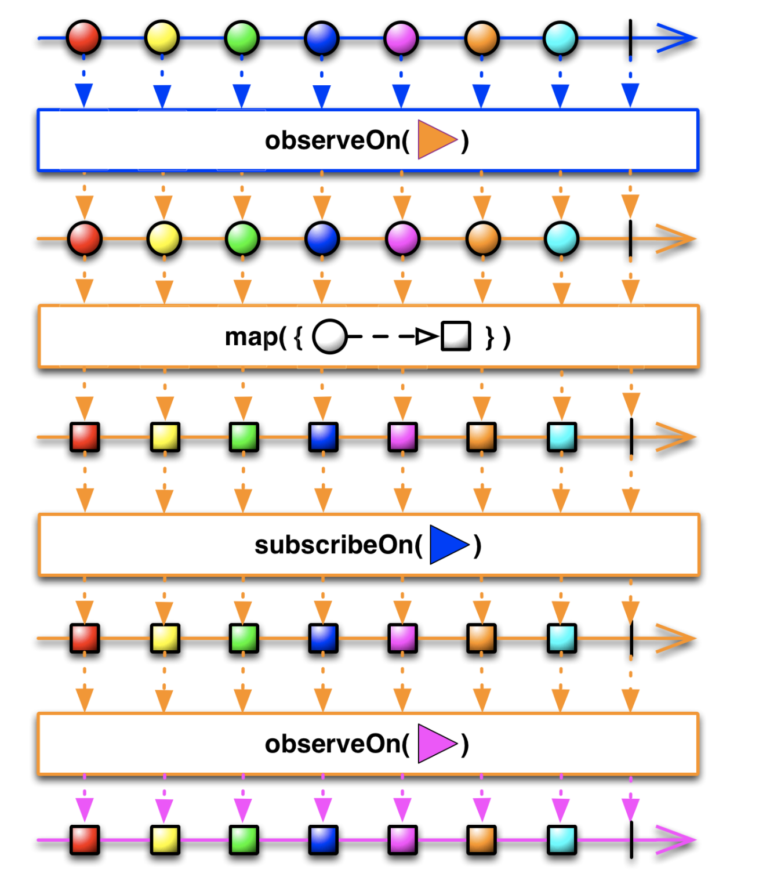
Observable, Subscriber, Scheduler
The Scheduler

Slide 11
Observable, Subscriber, Scheduler
Common schedulers
Schedulers.computation
Computation Scheduler by default limits the number of threads running in parallel to the value of availableProcessors(), as found in the Runtime.getRuntime() utility class.
Schedulers.from
It is a wrapper that can turn Executor into Scheduler using the from factory method:
Scheduler schedulerA = Schedulers.from(newFixedThreadPool(10, threadFactory("Sched-A-%d")));
Schedulers.trampoline
All jobs that subscribes on trampoline() will be queued and executed one by one
Schedulers.io
Resizable, contains a pool of single-threaded ScheduledExecutorService instances, used for blocking or unblocking I/O work , not for computational work

Slide 12
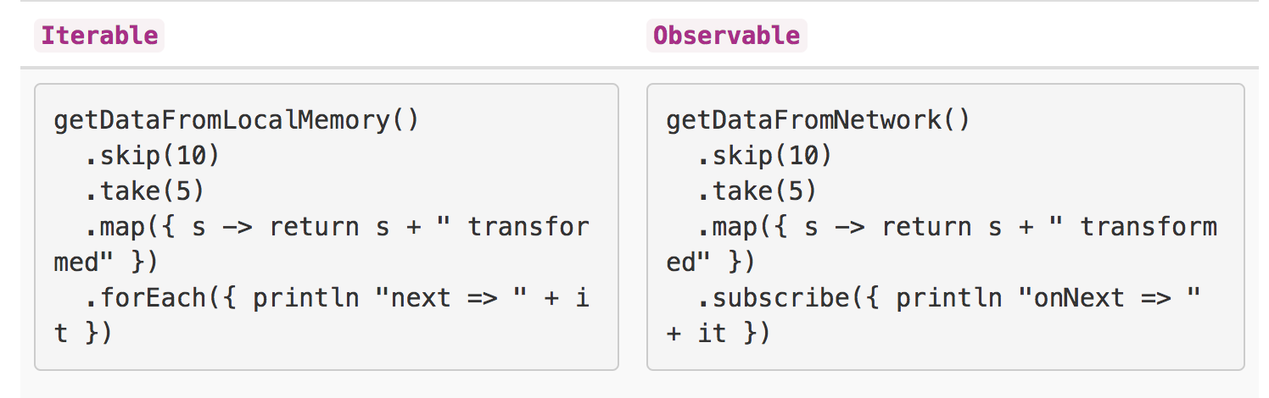
Operators
ReactiveX provides a collection of operators with which you can filter, select, transform, combine, and compose Observables.
This allows for efficient execution and composition

Slide 13
Operators
Creating Observables
1. Range - create an Observable that emits a range of sequential integers
exp: Flowable.range(1, 10)
2. From* (fromIterable, fromArray, fromFuture, etc.) - convert some other object or data structure into an Observable
exp: Flowable.fromIterable(Arrays.asList(“One”, “Two”, “Three”))
3. Just - convert an object or a set of objects into an Observable that emits that or those objects
exp: Flowable.just(“maybe”)
4. Zip - combine the emissions of multiple Observables together via a specified function and emit single items for each combination based on the results of this function
see ZipSample.java

Slide 14
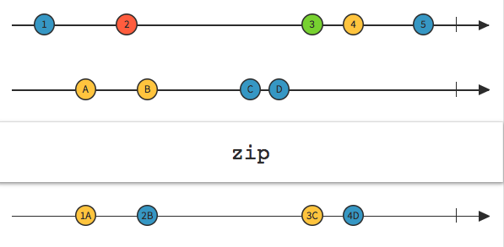
Operators
Combining Observables
Zip - combine the emissions of multiple Observables together via a specified function and emit single items for each combination based on the results of this function
see ZipSample.java

Slide 15
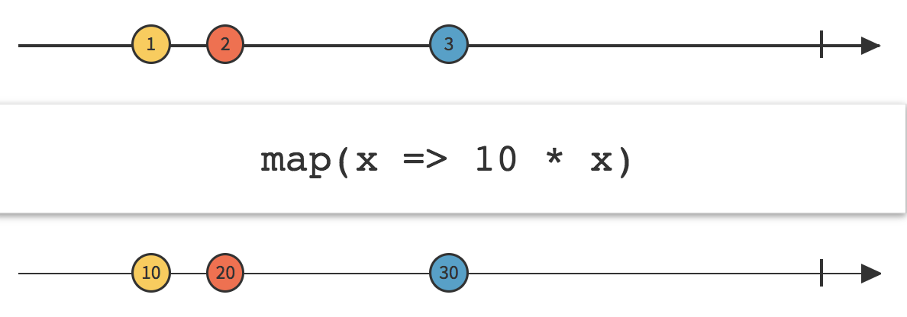
Operators
Transformer operators - map
Similar to the java streams map operator:

Slide 16
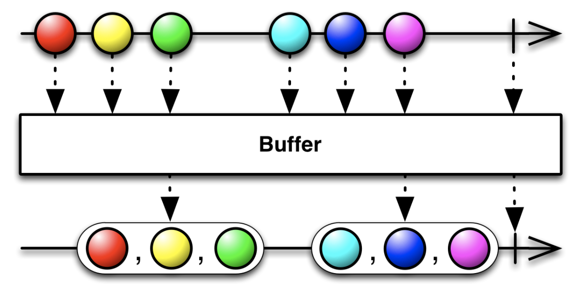
Operators
Transformer operators - buffer
periodically gather items emitted by an Observable into bundles and emit these bundles rather than emitting the items one at a time

Slide 17
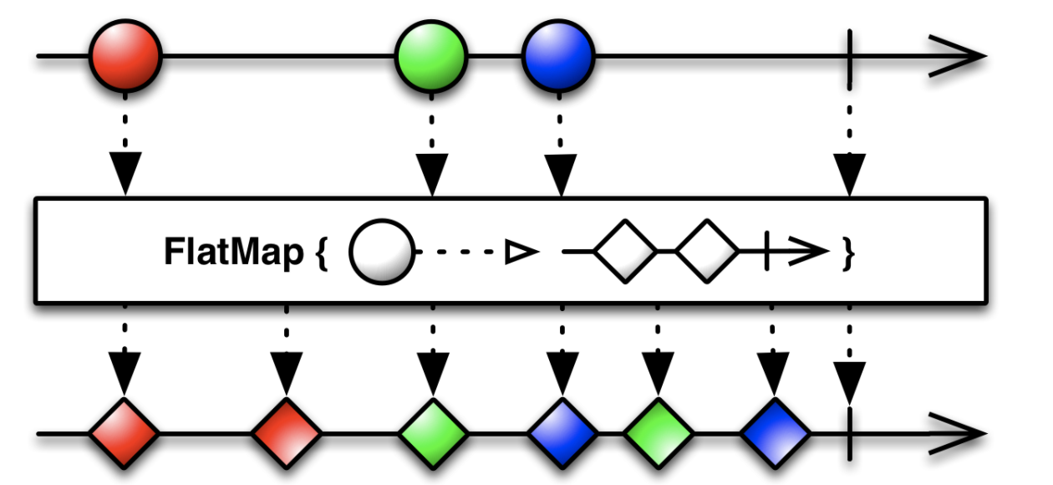
Operators
Transformer operators - flatMap
transform the items emitted by an Observable into Observables, then flatten the emissions from those into a single Observable

Slide 18
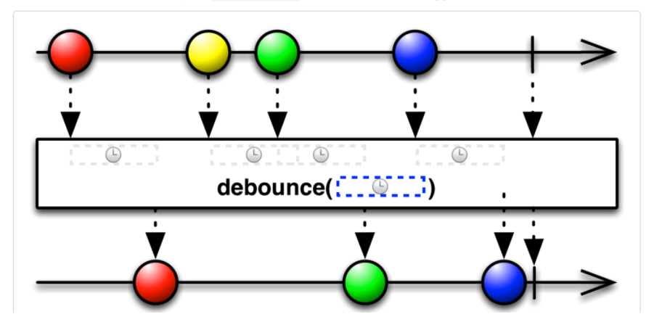
Operators
Filtering operators
Filter — emit only those items from an Observable that pass a predicate test
Flowable.just("Hello World") .filter(s -> s.startsWith("W"));
Take - emit only the first n items emitted by an Observable
ElementAt - emit only item n emitted by an Observable
Debounce (ThrottleWithTimeout) - Only emit an item from an Observable if a particular timespan has passed without it emitting another item

Slide 19
“Hot” and “Cold” Observables
A “cold” Observable, on the other hand, waits until an observer subscribes to it before it begins to emit items
A “hot” Observable may begin emitting items as soon as it is created:
ConnectableObservable – starts emitting on connect()
Subject - is a sort of bridge or proxy that acts both as an Subscriber and as an Observable. Because it is a Subscriber, it can subscribe to one or more Observables, and because it is an Observable, it can pass through the items it observes by reemitting them, and it can also emit new items.
Extends Observable and implements Observer
Processor (implements org.reactivestreams.Processor) - is the backpressure-enabled version of the Subject
Extends Flowable and implements FlowableProcessor and Subscriber

Slide 20
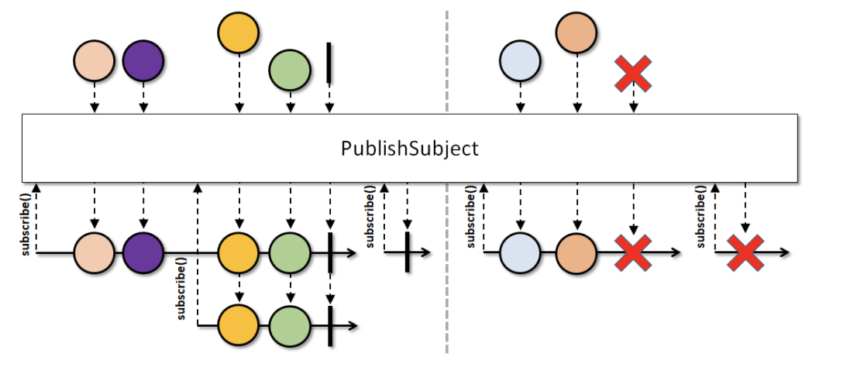
“Hot” and “Cold” Observables
Types of subjects/processors
PublishSubject
A Subject that emits (multicasts) items to currently subscribed Observers and terminal events to current or late Observers.

Slide 21
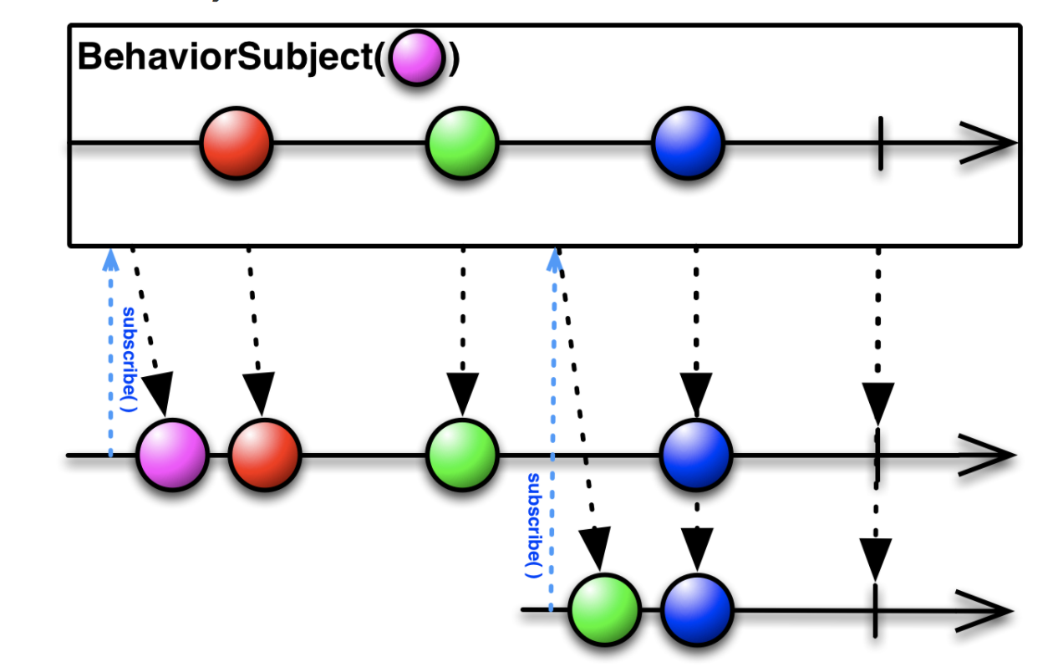
“Hot” and “Cold” Observables
Types of subjects/processors
BehaviorSubject
Subject that emits the most recent item it has observed and all subsequent observed items to each subscribed Observer.

Slide 22
Backpressure
In RxJava 2, the backpressure enabled interfaces are the ones inspired from (and extending) the Reactive Streams implementation in JDK 9
In particular, the Flowable interface offers a variety of backpressure operators:
onBackpressureBuffer() – accept only buffer-size items
onBackpressureDrop() – the items will be dropped if the downstream is not ready to receive
onBackpressureLatest() - keeps only the latest value and practically overwrites older, undelivered values
Also, we can achieve backpressure by using a PublishProcessor with a buffer operator:
PublishProcessor.create().buffer(1024)
Or with a time sample operator:
PublishProcessor.create().sample(1, TimeUnit.MILLISECONDS)

Slide 23
Useful Links
- ReactiveX initiative website
http://reactivex.io/
- RxJava Github page
https://github.com/ReactiveX/RxJava
- Understanding marble diagrams
https://medium.com/@jshvarts/read-marble-diagrams-like-a-pro-3d72934d3ef5
- Useful samples of RxJava
https://www.infoq.com/articles/rxjava2-by-example
- The Reactive Manifesto
https://www.reactivemanifesto.org/

Slide 24
Q&A Session
Thank you !

