Slide 1
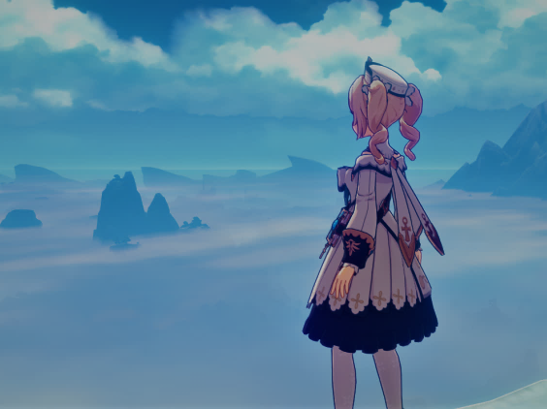
Antivision
My „Gaming Blog“
December
2020

Slide 2
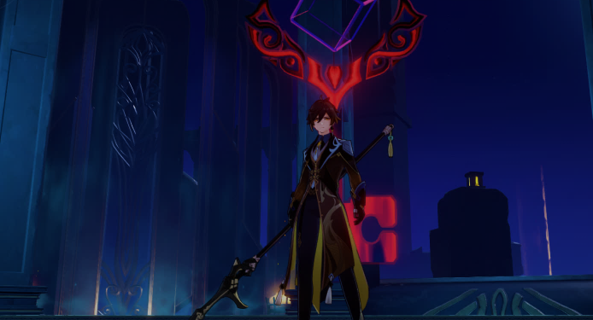
Inhalt
Description
Process
Inspiration
Posts
Games
Playtime

Slide 3
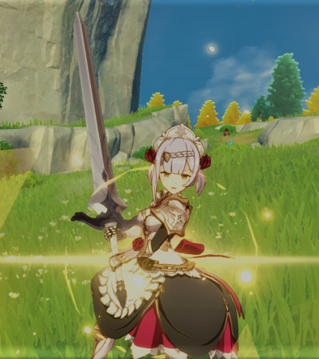
Description
What is AntiVision?
AntiVision is a simple Website attempting to be a gaming blog.
It contains posts about my gaming experiences.

Slide 4

The Process

Slide 5



Tools

Slide 6

References

Slide 7
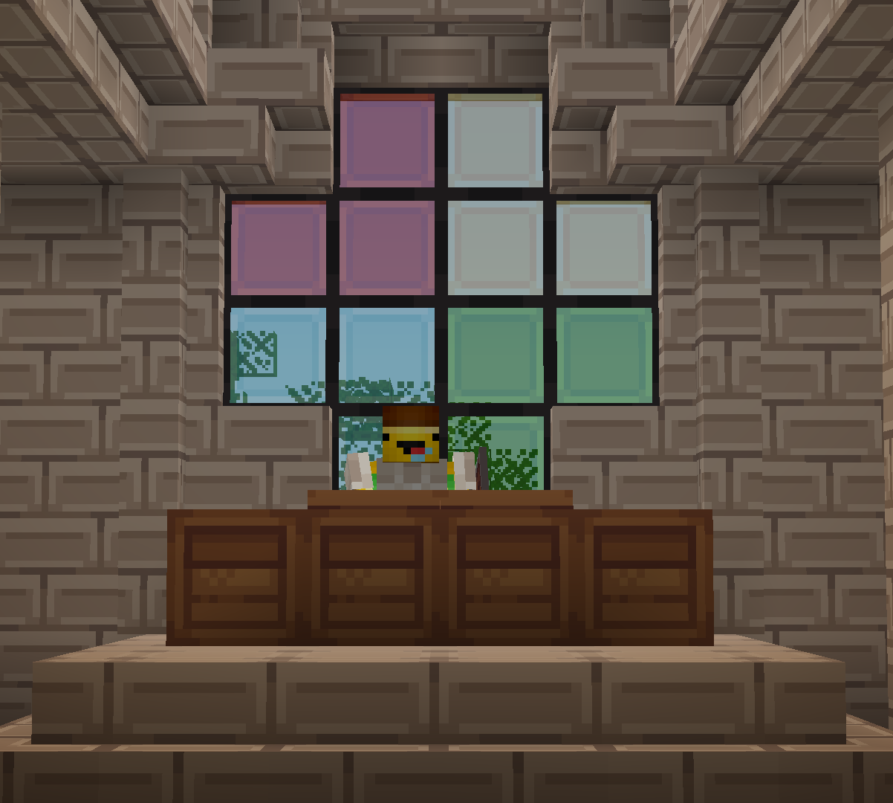
Inspiration
What brought me to this idea?
Playing video games is exciting.
Sharing fun moments with others.
Making friends
-That is our cult´s church.-

Slide 8
Posts
All the posts on the Website are about the games I play, a few of those are:
Genshin Impact
Minecraft
Rocket League
Developed by miHoYo
Open World Action Role-Playing Game
Offers a variety of characters to play with.
Splish splash, hack and slash.
Developed by Mojang
Sandbox game
Very popular among various age groups.
Creeper, aw man.
Developed by Psyonix
Vehicular soccer game
Car go brrrrrr.
Gotta go fast.

Slide 9
Playtime
This pie chart divides the time I‘ve spent on each one of those three games.

Slide 10

VIELEN
DANK!
Antonio-I.
Pirvu
Telefon
079-815-12-82
E-Mail
Antonio.pirvu@ict.csbe.ch

