Slide 1
INTUITIONS

Slide 2
The Difference
AI
ML
DL
Data science

Slide 3
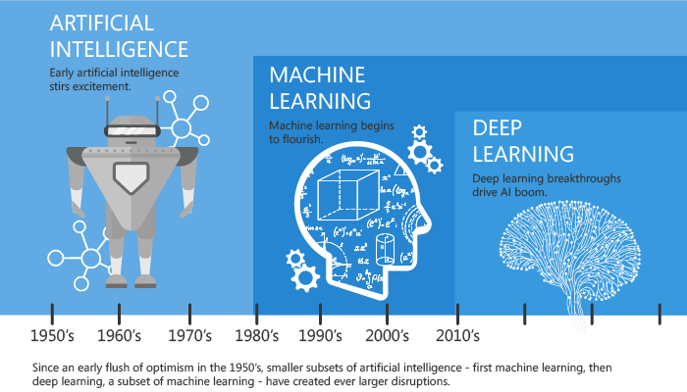
A Quick History
DL

Slide 4
PROBABILITY
CALCULUS
ML
LINEAR ALGEBRA
STATISTICS

Slide 5
When we do ML ?
You cannot code the rules
Many human tasks (such as recognizing whether an email is spam or not spam) cannot be adequately solved using a simple rule-based solution. A large number of factors could influence the answer. When rules depend on too many factors and many of these rules overlap or need to be tuned very finely, it soon becomes difficult for a human to accurately code the rules. You can use ML to effectively solve this problem.

Slide 6
When we do ML ?
You cannot scale
You might be able to manually recognize a few hundred emails and decide whether they are spam or not. However, this task becomes tedious for millions of emails. ML solutions are effective at handling large-scale problems.

Slide 7
Types of Learning
Supervised Learning – Given: training data + desired outputs (labels)
Unsupervised learning – Given: training data (without desired outputs)
Reinforcement learning – Rewards from sequence of actions

Slide 8
The official definitions
“The field of study that gives computers the ability to learn without being explicitly programmed”
Arthur samuel

Slide 9
Supervised Learning
How much money will we make by spending more dollars on digital advertising?
Will this loan applicant pay back the loan or not?
Predict breast cancer as malignant or benign ?

Slide 10
Supervised Learning
Classification : A classification problem is when the output variable is a category, such as “red” or “blue” or “disease” and “no disease”
Regression : A regression problem is when the output variable is a real value, such as “dollars” or “weight”

Slide 11
Unsupervised Learning
How do you find the underlying structure of a dataset?
How do you summarize it and group it most usefully?
How do you effectively represent data in a compressed format?

Slide 12
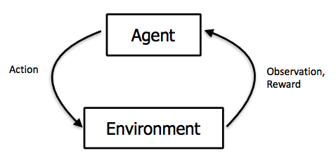
Reinforcement Learning

Slide 13
ML in practice
Understand domain, prior knowledge,and goals
Data integration, selection,cleaning,pre-processing,etc.
Learn models
Interpret results
Consolidate and deploy discovered knowledge
LOOP

Slide 14
State of the Art Applications of Machine Learning
Prediction — Machine learning can also be used in the prediction systems. Considering the loan example, to compute the probability of a fault, the system will need to classify the available data in groups.

Slide 15
State of the Art Applications of Machine Learning
Image recognition — Machine learning can be used for face detection in an image as well. There is a separate category for each person in a database of several people.

Slide 16
State of the Art Applications of Machine Learning
Speech Recognition — It is the translation of spoken words into the text. It is used in voice searches and more. Voice user interfaces include voice dialing, call routing, and appliance control. It can also be used a simple data entry and the preparation of structured documents.

Slide 17
State of the Art Applications of Machine Learning
Medical diagnoses — ML is trained to recognize cancerous tissues.
Financial industry and trading — companies use ML in fraud investigations and credit checks

Slide 18
Timeline
Introduction to ML (6 hours)
Implementation of basic statistic pillars of ML
Production Track : Basics for building and deploying ML applications in Cloud
Level 2 (8 hours)
Regularization
Neural Networks
Production Track : Structuring
Level 3 (8 hours)
Support Vector Machines
Unsupervised Learning
Dimensionality Reduction

Slide 19
Timeline
Level 4 (3 hours)
Recommender Systems
Deep Learning (8 hours)
Neural Networks
Structuring Deep Learning
Artificial Intelligence (other than ML) (5 hours)
Foundation

Slide 20
Level - 1

Slide 21
Implementation of basic statistic pillars of ML
We will discuss
Linear Algebra: Implementation in ML perspective - Practice in Numpy
Linear Regression: Implementation in ML perspective - Practice in Numpy
Logistic Regression: Implementation in ML perspective - Practice in Numpy
Calculus: Learning algorithms
Cost Function

Slide 22
Linear Regression
In supervised learning we have 2 two tasks
Regression
Classification

Slide 23
How we represent the model
Training set
Learning Algorithm
X
Estimated value of y
h

Slide 24
Cost function
Training set
Size in feet
1500
1808
1340
2100
2040
…...
Price in 1000’s$
390
414
330
504
456
…..
m = 54

Slide 25
How we represent the model
Training set
Learning Algorithm
X
Estimated value of y
h

Slide 26
Cost function
Hypothesis
h(x) = θ0 +θ1x

Slide 27
Cost function
Parameters
h(x) = θ0 +θ1x

Slide 28
Cost function
Let’s change the parameters
θ0 = 1.5
θ1 = 0
θ0 = 0
θ1 = 1
θ0 = 0.5
θ1 = 2

Slide 29
Cost function
Choose the appropriate parameters so that hypothesis is close to y for your training examples
Minimize θ0,θ1

Slide 30
Cost function
Let’s look have an example
h(x)
j(θ1)

Slide 31
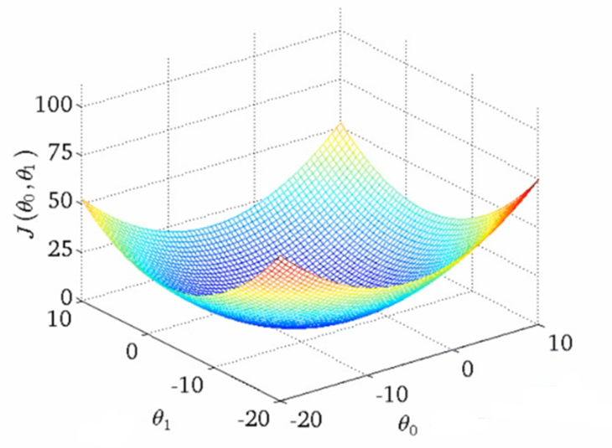
Cost function

Slide 33
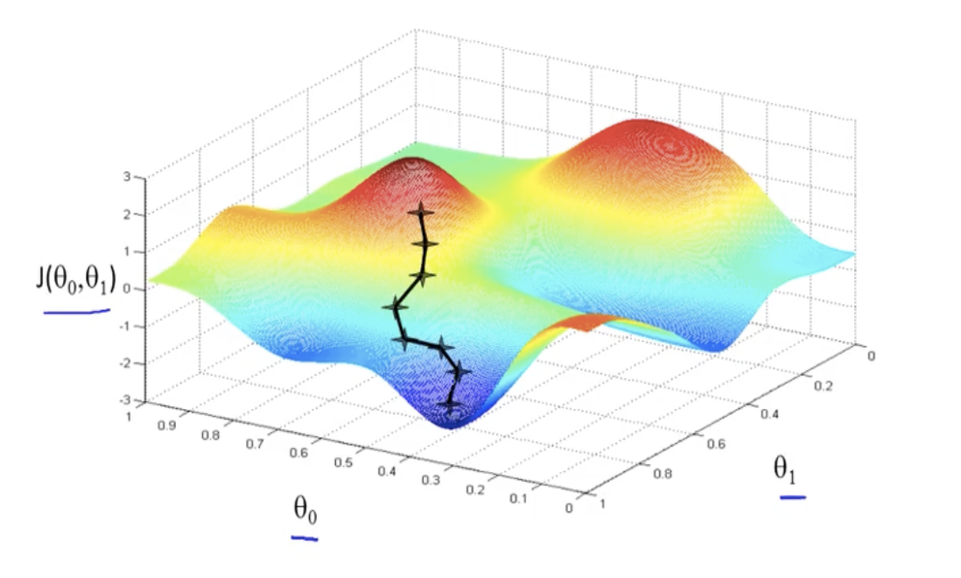
Gradient Descent

Slide 34
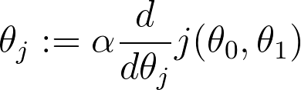
Gradient Descent
Repeat until convergence
{
}
( For j = 0 and 1 )

Slide 35
Gradient Descent
Simultaneously update

Slide 36
Production Track
Jupyter notebook
Git - version control
NumPy
Scikit
GCP - Intro

Slide 37
Production Track
Jupyter notebook
The Jupyter Notebook is an interactive computing environment that enables users to author notebook documents that include: - Live code - Interactive widgets - Plots - Narrative text - Equations - Images - Video

Slide 38
Production Track
Git - Version control
Git is an example of a distributed version control system (DVCS) commonly used for open source and commercial software development. DVCSs allow full access to every file, branch, and iteration of a project, and allows every user access to a full and self-contained history of all changes. Unlike once popular centralized version control systems

Slide 39
Production Track
Git - Version control
You’ll learn how to:
Create and use a repository
Start and manage a new branch
Make changes to a file and push them to GitHub as commits
Open and merge a pull request

Slide 40
Production Track
Git - Version control
Step 1. Create a Repository

Slide 41
Production Track
Git - Version control
Step 1. Create a Repository
Step 2. Start and manage a new branch
Step 3. Make changes to a file and push them to GitHub as commits
Step 4. Open and merge a pull request

