Slide 1

AIMLOPS
Valtteri Viinikainen
Ayush Ghimire
Yanli Jia

Slide 2
Project Introduction
Local Installation: Installed and tested locally on both Windows and macOS systems for compatibility.
Cloud Deployment: Successfully deployed on the CSC CPouta cloud platform.
Security Enhancement: Upgraded from HTTP to HTTPS for secure communication.

Slide 3
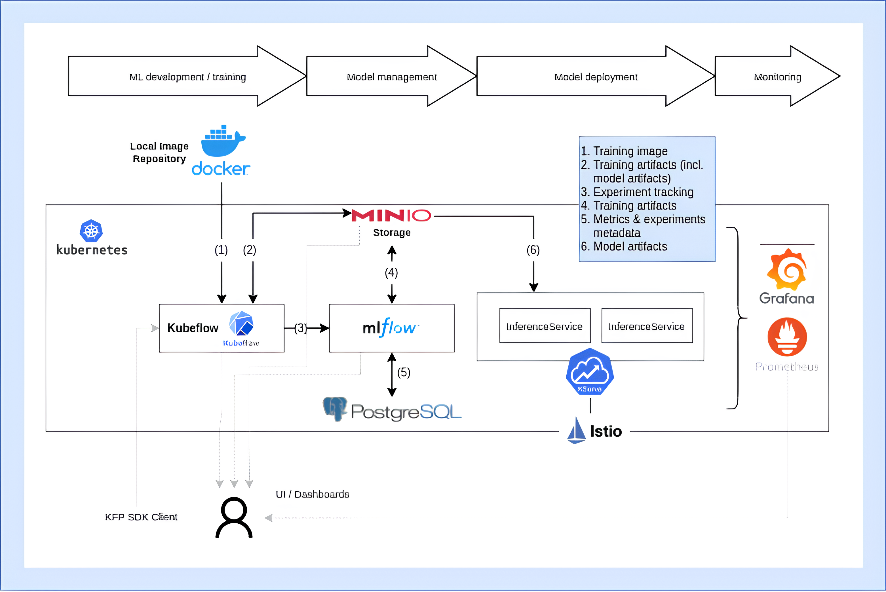

Slide 4
Connection to Kubeflow in Cpouta
CPouta
Github AIMLOPS Organisation
Standalone KFP and Kserve
Sudo SSH –L 8080:localhost:8080 username@IPaddress -i secretkey.pem
Install local docker registry NO
Install Ray 4 additional CPUs NO
Ubuntu
Kind Cluster installation YES

Slide 5
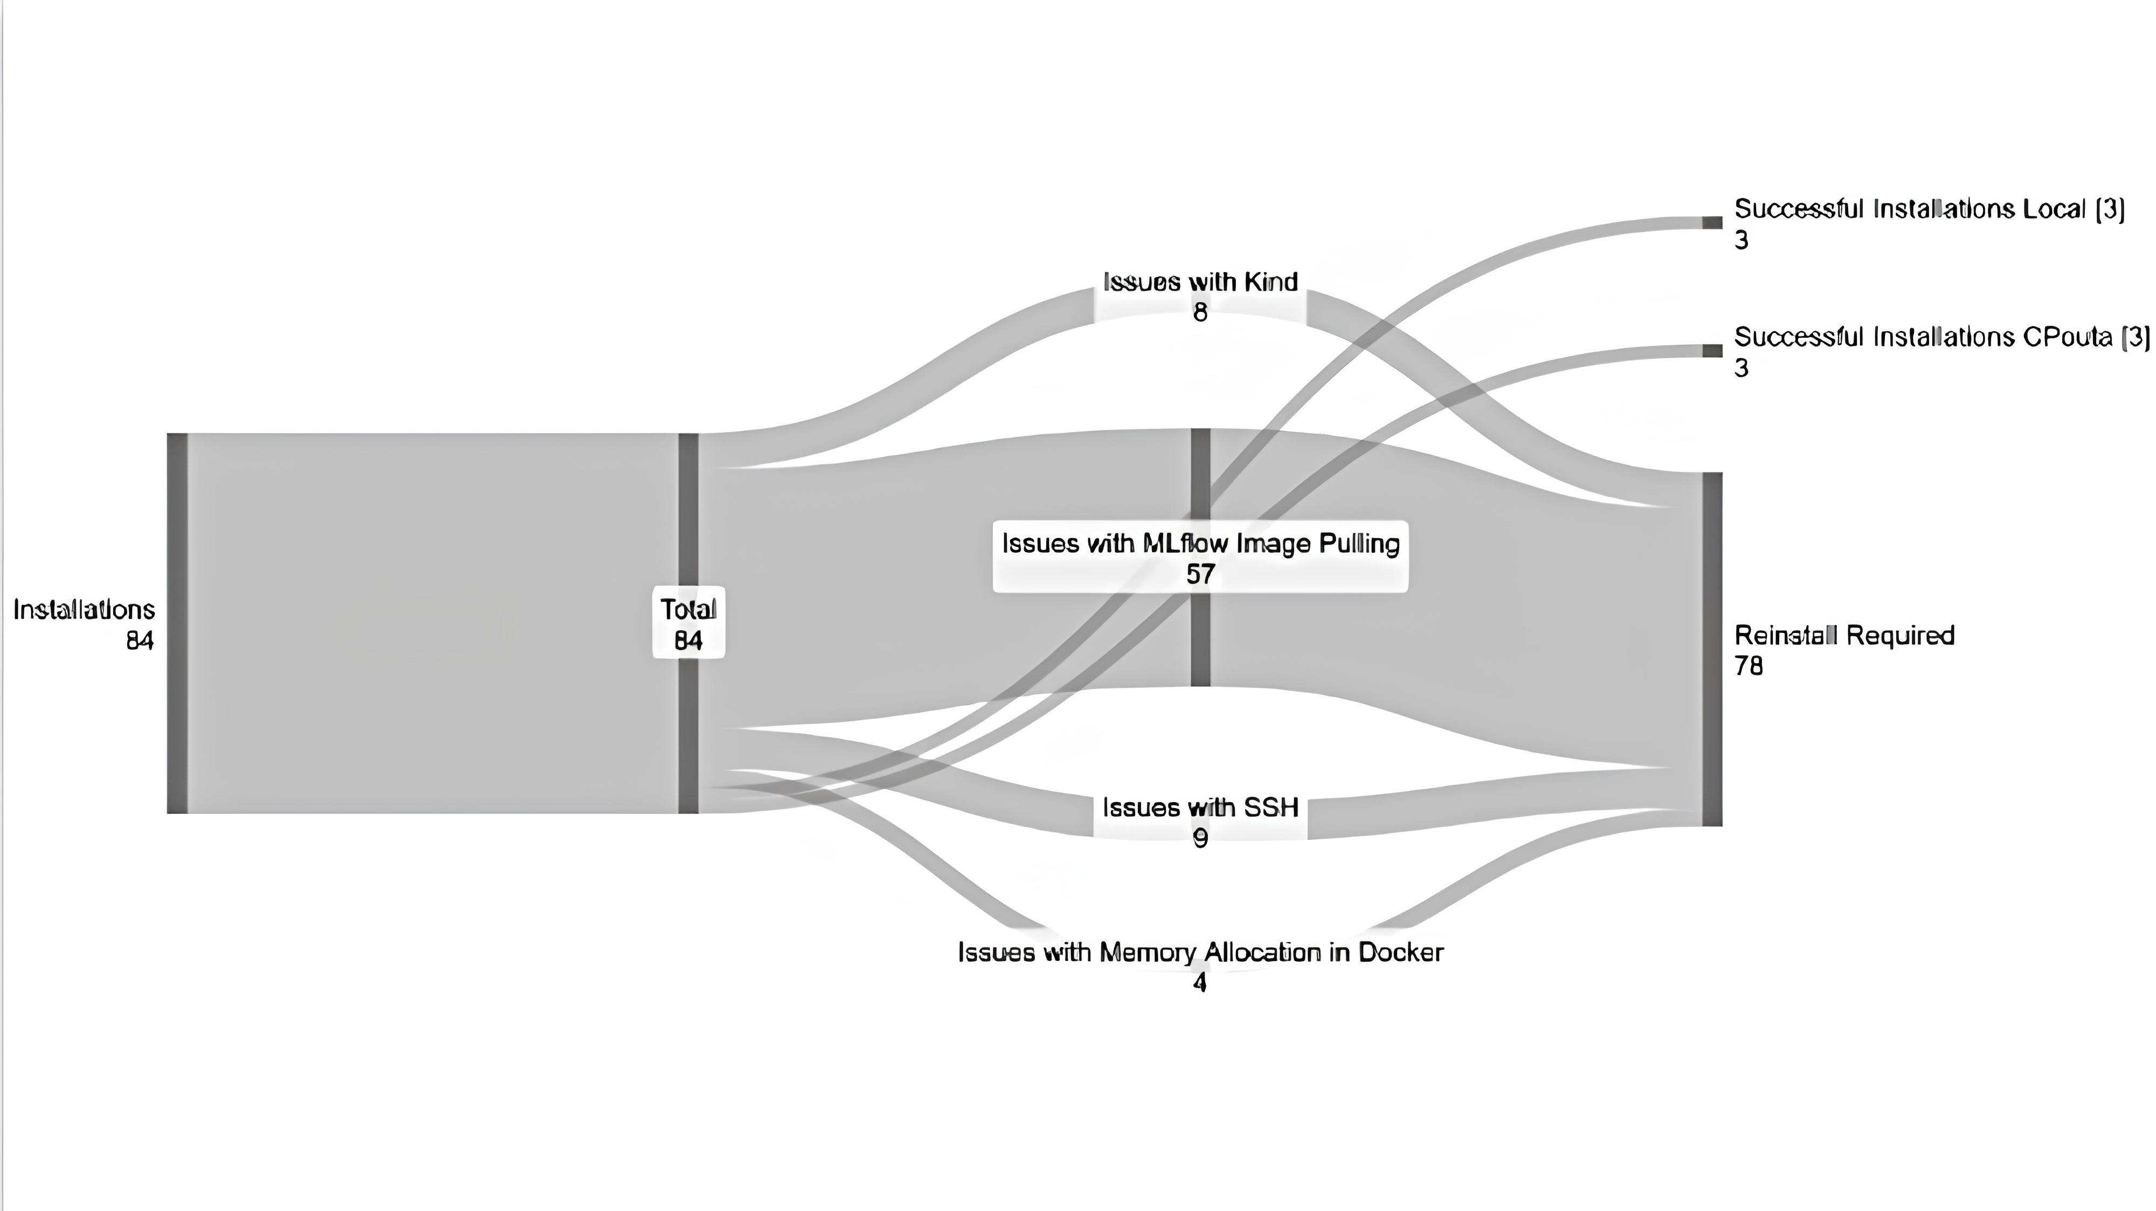

Slide 6
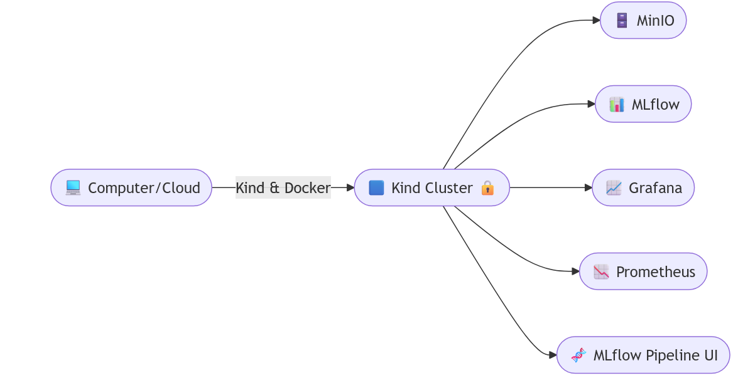

Slide 7
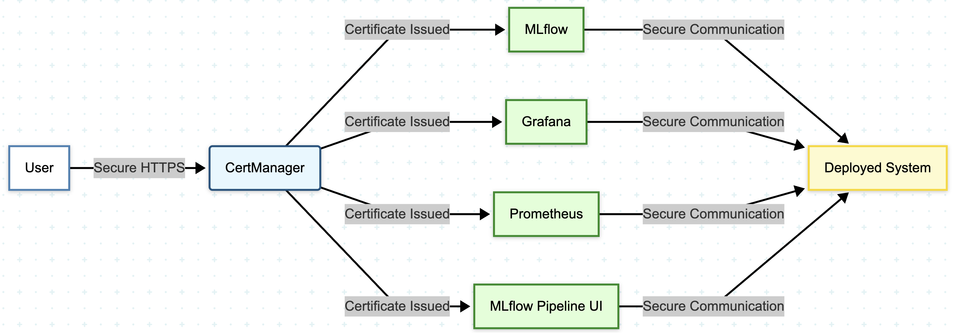

Slide 8
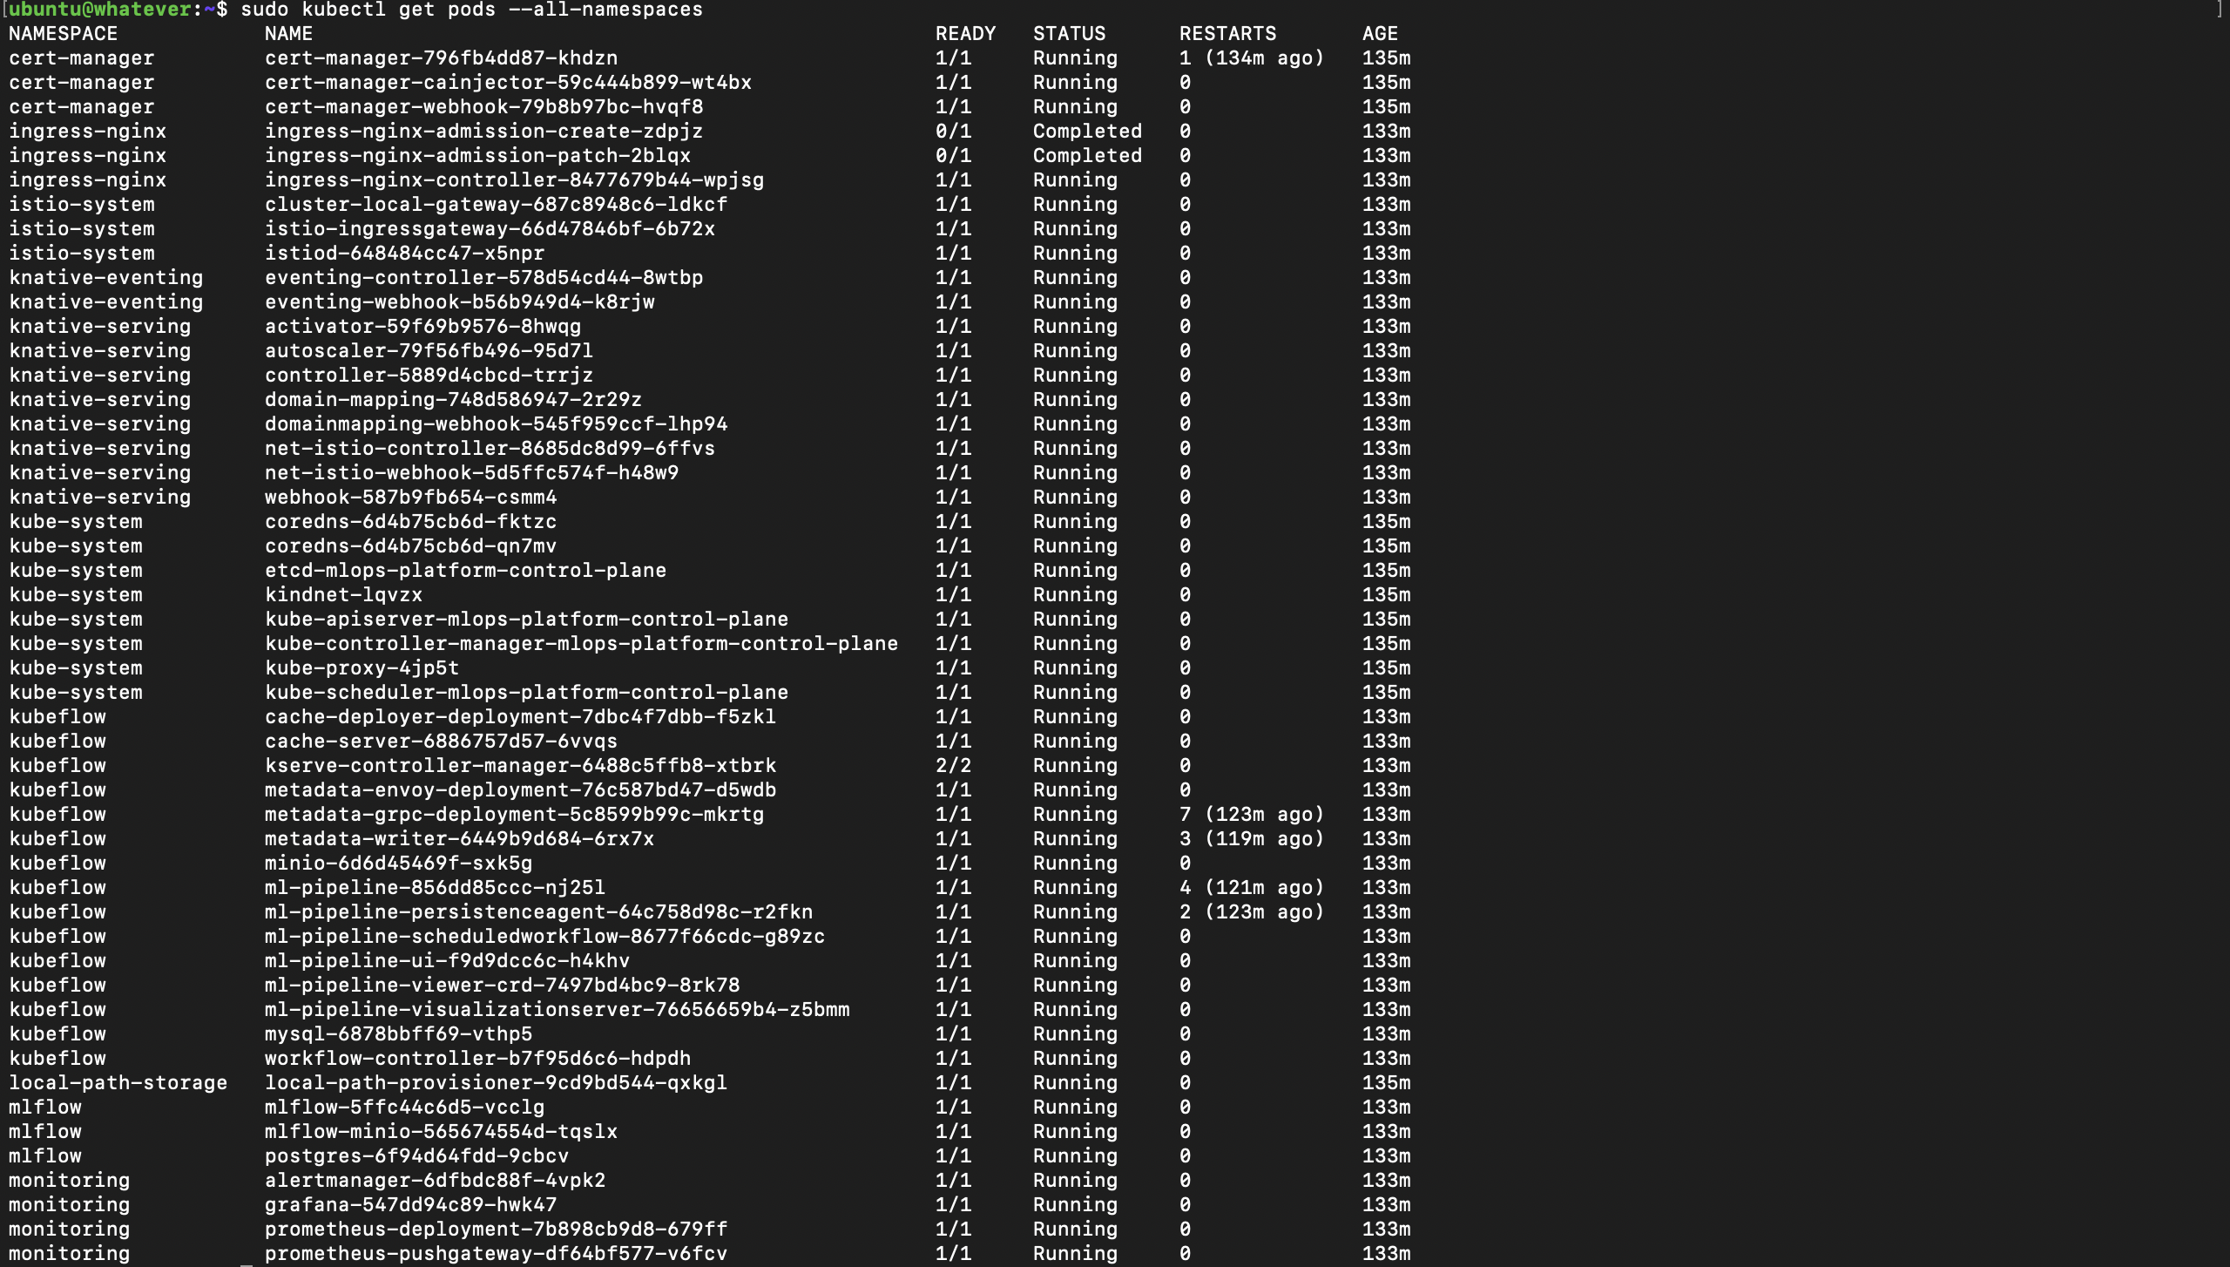

Slide 9
Web Browser
Nginx Ingress Controller
HTTPS Request
Route Traffic
Service 1
Backend Service
Ingress Rules
Service 2
Define Routing
Service N

Slide 10
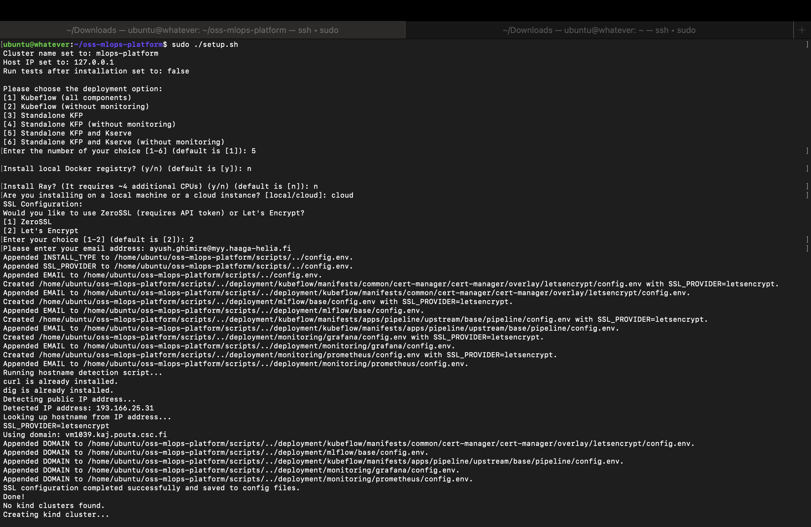

Slide 11
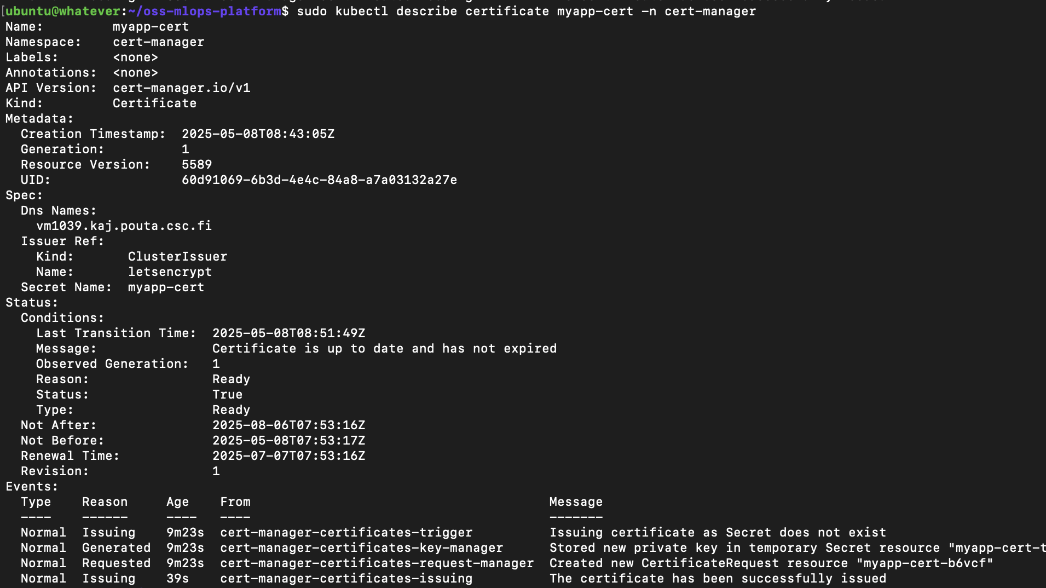

Slide 12
The Setup Steps (Behind the Scenes)
Step 1: The Interview (SSL_Details.sh)
Asks if you're local or cloud.
Asks for your email (for security alerts).
Asks if you prefer "Let's Encrypt" (free, common) or "ZeroSSL" for HTTPS.
Saves your answers in config files.
Step 2: Finding the House Number (Finding_Hostname.sh) (Only if you chose cloud)
Like finding your house address on the internet.
Uses tools (curl, dig) to get your public IP or hostname.
Tells other scripts and tools what this address is.

Slide 13
The Setup Steps (Behind the Scenes)
Step 3: Building the Playground (create_cluster.sh)
Uses "Kind" and "Docker" to build the mini Kubernetes lab.
Opens the "doors" (ports 80 & 443) so web browsers can connect.
Step 4: Installing the Security Guard (SSL_Creation.sh)
Installs "Cert-Manager" inside the cluster – it's like a security guard for HTTPS.
Tells Cert-Manager: "Use Let's Encrypt (or ZeroSSL) to automatically get security certificates for the address we found earlier."

Slide 14
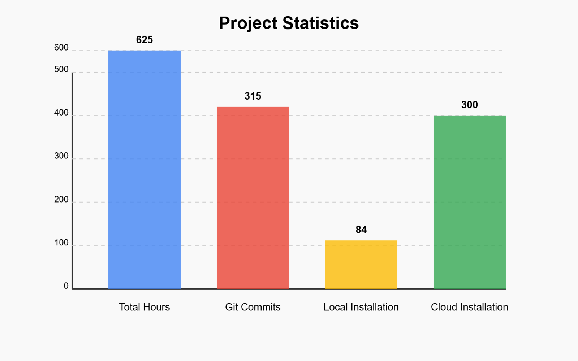
https://github.com/ictaiproject/oss-mlops-platform/wiki

Slide 15

Thank you! Q&A

