Slide 1
Exploratory Data Analysis I

Slide 2
Exploratory Data Analysis (EDA) I

Slide 3
R with R Studio and/or R Studio.cloud

Slide 4
Course Contents
2022-12-07: Introduction: About the course [lead by TK] - An introduction to open and public data, and data science
2022-12-14: Exploratory Data Analysis (EDA) 1 [lead by hs] - R Basics with RStudio and/or RStudio.cloud; Toy Data
2022-12-21: Exploratory Data Analysis (EDA) 2 [lead by hs] - R Markdown; Introduction to tidyverse I; Public Data, WDI
2023-01-11: Exploratory Data Analysis (EDA) 3 [lead by hs] - Introduction to tidyverseII; WDI, WIR, etc
2023-01-18: Exploratory Data Analysis (EDA) 4 [lead by hs] - Introduction to tidyverse III; WDI, WIR, etc
2023-01-25: Exploratory Data Analysis (EDA) 5 [lead by hs] - Introduction to tidyverse III; WDI, WIR, etc
2023-02-01: Introduction to PPDAC (Problem-Plan-Data-Analysis-Conclusion) Cycle: [lead by TK]
2023-02-08: Model building I [lead by TK] -Collecting and visualizing data and Introduction to WDI (World Development Indicators by World Bank)
2023-02-15: Model building II [lead by TK] -Analyzing data and communications
2023-02-22: Project Presentation

Slide 5
Learning Resources
Textbooks and References
“R for Data Science” by Hadley Wickham and Garrett Grolemund:
Free Online Book: https://r4ds.had.co.nz
Visit bookdown site: https://bookdown.org
Many more on the archive page.
Interactive Exercises
Posit Primers:https://posit.cloud/learn/primers:
The Basics, Work with Data, Visualize Data, Tidy Your Data, Report Reproducibly
{swirl} Learn R, in R: https://swirlstats.com
Designed and developed by a team at Johns Hopkins University for coursera courses

Slide 6
Posit Primers created by learnr
learnr Interactive Tutorials for R
Posit Primers https://posit.cloud/learn/primers
The Basics – r4ds: Explore, I
Visualization Basics
Programming Basics
Work with Data – r4ds: Wrangle, I
Working with Tibbles
Isolating Data with dplyr
Deriving Information with dplyr
Visualize Data – r4ds: Explore, II
Tidy Your Data – r4ds: Wrangle, II
Iterate – r4ds: Program
Write Functions – r4ds: Program

Slide 7
Data Science and EDA
Wikipedia https://en.wikipedia.org/wiki/Data_science
An inter-disciplinary field that uses scientific methods, processes, algorithms and systems to extract knowledge and insights from many structural and unstructured data.
Create Insights
Impact Decision Making
Maintain & Improve Overtime

Slide 8
What is R?
R (programming language), Wikipedia
R is a programming language and free software environment for statistical computing and graphics supported by the R Foundation for Statistical Computing.
The R language is widely used among statisticians and data miners for developing statistical software and data analysis.
A GNU package, the official R software environment is written primarily in C, Fortran, and R itself (thus, it is partially self-hosting) and is freely available under the GNU General Public License.

Slide 9
History of R and more
“R Programming for Data Science” by Roger Peng
Chapter 2. History and Overview of R
Overview and History of R: Youtube video

Slide 10
Why R? – Responses by Hadley Wickham
r4ds: R is a great place to start your data science journey because
R is an environment designed from the ground up to support data science.
R is not just a programming language, but it is also an interactive environment for doing data science.
To support interaction, R is a much more flexible language than many of its peers.

Slide 11
Why R today?
When you talk about choosing programming languages, I always say you shouldn’t pick them based on technical merits, but rather pick them based on the community. And I think the R community is like really, really strong, vibrant, free, welcoming, and embraces a wide range of domains. So, if there are like people like you using R, then your life is going to be much easier. That’s the first reason.
Interview: “Advice to Young (and Old) Programmers, H. Wickham”

Slide 12
What is RStudio? https://posit.com
RStudio is an integrated development environment, or IDE, for R programming.
R Studio (Wikipedia)
RStudio is an integrated development environment (IDE) for R, a programming language for statistical computing and graphics. It is available in two formats: RStudio Desktop is a regular desktop application while RStudio Server runs on a remote server and allows accessing RStudio using a web browser.

Slide 13
Installation of R and R Studio
R Installation
To download R, go to CRAN, the comprehensive R archive network. CRAN is composed of a set of mirror servers distributed around the world and is used to distribute R and R packages. Don’t try and pick a mirror that’s close to you: instead use the cloud mirror, https://cloud.r-project.org, which automatically figures it out for you.
A new major version of R comes out once a year, and there are 2-3 minor releases each year. It’s a good idea to update regularly.
R Studio Installation
Download and install it from http://www.rstudio.com/download.
RStudio is updated a couple of times a year. When a new version is available, RStudio will let you know.

Slide 14
R Studio
The First Step
Start R Studio Application
Top Menu: File > New Project > New Directory > New Project > Directory name or Browse the directory and choose the parent directory you want to create the directory
When You Start the Project
Go to the directory you created
Double click _‘Directory Name’.Rproj
Or,
Start R Studio
File > Open Project (or choose from Recent Project)
In this way the working directory of the session is set to the project directory and R can search releted files without difficulty (getwd(), setwd())

Slide 15
Posit Cloud
RStudio Cloud is a lightweight, cloud-based solution that allows anyone to do, share, teach and learn data science online.
Cloud Free
Up to 15 projects total
1 shared space (5 members and 10 projects max)
15 project hours per month
Up to 1 GB RAM per project
Up to 1 CPU per project
Up to 1 hour background execution time

Slide 16
How to Start Posit Cloud
Go to https://posit.cloud/
Sign Up: top right
Email address or Google account
New Project: Project Name
R Console

Slide 17
Let’s Get Started
Start RStudio and create a project, or login to Posit Cloud and create a project.

Slide 18
The First Examples
Input the following codes into Console in the left bottom pane.
The first two:
head(cars)
## speed dist ## 1 4 2 ## 2 4 10 ## 3 7 4 ## 4 7 22 ## 5 8 16 ## 6 9 10

Slide 19
str(cars)
## 'data.frame': 50 obs. of 2 variables: ## $ speed: num 4 4 7 7 8 9 10 10 10 11 ... ## $ dist : num 2 10 4 22 16 10 18 26 34 17 ...

Slide 20
Two more:
summary(cars)
## speed dist ## Min. : 4.0 Min. : 2.00 ## 1st Qu.:12.0 1st Qu.: 26.00 ## Median :15.0 Median : 36.00 ## Mean :15.4 Mean : 42.98 ## 3rd Qu.:19.0 3rd Qu.: 56.00 ## Max. :25.0 Max. :120.00

Slide 21
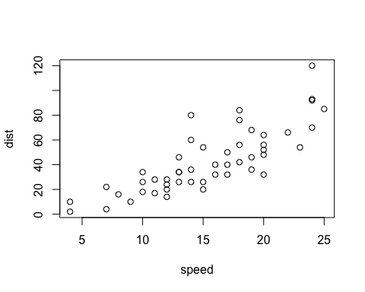
plot(cars)

Slide 22
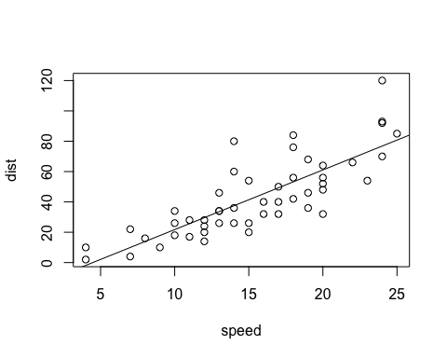
And three more:
plot(cars) # cars: Speed and Stopping Distances of Cars abline(lm(cars$dist~cars$speed))

Slide 23
lm(cars$dist~cars$speed)
## ## Call: ## lm(formula = cars$dist ~ cars$speed) ## ## Coefficients: ## (Intercept) cars$speed ## -17.579 3.932

Slide 24
summary(lm(cars$dist~cars$speed))
## ## Call: ## lm(formula = cars$dist ~ cars$speed) ## ## Residuals: ## Min 1Q Median 3Q Max ## -29.069 -9.525 -2.272 9.215 43.201 ## ## Coefficients: ## Estimate Std. Error t value Pr(>|t|) ## (Intercept) -17.5791 6.7584 -2.601 0.0123 * ## cars$speed 3.9324 0.4155 9.464 1.49e-12 *** ## --- ## Signif. codes: 0 '***' 0.001 '**' 0.01 '*' 0.05 '.' 0.1 ' ' 1 ## ## Residual standard error: 15.38 on 48 degrees of freedom ## Multiple R-squared: 0.6511, Adjusted R-squared: 0.6438 ## F-statistic: 89.57 on 1 and 48 DF, p-value: 1.49e-12

Slide 25
Brief Explanation
head(cars): The first 6 rows of the pre-installed data cars.
str(cars): The data structure of the pre-installed data cars.
summary(cars): The summary of the pre-installed data cars.
plot(cars): A scatter plot of the pre-installed data cars.
plot(cars$dist~cars$speed)
cars$dist, cars$[[2]], cars[,2] are same
abline(lm(cars$dist~cars$speed)): Add a regression line of a linear model
lm(cars$dist~cars$speed): The equation of the regression line
summary(lm(cars$dist~cars$speed): The summary of the linear regression model

Slide 26
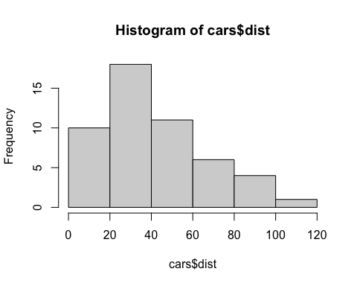
hist(cars$dist)

Slide 27
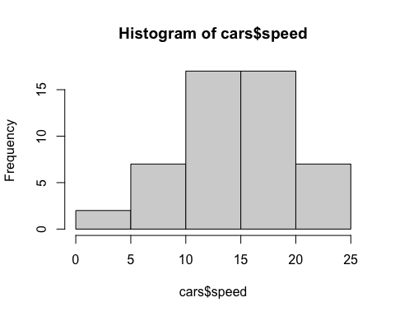
hist(cars$speed)

Slide 28
View and help
View(cars)
?cars: same as help(cars)
??cars: same as `help.search(“cars”)
datasets
?datasets
library(help = "datasets")
data() shows all data already attached and available.

Slide 29
Practicum
Pick a data in the datasets package and try
head()
str()
summary()
and some more.

Slide 30
iris
head(iris)
## Sepal.Length Sepal.Width Petal.Length Petal.Width Species ## 1 5.1 3.5 1.4 0.2 setosa ## 2 4.9 3.0 1.4 0.2 setosa ## 3 4.7 3.2 1.3 0.2 setosa ## 4 4.6 3.1 1.5 0.2 setosa ## 5 5.0 3.6 1.4 0.2 setosa ## 6 5.4 3.9 1.7 0.4 setosa

Slide 31
str(iris)
## 'data.frame': 150 obs. of 5 variables: ## $ Sepal.Length: num 5.1 4.9 4.7 4.6 5 5.4 4.6 5 4.4 4.9 ... ## $ Sepal.Width : num 3.5 3 3.2 3.1 3.6 3.9 3.4 3.4 2.9 3.1 ... ## $ Petal.Length: num 1.4 1.4 1.3 1.5 1.4 1.7 1.4 1.5 1.4 1.5 ... ## $ Petal.Width : num 0.2 0.2 0.2 0.2 0.2 0.4 0.3 0.2 0.2 0.1 ... ## $ Species : Factor w/ 3 levels "setosa","versicolor",..: 1 1 1 1 1 1 1 1 1 1 ...

Slide 32
summary(iris)
## Sepal.Length Sepal.Width Petal.Length Petal.Width ## Min. :4.300 Min. :2.000 Min. :1.000 Min. :0.100 ## 1st Qu.:5.100 1st Qu.:2.800 1st Qu.:1.600 1st Qu.:0.300 ## Median :5.800 Median :3.000 Median :4.350 Median :1.300 ## Mean :5.843 Mean :3.057 Mean :3.758 Mean :1.199 ## 3rd Qu.:6.400 3rd Qu.:3.300 3rd Qu.:5.100 3rd Qu.:1.800 ## Max. :7.900 Max. :4.400 Max. :6.900 Max. :2.500 ## Species ## setosa :50 ## versicolor:50 ## virginica :50 ## ## ##

Slide 33
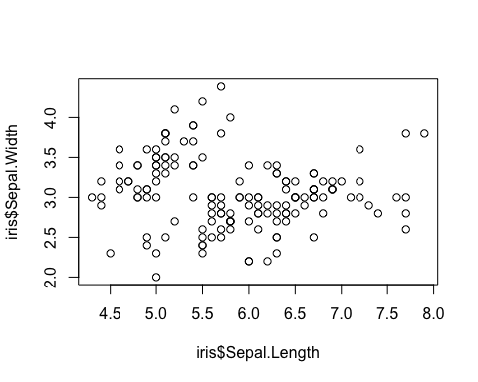
Can you plot?
plot(iris$Sepal.Length, iris$Sepal.Width)

Slide 34
tidyverse Packages
Brief Introduction to R on RStudio
Four Panes and Tabs
Top Left: Source Editor
Top Right: Environment, History, etc.
Bottom Left: Console, Terminal, Render, Background Jobs
Bottom Right: Files, Plots, Packages, Help, Viewer, Presentation

Slide 35
Set up
Highly recommend to set the language to be “English”.
Create “data” directory.
Sys.setenv(LANG = "en") dir.create("data")

Slide 36
Three Ways to Run Codes
Console - Bottom Left Pane
R Script - pull down menu under File
R Notebook, R Markdown - pull down menu under File

Slide 37
Second Way: R Script
Examples: R Scripts in Moodle
basics.R
coronavirus.R
Copy a script in Moodle: {file name}.R
In RStudio (create Project in RStudio) choose File > New File > R Script and paste it.
Choose File > Save with a name; e.g. {file names} (.R will be added automatically)
To run a code: at the cursor press Ctrl+Shift+Enter (Win) or Cmd+Shift+Enter (Mac).

Slide 38
Packages
R packages are extensions to the R statistical programming language. R packages contain code, data, and documentation in a standardised collection format that can be installed by users of R, typically via a centralised software repository such as CRAN (the Comprehensive R Archive Network).
Installation and attachement
You can install packages by “Install Packages…” under “Tool” in the top menu.
install.packages("tidyverse")
install.packages("rmarkdown")

Slide 39
Third Way: R Notebook
Choose R Notebook from the pull down File menu in the top bar.
Edit YAML
Default* is as follows
--- title: "R Notebook" output: html_notebook ---

Slide 40
Template
--- title: "Title of R Notebook" author: "ID and Your Name" date: "2022-12-17" output: html_notebook: # number_sections: yes # toc: true # toc_float: true ---
Don’t change the format. Indention matters.
The statement after # is ignored.
Date is automatically inserted when you compile the file.
You can replace “2022-12-17” by “2022-12-14” or in any date format surrounded by double quotation marks.
Section numbers: - default is number_sections: no.
Table of contents, toc: true - default is toc: false.
Floating table of contents in HTML output, toc_float: true - default is toc_float: false

Slide 41
Create a Code Chunk to Attach Packages
Insert Chunk in Code pull down menu in the top bar, or use the C button on top. You can use shortcut keys listed under Tools in the top bar.
library(tidyverse)
## ── Attaching packages ─────────────────────────────────────── tidyverse 1.3.2 ── ## ✔ ggplot2 3.4.0 ✔ purrr 0.3.5 ## ✔ tibble 3.1.8 ✔ dplyr 1.0.10 ## ✔ tidyr 1.2.1 ✔ stringr 1.4.1 ## ✔ readr 2.1.3 ✔ forcats 0.5.2 ## ── Conflicts ────────────────────────────────────────── tidyverse_conflicts() ── ## ✖ dplyr::filter() masks stats::filter() ## ✖ dplyr::lag() masks stats::lag()

Slide 42
First Example
Importing data
Let us assign the iris data in the pre-installed package datasets to df_iris. You can give any name starting from an alphabet, though there are some rules.
df_iris <- datasets::iris class(df_iris)
## [1] "data.frame"
The class of data iris is data.frame, the basic data class of R. You can assign the same data as a tibble, the data class of tidyverse as follows.
tbl_iris <- as_tibble(datasets::iris) class(tbl_iris)
## [1] "tbl_df" "tbl" "data.frame"
df_iris <- iris can replace df_iris <- datasets::iris because the package datasets is installed and attached as default. Since you may have other data called iris included in a different package or you may have changed iris before, it is safer to specify the name of the package with the name of the data.
Within R Notebook or in Console, you may get different output, and tf_iris and tbl_iris behave differently. It is because of the default settings of R Markdown.

Slide 43
Look at the data
Several ways to view the data.
The View command open up a window to show the contents of the data and you can use the filter as well.
View(df_iris)

Slide 44
The following simple command also shows the data.
df_iris
## Sepal.Length Sepal.Width Petal.Length Petal.Width Species ## 1 5.1 3.5 1.4 0.2 setosa ## 2 4.9 3.0 1.4 0.2 setosa ## 3 4.7 3.2 1.3 0.2 setosa ## 4 4.6 3.1 1.5 0.2 setosa ## 5 5.0 3.6 1.4 0.2 setosa ## 6 5.4 3.9 1.7 0.4 setosa ## 7 4.6 3.4 1.4 0.3 setosa ## 8 5.0 3.4 1.5 0.2 setosa ## 9 4.4 2.9 1.4 0.2 setosa ## 10 4.9 3.1 1.5 0.1 setosa ## 11 5.4 3.7 1.5 0.2 setosa ## 12 4.8 3.4 1.6 0.2 setosa ## 13 4.8 3.0 1.4 0.1 setosa ## 14 4.3 3.0 1.1 0.1 setosa ## 15 5.8 4.0 1.2 0.2 setosa ## 16 5.7 4.4 1.5 0.4 setosa ## 17 5.4 3.9 1.3 0.4 setosa ## 18 5.1 3.5 1.4 0.3 setosa ## 19 5.7 3.8 1.7 0.3 setosa ## 20 5.1 3.8 1.5 0.3 setosa ## 21 5.4 3.4 1.7 0.2 setosa ## 22 5.1 3.7 1.5 0.4 setosa ## 23 4.6 3.6 1.0 0.2 setosa ## 24 5.1 3.3 1.7 0.5 setosa ## 25 4.8 3.4 1.9 0.2 setosa ## 26 5.0 3.0 1.6 0.2 setosa ## 27 5.0 3.4 1.6 0.4 setosa ## 28 5.2 3.5 1.5 0.2 setosa ## 29 5.2 3.4 1.4 0.2 setosa ## 30 4.7 3.2 1.6 0.2 setosa ## 31 4.8 3.1 1.6 0.2 setosa ## 32 5.4 3.4 1.5 0.4 setosa ## 33 5.2 4.1 1.5 0.1 setosa ## 34 5.5 4.2 1.4 0.2 setosa ## 35 4.9 3.1 1.5 0.2 setosa ## 36 5.0 3.2 1.2 0.2 setosa ## 37 5.5 3.5 1.3 0.2 setosa ## 38 4.9 3.6 1.4 0.1 setosa ## 39 4.4 3.0 1.3 0.2 setosa ## 40 5.1 3.4 1.5 0.2 setosa ## 41 5.0 3.5 1.3 0.3 setosa ## 42 4.5 2.3 1.3 0.3 setosa ## 43 4.4 3.2 1.3 0.2 setosa ## 44 5.0 3.5 1.6 0.6 setosa ## 45 5.1 3.8 1.9 0.4 setosa ## 46 4.8 3.0 1.4 0.3 setosa ## 47 5.1 3.8 1.6 0.2 setosa ## 48 4.6 3.2 1.4 0.2 setosa ## 49 5.3 3.7 1.5 0.2 setosa ## 50 5.0 3.3 1.4 0.2 setosa ## 51 7.0 3.2 4.7 1.4 versicolor ## 52 6.4 3.2 4.5 1.5 versicolor ## 53 6.9 3.1 4.9 1.5 versicolor ## 54 5.5 2.3 4.0 1.3 versicolor ## 55 6.5 2.8 4.6 1.5 versicolor ## 56 5.7 2.8 4.5 1.3 versicolor ## 57 6.3 3.3 4.7 1.6 versicolor ## 58 4.9 2.4 3.3 1.0 versicolor ## 59 6.6 2.9 4.6 1.3 versicolor ## 60 5.2 2.7 3.9 1.4 versicolor ## 61 5.0 2.0 3.5 1.0 versicolor ## 62 5.9 3.0 4.2 1.5 versicolor ## 63 6.0 2.2 4.0 1.0 versicolor ## 64 6.1 2.9 4.7 1.4 versicolor ## 65 5.6 2.9 3.6 1.3 versicolor ## 66 6.7 3.1 4.4 1.4 versicolor ## 67 5.6 3.0 4.5 1.5 versicolor ## 68 5.8 2.7 4.1 1.0 versicolor ## 69 6.2 2.2 4.5 1.5 versicolor ## 70 5.6 2.5 3.9 1.1 versicolor ## 71 5.9 3.2 4.8 1.8 versicolor ## 72 6.1 2.8 4.0 1.3 versicolor ## 73 6.3 2.5 4.9 1.5 versicolor ## 74 6.1 2.8 4.7 1.2 versicolor ## 75 6.4 2.9 4.3 1.3 versicolor ## 76 6.6 3.0 4.4 1.4 versicolor ## 77 6.8 2.8 4.8 1.4 versicolor ## 78 6.7 3.0 5.0 1.7 versicolor ## 79 6.0 2.9 4.5 1.5 versicolor ## 80 5.7 2.6 3.5 1.0 versicolor ## 81 5.5 2.4 3.8 1.1 versicolor ## 82 5.5 2.4 3.7 1.0 versicolor ## 83 5.8 2.7 3.9 1.2 versicolor ## 84 6.0 2.7 5.1 1.6 versicolor ## 85 5.4 3.0 4.5 1.5 versicolor ## 86 6.0 3.4 4.5 1.6 versicolor ## 87 6.7 3.1 4.7 1.5 versicolor ## 88 6.3 2.3 4.4 1.3 versicolor ## 89 5.6 3.0 4.1 1.3 versicolor ## 90 5.5 2.5 4.0 1.3 versicolor ## 91 5.5 2.6 4.4 1.2 versicolor ## 92 6.1 3.0 4.6 1.4 versicolor ## 93 5.8 2.6 4.0 1.2 versicolor ## 94 5.0 2.3 3.3 1.0 versicolor ## 95 5.6 2.7 4.2 1.3 versicolor ## 96 5.7 3.0 4.2 1.2 versicolor ## 97 5.7 2.9 4.2 1.3 versicolor ## 98 6.2 2.9 4.3 1.3 versicolor ## 99 5.1 2.5 3.0 1.1 versicolor ## 100 5.7 2.8 4.1 1.3 versicolor ## 101 6.3 3.3 6.0 2.5 virginica ## 102 5.8 2.7 5.1 1.9 virginica ## 103 7.1 3.0 5.9 2.1 virginica ## 104 6.3 2.9 5.6 1.8 virginica ## 105 6.5 3.0 5.8 2.2 virginica ## 106 7.6 3.0 6.6 2.1 virginica ## 107 4.9 2.5 4.5 1.7 virginica ## 108 7.3 2.9 6.3 1.8 virginica ## 109 6.7 2.5 5.8 1.8 virginica ## 110 7.2 3.6 6.1 2.5 virginica ## 111 6.5 3.2 5.1 2.0 virginica ## 112 6.4 2.7 5.3 1.9 virginica ## 113 6.8 3.0 5.5 2.1 virginica ## 114 5.7 2.5 5.0 2.0 virginica ## 115 5.8 2.8 5.1 2.4 virginica ## 116 6.4 3.2 5.3 2.3 virginica ## 117 6.5 3.0 5.5 1.8 virginica ## 118 7.7 3.8 6.7 2.2 virginica ## 119 7.7 2.6 6.9 2.3 virginica ## 120 6.0 2.2 5.0 1.5 virginica ## 121 6.9 3.2 5.7 2.3 virginica ## 122 5.6 2.8 4.9 2.0 virginica ## 123 7.7 2.8 6.7 2.0 virginica ## 124 6.3 2.7 4.9 1.8 virginica ## 125 6.7 3.3 5.7 2.1 virginica ## 126 7.2 3.2 6.0 1.8 virginica ## 127 6.2 2.8 4.8 1.8 virginica ## 128 6.1 3.0 4.9 1.8 virginica ## 129 6.4 2.8 5.6 2.1 virginica ## 130 7.2 3.0 5.8 1.6 virginica ## 131 7.4 2.8 6.1 1.9 virginica ## 132 7.9 3.8 6.4 2.0 virginica ## 133 6.4 2.8 5.6 2.2 virginica ## 134 6.3 2.8 5.1 1.5 virginica ## 135 6.1 2.6 5.6 1.4 virginica ## 136 7.7 3.0 6.1 2.3 virginica ## 137 6.3 3.4 5.6 2.4 virginica ## 138 6.4 3.1 5.5 1.8 virginica ## 139 6.0 3.0 4.8 1.8 virginica ## 140 6.9 3.1 5.4 2.1 virginica ## 141 6.7 3.1 5.6 2.4 virginica ## 142 6.9 3.1 5.1 2.3 virginica ## 143 5.8 2.7 5.1 1.9 virginica ## 144 6.8 3.2 5.9 2.3 virginica ## 145 6.7 3.3 5.7 2.5 virginica ## 146 6.7 3.0 5.2 2.3 virginica ## 147 6.3 2.5 5.0 1.9 virginica ## 148 6.5 3.0 5.2 2.0 virginica ## 149 6.2 3.4 5.4 2.3 virginica ## 150 5.9 3.0 5.1 1.8 virginica
The output within R Notebook is a tibble style. Try the same command in Console.

Slide 45
slice(df_iris, 1:10)
## Sepal.Length Sepal.Width Petal.Length Petal.Width Species ## 1 5.1 3.5 1.4 0.2 setosa ## 2 4.9 3.0 1.4 0.2 setosa ## 3 4.7 3.2 1.3 0.2 setosa ## 4 4.6 3.1 1.5 0.2 setosa ## 5 5.0 3.6 1.4 0.2 setosa ## 6 5.4 3.9 1.7 0.4 setosa ## 7 4.6 3.4 1.4 0.3 setosa ## 8 5.0 3.4 1.5 0.2 setosa ## 9 4.4 2.9 1.4 0.2 setosa ## 10 4.9 3.1 1.5 0.1 setosa
1:10
## [1] 1 2 3 4 5 6 7 8 9 10

Slide 46
`
Data Structure
Let us look at the structure of the data. You can try str(df_iris) on Console or by adding a code chunk in R Notebook introducing later.
glimpse(df_iris)
## Rows: 150 ## Columns: 5 ## $ Sepal.Length <dbl> 5.1, 4.9, 4.7, 4.6, 5.0, 5.4, 4.6, 5.0, 4.4, 4.9, 5.4, 4.… ## $ Sepal.Width <dbl> 3.5, 3.0, 3.2, 3.1, 3.6, 3.9, 3.4, 3.4, 2.9, 3.1, 3.7, 3.… ## $ Petal.Length <dbl> 1.4, 1.4, 1.3, 1.5, 1.4, 1.7, 1.4, 1.5, 1.4, 1.5, 1.5, 1.… ## $ Petal.Width <dbl> 0.2, 0.2, 0.2, 0.2, 0.2, 0.4, 0.3, 0.2, 0.2, 0.1, 0.2, 0.… ## $ Species <fct> setosa, setosa, setosa, setosa, setosa, setosa, setosa, s…
There are six types of data in R; Double, Integer, Character, Logical, Raw, Complex.
The names after $ are column names. If you call df_iris$Species, you have the Species column. Species is in the 5th collumn, typeof(df_iris[[5]]) does the same as the next.
df_iris[2,4] =0.2 is the fourth entry of Sepal.Width.

Slide 47
typeof(df_iris$Species)
## [1] "integer"
class(df_iris$Species)
## [1] "factor"
For factors = fct see the R Document or an explanation in Factor in R: Categorical Variable & Continuous Variables.

Slide 48
typeof(df_iris$Sepal.Length)
## [1] "double"
class(df_iris$Sepal.Length)
## [1] "numeric"
Q1. What are the differences ofdf_iris, slice(df_iris, 1:10) and glimpse(df_iris) above?
Q2. What are the differences ofdf_iris, slice(df_iris, 1:10) and glimpse(df_iris) in the console?

Slide 49
Summary of the Data
The following is very convenient to get the summary information of a data.
summary(df_iris)
## Sepal.Length Sepal.Width Petal.Length Petal.Width ## Min. :4.300 Min. :2.000 Min. :1.000 Min. :0.100 ## 1st Qu.:5.100 1st Qu.:2.800 1st Qu.:1.600 1st Qu.:0.300 ## Median :5.800 Median :3.000 Median :4.350 Median :1.300 ## Mean :5.843 Mean :3.057 Mean :3.758 Mean :1.199 ## 3rd Qu.:6.400 3rd Qu.:3.300 3rd Qu.:5.100 3rd Qu.:1.800 ## Max. :7.900 Max. :4.400 Max. :6.900 Max. :2.500 ## Species ## setosa :50 ## versicolor:50 ## virginica :50 ## ## ##
Minimum, 1st Quadrant (25%), Median, Mean, 3rd Quadrant (75%), Maximum, and the count of each factor.

Slide 50
Visualizing Data
Scatter Plot
We use ggplot to draw graphs. The scatter plot is a projection of data with two variables $x$ and $y$.
ggplot(data = <data>, aes(x = <column name for x>, y = <column name for y>)) + geom_point()
ggplot(data = df_iris, aes(x = Sepal.Length, y = Sepal.Width)) + geom_point()

Slide 51
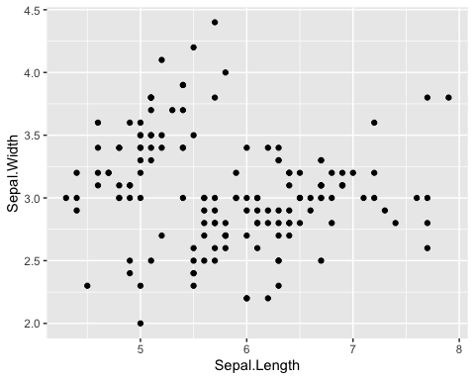
ggplot(data = df_iris, aes(x = Sepal.Length, y = Sepal.Width)) + geom_point()

Slide 52
Scatter Plot with Labels
Add title and labels adding labs().
ggplot(data = <data>, aes(x = <column name for x>, y = <column name for y>)) + geom_point() + labs(title = "Title", x = "Label for x", y = "Label for y")

Slide 53
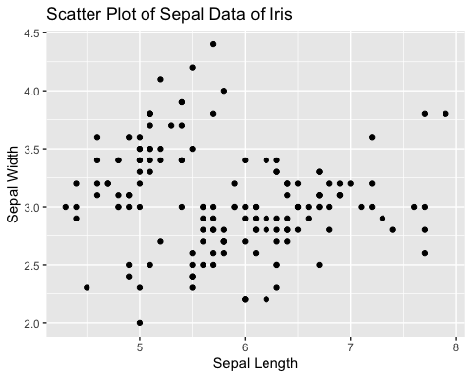
ggplot(data = df_iris, aes(x = Sepal.Length, y = Sepal.Width)) + geom_point() + labs(title = "Scatter Plot of Sepal Data of Iris", x = "Sepal Length", y = "Sepal Width")

Slide 54
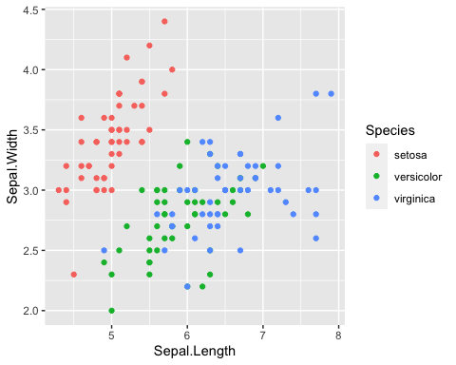
Scatter Plot with Colors
Add different colors automatically to each species. Can you see each group?
ggplot(data = df_iris, aes(x = Sepal.Length, y = Sepal.Width, color = Species)) + geom_point()

Slide 55
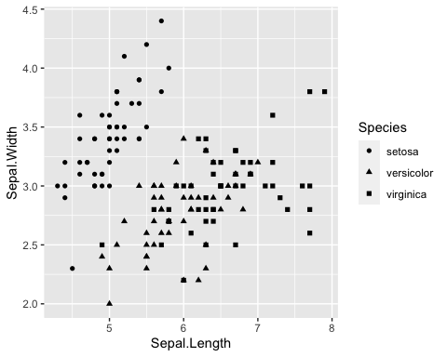
Scatter Plot with Shapes
ggplot(data = df_iris, aes(x = Sepal.Length, y = Sepal.Width, shape = Species)) + geom_point()

Slide 56
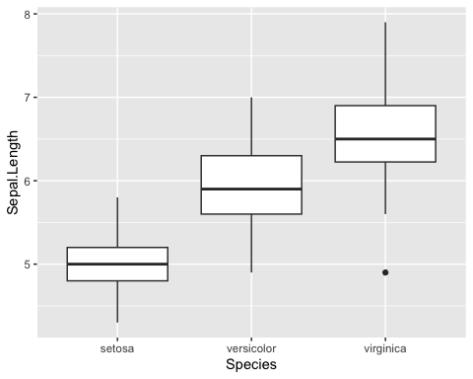
Boxplot
The boxplot compactly displays the distribution of a continuous variable.
ggplot(data = df_iris, aes(x = Species, y = Sepal.Length)) + geom_boxplot()

Slide 57
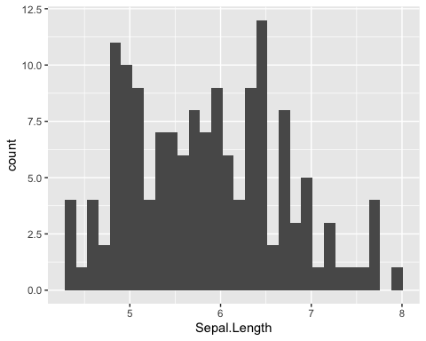
Histogram
Visualize the distribution of a single continuous variable by dividing the x axis into bins and counting the number of observations in each bin. Histograms (geom_histogram()) display the counts with bars.
ggplot(data = df_iris, aes(x = Sepal.Length)) + geom_histogram()

Slide 58
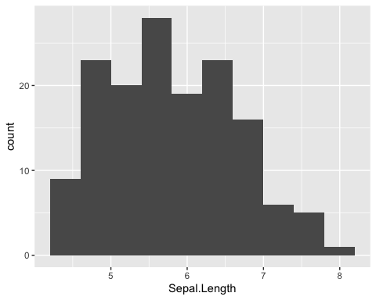
Change the number of bins by bins = <number>.
ggplot(data = df_iris, aes(x = Sepal.Length)) + geom_histogram(bins = 10)

Slide 59
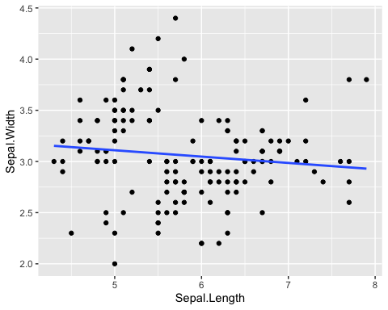
Data Modeling
Professor Kaizoji will cover the mathematical models and hypothesis testings.
ggplot(data = df_iris, aes(x = Sepal.Length, y = Sepal.Width)) + geom_point() + geom_smooth(method = "lm", se = FALSE)

Slide 60
Comments on Week 2
Helpful Resources
Cheat Sheet in RStudio: https://www.rstudio.com/resources/cheatsheets/
RStudio IED
Base R Cheat Sheet
‘Quick R’ by DataCamp: https://www.statmethods.net/management
An Introduction to R
Practicum
Posit Primers: The Basics: https://posit.cloud/learn/primers/1
Complete Visualization Basics and Programming Basics
Assignments - See Moodle
Assignment Week 2-1: Introduction Plus Forum
Due: Tuesday, 20 December 2022, 11:59 PM
Assignment Week 2-2: Quiz 1 on R Basics
Due: Tuesday, 20 December 2022, 11:59 PM

Slide 61
Swirl: An interactive learning environment for R and statistics
{swirl} website: https://swirlstats.com
JHU Data Science in coursera uses swirl for exercises.
Swirl Courses
R Programming: The basics of programming in R
Regression Models: The basics of regression modeling in R
Statistical Inference: The basics of statistical inference in R
Exploratory Data Analysis: The basics of exploring data in R
You can install other swirl courses as well
Swirl Courses Organized by Title
Swirl Courses Organized by Author’s Name
Github: swirl courses
install_course("Course Name Here")

Slide 62
Install and Start Swirl Courses
Three Steps to Start Swirl
install.packages("swirl") # Only the first time. library(swirl) # Everytime you start swirl swirl() # Everytime you start or resume swirl
R Programming: The basics of programming in R
1: Basic Building Blocks 2: Workspace and Files 3: Sequences of Numbers 4: Vectors 5: Missing Values 6: Subsetting Vectors 7: Matrices and Data Frames 8: Logic 9: Functions 10: lapply and sapply 11: vapply and tapply 12: Looking at Data 13: Simulation 14: Dates and Times 15: Base Graphics
Recommended Sections in Order
1, 3, 4, 5, 6, 7, 12, 15, 14, 8, 9, 10, 11, 13, 2
Section 2 discusses the directories and file systems of a computer
Sections 9, 10, 11 are for programming

Slide 63
Controling a swirl Session
… <– That’s your cue to press Enter to continue
You can exit swirl and return to the R prompt (>) at any time by pressing the Esc key.
If you are already at the prompt, type bye() to exit and save your progress. When you exit properly, you’ll see a short message letting you know you’ve done so.
When you are at the R prompt (>):
Typing skip() allows you to skip the current question.
Typing play() lets you experiment with R on your own; swirl will ignore what you do…
UNTIL you type nxt() which will regain swirl’s attention.
Typing bye() causes swirl to exit. Your progress will be saved.
Typing main() returns you to swirl’s main menu.
Typing info() displays these options again.

Slide 64
Final Remark
You will encounter the message like ‘Would you like to receive credit for completing this course on Coursera.org?’ at the end of each course. This is for coursera courses. Select ‘NO’.

Slide 65
More on R Script: Examples
R Scripts in Moodle
basics.R
coronavirus.R
Copy a script in Moodle: {file name}.R
In RStudio (Workspace in RStudio.cloud, Project in RStudio) choose File > New File > R Script and paste it.
Choose File > Save with a name; e.g. {file names} (.R will be added automatically)

Slide 66
basics.R
The script with the outputs.
################# # # basics.R # ################ # 'Quick R' by DataCamp may be a handy reference: # https://www.statmethods.net/management/index.html # Cheat Sheet at RStudio: https://www.rstudio.com/resources/cheatsheets/ # Base R Cheat Sheet: https://github.com/rstudio/cheatsheets/raw/main/base-r.pdf # To execute the line: Control + Enter (Window and Linux), Command + Enter (Mac) ## try your experiments on the console ## calculator 3 + 7 ### +, -, *, /, ^ (or **), %%, %/% 3 + 10 / 2 3^2 2^3 2*2*2 ### assignment: <-, (=, ->, assign()) x <- 5 x #### object_name <- value, '<-' shortcut: Alt (option) + '-' (hyphen or minus) #### Object names must start with a letter and can only contain letter, numbers, _ and . this_is_a_long_name <- 5^3 this_is_a_long_name char_name <- "What is your name?" char_name #### Use 'tab completion' and 'up arrow' ### ls(): list of all assignments ls() ls.str() #### check Environment in the upper right pane ### (atomic) vectors 5:10 a <- seq(5,10) a b <- 5:10 identical(a,b) seq(5,10,2) # same as seq(from = 5, to = 10, by = 2) c1 <- seq(0,100, by = 10) c2 <- seq(0,100, length.out = 10) c1 c2 length(c1) #### ? seq ? length ? identical (die <- 1:6) zero_one <- c(0,1) # same as 0:1 die + zero_one # c(1,2,3,4,5,6) + c(0,1). re-use d1 <- rep(1:3,2) # repeat d1 die == d1 d2 <- as.character(die == d1) d2 d3 <- as.numeric(die == d1) d3 ### class() for class and typeof() for mode ### class of vectors: numeric, charcters, logical ### types of vectors: doubles, integers, characters, logicals (complex and raw) typeof(d1); class(d1) typeof(d2); class(d2) typeof(d3); class(d3) sqrt(2) sqrt(2)^2 sqrt(2)^2 - 2 typeof(sqrt(2)) typeof(2) typeof(2L) 5 == c(5) length(5) ### Subsetting (A_Z <- LETTERS) A_F <- A_Z[1:6] A_F A_F[3] A_F[c(3,5)] large <- die > 3 large even <- die %in% c(2,4,6) even A_F[large] A_F[even] A_F[die < 4] ### Compare df with df1 <- data.frame(number = die, alphabet = A_F) df <- data.frame(number = die, alphabet = A_F, stringsAsFactors = FALSE) df df$number df$alphabet df[3,2] df[4,1] df[1] class(df[1]) class(df[[1]]) identical(df[[1]], die) identical(df[1],die) #################### # The First Example #################### plot(cars) # Help ? cars # cars is in the 'datasets' package data() # help(cars) does the same as ? cars # You can use Help tab in the right bottom pane help(plot) ? par head(cars) str(cars) summary(cars) x <- cars$speed y <- cars$dist min(x) mean(x) quantile(x) plot(cars) abline(lm(cars$dist ~ cars$speed)) summary(lm(cars$dist ~ cars$speed)) boxplot(cars) hist(cars$speed) hist(cars$dist) hist(cars$dist, breaks = seq(0,120, 10))

Slide 67
coronavirus.R
The script and its outputs. coronavirus.csv is very large
# https://coronavirus.jhu.edu/map.html # JHU Covid-19 global time series data # See R pakage coronavirus at: https://github.com/RamiKrispin/coronavirus # Data taken from: https://github.com/RamiKrispin/coronavirus/tree/master/csv # Last Updated Sys.Date() ## Download and read csv (comma separated value) file coronavirus <- read.csv("https://github.com/RamiKrispin/coronavirus/raw/master/csv/coronavirus.csv") # write.csv(coronavirus, "data/coronavirus.csv") ## Summaries and structures of the data head(coronavirus) str(coronavirus) coronavirus$date <- as.Date(coronavirus$date) str(coronavirus) range(coronavirus$date) unique(coronavirus$country) unique(coronavirus$type) ## Set Country COUNTRY <- "Japan" df0 <- coronavirus[coronavirus$country == COUNTRY,] head(df0) tail(df0) (pop <- df0$population[1]) df <- df0[c(1,6,7,13)] str(df) head(df) ### alternatively, head(df0[c("date", "type", "cases", "population")]) ### ## Set types df_confirmed <- df[df$type == "confirmed",] df_death <- df[df$type == "death",] df_recovery <- df[df$data_type == "recovery",] head(df_confirmed) head(df_death) head(df_recovery) ## Histogram plot(df_confirmed$date, df_confirmed$cases, type = "h") plot(df_death$date, df_death$cases, type = "h") # plot(df_recovered$date, df_recovered$cases, type = "h") # no data for recovery ## Scatter plot and correlation plot(df_confirmed$cases, df_death$cases, type = "p") cor(df_confirmed$cases, df_death$cases) ## In addition set a period start_date <- as.Date("2021-07-01") end_date <- Sys.Date() df_date <- df[df$date >=start_date & df$date <= end_date,] ## ## Set types df_date_confirmed <- df_date[df_date$type == "confirmed",] df_date_death <- df_date[df_date$type == "death",] df_date_recovery <- df_date[df_date$data_type == "recovery",] head(df_date_confirmed) head(df_date_death) head(df_date_recovery) ## Histogram plot(df_date_confirmed$date, df_date_confirmed$cases, type = "h") plot(df_date_death$date, df_date_death$cases, type = "h") # plot(df_date_recovered$date, df_date_recovered$cases, type = "h") # no data for recovery plot(df_date_confirmed$cases, df_date_death$cases, type = "p") cor(df_date_confirmed$cases, df_date_death$cases) ### Q0. Change the values of the location and the period and see the outcomes. ### Q1. What is the correlation between df_confirmed$cases and df_death$cases? ### Q2. Do we have a larger correlation value if we shift the dates to implement the time-lag? ### Q3. Do you have any other questions to explore? #### Extra plot(df_confirmed$date, df_confirmed$cases, type = "h", main = paste("Comfirmed Cases in",COUNTRY), xlab = "Date", ylab = "Number of Cases")
:::

Slide 68
gapminder Package
Hans Rosling (1948 – 2017)
Hans Rosling was a Swedish physician, academic, and public speaker. He was a professor of international health at Karolinska Institute[4] and was the co-founder and chairman of the Gapminder Foundation, which developed the Trendalyzer software system. (wikipedia)
Books:
Factfulness: Ten Reasons We’re Wrong About The World - And Why Things Are Better Than You Think, 2018
How I Learned to Understand the World: A Memoir, 2020
Gapminder: https://www.gapminder.org
You are probably wrong about: Upgrade Your World View
Bubble Chart: Income vs Life Expectancy over time, 1800 - 2020
How many variables?
Videos: The best stats you’ve ever seen, Hans Rosling

Slide 69
Factfulness is … From the book
recognizing when a decision feels urgent and remembering that it rarely is.
To control the urgency instinct, take small steps.
Take a breath. When your urgency instinct is triggered, your other instincts kick in and your analysis shuts down. Ask for more time and more information. It’s rarely now or never and it’s rarely either/or.
Insist on the data. If something is urgent and important, it should be measured. Beware of data that is relevant but inaccurate, or accurate but irrelevant. Only relevant and accurate data is useful.
Beware of fortune-tellers. Any prediction about the future is uncertain. Be wary of predictions that fail to acknowledge that. Insist on a full range of scenarios, never just the best or worst case. Ask how often such predictions have been right before.
Be wary of drastic action. Ask what the side effects will be. Ask how the idea has been tested. Step-by-step practical improvements, and evaluation of their impact, are less dramatic but usually more effective.

Slide 70
# install.packages("gapminder") library(gapminder)
df <- gapminder df
## # A tibble: 1,704 × 6 ## country continent year lifeExp pop gdpPercap ## <fct> <fct> <int> <dbl> <int> <dbl> ## 1 Afghanistan Asia 1952 28.8 8425333 779. ## 2 Afghanistan Asia 1957 30.3 9240934 821. ## 3 Afghanistan Asia 1962 32.0 10267083 853. ## 4 Afghanistan Asia 1967 34.0 11537966 836. ## 5 Afghanistan Asia 1972 36.1 13079460 740. ## 6 Afghanistan Asia 1977 38.4 14880372 786. ## 7 Afghanistan Asia 1982 39.9 12881816 978. ## 8 Afghanistan Asia 1987 40.8 13867957 852. ## 9 Afghanistan Asia 1992 41.7 16317921 649. ## 10 Afghanistan Asia 1997 41.8 22227415 635. ## # … with 1,694 more rows

Slide 71
glimpse(df)
## Rows: 1,704 ## Columns: 6 ## $ country <fct> "Afghanistan", "Afghanistan", "Afghanistan", "Afghanistan", … ## $ continent <fct> Asia, Asia, Asia, Asia, Asia, Asia, Asia, Asia, Asia, Asia, … ## $ year <int> 1952, 1957, 1962, 1967, 1972, 1977, 1982, 1987, 1992, 1997, … ## $ lifeExp <dbl> 28.801, 30.332, 31.997, 34.020, 36.088, 38.438, 39.854, 40.8… ## $ pop <int> 8425333, 9240934, 10267083, 11537966, 13079460, 14880372, 12… ## $ gdpPercap <dbl> 779.4453, 820.8530, 853.1007, 836.1971, 739.9811, 786.1134, …

Slide 72
summary(df)
## country continent year lifeExp ## Afghanistan: 12 Africa :624 Min. :1952 Min. :23.60 ## Albania : 12 Americas:300 1st Qu.:1966 1st Qu.:48.20 ## Algeria : 12 Asia :396 Median :1980 Median :60.71 ## Angola : 12 Europe :360 Mean :1980 Mean :59.47 ## Argentina : 12 Oceania : 24 3rd Qu.:1993 3rd Qu.:70.85 ## Australia : 12 Max. :2007 Max. :82.60 ## (Other) :1632 ## pop gdpPercap ## Min. :6.001e+04 Min. : 241.2 ## 1st Qu.:2.794e+06 1st Qu.: 1202.1 ## Median :7.024e+06 Median : 3531.8 ## Mean :2.960e+07 Mean : 7215.3 ## 3rd Qu.:1.959e+07 3rd Qu.: 9325.5 ## Max. :1.319e+09 Max. :113523.1 ##

Slide 73
Questions
List questions based on this data.
What do you want to see?
What kind of chart do you want to construct?

