Slide 1
Testing R Markdown Formats
DS-SL

Slide 2
Test File of R Markdown

Slide 3
R Notebook
This is an R Markdown file ‘test-rmarkdown.Rmd’ with various output formats, created using ‘RNotebook_Template.Rmd’. When you execute or run a code within the notebook, the results appear beneath the code.
Try executing this chunk by clicking the Run button, a triangle pointing right, within the chunk or by placing your cursor inside it and pressing Ctrl+Shift+Enter (Win) or Cmd+Shift+Enter (Mac).

Slide 4
Test Code Chunk (1)
head(cars)
## speed dist ## 1 4 2 ## 2 4 10 ## 3 7 4 ## 4 7 22 ## 5 8 16 ## 6 9 10

Slide 5
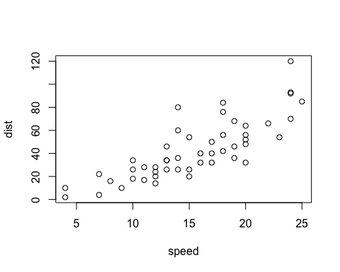
Test Code Chunk (2)
plot(cars)

Slide 6
Test Code Chunk (3)
Sepal.Length | Sepal.Width | Petal.Length | Petal.Width | Species
5.1 | 3.5 | 1.4 | 0.2 | setosa
4.9 | 3.0 | 1.4 | 0.2 | setosa
4.7 | 3.2 | 1.3 | 0.2 | setosa
4.6 | 3.1 | 1.5 | 0.2 | setosa
5.0 | 3.6 | 1.4 | 0.2 | setosa
5.4 | 3.9 | 1.7 | 0.4 | setosa
knitr::kable(iris[1:6, ])

Slide 7
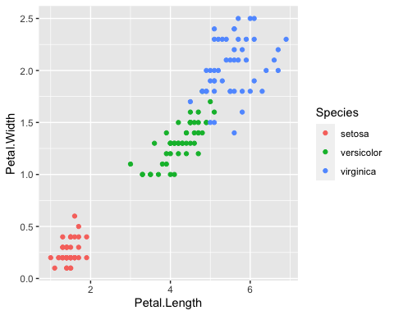
Test Code Chunk (4)
ggplot(iris, aes(x = Petal.Length, y = Petal.Width, col = Species)) + geom_point()

Slide 8
New Code Chunk
Add a new chunk by clicking the Insert Chunk button on the toolbar or by pressing Ctrl+Option+I (Win) or Cmd+Option+I (Mac).
When you save the notebook, an HTML file containing the code and output will be saved alongside it (click the Preview button or press Ctrl+Shift+K (Win) or Cmd+Shift+K (Mac) to preview the HTML file).

Slide 9
The preview shows you a rendered HTML copy of the contents of the editor. Consequently, unlike Knit, Preview does not run any R code chunks. Instead, the output of the chunk when it was last run in the editor is displayed.

Slide 10
YAML for R Notebook
There are three lines of options in the top YAML. If you delete #, the line becomes active.
number_sections: yes # for automatic numbering of sections
toc: true # for table of contents
toc_float: true # for floating table of contents

Slide 11
YAML for Various Output Formats
output: html_notebook: number_sections: yes html_document: df_print: paged number_sections: yes word_document: number_sections: yes pdf_document: number_sections: yes powerpoint_presentation: default ioslides_presentation: widescreen: yes smaller: yes slidy_presentation: default beamer_presentation: default

Slide 12
Note

Slide 13
Comments on Presentation Formats
For slides, a new slide starts at ##, the second-level heading.
--- is page break for presentation formats.
For Word and Powerpoint, you can add your template. See the documents in References

Slide 14
References
Posit Primers: Report Reproducibly
Markdown Quick Reference: Top Menu Bar > Help > Markdown Quick Reference
Cheat Sheet (Top Menu Bar: Help > Cheat Sheets): RMarkdown Cheat Sheet, RMarkdown Reference Guide
Books:
R Markdown: The Definitive Guide
R Markdown Cookbook
Post error messages to a web search engine.

