Slide 1
FT sensors: an application for Camozzi

Slide 2
Objective
Usage of a PMSM motor to drive an electric gripper
The motor will be controlled by the AMC_BLDC board
Necessity to identify the motor parameters
Identification in static conditions
Identification in dynamic conditions
Notes:
To merge with 3

Slide 3
Static Identification
AMC_BLDC
PMSM
Motor
Torque Sensor
CAN Msg
Reader

Slide 4
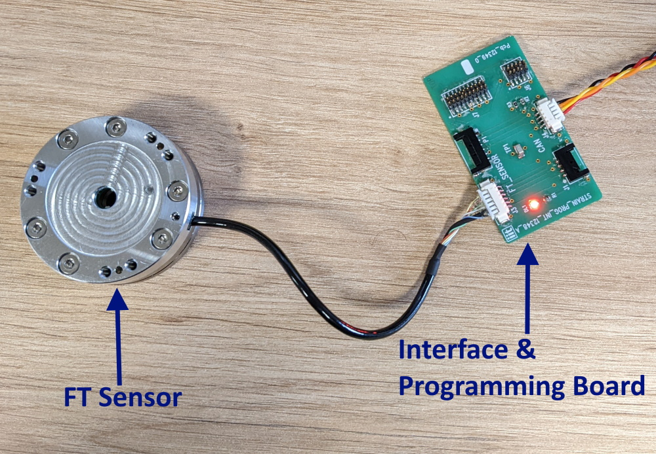
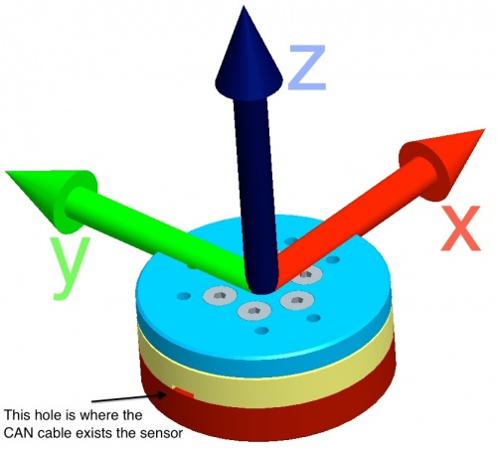
FT45 Sensor
6 Degrees of Freedom Sensor
Based on a Wheatstone bridge
12 semiconductor strain gauges arranged in a 6 half-bridges configuration

Slide 5
Current CAN messaging method
ESD CAN PICTURE
SIMULINK MODEL WITH CUSTOM BLOCKS

Slide 6
Proposed CAN messaging with Vector and Simulink
DIAGRAM WITH VECTOR

Slide 7
Demo video with vector with preliminary acquisitions

