Slide 1

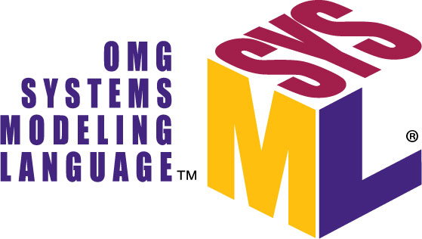
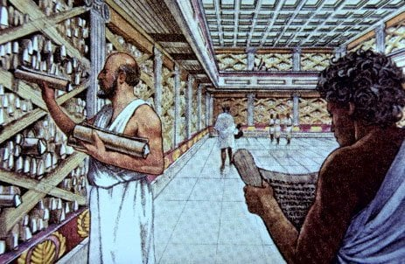
Rework of robots-configuration​
ALEXANDRIA
"Where all the knowledge of
robots-configuration is stored"
https://github.com/icub-tech-iit/study-alexandria

Slide 2

PREVIOUSLY ON…

Slide 3
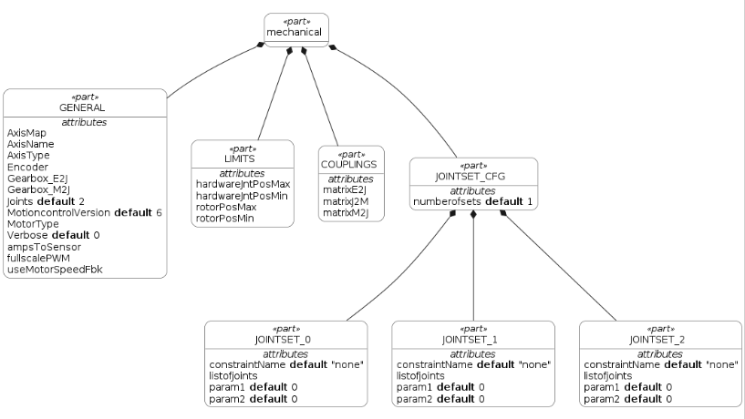
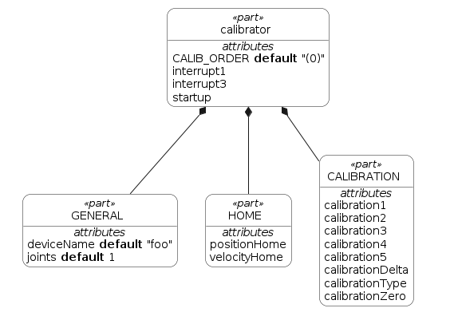
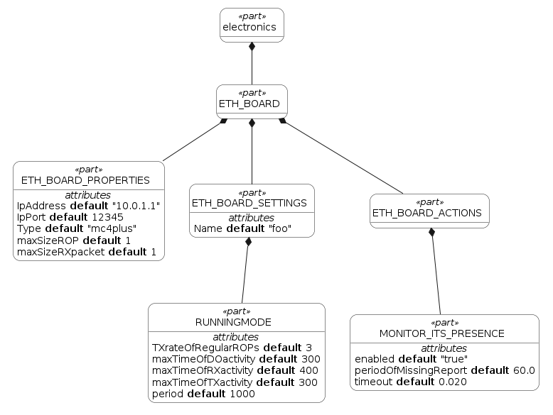
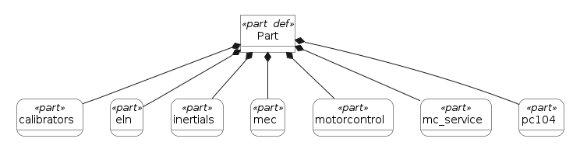
ALEXANDRIA MVP-2
We started from the templatization of the atomic components of the robot architecture (calibrators, electronics, mechanicals, motorControl, and so on)
And then we put all the atomic components together to form a part

Slide 4
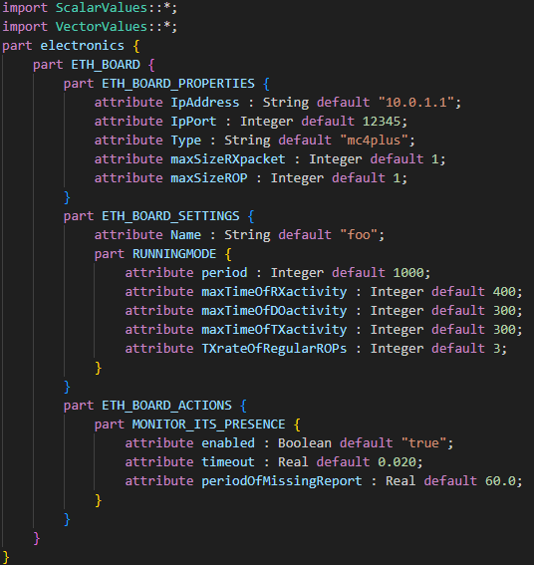
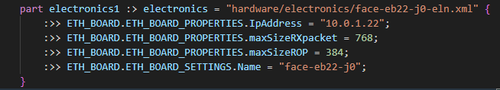

ALEXANDRIA MVP-2
Starting from the default parameters defined in the SysML templates ...
… and specifying the overridden ones …
MVP-2
… we were able to generate the XML for a robot made by one part only

Slide 5
ALEXANDRIA MVP-3
Goals:
Get rid of the hand-written parser in favor of a more robust one
Add the templates for the missing components (e.g. cartesian, FT, skin, MAIS)
Generate XML files for a more complex robot and for multiple robots at the same time

Slide 6
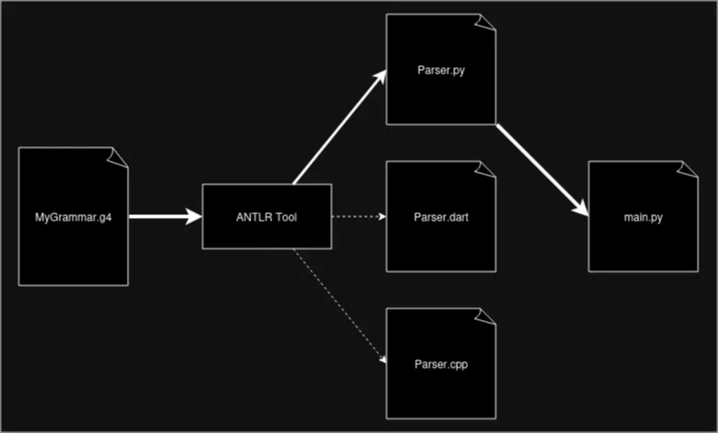
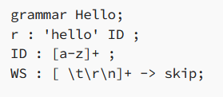
sysmlv2parser
ANTLR (Another Tool for Language Recognition) is a parser generator: it takes a grammar description and generates a parser in many languages.
From a grammar file in which you can define some rules to parse the single elements of your file, it generates a parser that can build and walk parse trees.
MyGrammar.g4
Is able to recognize the language “Hello <any_string>”

Slide 7


sysmlv2parser
With sysmlv2parser we get rid of the previous hand-written parser based on regex
Before:
Complex regex to extract structured data
Difficult to maintain and error-prone
With sysmlv2parser:
Structured, readable parsing logic
Improved maintainability and clarity

Slide 8
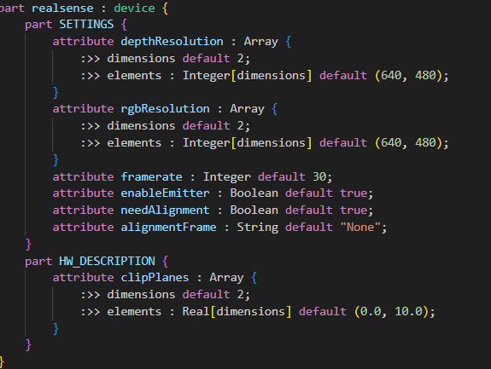
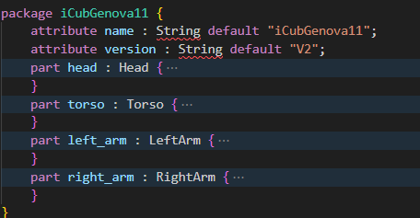
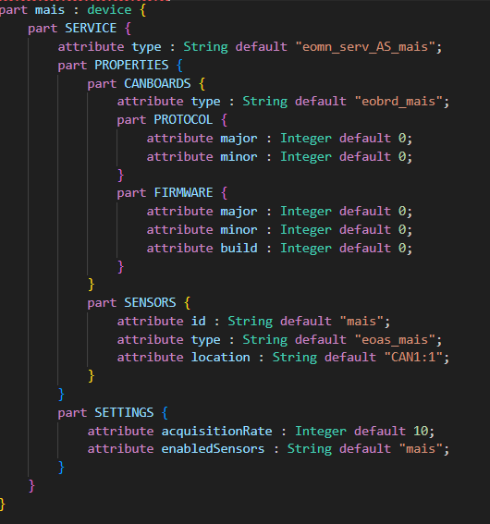
TEMPLATIZE AN UPPER BODY ROBOT
New templates for the missing elements were added (e.g. FT sensors, cartesian, cameras, …)
Added torso, left arm and right arm parts to complete an upperbody iCub.

Slide 9
IMPROVEMENTS
1. Use meaningful names for the instances of elements within the sysml.
2. Improvements in the definition of the default values within the sysml templates.
From:
In this way, the number of overridden parameters is reduced as well.
The instances are named as the corresponding XML to be generated.

Slide 10
GENERATE XML
We are now able to generate the XML for more complex robots that one head (iCubGenova11 upperbody, for example) and for multiple robots at the same time
HOW DOES IT WORK?
To generate the XML files for one or more specific robots:
python3 src/main.py --robot <robots-name> --config <absolute-path-to-sysml-directory>
where:
<robots-name> is a space-separated list that contains the name of the robots (e.g., `iCubGenova11 iCubErzelli03`).
<absolute-path-to-sysml-directory>`is the absolute path to the directory containing the SysML files (e.g., <path-to-study_alexandria-repository/sysml>).
This script will create a folder for the specified robot, mirroring the architecture of robots-configuration.

Slide 11
FUTURE WORK
Add wrapper/remapper
Add left/right leg templates
Implement from_xml and to_sysml methods
Handle external services (like wbd, telemetryDeviceDumper)
Handle the includes of other XML files
Prettify the XML
Versioning the project

Slide 12




QUESTIONS?

Slide 13


REWORK OF ROBOTS-CONFIGURATION
Are there more scalable tools than UML?
Evaluate SysML v2 as tool to create the hierarchical architecture of robots-configuration
Goal:
Create a .sysml template for each atomic element of the tree
Implement a script to parse these templates and create the corresponding xml files
Reproduce the folders tree we have in robots-configuration
Problems:
We don’t have the information about what elements a robot is composed of (parts, boards, version, …)

Slide 14
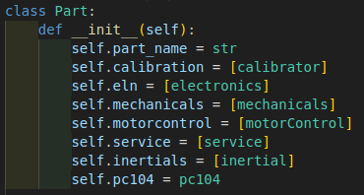
TEMPLATIZE AN ICUB
We replicate the same architecture using python classes
from_sysml
to_xml
Read the corresponding SysML file
Parse it
Populate the py class
Check if override parameters are defined and, if necessary, update them
Generate the XML

