Slide 1

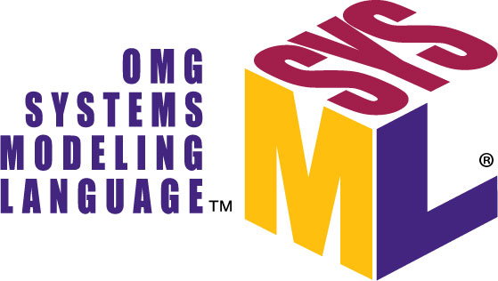
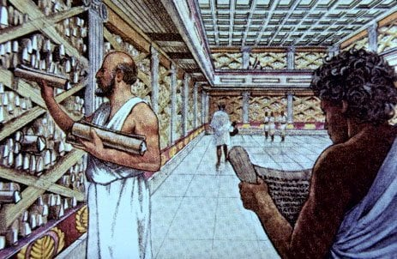
Rework of robots-configuration​
ALEXANDRIA
"Where all the knowledge of
robots-configuration is stored"
https://github.com/icub-tech-iit/study-alexandria

Slide 2

CONTENTS
What is SysML?
From SysML v1 to SysML v2
SysML v2 in our rework of robots-configuration

Slide 3
WHAT IS SYSML?
Systems Modeling Language (SysML) is a modeling language for Systems Engineering applications.
UML
SysML
SysML reuses a subset of Unified Modeling Language (UML) and provides additional extensions to satisfy the requirements of the language, using a vocabulary more suited for SE.
Not required by SysML
SysML extension
UML reused by SysML
https://sysml.org/.res/docs/specs/OMGSysML-v1.4-15-06-03.pdf

Slide 4
FROM SYSML V1 TO V2
Enhancements:
Language precision to reduce ambiguity
Expressiveness of the language
Consistency
Interoperability with other engineering models and tools
Usability by both developers and consumers
Extensibility
SysML v2 is the next generation systems modeling language
https://medium.com/@tom_80522/sysml-v2-a-streamlined-language-for-systems-engineering-8e614346221b

Slide 5
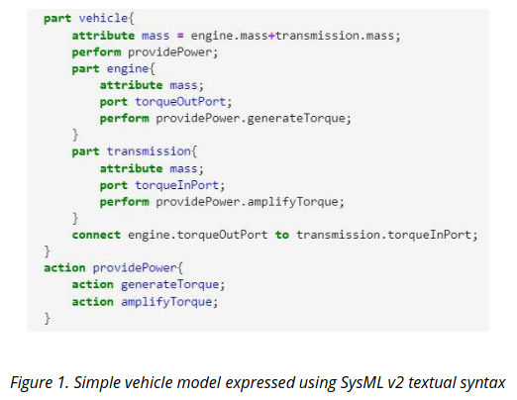
SYSML V2
It includes both textual ...
The textual syntax enables a close-in look at the selected portions of the model
Notes:
The vehicle has an attribute mass. The vehicle is composed of two parts, an engine and a transmission which each have an attribute mass. The vehicle mass is the sum of the engine.mass and the transmission.mass
The engine and transmission have ports torqueOutPort and torqueIpPort which are connected. The vehicle also performs an action providePower that refers to the providePower action below which is composed of the generateTorque and amplifyTorque actions. The engine and transmission each perform actions to generateTorque and amplifyTorque respectively

Slide 6
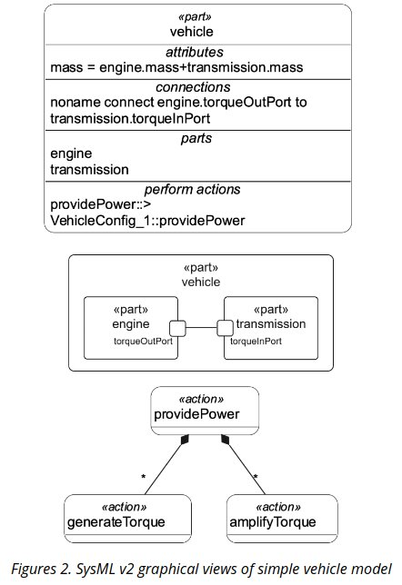

SYSML V2
… and graphical notations
For complex systems composed by many relationships, the graphical view could be very critical.

Slide 7
ROADMAP

Slide 8
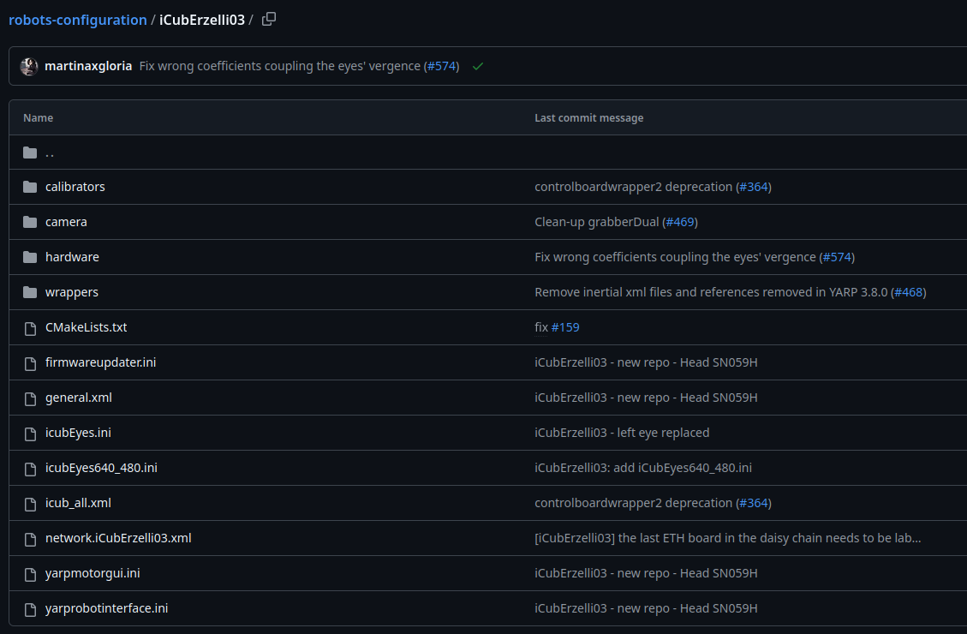
REWORK OF ROBOTS-CONFIGURATION
Started from:
Which are the main components of a simple robot?

Slide 9
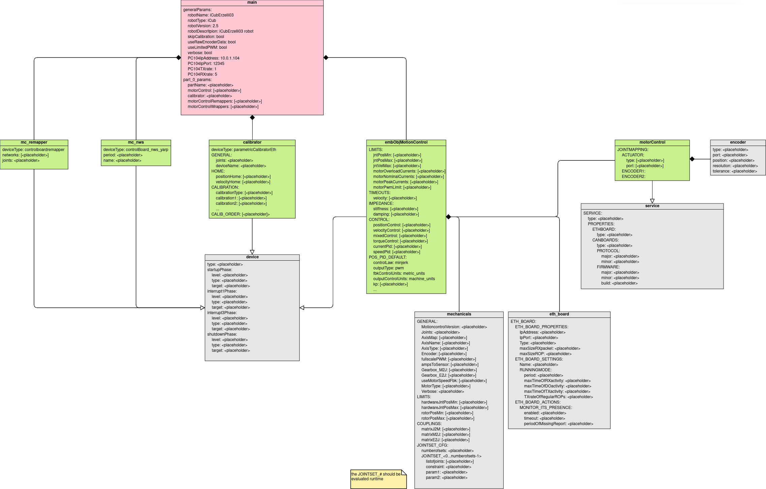
REWORK OF ROBOTS-CONFIGURATION
UML class diagram used for breaking down and representing the architecture of iCubErzelli03, from the atomical components up to the root element of the tree

Slide 10


REWORK OF ROBOTS-CONFIGURATION
Are there more scalable tools than UML?
Evaluate SysML v2 as tool to create the hierarchical architecture of robots-configuration
Goal:
Create a .sysml template for each atomic element of the tree
Implement a script to parse these templates and create the corresponding xml files
Reproduce the folders tree we have in robots-configuration
Problems:
We don’t have the information about what elements a robot is composed of (parts, boards, version, …)

Slide 11
REWORK OF ROBOTS-CONFIGURATION
1. Store robot information into JSON files:
{
"iCub": [
{
"robotName": "iCubErzelli03",
"robotVersion": "1.0",
"parts": [
"head"
]
},
...
]
"ergoCub": [
...
}
{
"head": {
"calibrator": {
"count": 2,
"path": "calibrators",
"files": [
"face-calib.xml",
"head-calib.xml"
]
},
"eln": {
"count": 3,
"path": "hardware/electronics",
"files": [
"face-eb22-j0-eln.xml",
"head-eb20-j0_1-eln.xml",
"head-eb21-j2_5-eln.xml"
]
},
...
}
"torso": {
...
}
Figure 1. List of robots and their main features
Figure 2. Parts description

Slide 12
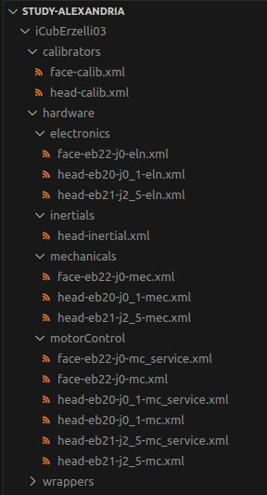
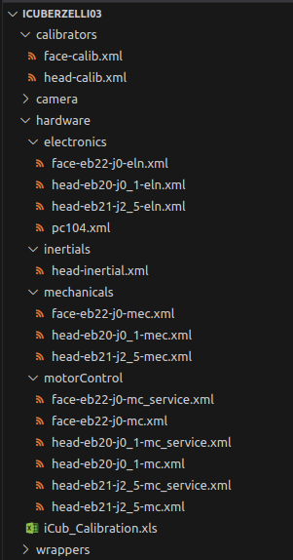
REWORK OF ROBOTS-CONFIGURATION
2. Parse the SysML files, extract the info for each robot
and generate the XML files
vs
Alexandria
robots-configuration

Slide 13
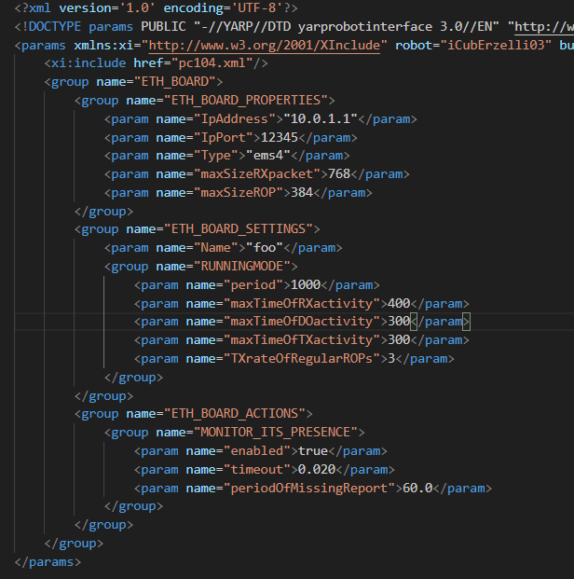
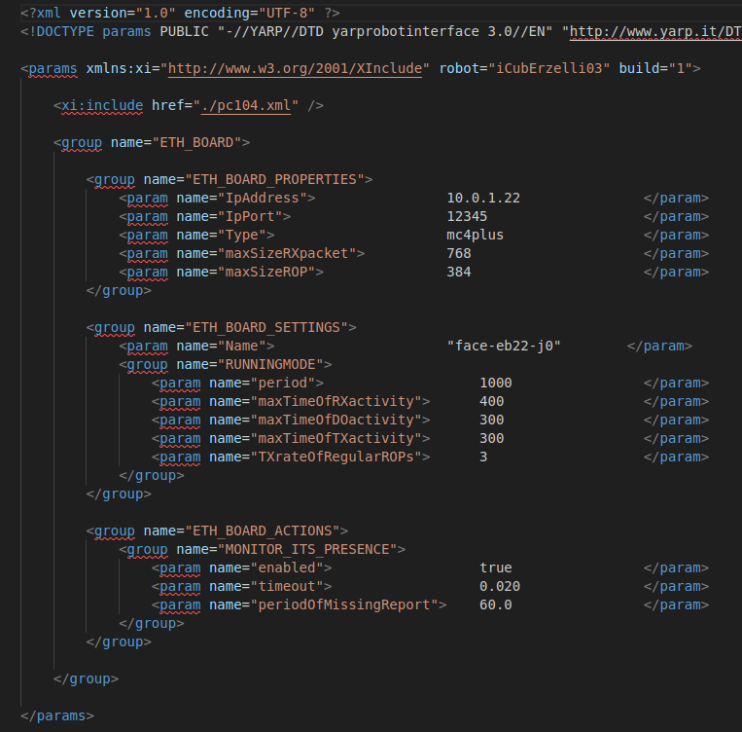
REWORK OF ROBOTS-CONFIGURATION
2. Parse the SysML files, extract the info for each robot
and generate the XML files
vs
Alexandria
robots-configuration

Slide 14


MAY IT BE OUR WAY?

