Slide 1

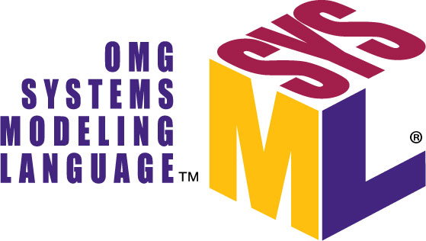
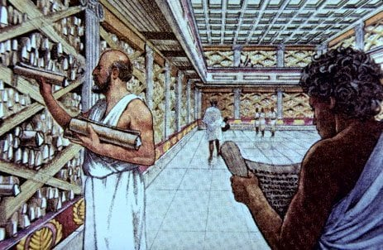
Rework of robots-configuration​
ALEXANDRIA
"Where all the knowledge of
robots-configuration is stored"
https://github.com/icub-tech-iit/study-alexandria

Slide 2

PREVIOUSLY ON…

Slide 3
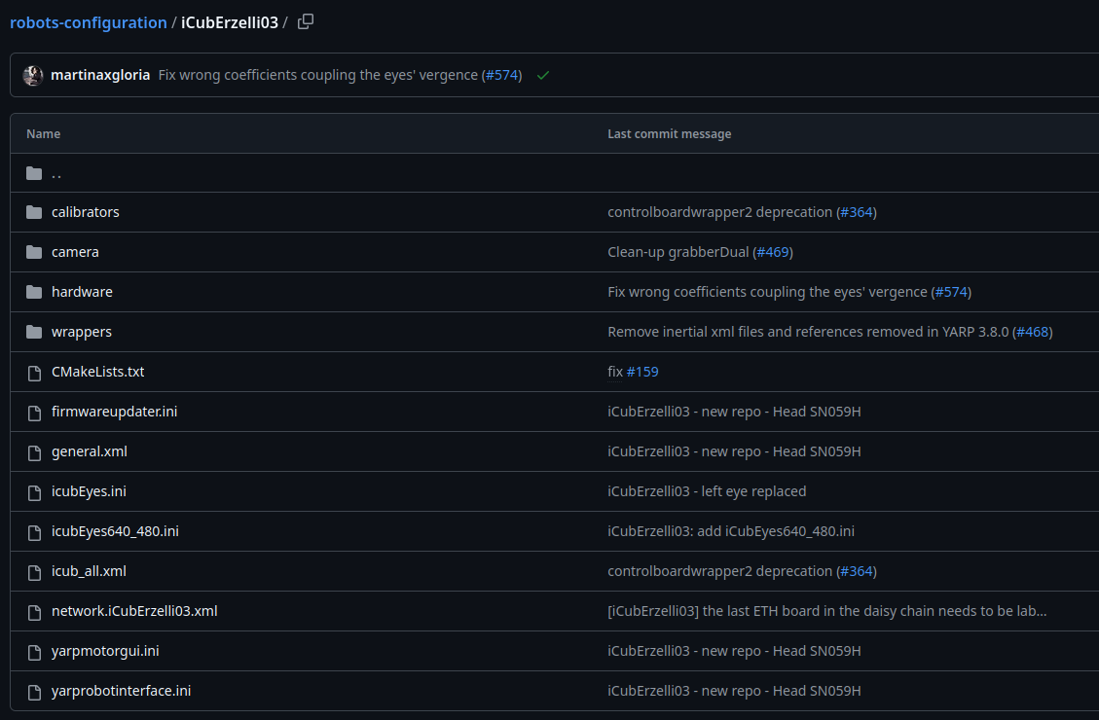
ALEXANDRIA MVP-1
Started from:
Which are the main components of a simple robot?

Slide 4
ALEXANDRIA MVP-1
Store robot information into JSON files:
{
"iCub": [
{
"robotName": "iCubErzelli03",
"robotVersion": "1.0",
"parts": [
"head"
]
},
...
]
"ergoCub": [
...
}
{
"head": {
"calibrator": {
"count": 2,
"path": "calibrators",
"files": [
"face-calib.xml",
"head-calib.xml"
]
},
"eln": {
"count": 3,
"path": "hardware/electronics",
"files": [
"face-eb22-j0-eln.xml",
"head-eb20-j0_1-eln.xml",
"head-eb21-j2_5-eln.xml"
]
},
...
}
"torso": {
...
}
Figure 1. List of robots and their main features
Figure 2. Parts description

Slide 5
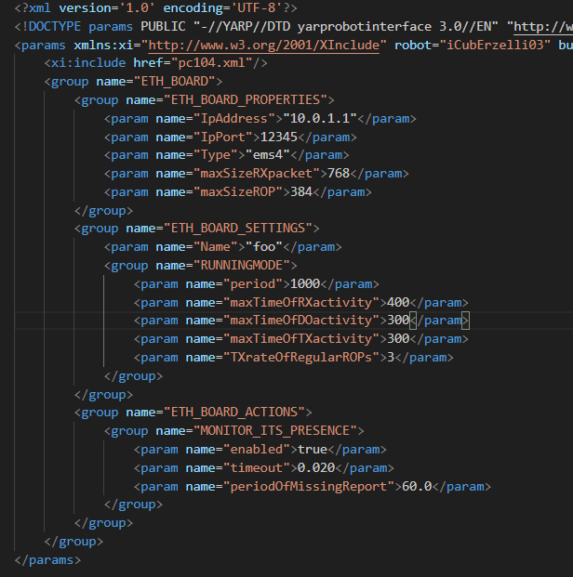
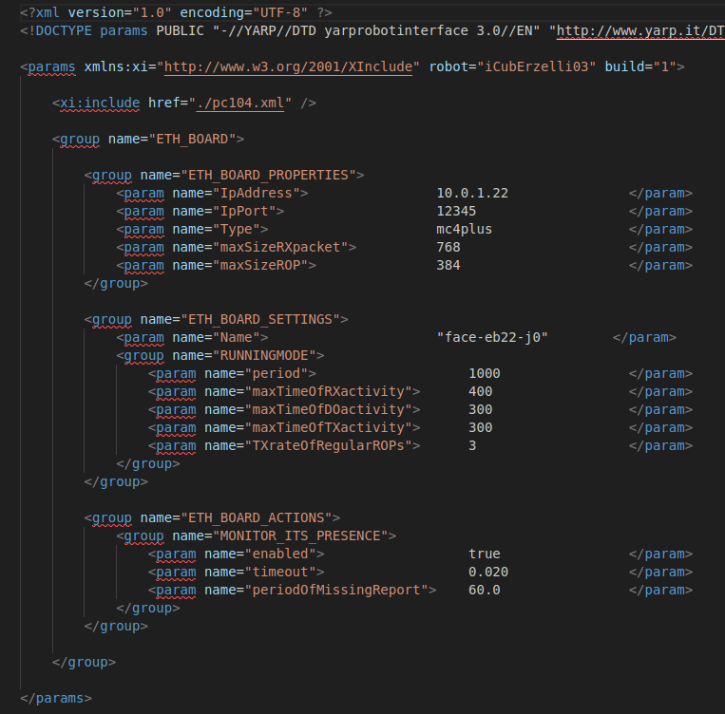

ALEXANDRIA MVP-1
Create SysML templates, parse the SysML files, extract the info for each robot
and generate the XML files
vs
MVP-1
Alexandria
robots-configuration

Slide 6
ALEXANDRIA MVP-2
Goals:
Remove JSON configuration files
Templatize an iCub
Manage to generate a complete robot with overridden and default parameters

Slide 7
REMOVE JSON
{
"head": {
"calibrator": {
"count": 2,
"path": "calibrators",
"files": [
"face-calib.xml",
"head-calib.xml"
]
},
"eln": {
"count": 3,
"path": "hardware/electronics",
"files": [
"face-eb22-j0-eln.xml",
"head-eb20-j0_1-eln.xml",
"head-eb21-j2_5-eln.xml"
]
},
...
}
"torso": {
...
}
{": [
{
"robotName": "iCubErzelli03",
"robotVersion": "1.0",
"parts": [
"head"
]
},
...
]
"ergoCub": [
...
}
Figure 1. List of robots and their main features
Figure 2. Parts description

Slide 8
REMOVE JSON
{
"head": {
"calibrator": {
"count": 2,
"path": "calibrators",
"files": [
"face-calib.xml",
"head-calib.xml"
]
},
"eln": {
"count": 3,
"path": "hardware/electronics",
"files": [
"face-eb22-j0-eln.xml",
"head-eb20-j0_1-eln.xml",
"head-eb21-j2_5-eln.xml"
]
},
...
}
"torso": {
...
}
{": [
{
"robotName": "iCubErzelli03",
"robotVersion": "1.0",
"parts": [
"head"
]
},
...
]
"ergoCub": [
...
}
Figure 1. List of robots and their main features
This info are now stored in the SysML files → use one format only
Figure 2. Parts description

Slide 9
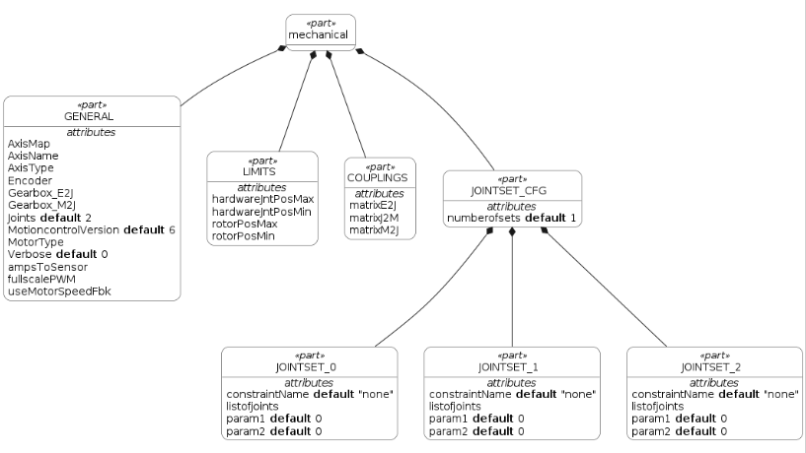
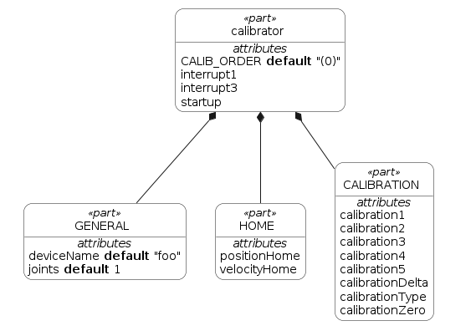
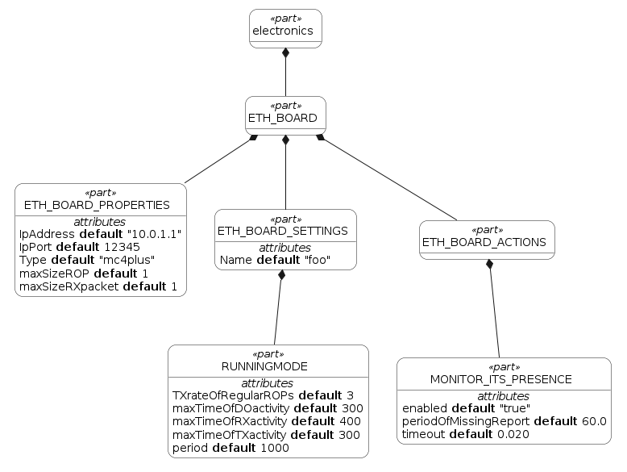
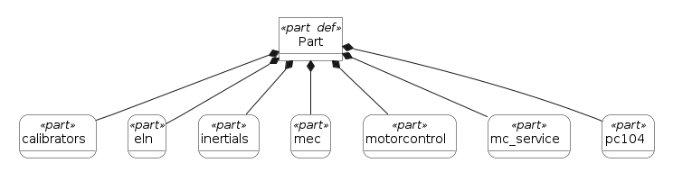
TEMPLATIZE AN ICUB
We started from the templatization of the atomic components of the robot architecture (calibrators, electronics, mechanicals, motorControl, and so on)
And then we put all the atomic components together to form a part
Notes:
Le informazioni sono ripetute una volta soltanto a livello di sysml e utilizzando questa architettura templatizzata possiamo generare X robot senza ripetere le informazioni in vari file (es ip della board, nome del file da generare, parametro X generale per la parte Y)

Slide 10
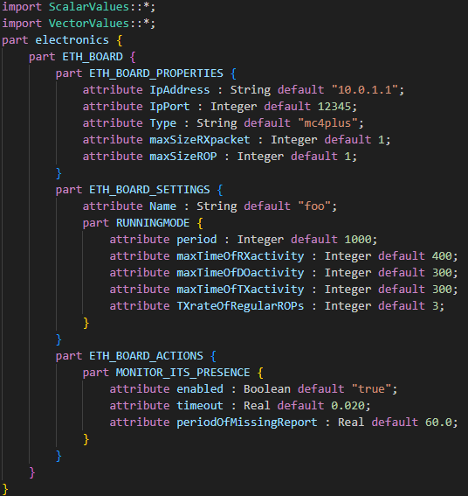
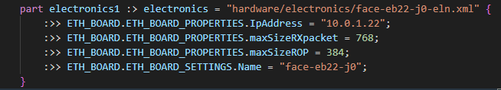
GENERATE AN ENTIRE ROBOT
Starting from the default parameters defined in the SysML templates ...
… and specifying the overridden ones …

Slide 11
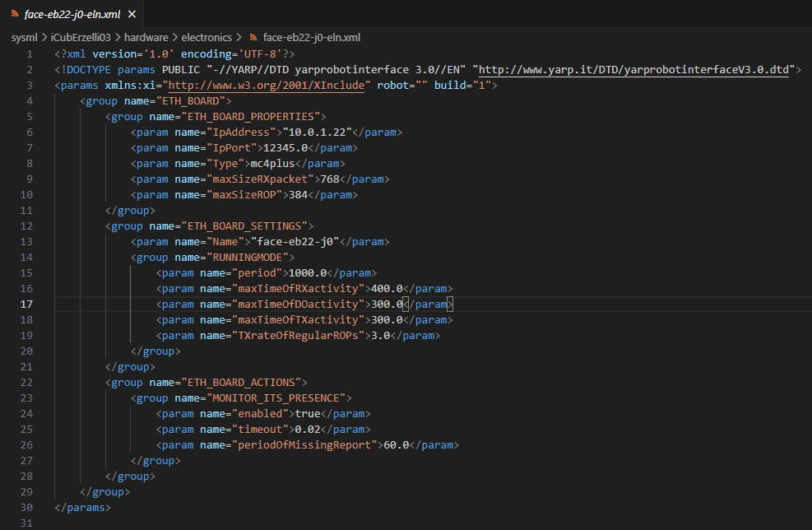
GENERATE AN ENTIRE ROBOT
… the XML are generated with the specific parameters for each board/part/robot 🚀

Slide 12




FUTURE WORK
Remove the regex from the parser
In general, make the parser more robust
Clean up the code
…

Slide 13




QUESTIONS?

Slide 14


REWORK OF ROBOTS-CONFIGURATION
Are there more scalable tools than UML?
Evaluate SysML v2 as tool to create the hierarchical architecture of robots-configuration
Goal:
Create a .sysml template for each atomic element of the tree
Implement a script to parse these templates and create the corresponding xml files
Reproduce the folders tree we have in robots-configuration
Problems:
We don’t have the information about what elements a robot is composed of (parts, boards, version, …)

Slide 15
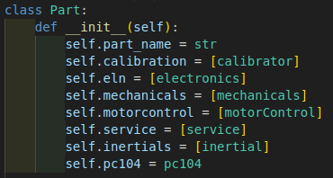
TEMPLATIZE AN ICUB
We replicate the same architecture using python classes
from_sysml
to_xml
Read the corresponding SysML file
Parse it
Populate the py class
Check if override parameters are defined and, if necessary, update them
Generate the XML

