Slide 1
Simscape
A quick overview
Material supporting the Simscape training

Slide 2
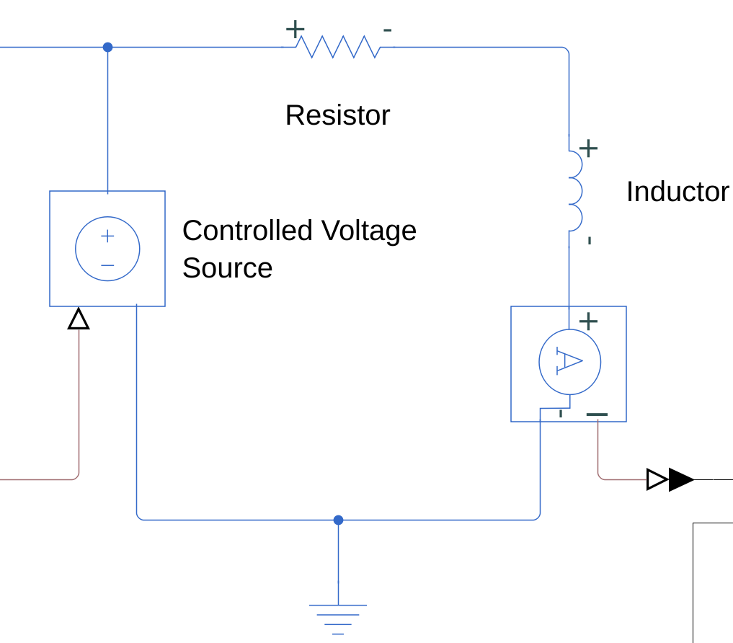
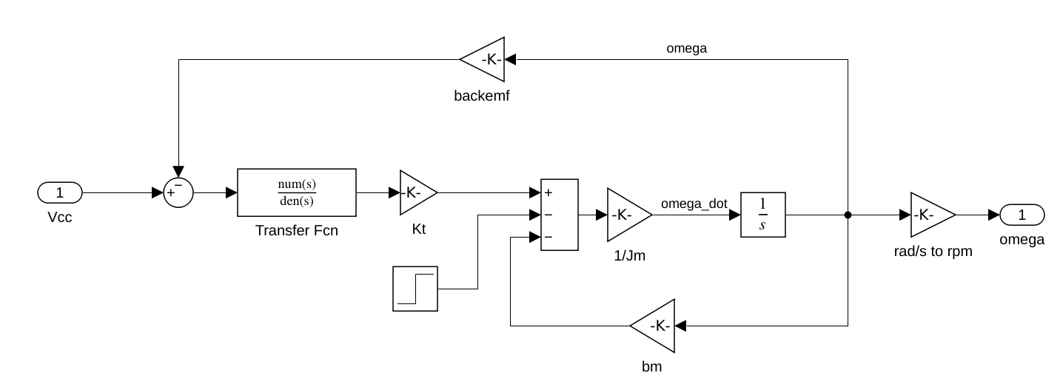
What is Simscape?
Collection of Simulink toolboxes to model physical systems in various domains
Electrical
Mechanical (called Driveline)
Articulated mechanisms (called Multibody)
Fluids (not covered here)
Simscape models employ a different philosphy compared to regular Simulink models
Notes:
To merge with 3

Slide 3
The principles
Systems are represented by physical networks
Each element exchanges energy in the network
Energy flow defined by two types of variables
Through variables: measured with a sensor connected in series to an element
Across variables: measured with a sensor parallel in series to an element
Their product results in power expressed in Watts
Domain | Through | Across
Mech Rotational | Force | Velocity
Mech Translational | Torque | Angular velocity
Electrical | Current | Voltage
Notes:
To merge with 3

Slide 4
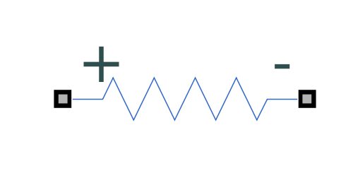
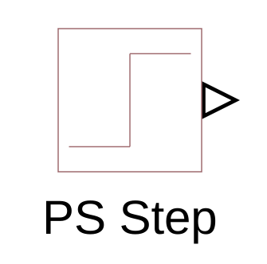
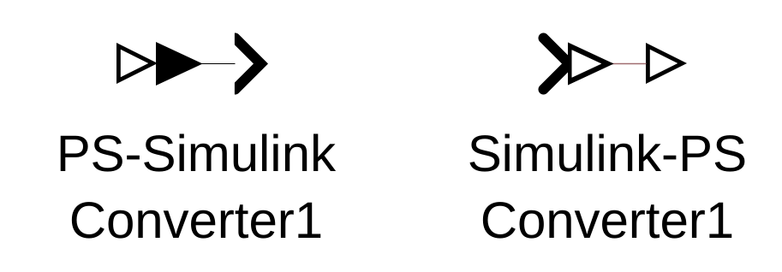
Blocks and their quirks
Energy conserving blocks (we also can create our own)
Physical Signal blocks
Simulink-Simscape interface blocks
Notes:
To merge with 3

Slide 5
Why use it?
We can model complex physical systems in a much more graphically intuitive way
Methodology less prone to errors
Enforcement of units of measurement
Simscape Multibody is compatible with CAD modeling software
Notes:
To merge with 3

Slide 6
Training outline
Model a RL circuit
Add an electromechanical conversion and add an inertia to create a simple motor
Add a damping and opposing torque
Add a gearbox and compare to the block diagram
Add a simple PI control to move the motor to a desired speed
Replace the constant load with the inertia of a 3D multibody model
Import the four-bar linkage in the model and control the follower angle
Notes:
To merge with 3

